Slide 1
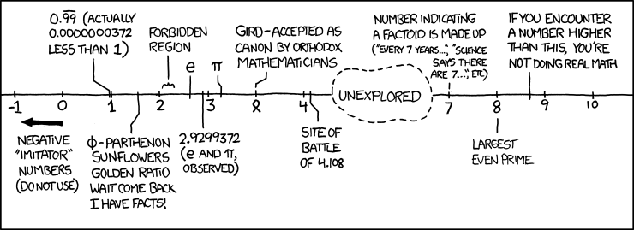
Floating Point II
http://xkcd.com/899/

Slide 2
Denorm Numbers
This is extra (non-testable) material
Denormalized numbers (E = 0x00)
  No leading 1
  Uses implicit exponent of –126
Denormalized numbers close the gap between zero and the smallest normalized number
  Smallest norm: ± 1.0…0_{two}×2⁻¹²⁶ = ± 2⁻¹²⁶
  Smallest denorm: ± 0.0…01_{two}×2⁻¹²⁶ = ± 2⁻¹⁴⁹
    There is still a gap between zero and the smallest denormalized number
So much
closer to 0

Slide 3
Other Special Cases
E = 0xFF, M = 0: ± ∞
  e.g. division by 0
  Still work in comparisons!
E = 0xFF, M ≠ 0: Not a Number (NaN)
  e.g. square root of negative number, 0/0, ∞–∞
  NaN propagates through computations
  Value of M can be useful in debugging
New largest value (besides ∞)?
  E = 0xFF has now been taken!
  E = 0xFE has largest: 1.1…1₂×2¹²⁷ = 2¹²⁸ – 2¹⁰⁴

Slide 4
Floating Point Encoding Summary
E | M | Meaning
0x00 | 0 | ± 0
0x00 | non-zero | ± denorm num
0x01 – 0xFE | anything | ± norm num
0xFF | 0 | ± ∞
0xFF | non-zero | NaN

Slide 5
Floating point topics
Fractional binary numbers
IEEE floating-point standard
Floating-point operations and rounding
Floating-point in C
There are many more details that we won’t cover
  It’s a 58-page standard…
Notes:
Start by talking about representing fractional numbers in binary in general
Then about the IEEE Standard for floating point representation, operations,
Will not cover:
All the details of the 58-page spec
Or expect you to perform operations
Want to show you how floating point values are represented
To give you a sense of the kinds of things that can go wrong with them

Slide 6
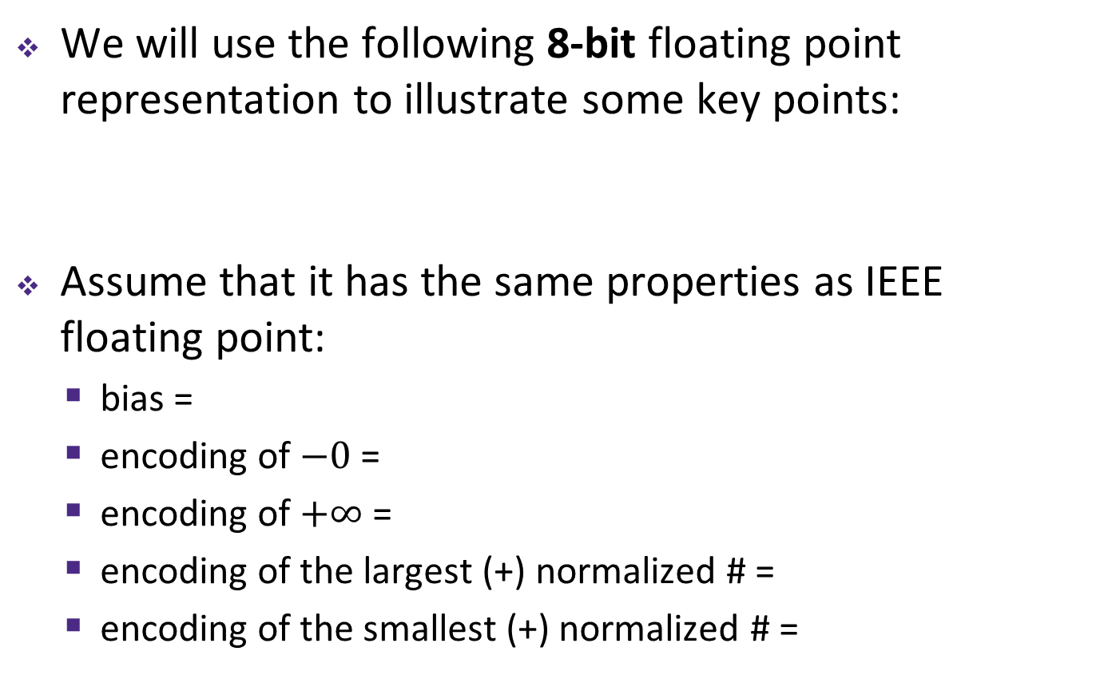
Tiny Floating Point Representation
We will use the following 8-bit floating point representation to illustrate some key points:
Assume that it has the same properties as IEEE floating point:
  bias =
  encoding of $−0$ =
  encoding of $+∞$ =
  encoding of the largest (+) normalized # =
  encoding of the smallest (+) normalized # =
S
E
M
1
4
3

Slide 7
Peer Instruction Question
Using our 8-bit representation, what value gets stored when we try to encode 2.625 = 2¹ + 2⁻¹ + 2⁻³?
+ 2.5
+ 2.625
+ 2.75
+ 3.25
We’re lost…
S
E
M
1
4
3

Slide 8
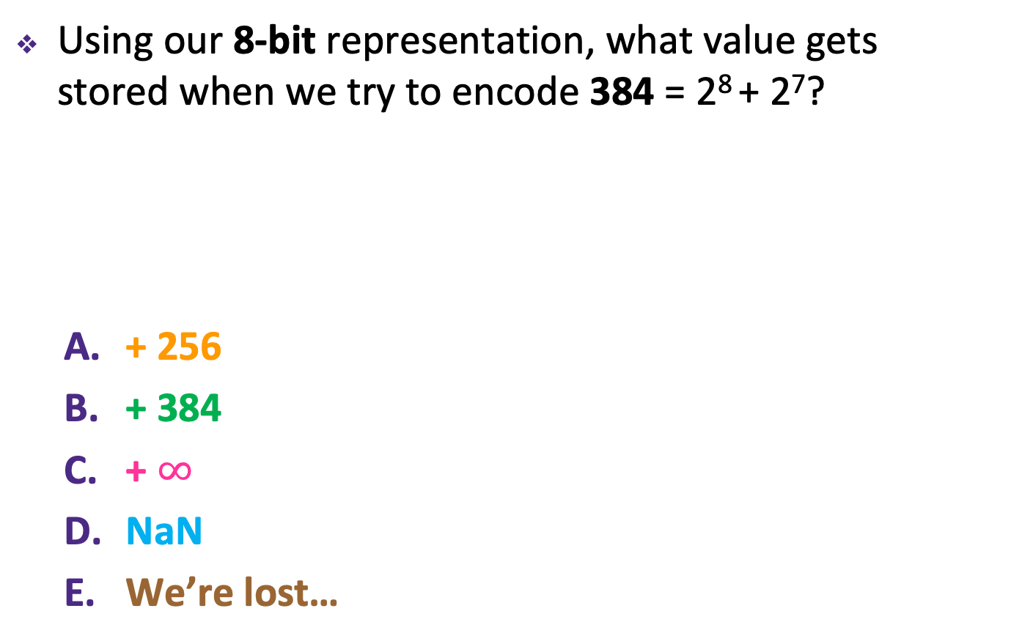
Peer Instruction Question
Using our 8-bit representation, what value gets stored when we try to encode 384 = 2⁸ + 2⁷?
+ 256
+ 384
+ $∞$
NaN
We’re lost…
S
E
M
1
4
3

Slide 9
Distribution of Values
What ranges are NOT representable?
  Between largest norm and infinity
  Between zero and smallest denorm
  Between norm numbers?
Given a FP number, what’s the bit pattern of the next largest representable number?
  What is this “step” when Exp = 0?
  What is this “step” when Exp = 100?
Distribution of values is denser toward zero
Overflow (Exp too large)
Underflow (Exp too small)
Rounding

Slide 10
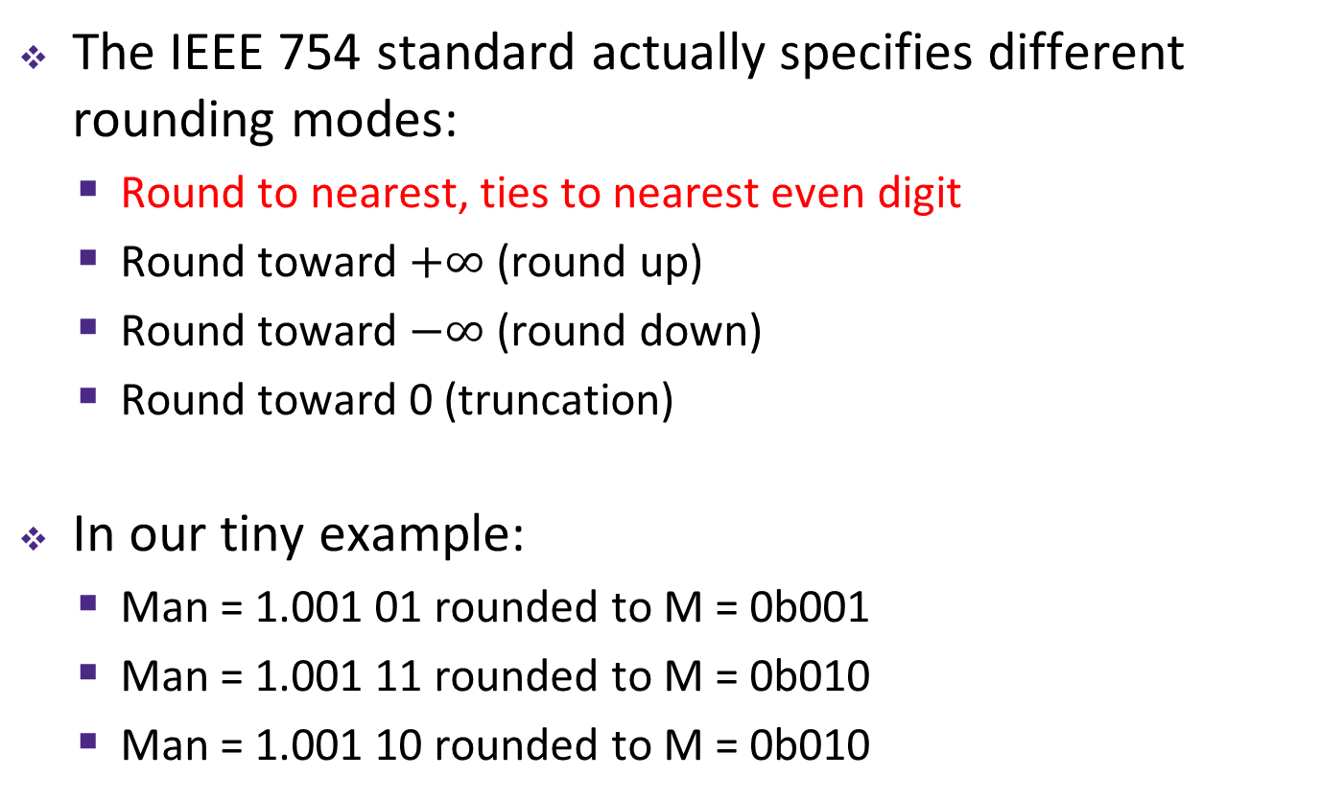
Floating Point Rounding
This is extra (non-testable) material
The IEEE 754 standard actually specifies different rounding modes:
  Round to nearest, ties to nearest even digit
  Round toward $+∞$ (round up)
  Round toward $−∞$ (round down)
  Round toward 0 (truncation)
In our tiny example:
  Man = 1.001 01 rounded to M = 0b001
  Man = 1.001 11 rounded to M = 0b010
  Man = 1.001 10 rounded to M = 0b010
S
E
M
1
4
3

Slide 11
Floating Point Operations: Basic Idea
x +_{f} y = Round(x + y)
x *_{f} y = Round(x * y)
Basic idea for floating point operations:
  First, compute the exact result
  Then round the result to make it fit into the specificed precision (width of M)
    Possibly over/underflow if exponent outside of range
Value = (-1)^{S}×Mantissa×2^{Exponent}
S
E
M
Notes:
We won’t be asking you to do these yourself, but seeing a bit about how it works will help you understand the ways in which it can go wrong, which we may ask you about

Slide 12
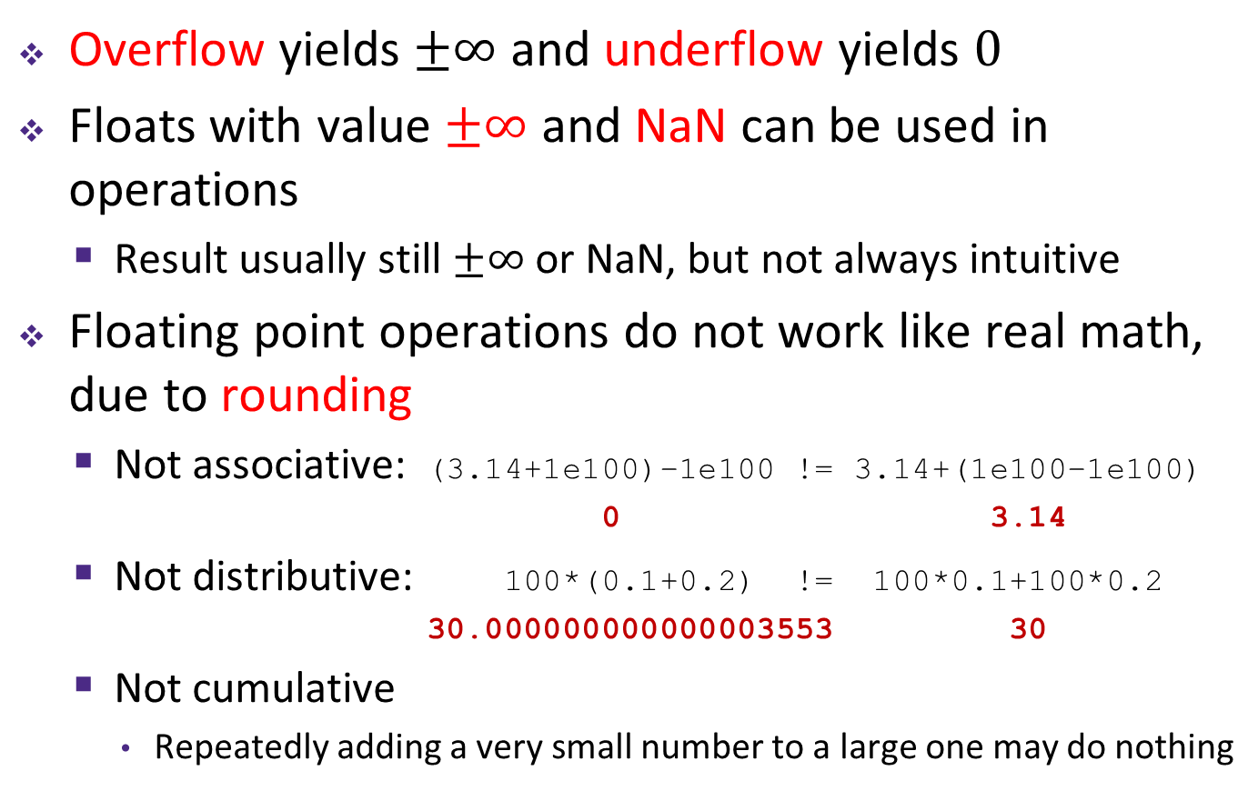
Mathematical Properties of FP Operations
Overflow yields $±∞$ and underflow yields $0$
Floats with value $±∞$ and NaN can be used in operations
  Result usually still $±∞$ or NaN, but not always intuitive
Floating point operations do not work like real math, due to rounding
  Not associative: (3.14+1e100)–1e100 != 3.14+(1e100–1e100)
  0 3.14
  Not distributive: 100*(0.1+0.2) != 100*0.1+100*0.2
  30.000000000000003553 30
  Not cumulative
    Repeatedly adding a very small number to a large one may do nothing
Notes:
NaNs or infinity can taint results, spread through a numerical computations
Floating point operations are not like real mathematical operations
The same algebraic properties, associative, commutative, distributive, no longer work right

Slide 13
Floating point topics
Fractional binary numbers
IEEE floating-point standard
Floating-point operations and rounding
Floating-point in C
There are many more details that we won’t cover
  It’s a 58-page standard…
Notes:
Start by talking about representing fractional numbers in binary in general
Then about the IEEE Standard for floating point representation, operations,
Will not cover:
All the details of the 58-page spec
Or expect you to perform operations
Want to show you how floating point values are represented
To give you a sense of the kinds of things that can go wrong with them

Slide 14
Floating Point in C
!!!
Two common levels of precision:
  float 1.0f single precision (32-bit)
  double 1.0 double precision (64-bit)
#include <math.h> to get INFINITY and NAN constants
Equality (==) comparisons between floating point numbers are tricky, and often return unexpected results, so just avoid them!

Slide 15
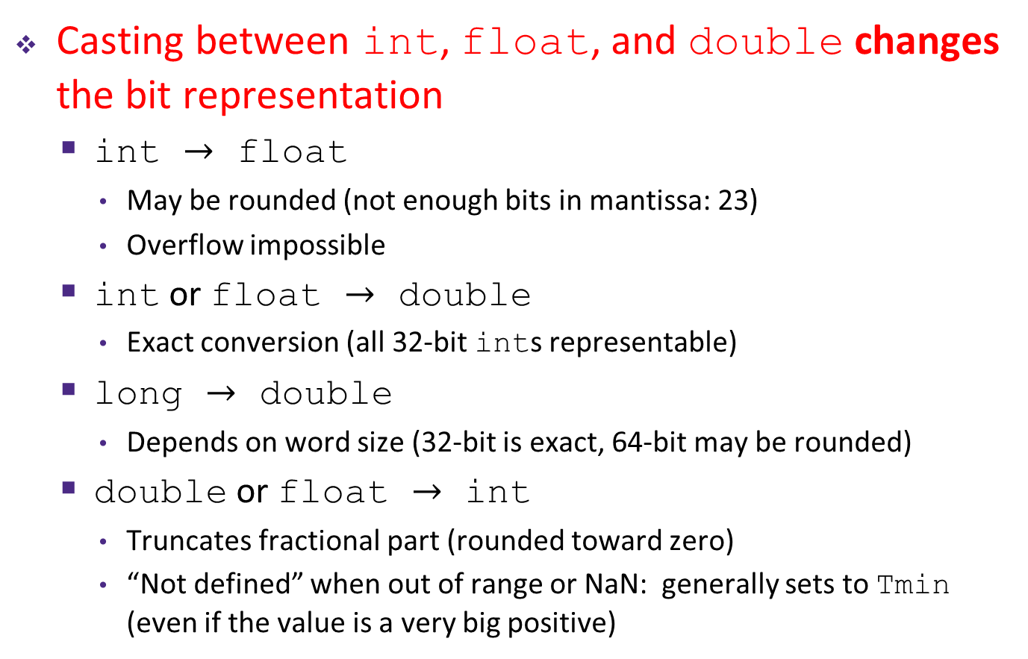
Floating Point Conversions in C
!!!
Casting between int, float, and double changes the bit representation
  int $→$ float
    May be rounded (not enough bits in mantissa: 23)
    Overflow impossible
  int or float $→$ double
    Exact conversion (all 32-bit ints representable)
  long $→$ double
    Depends on word size (32-bit is exact, 64-bit may be rounded)
  double or float $→$ int
    Truncates fractional part (rounded toward zero)
    “Not defined” when out of range or NaN: generally sets to Tmin
    (even if the value is a very big positive)

Slide 16
Peer Instruction Question
We execute the following code in C. How many bytes are the same (value and position) between i and f?
0 bytes
1 byte
2 bytes
3 bytes
We’re lost…
int i = 384; // 2^8 + 2^7
float f = (float) i;
Notes:
Purposely choose to skip this one. But do include solution in posted materials.

Slide 17
Floating Point and the Programmer
#include <stdio.h>
int main(int argc, char* argv[]) {
float f1 = 1.0;
float f2 = 0.0;
int i;
for (i = 0; i < 10; i++)
f2 += 1.0/10.0;
printf("0x%08x 0x%08x\n", *(int*)&f1, *(int*)&f2);
printf("f1 = %10.9f\n", f1);
printf("f2 = %10.9f\n\n", f2);
f1 = 1E30;
f2 = 1E-30;
float f3 = f1 + f2;
printf("f1 == f3? %s\n", f1 == f3 ? "yes" : "no" );
return 0;
}
$ ./a.out
0x3f800000 0x3f800001
f1 = 1.000000000
f2 = 1.000000119
f1 == f3? yes

Slide 18
Floating Point Summary
Floats also suffer from the fixed number of bits available to represent them
  Can get overflow/underflow
  “Gaps” produced in representable numbers means we can lose precision, unlike ints
    Some “simple fractions” have no exact representation (e.g. 0.2)
    “Every operation gets a slightly wrong result”
Floating point arithmetic not associative or distributive
  Mathematically equivalent ways of writing an expression may compute different results
Never test floating point values for equality!
Careful when converting between ints and floats!

Slide 19
Number Representation Really Matters
1991: Patriot missile targeting error
  clock skew due to conversion from integer to floating point
1996: Ariane 5 rocket exploded ($1 billion)
  overflow converting 64-bit floating point to 16-bit integer
2000: Y2K problem
  limited (decimal) representation: overflow, wrap-around
2038: Unix epoch rollover
  Unix epoch = seconds since 12am, January 1, 1970
  signed 32-bit integer representation rolls over to TMin in 2038
Other related bugs:
  1982: Vancouver Stock Exchange 10% error in less than 2 years
  1994: Intel Pentium FDIV (floating point division) HW bug ($475 million)
  1997: USS Yorktown “smart” warship stranded: divide by zero
  1998: Mars Climate Orbiter crashed: unit mismatch ($193 million)
Notes:
This is the part where I try to scare you…

