Slide 1
Caches and Memory Hierarchy
CMPT 295 Week 7

Slide 2
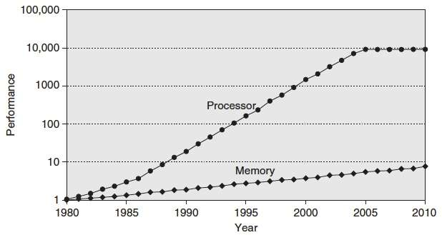
Processor-Memory Gap
“Moore’s Law”
µProc
55%/year
(2X/1.5yr)
Processor-Memory
Performance Gap
(grows 50%/year)
DRAM
7%/year
(2X/10yrs)
1989 first Intel CPU with cache on chip
1998 Pentium III has two cache levels on chip
Notes:
How fast you can crunch stuff
How fast you can get stuff

Slide 3
Problem: Processor-Memory Bottleneck
Processor performance
doubled about
every 18 months
Bus latency / bandwidth
evolved much slower
Main Memory
CPU
Reg
Problem: lots of waiting on memory
Notes:
What is a cycle
Only 2 hard problems in computer science: cache invalidation, naming things, and off-by-one errors.
I can process avocados very quickly
It takes me a long time to get them

Slide 4
Problem: Processor-Memory Bottleneck
Processor performance
doubled about
every 18 months
Bus latency / bandwidth
evolved much slower
Main Memory
CPU
Reg
Cache
Solution: caches
Smaller memories, closer to CPU → faster
Notes:
Avocado cache

Slide 5
General Cache Mechanics
Smaller, faster, more expensive memory
Caches a subset of the blocks
Cache
7
9
14
3
Data is copied in block-sized transfer units
Memory
0
1
2
3
Larger, slower, cheaper memory.
Viewed as partitioned into “blocks”
4
5
6
7
8
9
10
11
12
13
14
15
Notes:
Note: these are not bytes: blocks

Slide 6
General Cache Concepts: Hit
Request: 14
Data in block b is needed
Block b is in cache:
Hit!
Cache
7
9
14
3
14
Data is returned to CPU
Memory
0
1
2
3
4
5
6
7
8
9
10
11
12
13
14
15

Slide 7
General Cache Concepts: Miss
Request: 12
Data in block b is needed
Block b is not in cache:
Miss!
Cache
7
9
14
3
12
Block b is fetched from
memory
12
Request: 12
Block b is stored in cache
Placement policy:
determines where b goes
Replacement policy:
determines which block
gets evicted (victim)
Memory
0
1
2
3
4
5
6
7
8
9
10
11
12
12
13
14
15
Data is returned to CPU

Slide 8
Why Caches Work
Locality: Programs tend to use data and instructions with addresses near or equal to those they have used recently
Temporal locality:
  Recently referenced items are likely
  to be referenced again in the near future
Spatial locality:
  Items with nearby addresses tend
  to be referenced close together in time
How do caches take advantage of this?
block
block
Notes:
Near

Slide 9
Example: Any Locality?
sum = 0;
for (i = 0; i < n; i++) {
sum += a[i];
}
return sum;
Data:
  Temporal: sum referenced in each iteration
  Spatial: array a[] accessed in stride-1 pattern
Instructions:
  Temporal: cycle through loop repeatedly
  Spatial: reference instructions in sequence

Slide 10
Access Pattern
for i = 0 to 8, i++ vs. for i = 0 to 8, i=i+2
Data layout
int a[8] vs. short a[8]
int a[8] vs. int a[16]
Cache Geometry
Direct mapped vs. Set Associative (more later..)

Slide 11
Int. Stride 1
// Block size 64 bytes
int a[8];
for (i = 0; i < 8; i++) {
tmp = a[i]
Number of elements per block = 64/4 = 16
Hit:Access = 7:8 (Hit Rate)
Miss:Access = 1:8 (Miss Rate)
If we change loop to “i<16” and change array definition to int a[16], how would hit rate change?

Slide 12
Short Stride 1
// Block size 64 bytes
short a[20];
for (i = 0; i < 20; i++) {
tmp = a[i]
Number of elements per block = 64/2 = 32
Hit:Access = 19:20
Miss:Access = 1:20

Slide 13
Int Stride 2
// Block size 64 bytes
int a[16];
for (i = 0; i < 16; i=i+2) {
tmp = a[i]
Number of elements per block = 64/4 = 16
Accessed Elements per block = 16/2 = 8
Hit:Access = 7:8
Miss:Access = 1:8

Slide 14
Caching in general
  Successively higher levels contain “most used” data from lower levels
  Exploits temporal and spatial locality
  Caches are intermediate storage levels used to optimize data transfers between any system elements with different characteristics
Cache Performance
  Ideal case: found in cache (hit)
  Bad case: not found in cache (miss), search in next level
  Average Memory Access Time (AMAT) = HT + MR × MP
    Hurt by Miss Rate and Miss Penalty

Slide 15

Row Major
for (i = 0; i < 4; i++) {
for (j = 0; j < 4; j++) {
A[i][j]
Cache: 256 bytes. 16x256 image
Hits: N-1 (N: number of elements per block)
Misses: 1024

Slide 16
int sum_array_rows(int a[M][N])
{
int i, j, sum = 0;
for (i = 0; i < M; i++)
for (j = 0; j < N; j++)
sum += a[i][j];
return sum;
}
M = 3, N=4
a[0][0] |  | a[0][1] |  | a[0][2] |  | a[0][3]
a[1][0] |  | a[1][1] |  | a[1][2] |  | a[1][3]
a[2][0] |  | a[2][1] |  | a[2][2] |  | a[2][3]
Access Pattern:
stride = ?
1) | a[0][0]
2) | a[0][1]
3) | a[0][2]
4) | a[0][3]
5) | a[1][0]
6) | a[1][1]
7) | a[1][2]
8) | a[1][3]
9) | a[2][0]
10) | a[2][1]
11) | a[2][2]
12) | a[2][3]
Layout in Memory
a [0] [0] | a [0] [1] | a [0] [2] | a [0] [3] | a [1] [0] | a [1] [1] | a [1] [2] | a [1] [3] | a [2] [0] | a [2] [1] | a [2] [2] | a [2] [3]
76
92
108
Notes:
Stride of 1 (4 bytes)

Slide 17
Column Major
for (i = 0; i < 4; i++) {
for (j = 0; j < 4; j++) {
A[j][i]
Cache: 256 bytes. 16x256 image
Hits: 0
Misses: 4096

Slide 18
int sum_array_cols(int a[M][N])
{
int i, j, sum = 0;
for (j = 0; j < N; j++)
for (i = 0; i < M; i++)
sum += a[i][j];
return sum;
}
M = 3, N=4
a[0][0] |  | a[0][1] |  | a[0][2] |  | a[0][3]
a[1][0] |  | a[1][1] |  | a[1][2] |  | a[1][3]
a[2][0] |  | a[2][1] |  | a[2][2] |  | a[2][3]
Access Pattern:
stride = ?
1) | a[0][0]
2) | a[1][0]
3) | a[2][0]
4) | a[0][1]
5) | a[1][1]
6) | a[2][1]
7) | a[0][2]
8) | a[1][2]
9) | a[2][2]
10) | a[0][3]
11) | a[1][3]
12) | a[2][3]
Layout in Memory
a [0] [0] | a [0] [1] | a [0] [2] | a [0] [3] | a [1] [0] | a [1] [1] | a [1] [2] | a [1] [3] | a [2] [0] | a [2] [1] | a [2] [2] | a [2] [3]
76
92
108
Notes:
Stride of 4

Slide 19
Cache Performance
Two things hurt the performance of a cache:
  Miss rate and miss penalty
  Average Memory Access Time (AMAT): average time to access memory considering both hits and misses
  AMAT = Hit time + Miss rate × Miss penalty
  (abbreviated AMAT = HT + MR × MP)
99% hit rate can be twice as good as 97% hit rate!
  Assume HT of 1 clock cycle and MP of 100 clock cycles
  97%: AMAT =
  99%: AMAT =
Notes:
AMAT = always have to pay HT, only sometimes (MR) pay MP
HR = .97 -> 1 + .03 * 100 = 4 cycles
HR = .99 -> 1 + .01 * 100 = 2 cycles
Since MP is high, keep MR loooow

Slide 20
Can we have more than one cache?
Why would we want to do that?
  Avoid going to memory!
Typical performance numbers:
  Miss Rate
    L1 MR = 3-10%
    L2 Global MR = Quite small (e.g. < 1%), depending on parameters, etc.
    L2 (Local) MR typically larger than L1 MR (filtered by L1 hits)
  Hit Time
    L1 HT = 4 clock cycles
    L2 HT = 10 clock cycles
  Miss Penalty
    P = 50-200 cycles for missing in L2 & going to main memory
    Trend: increasing!
Notes:
Smaller cache will have higher MR, lower HT
We have 3 levels now!

Slide 21
An Example Memory Hierarchy
explicitly program-controlled (e.g. refer to exactly %t1, %t2)
registers
on-chip L1
cache (SRAM)
Smaller,
faster,
costlier
per byte
program sees “memory”;
hardware manages caching
transparently
off-chip L2
cache (SRAM)
Larger,
slower,
cheaper
per byte
main memory
(DRAM)
local secondary storage
(local disks)
remote secondary storage
(distributed file systems, web servers)
Notes:
So, why haven’t we seen caches before now in this class?
Because they’re designed to be architecturally transparent!
Never affect correctness, only performance

Slide 22
Intel Core i7 Cache Hierarchy
Processor package
Core 0
Core 3
Block size:
64 bytes for all caches
L1 i-cache and d-cache:
  32 KiB, 8-way,
  Access: 4 cycles
L2 unified cache:
  256 KiB, 8-way,
  Access: 11 cycles
L3 unified cache:
  8 MiB, 16-way,
  Access: 30-40 cycles
Regs
Regs
L1 D$
L1 I$
L1 D$
L1 I$
…
L2 unified cache
L2 unified cache
L3 unified cache
(shared by all cores)
Main memory
Notes:
i$ d$

Slide 23
Making memory accesses fast!
Cache basics
Principle of locality
Memory hierarchies
Cache organization
  Direct-mapped (sets; index + tag)
  Associativity (ways)
  Replacement policy
  Handling writes
Program optimizations that consider caches
Notes:
Divide addresses into “index” and “tag”

Slide 24
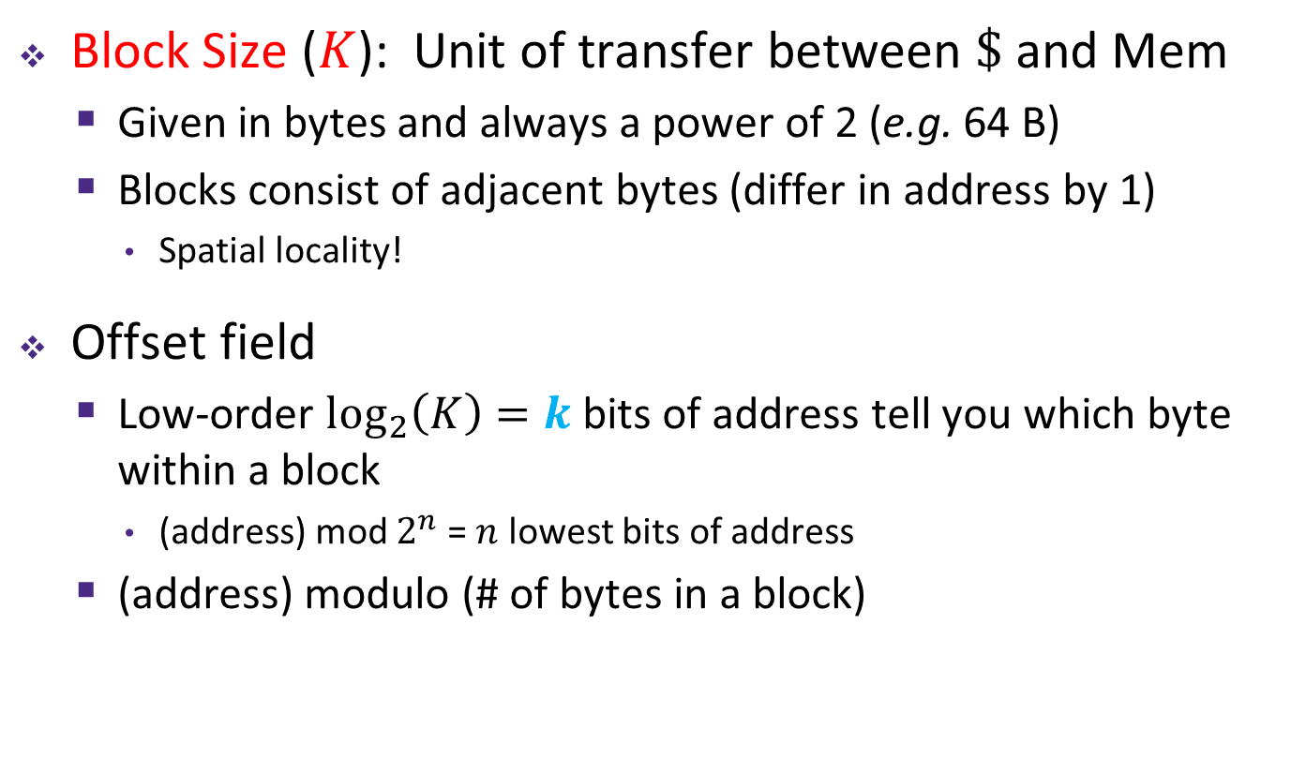
Cache Organization (1)
Note: The textbook uses “b” for offset bits
Block Size ($K$): Unit of transfer between $\$$ and Mem
  Given in bytes and always a power of 2 (e.g. 64 B)
  Blocks consist of adjacent bytes (differ in address by 1)
    Spatial locality!
Offset field
  Low-order $\log_{2}\left(K\right)=k$ bits of address tell you which byte within a block
    (address) mod $2^{n}$ = $n$ lowest bits of address
  (address) modulo (# of bytes in a block)
$m−k$ bits
$k$ bits
$m$-bit address:
(refers to byte in memory)
Block Number
Block Offset
Notes:
Just like withinBlock() from Lab 1!
Little k (or b) for offset bits

Slide 25
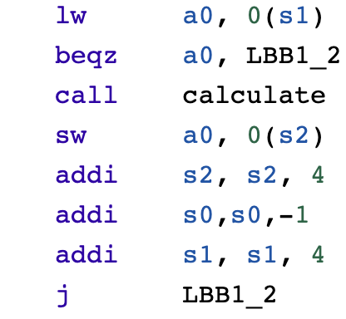
How to identify different blocks in cache?
I = 0 – 0x000000 Block: 0000
I = 1 - 0x000004 Block: 0001
I = 1 - 0x000008 Block: 0002
……………
for i = 0 to N
Calculate(A[i])
Cache (16 bytes, 4 blocks)
Main Memory (64bytes, 16 blocks)

Slide 26
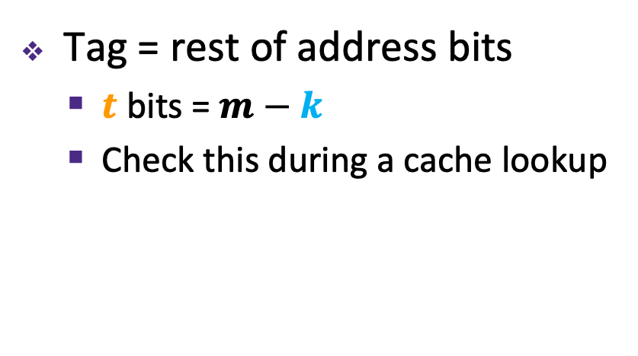
Tags Differentiate Blocks in Cache
Memory
Cache
Block Addr | Block Data
0000
0001
0010
0011
0100
0101
0110
0111
1000
1001
1010
1011
1100
1101
1110
1111
0000
0100
Here $K$ = 4 B
and $C/K$ = 4
1010
1111
Tag = rest of address bits
  $t$ bits = $m−k$
  Check this during a cache lookup
Notes:
Possible analogies for Tag:
Hash by first name, tag by last name
Hash by 7-digit phone number, tag by area code
Again, don’t memorize m – s – k

Slide 27
Tags Differentiate Blocks in Same Index
Memory
Cache
Block Addr | Block Data
0000
0001
0010
0011
0100
0101
0110
0111
1000
1001
1010
1011
1100
1101
1110
1111
Index | Tag |  | Block Data
00 | 00
01
10 | 01
11 | 01
Here $K$ = 4 B
and $C/K$ = 4
Tag = rest of address bits
  $t$ bits = $m−s−k$
  Check this during a cache lookup
Notes:
Possible analogies for Tag:
Hash by first name, tag by last name
Hash by 7-digit phone number, tag by area code
Again, don’t memorize m – s – k

Slide 28





Example Placement
block size: | 16 B
capacity: | 8 blocks
address: | 16 bits
Where would data from address 0x1833 be placed?
  Binary: 0b 0001 1000 0011 0011
$t$ = $m$–$s$–$k$
$s$ = $\log_{2}\left(C/(K∗E)\right)$
$k$ = $\log_{2}\left(K\right)$
$m$-bit address:
Tag ($t$)
Index ($s$)
Offset ($k$)
$s$ = ?
$s$ = ?
$s$ = ?
$s$ = 0
Direct-mapped
2-way set associative
4-way set associative
Fully associative
Set | Tag | Data
0
1
2
3
4
5
6
7
Set | Tag | Data
0
1
2
3
Set | Tag | Data
0
1
Set | Tag | Data
0
Notes:
28
k = 4
E = 1; s = 3; idx = 3. s : number of bits. Idx: actual value.
E = 2; s = 2; idx = 3
E = 4; s = 1; idx = 1
E =8; s = 0; idx = 0

Slide 29




Mapping Memory Address to Cache
CPU sends address request for chunk of data
Address breakdown:
  Index field tells you where to look in cache
  Tag field lets you check that data is the block you want
  Offset field selects specified start byte within block
  k = log₂(K); s = log₂(C/(K*E)); t = m - s - k
  K: Block Size (bytes), E: Associativity; C: Cache Size (bytes)
$m$-bit address:
Tag ($t$)
Index ($s$)
Offset ($k$)
Block Number
Notes:
Tio = uncle in spanish
Go through steps
Why are they in this order?
Offset must be last
You want index to ”change fast” to minimize collision
If you swapped tag and index, adjacent blocks would collide (jump forward two slides)

Slide 30
Cache Read
Locate set
Check if any line in set
is valid and has
matching tag: hit
Locate data starting
at offset
$E$ = blocks/lines per set
Address of byte in memory:
$t$ bits
$s$ bits
$k$ bits
$S$ = # sets
= $2^{s}$
tag
set
index
block
offset
data begins at this offset
v
tag
0
1
2
K-1
valid bit
$K$ = bytes per block

Slide 31
Example: Direct-Mapped Cache ($E$ = 1)
Direct-mapped: One line per set
Block Size $K$ = 8 B
Address of int:
v
tag
0
1
2
3
4
5
6
7
$t$ bits
0…01
100
v
tag
0
1
2
3
4
5
6
7
find set
$S$ = $2^{s}$ sets
v
tag
0
1
2
3
4
5
6
7
v
tag
0
1
2
3
4
5
6
7

Slide 32
Example: Direct-Mapped Cache ($E$ = 1)
Direct-mapped: One line per set
Block Size $K$ = 8 B
Address of int:
valid? +
match?: yes = hit
$t$ bits
0…01
100
v
tag
0
1
2
3
4
5
6
7
block offset

Slide 33
Example: Direct-Mapped Cache ($E$ = 1)
Direct-mapped: One line per set
Block Size $K$ = 8 B
Address of int:
valid? +
match?: yes = hit
$t$ bits
0…01
100
v
tag
0
1
2
3
4
5
6
7
block offset
int (4 B) is here
This is why we want alignment!
No match? Then old line gets evicted and replaced

Slide 34
Example: Set-Associative Cache ($E$ = 2)
2-way: Two lines per set
Block Size $K$ = 8 B
Address of short int:
$t$ bits
0…01
100
v
tag
0
1
2
3
4
5
6
7
v
tag
0
1
2
3
4
5
6
7
v
tag
0
1
2
3
4
5
6
7
v
tag
0
1
2
3
4
5
6
7
find set
v
tag
0
1
2
3
4
5
6
7
v
tag
0
1
2
3
4
5
6
7
v
tag
0
1
2
3
4
5
6
7
v
tag
0
1
2
3
4
5
6
7
Notes:
1 fewer s bit, 2x fewer sets

Slide 35
Example: Set-Associative Cache ($E$ = 2)
2-way: Two lines per set
Block Size $K$ = 8 B
Address of short int:
compare both
$t$ bits
0…01
100
valid? +
match: yes = hit
v
tag
tag
0
1
2
3
4
5
6
7
v
tag
0
1
2
3
4
5
6
7
block offset

Slide 36
Example: Set-Associative Cache ($E$ = 2)
2-way: Two lines per set
Block Size $K$ = 8 B
Address of short int:
compare both
$t$ bits
0…01
100
valid? +
match: yes = hit
v
tag
0
1
2
3
4
5
6
7
v
tag
0
1
2
3
4
5
6
7
block offset
short int (2 B) is here
No match?
One line in set is selected for eviction and replacement
Replacement policies: random, least recently used (LRU), …

Slide 37
Example Code Analysis Problem
Assuming the cache starts cold (all blocks invalid) and sum is stored in a register, calculate the miss rate:
  $m$ = 12 bits, $C$ = 256 B, $K$ = 32 B, $E$ = 2
#define SIZE 8
long ar[SIZE][SIZE], sum = 0; // &ar=0x800
for (int i = 0; i < SIZE; i++)
for (int j = 0; j < SIZE; j++)
sum += ar[i][j];
Notes:
k = 5 bits
256 / 32 = 8 blocks
8 / 2 = 4 sets
s = 2 bits
t = 12 – 5 – 2 = 5 bits
0x800 = 0b 1000 0000 0000
8 bytes per elem
4 longs fit in a block
¼ miss rate (missed are compulsory)

Slide 38
Sources of Cache Misses: The 3Cs
Compulsory: (Many names: cold start, process migration (switching processes), 1st reference)
  First access to block impossible to avoid;
  Effect is small for long running programs
Capacity:
  Cache cannot contain all blocks accessed by the program, so full associativity won’t hold all blocks
Conflict: (collision)
  Multiple memory locations mapped to the same cache location, so there is a lack of associativity

Slide 39
Peer Instruction Question
We have a cache of size 2 KiB with block size of 128 B. If our cache has 2 sets, what is its associativity?
2
4
8
16
We’re lost…
If addresses are 16 bits wide, how wide is the Tag field?
Notes:
C = 2^11 B
K = 2^7 B
2^4 = 16 blocks
16 / 2 = 8 E
k = 7; s = 1; t = 16 – 7 – 1 = 8

Slide 40
Other Questions
We have a cache with block size of 128 B. Cache is 4-way set-associative and has 8 sets. How big is the cache? (What is the cache capacity)?
A 4KB Cache is 4-way set associative with 64 B blocks. Which bits are used for set index? (Also: How many sets does the cache have?)
A 32KB Cache is 8-way set associative and has 16 sets. Which bits are used for byte offset? (Also: What is the block size?)
A direct-mapped cache uses 4 bits for set index and 6 bits for byte offset. How big is the cache?

