Slide 1
General Cache Mechanics
Smaller, faster, more expensive memory
Caches a subset of the blocks
Cache
7
9
14
3
Data is copied in block-sized transfer units
Memory
0
1
2
3
Larger, slower, cheaper memory.
Viewed as partitioned into “blocks”
4
5
6
7
8
9
10
11
12
13
14
15
Notes:
Note: these are not bytes: blocks

Slide 2
Why Caches Work
Locality: Programs tend to use data and instructions with addresses near or equal to those they have used recently
Temporal locality:
  Recently referenced items are likely
  to be referenced again in the near future
Spatial locality:
  Items with nearby addresses tend
  to be referenced close together in time
How do caches take advantage of this?
block
block
Notes:
Near

Slide 3
Access Pattern
for i = 0 to 8, i++. Vs for i = 0 to 8, i=i+2
Data layout
int a[8] vs short a[8]
int a[8] vs int a[16]
Cache Geometry
Direct mapped vs Set Associative (more later..)

Slide 4
Int. Stride 1
// Block size 64 bytes
int a[8];
for (i = 0; i < 8; i++) {
tmp = a[i]
Number of elements per block = 64/8 = 8
Hit:Miss = 7:8

Slide 5
Short Stride 1
// Block size 64 bytes
short a[8];
for (i = 0; i < 8; i++) {
tmp = a[i]
Number of elements per block = 64/8 = 8
Hit:Miss = 15:16

Slide 6
Int Stride 2
// Block size 64 bytes
int a[8];
for (i = 0; i < 8; i=i+2) {
tmp = a[i]
Number of elements per block = 64/8 = 8
Hit:Miss = 3:4

Slide 7
Caching in general
  Successively higher levels contain “most used” data from lower levels
  Exploits temporal and spatial locality
  Caches are intermediate storage levels used to optimize data transfers between any system elements with different characteristics
Cache Performance
  Ideal case: found in cache (hit)
  Bad case: not found in cache (miss), search in next level
  Average Memory Access Time (AMAT) = HT + MR × MP
    Hurt by Miss Rate and Miss Penalty

Slide 8

Row Major
for (i = 0; i < 4; i++) {
for (j = 0; j < 4; j++) {
A[i][j]
Cache: 256 bytes. 16x256 image
Hits: N-1 (N: number of elements per block)
Misses: 1024

Slide 9
M = 3, N=4
a[0][0] |  | a[0][1] |  | a[0][2] |  | a[0][3]
a[1][0] |  | a[1][1] |  | a[1][2] |  | a[1][3]
a[2][0] |  | a[2][1] |  | a[2][2] |  | a[2][3]
Access Pattern:
stride = ?
1) | a[0][0]
2) | a[0][1]
3) | a[0][2]
4) | a[0][3]
5) | a[1][0]
6) | a[1][1]
7) | a[1][2]
8) | a[1][3]
9) | a[2][0]
10) | a[2][1]
11) | a[2][2]
12) | a[2][3]
Layout in Memory
a [0] [0] | a [0] [1] | a [0] [2] | a [0] [3] | a [1] [0] | a [1] [1] | a [1] [2] | a [1] [3] | a [2] [0] | a [2] [1] | a [2] [2] | a [2] [3]
76
92
108
Notes:
Stride of 1 (4 bytes)

Slide 10
Column Major
for (i = 0; i < 4; i++) {
for (j = 0; j < 4; j++) {
A[j][i]
Cache: 256 bytes. 16x256 image
Hits: 0
Misses: 4096

Slide 11
M = 3, N=4
a[0][0] |  | a[0][1] |  | a[0][2] |  | a[0][3]
a[1][0] |  | a[1][1] |  | a[1][2] |  | a[1][3]
a[2][0] |  | a[2][1] |  | a[2][2] |  | a[2][3]
Access Pattern:
stride = ?
1) | a[0][0]
2) | a[1][0]
3) | a[2][0]
4) | a[0][1]
5) | a[1][1]
6) | a[2][1]
7) | a[0][2]
8) | a[1][2]
9) | a[2][2]
10) | a[0][3]
11) | a[1][3]
12) | a[2][3]
Layout in Memory
a [0] [0] | a [0] [1] | a [0] [2] | a [0] [3] | a [1] [0] | a [1] [1] | a [1] [2] | a [1] [3] | a [2] [0] | a [2] [1] | a [2] [2] | a [2] [3]
76
92
108
Notes:
Stride of 4

Slide 12

Tiled
for (i = 0; i < 2; i++)
for (j = 0; j < 2; j++)
            for (ii = 0; ii < 2; ii++)
        for (jj = 0; jj < 2; jj++)
A[I*2+ii][j*2+jj]

Slide 13

Producer
Consumer
for (i = 0; i < 4; i++) {
for (j = 0; x < 4; x++){
b[i][j] = tmp[i,j]+
tmp[i+1,j]+
tmp[i,j+1]+
tmp[i+1,j+1]
for (i = 0; i < 4; i++) {
for (j = 0; x < 4; x++){
tmp[i][j] = 1.5*a[i,j];
Consumer
Loads: 80
Stores: 32
Mul : 16

Slide 14

Fused
for (i = 0; i < 4; i++) {
for (j = 0; x < 4; x++){
b[i][j] = 1.5*tmp[i,j]+
1.5*tmp[I+1,j]+
1.5*tmp[i,j+1]+
1.5*tmp[I+1,j+1]
Loads: 64
Stores: 16
Mul : 64

Slide 15
Tiled Producer-Consumer
Loads: 48
Stores: 32
Mul : 16

Slide 16
Cache Performance
Two things hurt the performance of a cache:
  Miss rate and miss penalty
  Average Memory Access Time (AMAT): average time to access memory considering both hits and misses
  AMAT = Hit time + Miss rate × Miss penalty
  (abbreviated AMAT = HT + MR × MP)
99% hit rate can be twice as good as 97% hit rate!
  Assume HT of 1 clock cycle and MP of 100 clock cycles
  97%: AMAT =
  99%: AMAT =
Notes:
AMAT = always have to pay HT, only sometimes (MR) pay MP
HR = .97 -> 1 + .03 * 100 = 4 cycles
HR = .99 -> 1 + .01 * 100 = 2 cycles
Since MP is high, keep MR loooow

Slide 17
Can we have more than one cache?
Why would we want to do that?
  Avoid going to memory!
Typical performance numbers:
  Miss Rate
    L1 MR = 3-10%
    L2 MR = Quite small (e.g. < 1%), depending on parameters, etc.
  Hit Time
    L1 HT = 4 clock cycles
    L2 HT = 10 clock cycles
  Miss Penalty
    P = 50-200 cycles for missing in L2 & going to main memory
    Trend: increasing!
Notes:
Smaller cache will have higher MR, lower HT
We have 3 levels now!

Slide 18
An Example Memory Hierarchy
explicitly program-controlled (e.g. refer to exactly %t1, %t2)
registers
on-chip L1
cache (SRAM)
Smaller,
faster,
costlier
per byte
program sees “memory”;
hardware manages caching
transparently
off-chip L2
cache (SRAM)
Larger,
slower,
cheaper
per byte
main memory
(DRAM)
local secondary storage
(local disks)
remote secondary storage
(distributed file systems, web servers)
Notes:
So, why haven’t we seen caches before now in this class?
Because they’re designed to be architecturally transparent!
Never affect correctness, only performance

Slide 19
Making memory accesses fast!
Cache basics
Principle of locality
Memory hierarchies
Cache organization
  Direct-mapped (sets; index + tag)
  Associativity (ways)
  Replacement policy
  Handling writes
Program optimizations that consider caches
Notes:
Divide addresses into “index” and “tag”

Slide 20
Cache Organization (1)
Note: The textbook uses “b” for offset bits
Block Size ($K$): unit of transfer between $\$$ and Mem
  Given in bytes and always a power of 2 (e.g. 64 B)
  Blocks consist of adjacent bytes (differ in address by 1)
    Spatial locality!
Offset field
  Low-order $\log_{2}\left(K\right)=k$ bits of address tell you which byte within a block
    (address) mod $2^{n}$ = $n$ lowest bits of address
  (address) modulo (# of bytes in a block)
$m−k$ bits
$k$ bits
$m$-bit address:
(refers to byte in memory)
Block Number
Block Offset
Notes:
Just like withinBlock() from Lab 1!
Little k (or b) for offset bits

Slide 21
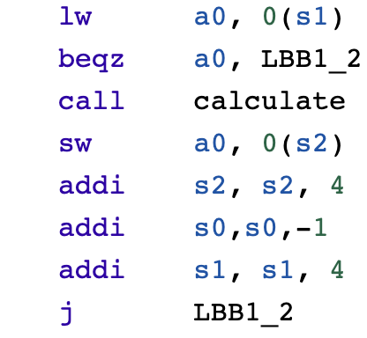
How to identify different blocks in cache?
I = 0 – 0x000000 Block: 0000
I = 1 - 0x000004 Block: 0001
I = 1 - 0x000008 Block: 0002
……………
for i – 0 to N
alculate(A[i])
Cache (16 bytes, 4 blocks)
Main Memory (64bytes, 16 blocks)

Slide 22
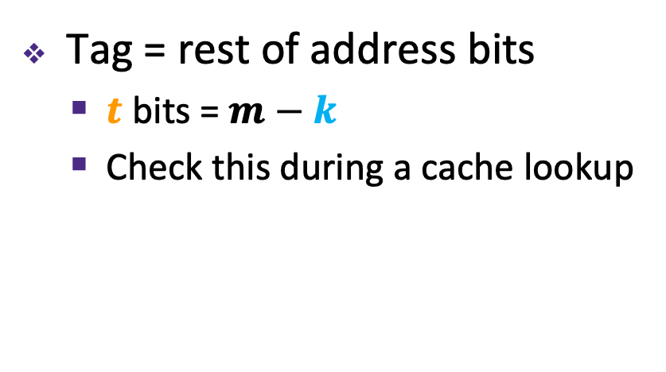
Tags Differentiate Blocks in Cache
Memory
Cache
Block Addr | Block Data
0000
0001
0010
0011
0100
0101
0110
0111
1000
1001
1010
1011
1100
1101
1110
1111
0000
0100
Here $K$ = 4 B
and $C/K$ = 4
1010
1111
Tag = rest of address bits
  $t$ bits = $m−k$
  Check this during a cache lookup
Notes:
Possible analogies for Tag:
Hash by first name, tag by last name
Hash by 7-digit phone number, tag by area code
Again, don’t memorize m – s – k

Slide 23
Tags Differentiate Blocks in Same Index
Memory
Cache
Block Addr | Block Data
0000
0001
0010
0011
0100
0101
0110
0111
1000
1001
1010
1011
1100
1101
1110
1111
Index | Tag |  | Block Data
00 | 00
01
10 | 01
11 | 01
Here $K$ = 4 B
and $C/K$ = 4
Tag = rest of address bits
  $t$ bits = $m−s−k$
  Check this during a cache lookup
Notes:
Possible analogies for Tag:
Hash by first name, tag by last name
Hash by 7-digit phone number, tag by area code
Again, don’t memorize m – s – k

Slide 24





Example Placement
block size: | 16 B
capacity: | 8 blocks
address: | 16 bits
Where would data from address 0x1833 be placed?
  Binary: 0b 0001 1000 0011 0011
$t$ = $m$–$s$–$k$
$s$ = $\log_{2}\left(C/(K∗E)\right)$
$k$ = $\log_{2}\left(K\right)$
$m$-bit address:
Tag ($t$)
Index ($s$)
Offset ($k$)
$s$ = ?
$s$ = ?
$s$ = ?
$s$ = 0
Direct-mapped
2-way set associative
4-way set associative
Fully associative
Set | Tag | Data
0
1
2
3
4
5
6
7
Set | Tag | Data
0
1
2
3
Set | Tag | Data
0
1
Set | Tag | Data
0
Notes:
24
k = 4
E = 1; s = 3; idx = 3. s : number of bits. Idx: actual value.
E = 2; s = 2; idx = 3
E = 4; s = 1; idx = 1
E =8; s = 0; idx = 0

Slide 25
Cache Read
Locate set
Check if any line in set
is valid and has
matching tag: hit
Locate data starting
at offset
$E$ = blocks/lines per set
Address of byte in memory:
$t$ bits
$s$ bits
$k$ bits
$S$ = # sets
= $2^{s}$
tag
set
index
block
offset
data begins at this offset
v
tag
0
1
2
K-1
valid bit
$K$ = bytes per block

Slide 26
Example: Direct-Mapped Cache ($E$ = 1)
Direct-mapped: One line per set
Block Size $K$ = 8 B
Address of int:
v
tag
0
1
2
3
4
5
6
7
$t$ bits
0…01
100
v
tag
0
1
2
3
4
5
6
7
find set
$S$ = $2^{s}$ sets
v
tag
0
1
2
3
4
5
6
7
v
tag
0
1
2
3
4
5
6
7

Slide 27
Example: Direct-Mapped Cache ($E$ = 1)
Direct-mapped: One line per set
Block Size $K$ = 8 B
Address of int:
valid? +
match?: yes = hit
$t$ bits
0…01
100
v
tag
0
1
2
3
4
5
6
7
block offset

Slide 28
Example: Direct-Mapped Cache ($E$ = 1)
Direct-mapped: One line per set
Block Size $K$ = 8 B
Address of int:
valid? +
match?: yes = hit
$t$ bits
0…01
100
v
tag
0
1
2
3
4
5
6
7
block offset
int (4 B) is here
This is why we want alignment!
No match? Then old line gets evicted and replaced

Slide 29
Example: Set-Associative Cache ($E$ = 2)
2-way: Two lines per set
Block Size $K$ = 8 B
Address of short int:
$t$ bits
0…01
100
v
tag
0
1
2
3
4
5
6
7
v
tag
0
1
2
3
4
5
6
7
v
tag
0
1
2
3
4
5
6
7
v
tag
0
1
2
3
4
5
6
7
find set
v
tag
0
1
2
3
4
5
6
7
v
tag
0
1
2
3
4
5
6
7
v
tag
0
1
2
3
4
5
6
7
v
tag
0
1
2
3
4
5
6
7
Notes:
1 fewer s bit, 2x fewer sets

Slide 30
Example: Set-Associative Cache ($E$ = 2)
2-way: Two lines per set
Block Size $K$ = 8 B
Address of short int:
compare both
$t$ bits
0…01
100
valid? +
match: yes = hit
v
tag
tag
0
1
2
3
4
5
6
7
v
tag
0
1
2
3
4
5
6
7
block offset

Slide 31
Example: Set-Associative Cache ($E$ = 2)
2-way: Two lines per set
Block Size $K$ = 8 B
Address of short int:
compare both
$t$ bits
0…01
100
valid? +
match: yes = hit
v
tag
0
1
2
3
4
5
6
7
v
tag
0
1
2
3
4
5
6
7
block offset
short int (2 B) is here
No match?
One line in set is selected for eviction and replacement
Replacement policies: random, least recently used (LRU), …

Slide 32
Example Code Analysis Problem
Assuming the cache starts cold (all blocks invalid) and sum is stored in a register, calculate the miss rate:
  $m$ = 12 bits, $C$ = 256 B, $K$ = 32 B, $E$ = 2
#define SIZE 8
long ar[SIZE][SIZE], sum = 0; // &ar=0x800
for (int i = 0; i < SIZE; i++)
for (int j = 0; j < SIZE; j++)
sum += ar[i][j];
Notes:
k = 5 bits
256 / 32 = 8 blocks
8 / 2 = 4 sets
s = 2 bits
t = 12 – 5 – 2 = 5 bits
0x800 = 0b 1000 0000 0000
8 bytes per elem
4 longs fit in a block
¼ miss rate (missed are compulsory)

