Slide 1
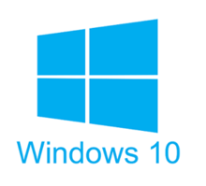





Roadmap
C:
Java:
Memory & data
Arrays & structs
Integers & floats
RISC V assembly
Procedures & stacks
Executables
Memory & caches
Processor Pipeline
Performance
Parallelism
car *c = malloc(sizeof(car));
c->miles = 100;
c->gals = 17;
float mpg = get_mpg(c);
free(c);
Car c = new Car();
c.setMiles(100);
c.setGals(17);
float mpg =
c.getMPG();
Assembly language:
OS:
Machine code:
0111010000011000
100011010000010000000010
1000100111000010
110000011111101000011111
Computer system:

Slide 2
Virtual Memory (VM*)
Overview and motivation
VM as a tool for caching
Address translation
VM as a tool for memory management
VM as a tool for memory protection
Warning: Virtual memory is pretty complex, but crucial for understanding how processes work and for debugging performance
*Not to be confused with “Virtual Machine” which is a whole other thing.

Slide 3
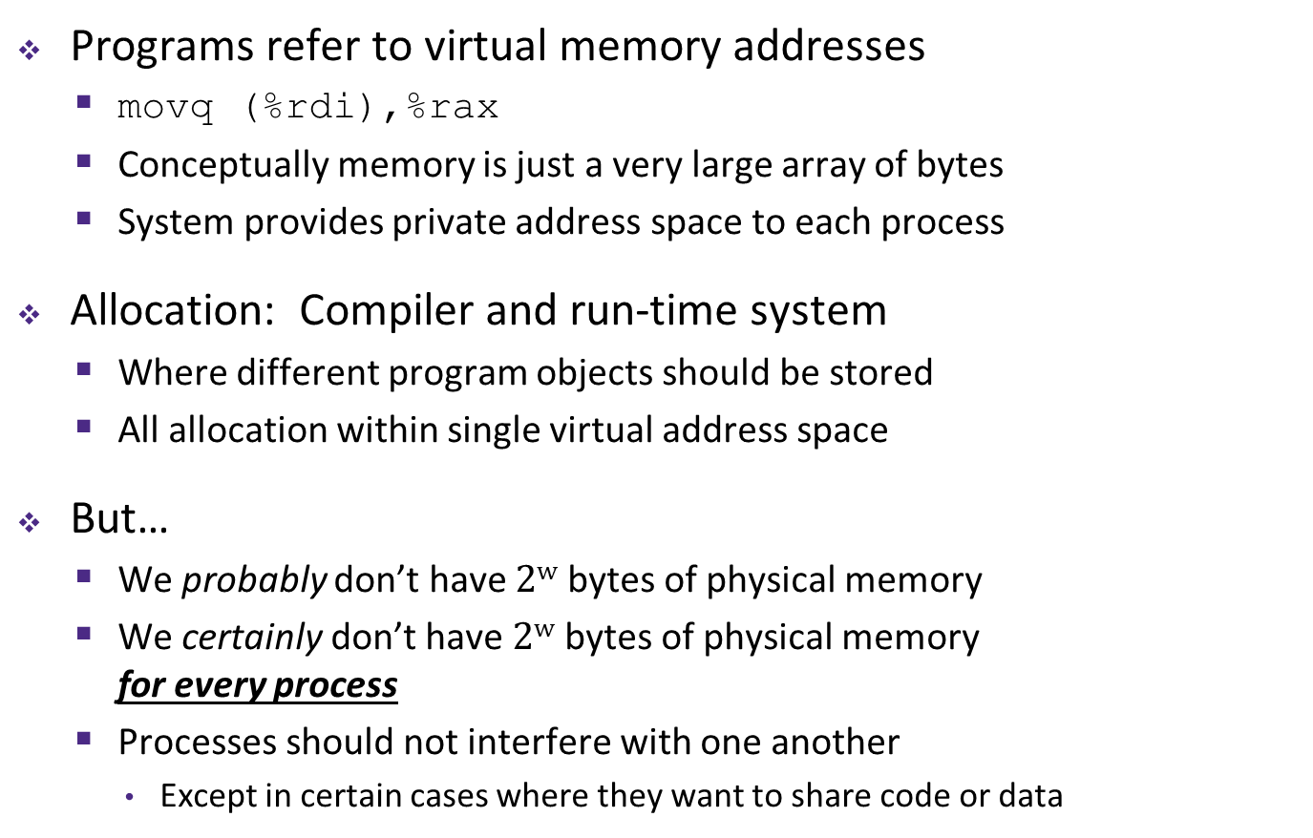
Memory as we know it so far… is virtual!
Programs refer to virtual memory addresses
  movq (%rdi),%rax
  Conceptually memory is just a very large array of bytes
  System provides private address space to each process
Allocation: Compiler and run-time system
  Where different program objects should be stored
  All allocation within single virtual address space
But…
  We probably don’t have $2w$ bytes of physical memory
  We certainly don’t have $2w$ bytes of physical memory
  for every process
  Processes should not interfere with one another
    Except in certain cases where they want to share code or data
0xFF∙∙∙∙∙∙F
0x00∙∙∙∙∙∙0

Slide 4
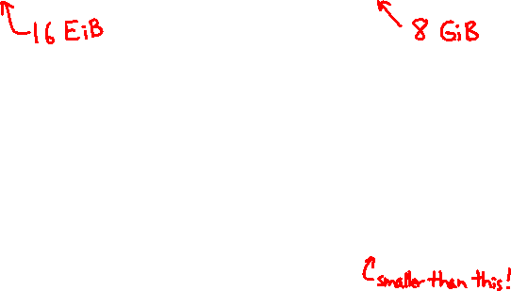
Problem 1: How Does Everything Fit?
64-bit virtual addresses can address
several exabytes
(18,446,744,073,709,551,616 bytes)
Physical main memory offers
a few gigabytes
(e.g. 8,589,934,592 bytes)
?
(Not to scale; physical memory would be smaller than the period at the end of this sentence compared to the virtual address space.)
1 virtual address space per process, with many processes…

Slide 5
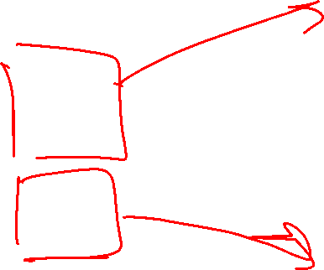
Problem 2: Memory Management
Physical main memory
We have multiple
processes:
Each process has…
Process 1
Process 2
Process 3
…
Process n
stack
heap
.text
.data
…
What goes where?
x

Slide 6
Problem 3: How To Protect
Physical main memory
Process i
Process j
Problem 4: How To Share?
Physical main memory
Process i
Process j

Slide 7
How can we solve these problems?
“Any problem in computer science can be solved by adding another level of indirection.” – David Wheeler, inventor of the subroutine
Without Indirection
With Indirection
P1
P2
Thing
P3
NewThing
P1
P2
Thing
P3
NewThing
What if I want to move Thing?
Notes:
Quote attributed to David Wheeler or Butler Lampson (http://en.wikipedia.org/wiki/Butler_Lampson)

Slide 8

Indirection
Indirection: The ability to reference something using a name, reference, or container instead of the value itself. A flexible mapping between a name and a thing allows changing the thing without notifying holders of the name.
  Adds some work (now have to look up 2 things instead of 1)
  But don’t have to track all uses of name/address (single source!)
Examples:
  Phone system: cell phone number portability
  Domain Name Service (DNS): translation from name to IP address
  Call centers: route calls to available operators, etc.
  Dynamic Host Configuration Protocol (DHCP): local network address assignment

Slide 9

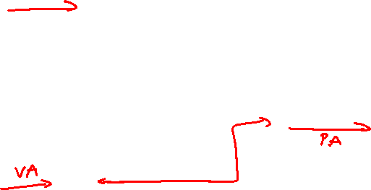
Indirection in Virtual Memory
Virtual memory
mapping
Process 1
Physical memory
Virtual memory
Process $n$
Each process gets its own private virtual address space
Solves the previous problems!

Slide 10
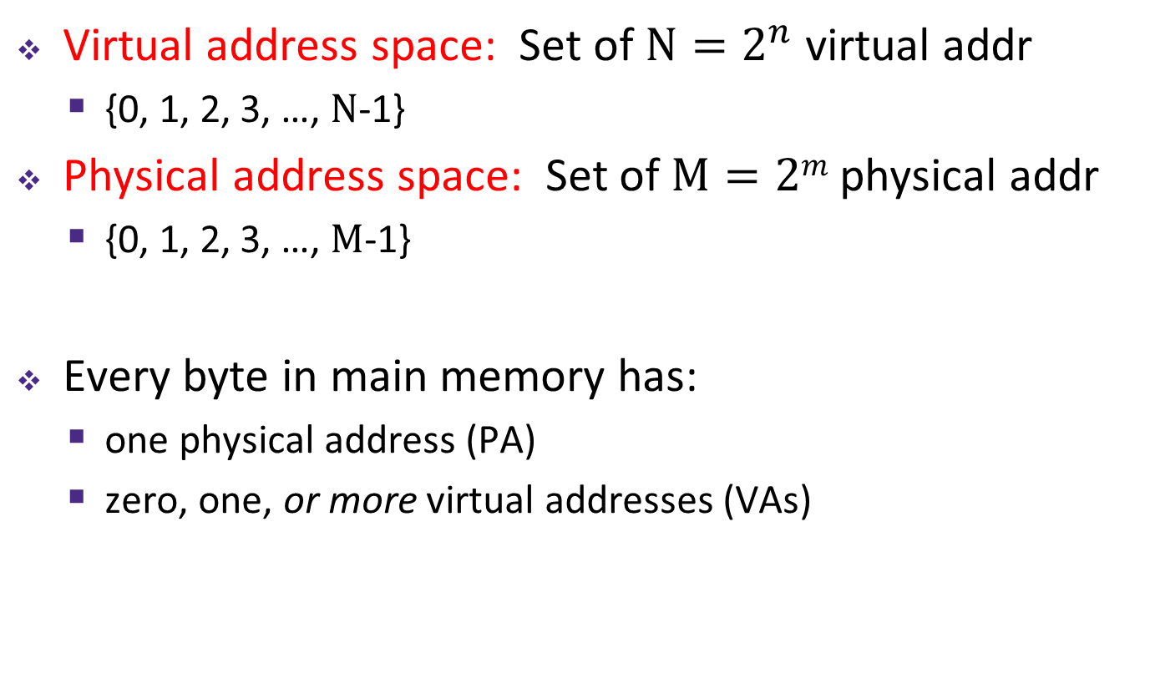
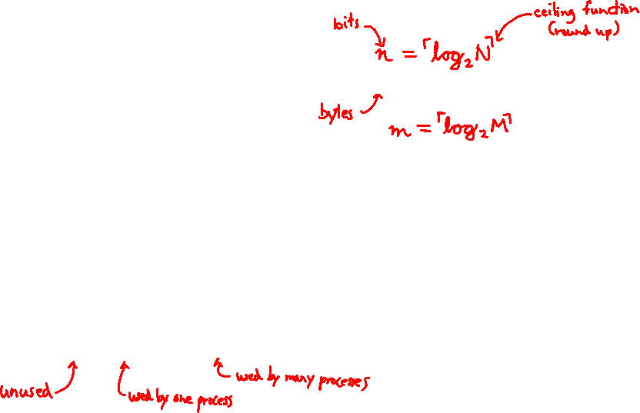
Address Spaces
Virtual address space: Set of $N=2^{n}$ virtual addr
  {0, 1, 2, 3, …, $N$-1}
Physical address space: Set of $M=2m$ physical addr
  {0, 1, 2, 3, …, $M$-1}
Every byte in main memory has:
  one physical address (PA)
  zero, one, or more virtual addresses (VAs)

Slide 11
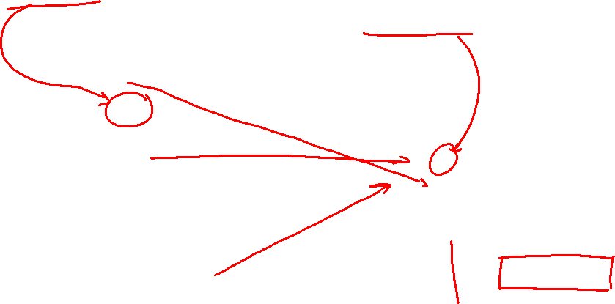
Mapping
A virtual address (VA) can be mapped to either physical memory or disk
  Unused VAs may not have a mapping
  VAs from different processes may map to same location in memory/disk
Process 1’s Virtual
Address Space
Physical Memory
Process 2’s Virtual
Address Space
Disk
“Swap Space”

Slide 12
Summary
Virtual memory provides:
  Ability to use limited memory (RAM) across multiple processes
  Illusion of contiguous virtual address space for each process
  Protection and sharing amongst processes

