Slide 1
Dynamic Memory Allocation
Programmers use dynamic memory allocators to acquire virtual memory at run time
  For data structures whose size
  (or lifetime) is known only at runtime
  Manage the heap of a process’
  virtual memory:
Types of allocators
  Explicit allocator: programmer allocates and frees space
    Example: malloc and free in C
  Implicit allocator: programmer only allocates space (no free)
    Example: garbage collection in Java, Caml, and Lisp
User stack
Heap (via malloc)
Uninitialized data (.bss)
Initialized data (.data)
Program text (.text)
0
Notes:
http://en.wikipedia.org/wiki/Data_segment#Program_memory
.data is for data that is initialized at compile-time: string literals, and static/global variables initialized to some value.
.bss is for static/global variables with no explicit initialization in the code.
http://en.wikipedia.org/wiki/.bss
.data is fixed-size, have to know ahead of time how much you need

Slide 2
Dynamic Memory Allocation
Allocator organizes heap as a collection of variable-sized blocks, which are either allocated or free
  Allocator requests pages in the heap region; virtual memory hardware and OS kernel allocate these pages to the process
  Application objects are typically smaller than pages, so the allocator manages blocks within pages
    (Larger objects handled too;
    ignored here)
User stack
Top of heap
(brk ptr)
Heap (via malloc)
Uninitialized data (.bss)
Initialized data (.data)
Program text (.text)
0

Slide 3
Memory Allocation Example in C
void foo(int n, int m) {
int i, *p;
p = (int*) malloc(n*sizeof(int)); /* allocate block of n ints */
if (p == NULL) { /* check for allocation error */
perror("malloc");
exit(0);
}
for (i=0; i<n; i++) /* initialize int array */
p[i] = i;
/* add space for m ints to end of p block */
p = (int*) realloc(p,(n+m)*sizeof(int));
if (p == NULL) { /* check for allocation error */
perror("realloc");
exit(0);
}
for (i=n; i < n+m; i++) /* initialize new spaces */
p[i] = i;
for (i=0; i<n+m; i++) /* print new array */
printf("%d\n", p[i]);
free(p); /* free p */
}

Slide 4
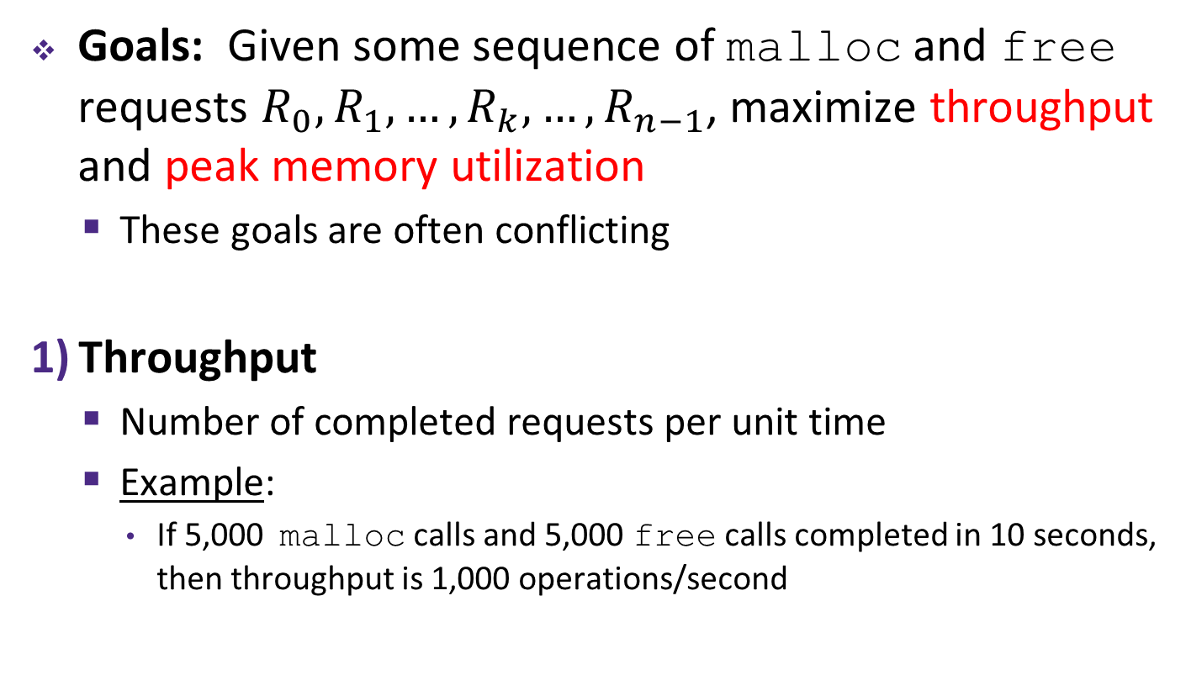
Performance Goals
Goals: Given some sequence of malloc and free requests $R_{0},R_{1},…,R_{k},…,R_{n−1}$, maximize throughput and peak memory utilization
  These goals are often conflicting
Throughput
  Number of completed requests per unit time
  Example:
    If 5,000 malloc calls and 5,000 free calls completed in 10 seconds, then throughput is 1,000 operations/second

Slide 5
Keeping Track of Free Blocks
= 8-byte word (free)
= 8-byte word (allocated)
Implicit free list using length – links all blocks using math
  No actual pointers, and must check each block if allocated or free
Explicit free list among only the free blocks, using pointers
Segregated free list
  Different free lists for different size “classes”
Blocks sorted by size
  Can use a balanced binary tree (e.g. red-black tree) with pointers within each free block, and the length used as a key
40
32
48
16
40
32
48
16

Slide 6
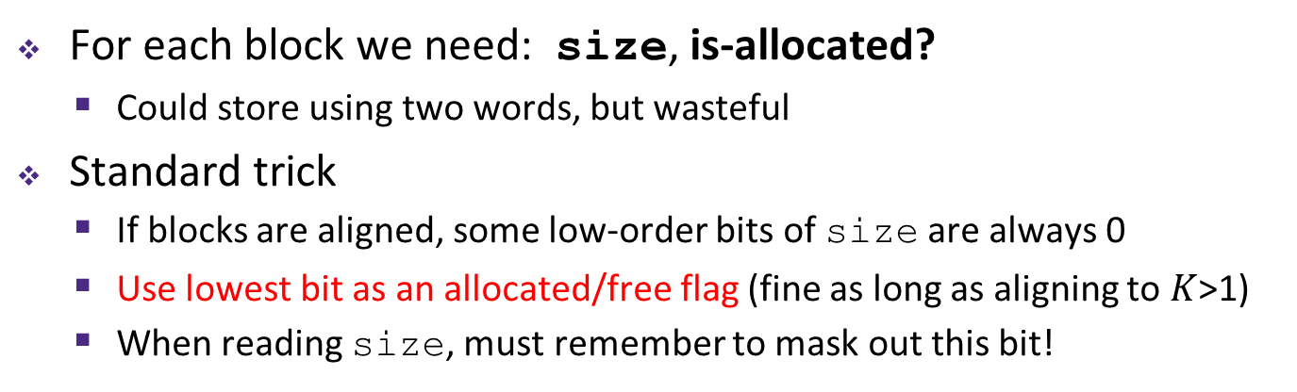
Implicit Free Lists
e.g. with 8-byte alignment, possible values for size:
00001000 = 8 bytes
00010000 = 16 bytes
00011000 = 24 bytes
. . .
For each block we need: size, is-allocated?
  Could store using two words, but wasteful
Standard trick
  If blocks are aligned, some low-order bits of size are always 0
  Use lowest bit as an allocated/free flag (fine as long as aligning to $K$>1)
  When reading size, must remember to mask out this bit!
8 bytes
Format of
allocated and
free blocks:
size
a
a = 1: allocated block
a = 0: free block
size: block size (in bytes)
payload: application data
(allocated blocks only)
size | a;
x & 1;
x & ~1;
If x is first word (header):
x = size | a;
a = x & 1;
size = x & ~1;
payload
optional
padding
Notes:
Where is p pointing?

Slide 7
Explicit Free Lists
Allocated block:
Free block:
size
a
size
a
payload and
padding
next
prev
size
a
size
a
(same as implicit free list)
Use list(s) of free blocks, rather than implicit list of all blocks
  The “next” free block could be anywhere in the heap
    So we need to store next/previous pointers, not just sizes
  Since we only track free blocks, so we can use “payload” for pointers
  Still need boundary tags (header/footer) for coalescing
Notes:
Storing pointers in the “payload” section of a free block could require a larger minimum block size, possibly increasing internal fragmentation.

Slide 8
Freeing with LIFO Policy (Case 1)
Boundary tags not shown, but don’t forget about them!
Before
free( )
Root
Insert the freed block at the root of the list
After
Root
Notes:
Note: all blue “next” pointers and red “previous” pointers should probably point to either the header or footer of the next/previous block – it shouldn’t matter which (I think), as long as it’s done consistently. The diagrams on this slide and on the next few do not always show pointers to the exact word for the block header/footer.

Slide 9
Freeing with LIFO Policy (Case 2)
Boundary tags not shown, but don’t forget about them!
Before
free( )
Root
Splice successor block out of list, coalesce both memory blocks, and insert the new block at the root of the list
After
Root
Notes:
Note: all blue “next” pointers and red “previous” pointers should probably point to either the header or footer of the next/previous block – it shouldn’t matter which (I think), as long as it’s done consistently. The diagrams on this slide and on the next few do not always show pointers to the exact word for the block header/footer.

Slide 10
Freeing with LIFO Policy (Case 3)
Boundary tags not shown, but don’t forget about them!
Before
free( )
Root
Splice predecessor block out of list, coalesce both memory blocks, and insert the new block at the root of the list
After
Root
Notes:
Note: all blue “next” pointers and red “previous” pointers should probably point to either the header or footer of the next/previous block – it shouldn’t matter which (I think), as long as it’s done consistently. The diagrams on this slide and on the next few do not always show pointers to the exact word for the block header/footer.

Slide 11
Freeing with LIFO Policy (Case 4)
Boundary tags not shown, but don’t forget about them!
Before
free( )
Root
Splice predecessor and successor blocks out of list, coalesce all 3 memory blocks, and insert the new block at the root of the list
After
Root

Slide 12
Explicit List Summary
Comparison with implicit list:
  Block allocation is linear time in number of free blocks instead of all blocks
    Much faster when most of the memory is full
  Slightly more complicated allocate and free since we need to splice blocks in and out of the list
  Some extra space for the links (2 extra pointers needed for each free block)
    Increases minimum block size, leading to more internal fragmentation
Most common use of explicit lists is in conjunction with segregated free lists
  Keep multiple linked lists of different size classes, or possibly for different types of objects

Slide 13
Allocation Policy Tradeoffs
Data structure of blocks on lists
  Implicit (free/allocated), explicit (free), segregated (many free lists) – others possible!
Placement policy: first-fit, next-fit, best-fit
  Throughput vs. amount of fragmentation
When do we split free blocks?
  How much internal fragmentation are we willing to tolerate?
When do we coalesce free blocks?
  Immediate coalescing: Every time free is called
  Deferred coalescing: Defer coalescing until needed
    e.g. when scanning free list for malloc or when external fragmentation reaches some threshold
Notes:
Deferred coalescing: if string of frees in same area of heap, can coalesce just once later. Example: freeing a entire linked list.

Slide 14
More Info on Allocators
D. Knuth, “The Art of Computer Programming”, 2nd edition, Addison Wesley, 1973
  The classic reference on dynamic storage allocation
Wilson et al, “Dynamic Storage Allocation: A Survey and Critical Review”, Proc. 1995 Int’l Workshop on Memory Management, Kinross, Scotland, Sept, 1995.
  Comprehensive survey
  Available from CS:APP student site (csapp.cs.cmu.edu)

