Slide 2
Binary Encoding
With N binary digits, how many “things” can you represent?
  Need N binary digits to represent $n$ things, where 2^{N} $≥n$
  Example: 5 binary digits for alphabet because 2⁵ = 32 > 26
A binary digit is known as a bit
A group of 4 bits (1 hex digit) is called a nibble
A group of 8 bits (2 hex digits) is called a byte
  1 bit $→$ 2 things, 1 nibble $→$ 16 things, 1 byte $→$ 256 things

Slide 3
Addresses and Pointers
64-bit example
(pointers are 64-bits wide)
big-endian
An address is a location in memory
A pointer is a data object that holds an address
  Address can point to any data
Pointer stored at
0x48 points to
address 0x38
  Pointer to a pointer!
Is the data stored
at 0x08 a pointer?
  Could be, depending
  on how you use it
Address
0x00
00
00
00
00
00
00
01
F8
0x08
0x10
0x18
0x20
0x28
0x30
00
00
00
00
00
00
00
08
0x38
0x40
00
00
00
00
00
00
00
38
0x48
Notes:
Note that everything is just padded with extra 0s

Slide 4
Data Representations
Sizes of data types (in bytes)
Java Data Type | C Data Type | 32-bit (old) | x86-64
boolean | bool | 1 | 1
byte | char | 1 | 1
char |  | 2 | 2
short | short int | 2 | 2
int | int | 4 | 4
float | float | 4 | 4
 | long int | 4 | 8
double | double | 8 | 8
long | long | 8 | 8
 | long double | 8 | 16
(reference) | pointer * | 4 | 8
(reference) | pointer * | 4 | 8
address size = word size
To use “bool” in C, you must #include <stdbool.h>
Notes:
This mapping is mostly an arbitrary historical artifact except for address sizes.

Slide 5
Arrays in C
Arrays are adjacent locations in memory storing the same type of data object
a (array name) returns the array’s address
&a[i] is the address of a[0] plus i times the element size in bytes
Declaration: int a[6];
Indexing: a[0] = 0x015f;
a[5] = a[0];
No bounds a[6] = 0xBAD;
checking: a[-1] = 0xBAD;
Pointers: int* p;
p = a;
p = &a[0];
*p = 0xA;
p[1] = 0xB;
*(p+1) = 0xB;
p = p + 2;
*p = a[1] + 1;
0x0
0x8
0x1
0x9
0x2
0xA
0x3
0xB
0x4
0xC
0x5
0xD
0x6
0xE
0x7
0xF
0x00
AD
0B
00
00
0x08
equivalent
a[0]
0A
00
00
00
0B
00
00
00
0x10
a[2]
0C
00
00
00
0x18
a[4]
5F
01
00
00
0x20
array indexing = address arithmetic
(both scaled by the size of the type)
AD
0B
00
00
0x28
0x30
equivalent
0x38
p
18
00
00
00
00
00
00
00
0x40
0x48

Slide 6
C Memory Layout
Program’s address space
contains 4 regions:
  Stack: local variables, grows downward
  Heap: space requested via malloc() and used with pointers; resizes dynamically, grows upward
  Static Data: global and static variables, does not grow or shrink
  Code: loaded when program
  starts, does not change
~ FFFF FFFF_{hex}
stack
heap
static data
code
~ 0_{hex}
OS prevents accesses
between stack and heap
(via virtual memory)

Slide 7


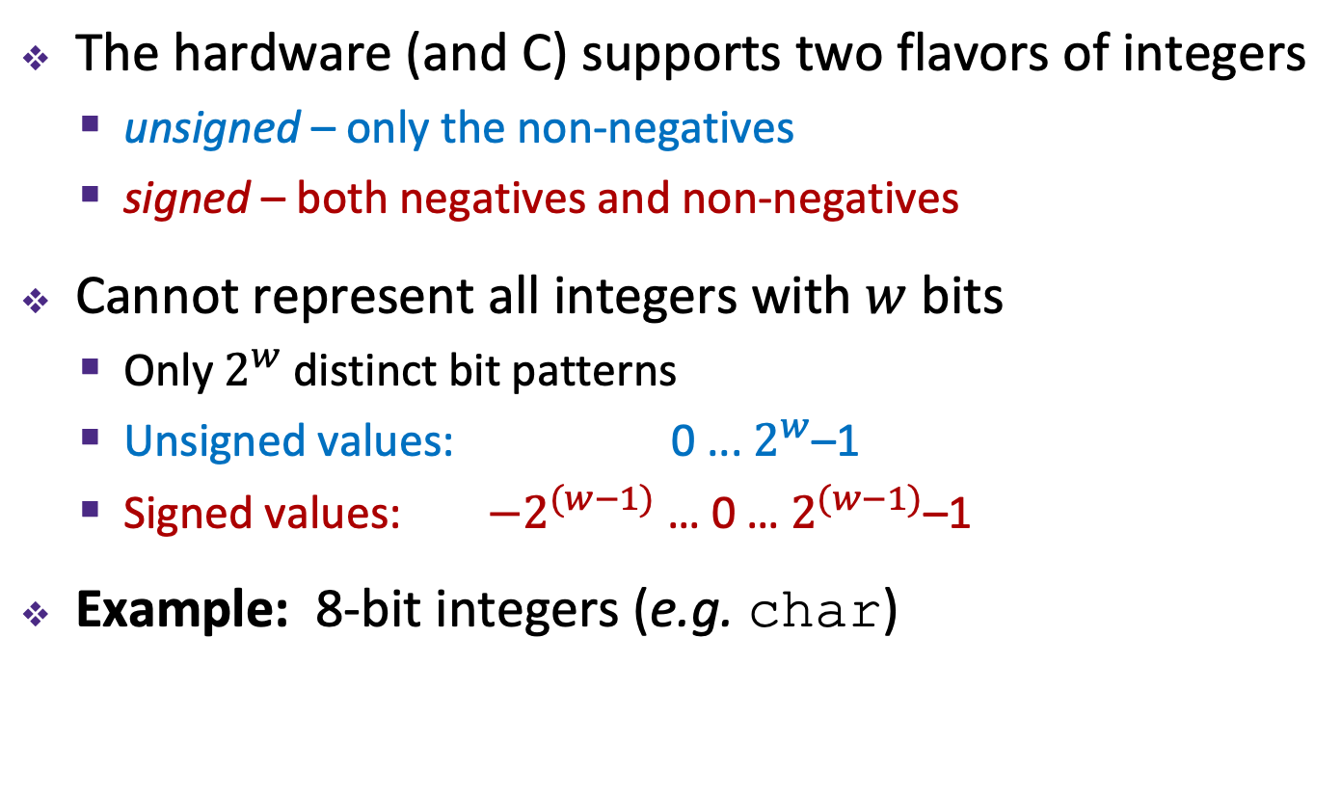








Encoding Integers
The hardware (and C) supports two flavors of integers
  unsigned – only the non-negatives
  signed – both negatives and non-negatives
Cannot represent all integers with $w$ bits
  Only $2^{w}$ distinct bit patterns
  Unsigned values: 0 ... $2^{w}$–1
  Signed values: $−2^{(w−1)}$ … 0 … $2^{(w−1)}$–1
Example: 8-bit integers (e.g. char)
-$∞$
+$∞$
$$−128$$
$$0$$
$$+128$$
$$+256$$
$${−2}^{8−1}$$
$$0$$
$${+2}^{8−1}$$
$$+2^{8}$$
Notes:
Okay, so now let’s talk some more about how we represent numbers, or integers to be specific
Multiple sizes of integers, using different numbers of bytes
But for each size, there are two ways of interpreting the bits…
Same width, just shifted

Slide 8
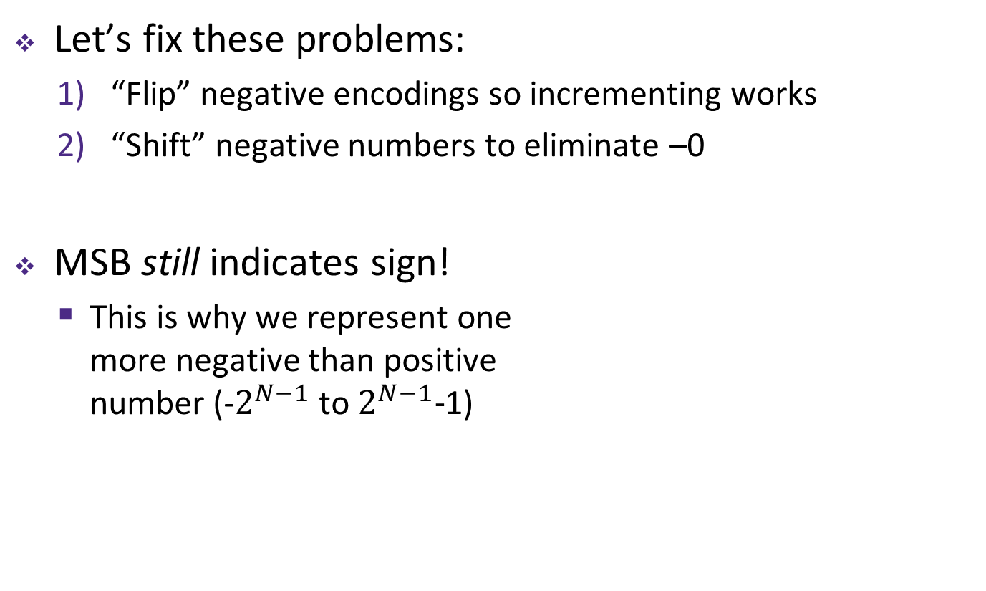
Two’s Complement
Let’s fix these problems:
  “Flip” negative encodings so incrementing works
  “Shift” negative numbers to eliminate –0
MSB still indicates sign!
  This is why we represent one
  more negative than positive
  number (-$2^{N−1}$ to $2^{N−1}−$1)
– 1
+ 0
– 2
1111
0000
+ 1
– 3
1110
0001
+ 2
1101
0010
– 4
1100
0011
+ 3
– 5
1011
0100
+ 4
1010
0101
– 6
1001
0110
+ 5
– 7
1000
0111
+ 6
– 8
+ 7
Notes:
We shift negatives so 0 == 0

Slide 9
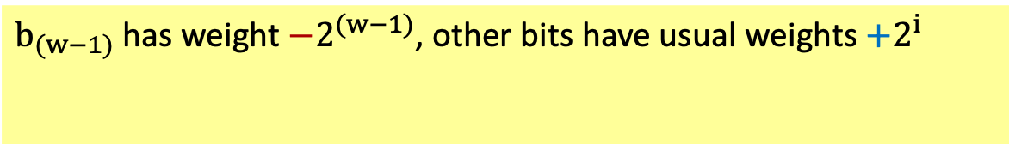
Two’s Complement Negatives
Accomplished with one neat mathematical trick!
  4-bit Examples:
    1010₂ unsigned:
    1*2³+0*2²+1*2¹+0*2⁰ = 10
    1010₂ two’s complement:
    -1*2³+0*2²+1*2¹+0*2⁰ = –6
  -1 represented as:
  1111₂ = -2³+(2³ – 1)
    MSB makes it super negative, add up
    all the other bits to get back up to -1
$b_{(w−1)}$ has weight $−2^{(w−1)}$, other bits have usual weights $+2^{i}$
b_{w-1}
b_{w-2}
. . .
b₀
– 1
+ 0
– 2
1111
0000
+ 1
– 3
1110
0001
+ 2
1101
0010
– 4
1100
0011
+ 3
Two’s
Complement
– 5
1011
0100
+ 4
1010
0101
– 6
1001
0110
+ 5
– 7
1000
0111
+ 6
– 8
+ 7
Notes:
Big negative shift!
8 + 2 = 10
-8 + 2 = -6

Slide 10
Why Two’s Complement is So Great
Roughly same number of (+) and (–) numbers
Positive number encodings match unsigned
Simple arithmetic (x + -y = x – y)
Single zero
All zeros encoding = 0
Simple negation procedure:
  Get negative representation
  of any integer by taking
  bitwise complement and
  then adding one!
  ( ~x + 1 == -x )
– 1
+ 0
– 2
1111
0000
+ 1
– 3
1110
0001
+ 2
1101
0010
– 4
1100
0011
+ 3
Two’s
Complement
– 5
1011
0100
+ 4
1010
0101
– 6
1001
0110
+ 5
– 7
1000
0111
+ 6
– 8
+ 7
Notes:
Memorize this trick. It’s very handy

Slide 11
RISC V

Slide 12
Aside: Registers are Inside the Processor
Processor
Memory
Input
Control
Enable?
Read/Write
Program
Datapath
Address
PC
Bytes
Registers
Write Data
Data
Arithmetic & Logic Unit
(ALU)
Read Data
Output
Processor-Memory Interface
I/O-Memory Interfaces

Slide 13
RISCV Registers
Register denoted by ‘x’ can be referenced by number (x0-x31) or name:
  Registers that hold programmer variables:
s0-s1 ⬌ x8-x9
s2-s11 ⬌ x18-x27
  Registers that hold temporary variables:
t0-t2 ⬌ x5-x7
t3-t6 ⬌ x28-x31
a0-a7 function args
a0-a1 return vals
ra return address
sp stack pointer
pc program counter

Slide 14
RISC V Instructions
i = “immediate”
(constant integer)
RISC-V Instructions
  Arithmetic: add, sub, addi,
  mult,div
  Data Transfer: lw, sw,
  lb, sb, lbu
  Branching: beq, bne, j, bge, blt,
jal;
  Bitwise: and, or, xor,
  andi, ori, xori
  Shifting: sll, srl, sra,
  slli, srli, srai
Notes:
Instructions shown in orange were presented in bonus slides from last lecture.

Slide 15
Loading and Storing Bytes
In addition to word data transfers
(lw, sw), RISC-V has byte data transfers:
  load byte: lb
  store byte: sb
Same format as lw, sw
E.g., lb x10,3(x11)
  contents of memory location with address = sum of “3” + contents of register x11 is copied to the low byte position of register x10.
xxxx xxxx xxxx xxxx xxxx xxxx
zzz zzzz
x10:
x
byte
loaded
…is copied to “sign-extend”
This bit
RISC-V also has “unsigned byte” loads (lbu) which zero extends to fill register. Why no unsigned store byte sbu?

