Slide 2
Discuss with Neighbors:
(previous midterm question)
In one word each, name the most common producer and consumer of the following items.
Choose from: Linker, Loader, Compiler, Assembler, Programmer
(item) | This is the output of: | This is the input to:
bne t0,s0,done
char *s = “hello world”;
app.o string.o
firefox
bne t0,s0,done | Compiler | Assembler
char *s = “hello world”; | Programmer | Compiler
app.o string.o | Assembler | Linker
firefox | Linker | Loader

Slide 3
Review (2/2)
Compiler converts a single HLL file into a single assembly file .c → .s
Assembler removes pseudo-instructions, converts what it can to machine language, and creates a checklist for linker (relocation table) .s → .o
  Resolves addresses by making 2 passes (for internal forward references)
Linker combines several object files and resolves absolute addresses .o → .out
  Enable separate compilation and use of libraries
Loader loads the executable into memory and begins execution .out → [running]

Slide 4
C.A.L.L. Example
#include <stdio.h>
int main(){
printf("Hello, %s\n","world");
return 0;
}
Notes:
printf sits in an external file that needs to be linked in!

Slide 5
Compiled Hello.c: Hello.s
.text
.align 2
.global main
main:
addi sp,sp,-16
sw ra,12(sp)
lui a0,%hi(str1)
addi a0,a0,%lo(str1)
lui a1,%hi(str2)
addi a1,a1,%lo(str2)
call printf
lw ra,12(sp)
addi sp,sp,16
li a0,0
ret
.section .rodata
.balign 4
str1:
.string "Hello, %s!\n"
str2:
.string "world"
# Directive: enter text section
#
#
#
# allocate stack frame
# save return address
# compute address of string1
#
# compute address of string2
#
# call function printf
# restore return address
# deallocate stack frame
# load return value 0
# return
#
#
# label for first string
#
# label for second string

Slide 6
Compiled Hello.c: Hello.s
.text
.align 2
.global main
main:
addi sp,sp,-16
sw ra,12(sp)
lui a0,%hi(str1)
addi a0,a0,%lo(str1)
lui a1,%hi(str2)
addi a1,a1,%lo(str2)
jal, ra, printf
lw ra,12(sp)
addi sp,sp,16
li a0,0
ret
.section .rodata
.balign 4
str1:
.string "Hello, %s!\n"
str2:
.string "world"
# Directive: enter text section
#
#
#
# allocate stack frame
# save return address
# compute address of string1
#
# compute address of string2
#
# call function printf
# restore return address
# deallocate stack frame
# load return value 0
# return
#
#
# label for first string
#
# label for second string

Slide 7
Compiled Hello.c: Hello.s
.text
.align 2
.global main
main:
addi sp,sp,-16
sw ra,12(sp)
lui a0,%hi(str1)
addi a0,a0,%lo(str1)
lui a1,%hi(str2)
addi a1,a1,%lo(str2)
jal, ra, printf
lw ra,12(sp)
addi sp,sp,16
addi a0, a0, 0
ret
.section .rodata
.balign 4
str1:
.string "Hello, %s!\n"
str2:
.string "world"
# Directive: enter text section
#
#
#
# allocate stack frame
# save return address
# compute address of string1
#
# compute address of string2
#
# call function printf
# restore return address
# deallocate stack frame
# load return value 0
# return
#
#
# label for first string
#
# label for second string

Slide 8
Compiled Hello.c: Hello.s
.text
.align 2
.global main
main:
addi sp,sp,-16
sw ra,12(sp)
lui a0,%hi(str1)
addi a0,a0,%lo(str1)
lui a1,%hi(str2)
addi a1,a1,%lo(str2)
jal, ra, printf
lw ra,12(sp)
addi sp,sp,16
addi a0, a0, 0
jalr, x0, ra, 0
.section .rodata
.balign 4
str1:
.string "Hello, %s!\n"
str2:
.string "world"
# Directive: enter text section
#
#
#
# allocate stack frame
# save return address
# compute address of string1
#
# compute address of string2
#
# call function printf
# restore return address
# deallocate stack frame
# load return value 0
# return
#
#
# label for first string
#
# label for second string

Slide 9
Compiled Hello.c: Hello.s
.text
main:
addi sp,sp,-16
sw ra,12(sp)
lui a0,???
addi a0,a0,???
lui a1,???
addi a1,a1,???
jal, ra, ???
lw ra,12(sp)
addi sp,sp,16
addi a0, a0, 0
jalr, x0, ra, 0
.data
str1:
.string "Hello, %s!\n"
str2:
.string "world"
# Directive: enter text section
#
#
#
# allocate stack frame
# save return address
# compute address of string1
#
# compute address of string2
#
# call function printf
# restore return address
# deallocate stack frame
# load return value 0
# return
#
#
# label for first string
#
# label for second string
Symbol Table:
Label: Offset: Type:
main 0x00000000 global text
str1 0x00000000 local data
str2 0x0000000c local data
0x00
0x04
0x08
0x0c
0x10
0x14
0x18
0x1c
0x20
0x24
0x28
0x00
0x0c
Relocation Table:
Offset: Inst: Dependency:
0x00000008 lui str1
0x0000000c addi str1
0x00000010 lui str2
0x00000014 addi str2
0x00000018 jal printf

Slide 10
Assembled Hello.s → Hello.o
00000000 <main>:
00: ff010113 addi sp,sp,-16
04: 00112623 sw ra,12(sp)
08: 00000537 lui a0,0x0 # addr placeholder
0c: 00050513 addi a0,a0,0 # addr placeholder
10: 000005b7 lui a1,0x0 # addr placeholder
14: 00058593 addi a1,a1,0 # addr placeholder
18: 000000ef jal ra,0x0 # addr placeholder
1c: 00c12083 lw ra,12(sp)
20: 01010113 addi sp,sp,16
24: 00000513 addi a0,a0,0
28: 00008067 jalr x0, ra, 0

Slide 11
Linker
hello.o
text 1
hello.out
data 1
data 1
STATIC
Relocated data 1
symbol
data 2
reloc
Relocated data 2
text 1
reloc
CODE
Relocated text 1
stdio.o
text 2
text 2
Relocated text 2
data 2
symbol

Slide 12
Linked Text
000101b0 <main>:
101b0: ff010113 addi sp,sp,-16
101b4: 00112623 sw ra,12(sp)
101b8: 00021537 lui a0,0x21
101bc: a1050513 addi a0,a0,-1520 #20a10<str1>
101c0: 000215b7 lui a1,0x21
101c4: a1c58593 addi a1,a1,-1508 #20a1c<str2>
101c8: 288000ef jal ra,10450 #<printf>
101cc: 00c12083 lw ra,12(sp)
101d0: 01010113 addi sp,sp,16
101d4: 00000513 addi a0,0,0
101d8: 00008067 jalr ra

Slide 13
Loader
STACK
HEAP
STATIC
CODE

Slide 14
Cache Revise

Slide 15
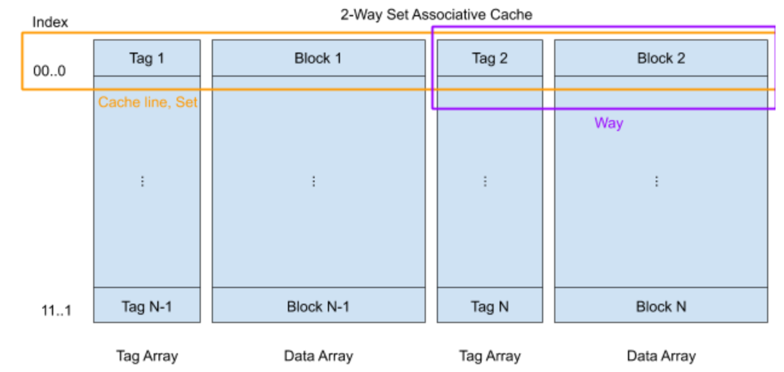
N-way Set Associative Caches:
Split slots into sets of size N, map into set, which is a row containing multiple blocks
Set (row) chosen by index, block (spot WITHIN row) chosen by replacement policy
# index bits = log_2( cache size / (N * block size) )

Slide 16
TIO breakdown of memory address
  Index field is result of hash function (which set, row)
    log_2( cache size / (N * block size) )
  Tag field is identifier (which block is currently in slot)
    addr - index - offset
  Offset field indexes into block
    log_2( block size)
Address
Tag
Index
Offset

Slide 17
Review
Cache performance measured using AMAT
  Parameters that matter:
    Hit Time (HT)
    Miss Rate (MR)
    Miss Penalty (MP)
  AMAT = Hit Time + Miss Rate x Miss Penalty
The 3 Cs of cache misses and their fixes
  Compulsory: Increase block size
  Capacity: Increase cache size
  Conflict: Make the cache fully associative

Slide 18
Virtual Memory Summary
Programmer’s view of virtual memory
  Each process has its own private linear address space
  Cannot be corrupted by other processes
System view of virtual memory
  Uses memory efficiently by caching virtual memory pages
    Efficient only because of locality
  Simplifies memory management and sharing
  Simplifies protection by providing permissions checking

Slide 19
Memory System Summary
Memory Caches (L1/L2/L3)
  Purely a speed-up technique
  Behavior invisible to application programmer and (mostly) OS
  Implemented totally in hardware
Virtual Memory
  Supports many OS-related functions
    Process creation, task switching, protection
  Operating System (software)
    Allocates/shares physical memory among processes
    Maintains high-level tables tracking memory type, source, sharing
    Handles exceptions, fills in hardware-defined mapping tables
  Hardware
    Translates virtual addresses via mapping tables, enforcing permissions
    Accelerates mapping via translation cache (TLB)

Slide 21
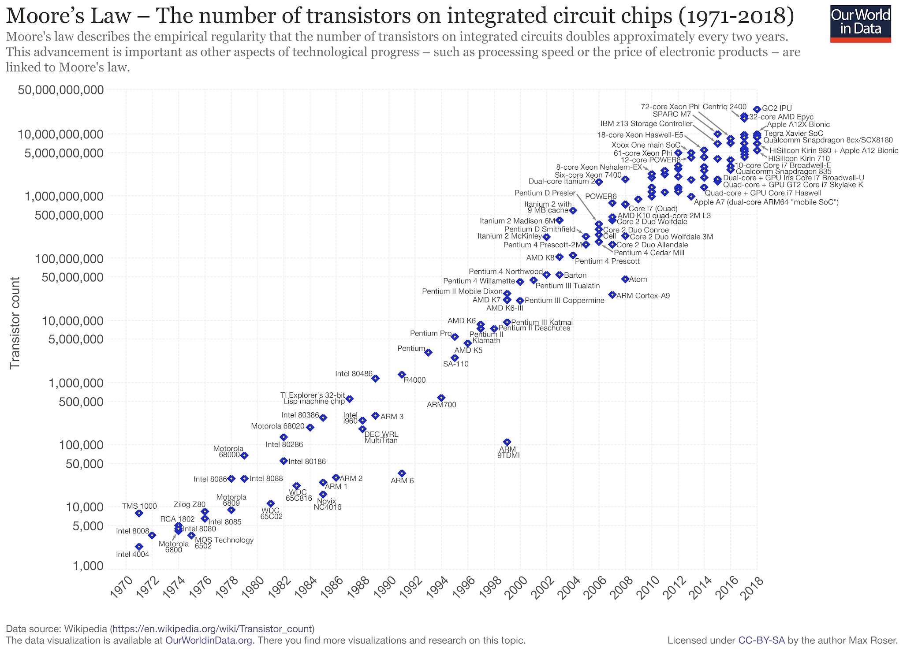

Slide 22
Review
Combinational Logic
A B C
Y
0 0 0
0 0 1
0 1 0
0 1 1
1 0 0
1 0 1
1 1 0
1 1 1
A
F
B
Y
C

Slide 23
Converting Combinational Logic
Try all input combinations
Circuit
Diagram
This is difficult to do efficiently!
Truth
Table
Try all input
combinations
Propagate signals
through gates
Wire inputs to proper gates
(easiest to use AND, OR, and NOT)
SoP or PoS
Boolean
Expression

Slide 24
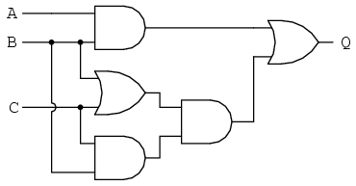
Question: Which boolean equation represents the following circuit?
(A)
AB+BC+C
(B)
AB+(B+C)BC
(C)
(A+B)((BC)+(B+C))
(D)
Q
Notes:
Took 4 min (9:53)

Slide 25
Question: Which boolean equation represents the following circuit?
AB + (B+C)BC
AB
B+C
(B+C)BC
BC
(A)
AB+BC+C
(B)
AB+(B+C)BC
(C)
(A+B)((BC)+(B+C))
(D)
Q
Notes:
Wait 3 min Takes 2 min to explain (9:57)

Slide 26
Question: What is the MOST simplified Boolean Algebra expression for the following circuit?
AB + (B+C)BC
AB
B+C
(B+C)BC
BC
(A)
B (A + C)
(B)
B + AC
(C)
AB + B + C
(D)
A + C
Notes:
Wait 3 min Takes 2 min to explain (9:57)

Slide 27
Question: What is the MOST simplified Boolean Algebra expression for the following circuit?
AB + (B+C)BC
AB
B+C
(B+C)BC
( (i==1) && (i==1) && (j==2) )
---> ( (i==1) && (j==2) )
BC
Q = AB + (B+C) * BC
By distributing the BC into (B+C) we get:
Q = AB + (BBC + CBC)
Using the multiplicative idempotent law again we know that B*B = B and that C*C=C so we get:
Q = AB + (BC + BC)
(A)
B (A + C)
(B)
B + AC
Using the additive idempotent law (B + B = B) we get:
Q = AB + BC
By factoring out the B, we get the final answer of
Q = B(A+C)
(C)
AB + B + C
(D)
A + C
Notes:
Wait 3 min Takes 2 min to explain (9:57)

