Slide 1
General Purpose
GPUs
Tony Nowatzki
UCLA: CS259
4/12/2018

Slide 2
Agenda
Why do we have GPUs?
What is a GPU?
  Hardware
  Execution Model
  Software Interface
Sources of GPU Efficiency/Inefficiency
Simple Programming Example
Goals:
  Convey why GPUs are much better than CPUs for machine learning
  Convey why still so much room to improve GPUs

Slide 3
GPU Agenda
Why do we have GPUs?
What is a GP GPU?
  Hardware
  Execution Model
  Software Interface
Sources of GPU Efficiency/Inefficiency
Very Simple Programming Example
Why still so much room to improve GPGPUs?

Slide 4
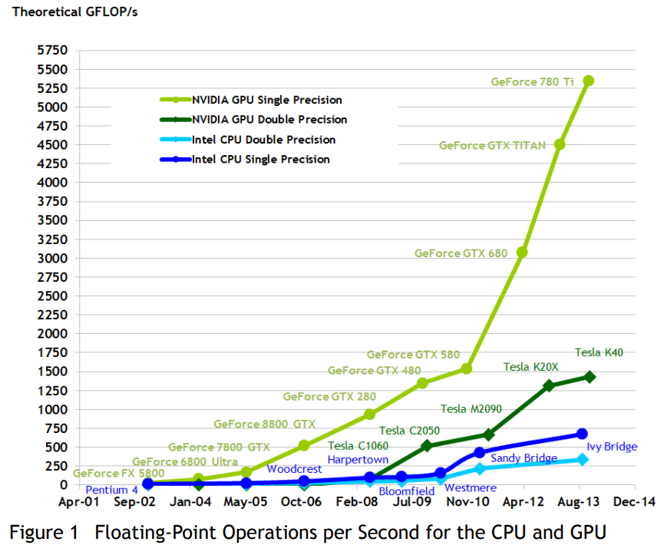
Graphics Processing Units (GPU)
Killer app for parallelism: graphics (3D games)
GFLOPS

Slide 5


Slide 6
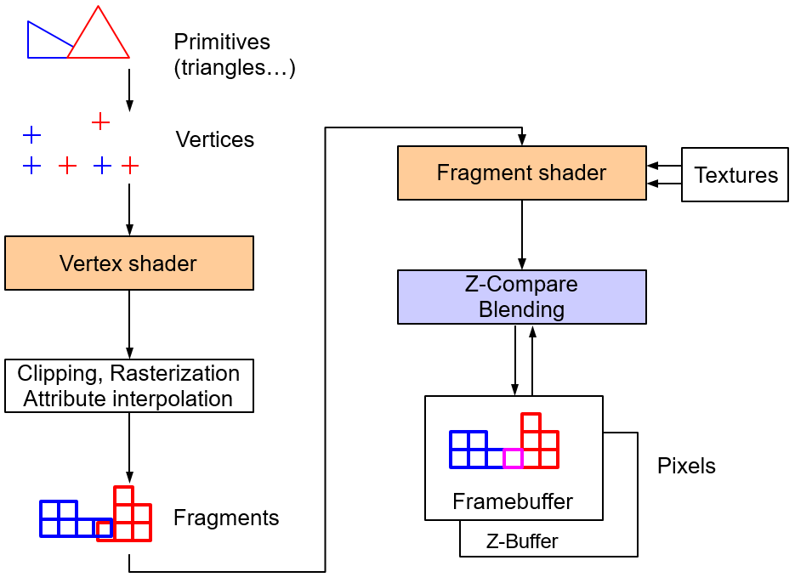
Why so parallel: Graphics!
Simplified
Rendering
Pipeline
What are its
properties?
1. Embarrassing
Parallelism…
2. Low locality…
First Question: What kind of a processor?

Slide 7
One solution: Application Specific Accelerators
DRAM
Storage
Vertex
Shader
Fragment
Shader
Raster-izer
Texture
Unit
…

Slide 8
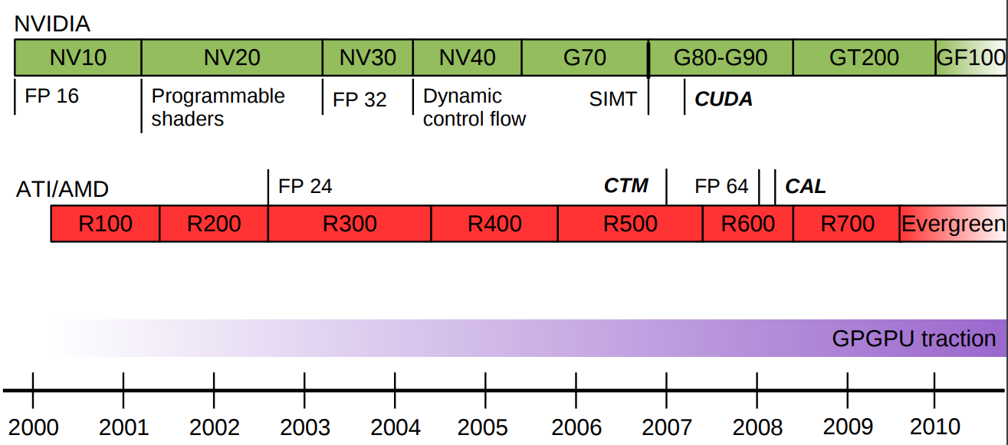
Historical Perspective
Programmability is important – so what to build?
(embarrassing parallelism + low locality)

Slide 9
So what kind of general purpose graphics core to build?

Slide 10
CPU Architecture: Out-of-order Core
L2
Cache
L1
Cache
Reg File
Notes:
Principles: Execute many instructions in parallel

Slide 11
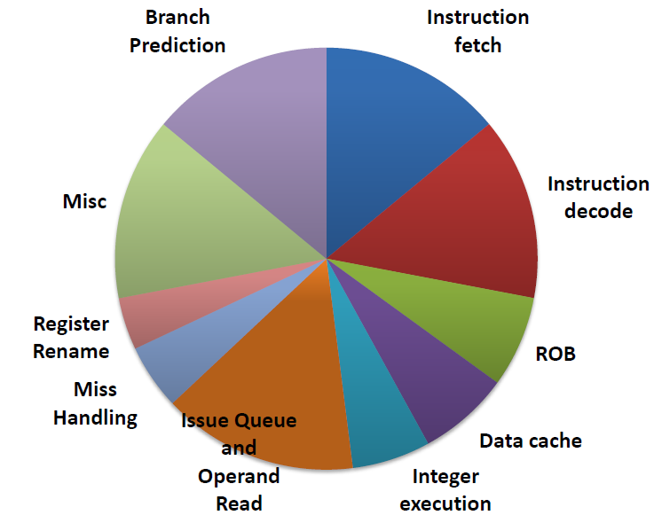
What’s the problem?
ARM Cortex A15
Power Breakdown
Power and area overhead too high...
Low Computational Density
How do we get this:
CPU1
CPU2
CPU3
CPU4
Execution Units

Slide 12
Sources of Parallelism?
Instruction Level Parallelism
  Between independent instructions in sequential program
TLP: Thread-Level Parallelism
  Between independent execution contexts: threads
DLP: Data-Level Parallelism
  Between elements of a vector: same operation on several elements
add r3 ← r1, r2
mul r0 ← r0, r1
sub r1 ← r3, r0
Parallel
Thread 1
Thread 2
vadd r←a,b
a
a
a
+
1
2
3
+ +
b₁ b₂ b₃
r₁ r₂ r₃

Slide 13
Instruction Level Parallelism
L2
Cache
L1
Cache
st
div
Reg File
Control Flow Graph
add
br
sub
st
ld
ld
br
add
sub
st
st
add
div
st
Notes:
Principles: Execute many instructions in parallel

Slide 14
Thread Level Parallelism
L2
Cache
L1
Cache
st
div
Reg File
Reg File
st
add
Thread 1
Thread 2
div
br
sub
st
ld
sub
ld
br
add
Typical Simultaneous
Threads = 2-4
st
Notes:
Why would I want to do this?

Slide 15
Why multiple threads?
Thread 1
Thread 2
ld
Cache Miss!

Slide 16
Data Level Parallelism
L2
Cache
L1
Cache
st
div
vec-reg
vec-reg
st
add
div
br
vmul
st
vld
Vector Instruction (vmul)
sub
vmul
vld
mul
mul
mul
mul
br
add
st
Notes:
Principles: Execute many instructions in parallel

Slide 17
Which kind to specialize for?
Instruction Level Parallelism
  Pro: Each thread go faster for free!
  Con: Power/Area overhead is so high!
TLP: Thread-Level Parallelism
  Pro: Hide memory latency for non-locality
  Con: Programmer/Compiler has to find threads. : (
DLP: Data-Level Parallelism
  Pro: Cheapest form of parallelism!!!
  Con: Programmer/Compiler has to find vectors…
add r3 ← r1, r2
mul r0 ← r0, r1
sub r1 ← r3, r0
Parallel
Thread 1
Thread 2
vadd r←a,b
a
a a
+
1
2
3
+ +
b₁ b₂ b₃
r₁ r₂ r₃

Slide 18
SIMT-GPGPU Core
Vector Reg File
Tid n+0
Tid n+15
Thread Select
add
Fetch
ld
Decode
…
st
Execute
add
Execute
mul
…
Threads
Execute
add
…
Memory
ld
Complete
st
Vec-size # of lanes

Slide 19
Basic GPGPU Core
Vector Reg File
Thread Select
add
Fetch
ld
Decode
st
Execute
L2
Cache
add
L1
Cache
(Other cores here)
Execute
mul
…
Lane 0
Lane N-1
Execute
add
Scratchpad
(shared memory)
Const. Cache
Memory
ld
Complete
Lane 0
Lane N-1
Lane 0
Lane N-1
st
Vec-size # of lanes

Slide 20
Abstraction to program vector lanes: Threads
Absolutely need to avoid having to use explicit SIMD instructions:
  add_vec vadd r←a,b
  Programming these is painful
Idea 1: Instead of programming with vectors, program with threads?
  So much data: can assign a data item to each thread!
  These threads all do basically the same thing!
Normally, threads are expensive:
  Independently scheduled, each run their own program
  Threads can migrate around between different cores, call OS, debug support
Idea 2: Restricted threads: execution model turns threads -> SIMD:
Idea: Break threads into chunks that we run on SIMD lanes
Tid 0
Tid 1
Tid 16
Tid 32

Slide 21
Abstraction to program vector lanes: Threads
Absolutely need to avoid having to use explicit SIMD instructions:
  add_vec vadd r←a,b
  Programming these is painful
Idea 1: Instead of programming with vectors, program with threads?
  So much data: can assign a data item to each thread!
  These threads all do basically the same thing!
Normally, threads are expensive:
  Independently scheduled, each run their own program
  Threads can migrate around between different cores, call OS, debug support
Idea 2: Restricted threads: execution model turns threads -> SIMD:
Idea: Break threads into chunks that we run on vector lanes
Called SIMT: Single Instruction, Multiple Threads
Group of threads executing together is called a WARP
Tid 0
Tid 1
Tid 16
Tid 16

Slide 22
SIMT-GPGPU Core
Vector Reg File
Tid n+0
Tid n+15
Warp Select
add
Fetch
ld
Decode
…
st
Execute
add
Execute
mul
…
Warps
Execute
add
…
Memory
ld
Complete
st
Warp Size

Slide 23
Programming Model: SIMT
SIMT: Single Instruction, Multiple Thread
  Split identical, independent work over multiple lockstep threads
  Group of threads executing together is called a WARP (32 threads)
Programming Example: (gpu worker thread)
Is a thread a real thread? Does it have a context?
Functional Perspective: Yes (almost)
  Each thread has own logical PC and register file
Performance Perspective: No
  All threads within a warp dynamically have same PC
  This is how instruction overhead is amortized!
  What about control flow?
gpu void add(int *a, int *b, int *c) {
c[tid] = a[tid] + b[tid];
}

Slide 24
What if threads go in different directions?
If(tid%2) {
c[tid] = a[tid] - b[tid];
else
c[tid] = a[tid] + b[tid];
Control Flow Graph
add
If tid%2
ld
sub
br
st
sub
add
add
st
st
st
First evaluate true side, then false side:
…
…
(hardware overhead to manage thread divergence… eg. divergence stack)

Slide 25
Execution Model Comparison
Conventional Thread
SIMD/Vector
SIMT
Example
Multicore CPUs
x86 SSE/AVX
GPUs
Easier to program,
Scatter & Gather operations
Pros
More general: better support for TLP
Able to mix serial and parallel code
Inefficient for data parallelism
Indirect memory is slow, hard to program
Gather/Scatter more complicated
Full Divergence kills performance
(though probably not as much as it hurts CPU)
Cons

Slide 26
SIMT-GPGPU Core
Vector Reg File
Tid n+0
Tid n+15
Warp Sched.
add
Fetch
ld
Decode
st
Execute
add
L1
Cache
Execute
mul
…
Lane 0
Lane N-1
Execute
add
Memory
ld
Complete
Branch Divergence Stack
st
# threads / warp (or smaller)

Slide 27
Lets talk about memory!

Slide 28
SIMT-GPGPU Core
Vector Reg File
Tid n+0
Tid n+15
Warp Sched.
add
Fetch
ld
Decode
st
Execute
add
L1
Cache
Execute
mul
…
Lane 0
Lane N-1
Execute
add
Memory
ld
Complete
Branch Divergence Stack
st
# threads / warp (or smaller)

Slide 29
Basic Memory Array Structure
Number of entries
  2^{n}, where n is number of address bits
  Example: 1024 entries, 10 bit address
  Decoder changes n-bit address to
  2^{n} bit “one-hot” signal
  One-bit address travels on “wordlines”
Size of entries
  Width of data accessed
  Data travels on “bitlines”
  256 bits (32 bytes) in example
0
1024*256
SRAM
1
2
3
10 bits
wordlines
1021
1022
1023
bitlines

Slide 30
Basic Cache Structure
Basic cache: array of block frames
  Example: 32KB cache (1024 frames, 32B blocks)
  “Hash table in hardware”
To find frame: decode part of address
  Which part?
  32-bit address
  32B blocks → 5 lowest bits locate byte in block
    These are called offset bits
  1024 frames → next 10 bits find frame
    These are the index bits
  Note: nothing says index must be these bits
  But these work best (think about why)
0
1024*
256bit
SRAM
1
2
3
wordlines
1021
1022
1023
bitlines
[31:15]
hash(address)
<<
index [14:5]
[4:0]
address
data

Slide 31
Basic Cache Structure
tag
valid
Each frame can hold one of 2¹⁷ blocks
  All blocks with same index bit pattern
How to know which if any is currently there?
  To each frame attach tag and valid bit
  Compare frame tag to address tag bits
    No need to match index bits (why?)
Lookup algorithm
  Read frame indicated by index bits
  “Hit” if tag matches and valid bit is set
  Otherwise, a “miss”. Fetch block
0
1
2
3
wordlines
1021
1022
1023
=
tag [31:15]
index [14:5]
[4:0]
<<
address
data
hit?

Slide 32
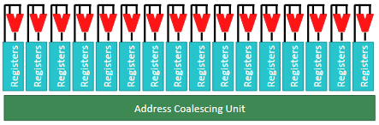
How many ports should my L1 have?
WARP: 32 Threads, 32 Load/Store Ports to L1 Cache?
  Non-starter, even banking doesn’t solve the problem…
  Should 32 cache misses cause 32 requests to memory!?
Common case:
  All threads in warp/wavefront access same cache block(s)
Addressing coalescing:
  Dynamically combine addresses generated from each lane
  Reduces in-flight memory requests, helps DRAM b/w, important

Slide 33
How do we do efficient memory access?
Pseudo CUDA for contiguous access:
Pseudo CUDA for non-contiguous access:
gpu void add(int *a, int *b, int *c) {
c[tid] = a[tid] + b[tid];
}
L1
Cache
Instead issue one access
A[n:n+16*4]
Coalescer
a+0
a+4
a+8
a+16*4
Lane 0
Lane N-1
gpu void add(int *a, int *b, int *c) {
c[tid] = a[tid*2] + b[tid];
}
a+32*4
Instead issue two access
A[n :n+16*4],
A[n+16*4:n+32*4]
a+0
a+8
a+16
(hardware overhead to dynamically coalesce memory access…
and collecting the operands )

Slide 34
Downsides of Cache
Not very energy efficient
  Complex Coalescing Logic
  Tag-checking is extra overhead
  Cache replacement policy implementation
  Cache causes implicit communication – communication kills perf.
Maybe software should be responsible for data reuse?
Scratchpad: Small, private, software-managed cache
  Separate address space that is shared between some threads
  Fully software managed: programmer decides what to bring in/out
  Extremely high bandwidth
  Low energy cost
  Much better for irregular access – don’t need to worry about coalescing

Slide 35
Scratchpad Organization
Banks divide the address space into chunks (corresponds to banks in hardware)
  Stripe Data across it
Threads can access different banks in parallel
Vector
Lanes
(threads)
Crossbar (fully connected network)
A[index(i)]
Banks
Array:
int A[N]
A[0]
A[1]
A[2]
A[3]
A[4]
A[5]
A[6]
A[7]
A[8]
A[9]
A[10]
A[11]
A[12]
A[13]
A[14]
A[15]
A[16]
A[17]
A[18]

Slide 36
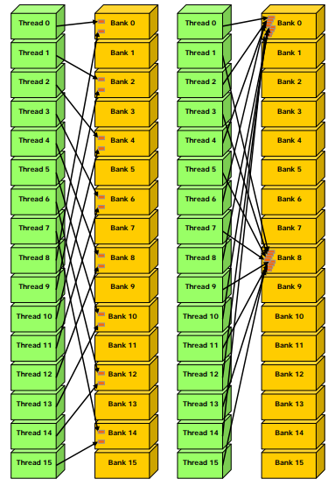

How does scratchpad deal with Conflicts?
Basic approach:
  Separate into non conflicting groups
  Service sequentially
In contrast to cache, groups don’t need to be the same sequential cache line

Slide 37
Other Memory Optimizations
Read-only Memory/Constant Caches
  Use for data that is guaranteed to be constant
Texture Caches/Images/Samplers
  Provides fast hardware 1D/2D/3D interpolation
  Very useful for graphics
  Before better caching for GPGPU, was used for compute apps

Slide 38
SIMT-GPGPU Core
Vector Reg File
Tid n+0
Tid n+15
Warp Sched.
add
Fetch
ld
Decode
st
Scratchpad
(shared memory)
Execute
L1
Cache
add
Execute
mul
~Crossbar
…
Coalescer
Lane 0
Lane N-1
Execute
Const. Cache
add
Lane 0
Lane N-1
Memory
ld
Lane 0
Lane N-1
Complete
st
Branch Divergence Stack
# threads / warp (or smaller)

Slide 39
Scaling up?
Need to scale up past the design I’m showing here…
Can’t naively make the vector-width longer
  (bad for programmability, not all programs have <32 vector width)
So, we go multicore!

Slide 40
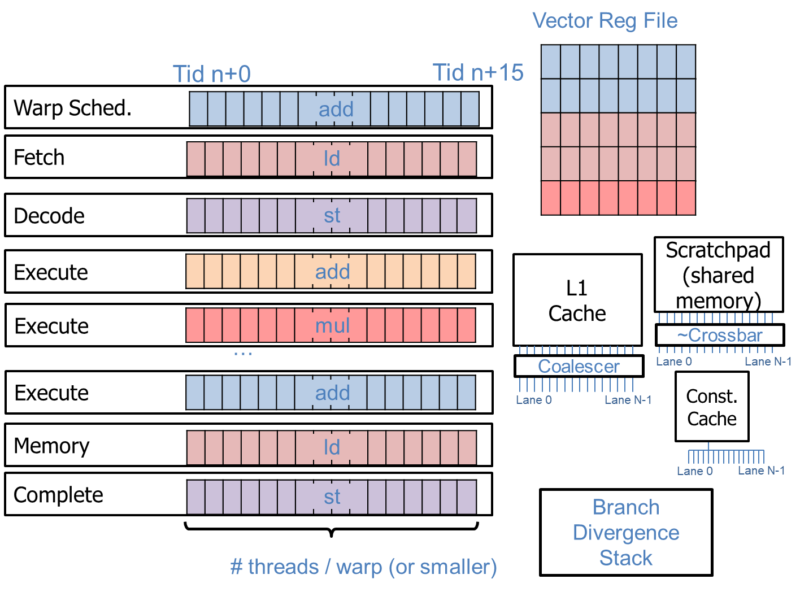
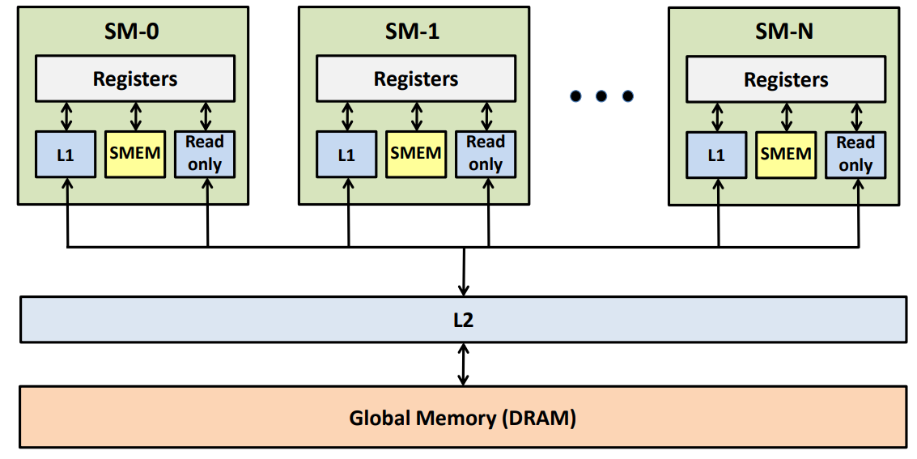
SIMT-GPGPU Core
“Streaming multi-processor”

Slide 41
GPU from Top Level
“Streaming multi-processor”
GPU Performance Analysis and Optimization -- Paulius Micikevicius

Slide 42
Programming Abstractions when we scale up…

Slide 43
Who should share a scratchpad?
All cores share one: Good for programmer, but …
  How to attain low latency and high bandwidth if shared?
Each Warp gets its own: limited sharing potential
What to do? Add another level of the hierarchy:
  Block: Group of threads that can access the same shared SPAD
  Multiple blocks may be mapped to one GPGPU Core
  But each block can only be mapped to one particular core
Grid
Block
Block
Scratchpad
Scratchpad
…

Slide 44
GPU SIMT Model Terminology
NVIDIA
CUDA/HIP
AMD
OpenCL
Thread
Work-item
(performance
abstraction only)
Warp
Wavefront
Block
Thread Block
Scratchpad
Workgroup
Grid
Block
Block
Scratchpad
Grid
(Kernel)
NDRange
(Kernel)
Scratchpad
…

Slide 45
Sycnhronization & Cache Coherence
Fun Fact: No prescribed way to synchronize between Blocks
  __syncthreads(): block-wide barrier
Grid
Block
Block
Block
Block
…

Slide 46
Core complete, here’s the Overall Picture
Grid
Block
Block
Block
Block
…
“Streaming multi-
processor”

Slide 47
Typical CPU/GPU Integration
“Streaming multi-processor”
1
2
3
4
CPU Cache
CPU DRAM
PCI-e

Slide 48
CPU/GPU Architectural Differences
CPUs
GPUs
Use caches and buffering in abundance.
Few large cores.
Much smaller BW.
Fast synchronization.
More threads to hide latency to memory.
Many small cores.
Much higher BW.
Slow/non-global synchronization.
Special HW function units (transcendentals, textures)

Slide 49
What’s “good” for executing on GPUs?
Abundant parallelism
  Rely on threads (threads and warps) to get parallel memory accesses
Workloads that take advantage of “special features” (eg. fixed-function sqrt units)
Workloads that require lots of bandwidth.
Regular data access patterns

Slide 50
Does the GPU Meet our design goals?
Design Goals:
  High Computation Density?
  Good for embarrassing parallelism?
  Good for low locality?
Much better than using
vectors, But still painful!
So lets learn
more about it!
int add_AVX(int size, int *first_array, int *second_array) {
int i = 0;
for (; i + 8 <= size; ++i) {
// load 128-bit chunks of each array
__m256i first_values = _mm_loadu_si256((__m128i*) &first_array[i]);
__m256i second_values = _mm_loadu_si256((__m128i*) &second_array[i]);
// add each pair of 32-bit integers in the 128-bit chunks
first_values = _mm_add_epi32(first_values, second_values);
// store 128-bit chunk to first array
_mm_storeu_si128((__m128i*) &first_array[i], first_values);
}
// handle left-over
for (; i < size; ++i) {
first_array[i] += second_array[i];
}
https://www.cs.virginia.edu/~cr4bd/3330/F2018/simdref.html

Slide 51
Programming GPUs
CUDA and clones: HIP, or OpenCL
  CUDA = Compute Unified Device Architecture
    NVIDIA’s proprietary solution
  OpenCL = Open Computing Language
    Open, industrywide standard
  HIP = Heterogeneous interface for portability
    AMD’s open solution, its successor to OpenCL
  Extensions to C for Defining SIMT kernel + launch
Other solutions:
  Higher level language: C++ AMP (Microsoft)
  OpenACC (extension to OpenMP)
  Libraries: CUBLAS, CUDNN (very useful, writing CUDA sucks!)
  Some efforts into automatic compilation from sequential, this is a grand challenge problem

Slide 52
What is CUDA?
Goal:
  Expose GPU parallelism for general-purpose computing
CUDA C/C++
  Based on industry-standard C/C++
  Small set of extensions to enable heterogeneous programming
  Straightforward APIs to manage devices, memory etc.

Slide 53
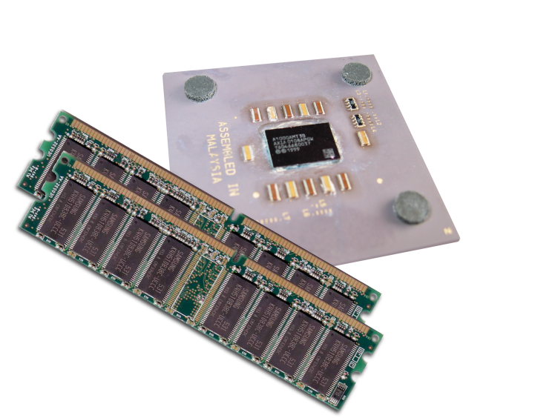
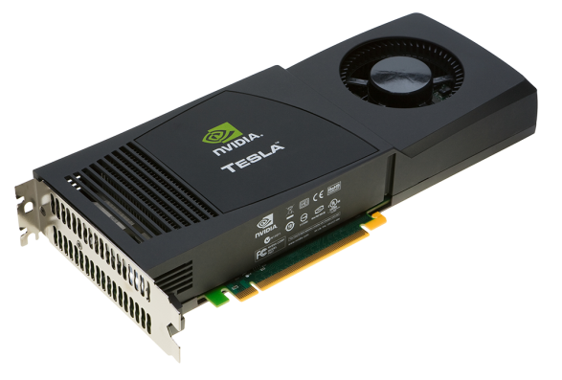
Heterogeneous Computing
Terminology:
  Host The CPU and its memory (host memory)
  Device The GPU and its memory (device memory)
Host
Device

Slide 54
Heterogeneous Computing
#include <iostream>
#include <algorithm>
using namespace std;
#define N 1024
#define RADIUS 3
#define BLOCK_SIZE 16
__global__ void stencil_1d(int *in, int *out) {
__shared__ int temp[BLOCK_SIZE + 2 * RADIUS];
int gindex = threadIdx.x + blockIdx.x * blockDim.x;
int lindex = threadIdx.x + RADIUS;
// Read input elements into shared memory
temp[lindex] = in[gindex];
if (threadIdx.x < RADIUS) {
temp[lindex - RADIUS] = in[gindex - RADIUS];
temp[lindex + BLOCK_SIZE] = in[gindex + BLOCK_SIZE];
}
// Synchronize (ensure all the data is available)
__syncthreads();
// Apply the stencil
int result = 0;
for (int offset = -RADIUS ; offset <= RADIUS ; offset++)
result += temp[lindex + offset];
// Store the result
out[gindex] = result;
}
void fill_ints(int *x, int n) {
fill_n(x, n, 1);
}
int main(void) {
int *in, *out; // host copies of a, b, c
int *d_in, *d_out; // device copies of a, b, c
int size = (N + 2*RADIUS) * sizeof(int);
// Alloc space for host copies and setup values
in = (int *)malloc(size); fill_ints(in, N + 2*RADIUS);
out = (int *)malloc(size); fill_ints(out, N + 2*RADIUS);
// Alloc space for device copies
cudaMalloc((void **)&d_in, size);
cudaMalloc((void **)&d_out, size);
// Copy to device
cudaMemcpy(d_in, in, size, cudaMemcpyHostToDevice);
cudaMemcpy(d_out, out, size, cudaMemcpyHostToDevice);
// Launch stencil_1d() kernel on GPU
stencil_1d<<<N/BLOCK_SIZE,BLOCK_SIZE>>>(d_in + RADIUS, d_out + RADIUS);
// Copy result back to host
cudaMemcpy(out, d_out, size, cudaMemcpyDeviceToHost);
// Cleanup
free(in); free(out);
cudaFree(d_in); cudaFree(d_out);
return 0;
}
parallel fn
serial code
parallel code
serial code

Slide 55
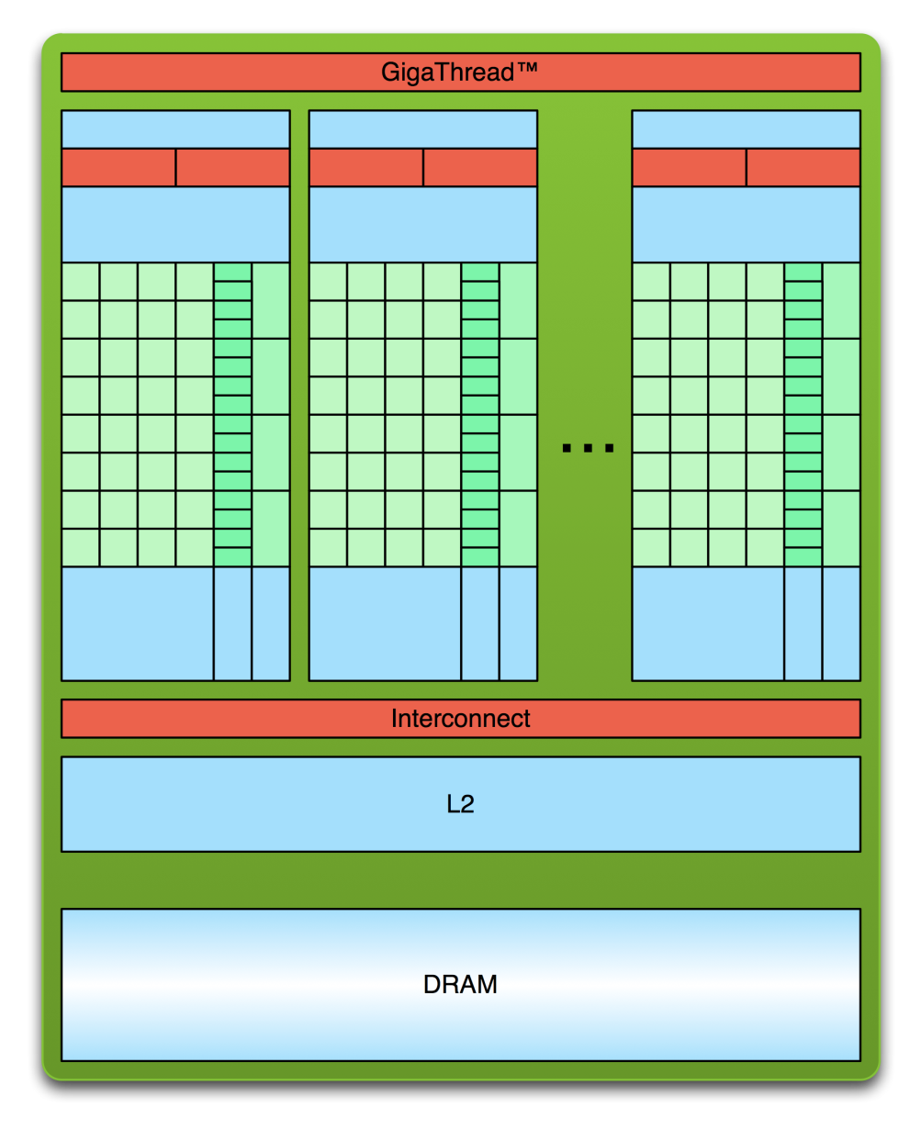
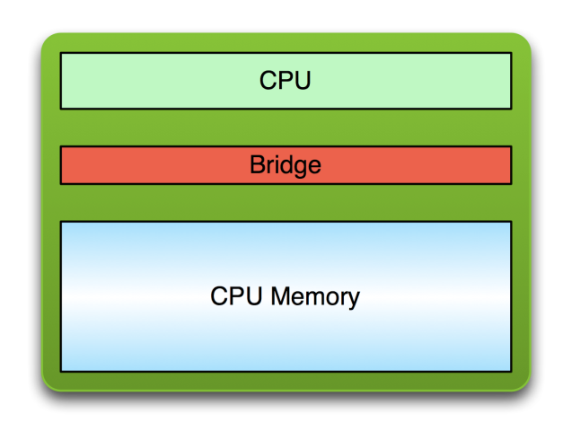
Simple Processing Flow
PCI Bus
Copy input data from CPU memory to GPU memory

Slide 56
Simple Processing Flow
PCI Bus
Copy input data from CPU memory to GPU memory
Load GPU program and execute,
caching data on chip for performance

Slide 57
Simple Processing Flow
PCI Bus
Copy input data from CPU memory to GPU memory
Load GPU program and execute,
caching data on chip for performance
Copy results from GPU memory to CPU memory

Slide 58
Hello World! with Device Code
__global__ void mykernel(void) {
}
int main(void) {
mykernel<<<1,1>>>();
printf("Hello World!\n");
return 0;
}
Two new syntactic elements…
  Global
  <<< >>>

Slide 59
Hello World! with Device Code
__global__ void mykernel(void) {
}
CUDA C/C++ keyword __global__ indicates a function that:
  Runs on the device
  Is called from host code
nvcc separates source code into host and device components
  Device functions (e.g. mykernel()) processed by NVIDIA compiler
  Host functions (e.g. main()) processed by standard host compiler
    gcc, cl.exe

Slide 60
Hello World! with Device COde
mykernel<<<1,1>>>();
Triple angle brackets mark a call from host code to device code
  Also called a “kernel launch”
  We’ll return to the parameters (1,1) in a moment
That’s all that is required to execute a function on the GPU!

Slide 61
Parallel Programming in CUDA C/C++
We’ll start by adding two integers and build up to vector addition
a
b
c

Slide 62
Addition on the Device
A simple kernel to add two integers
__global__ void add(int *a, int *b, int *c) {
*c = *a + *b;
}
As before __global__ is a CUDA C/C++ keyword meaning
  add() will execute on the device
  add() will be called from the host

Slide 63
Addition on the Device
Note that we use pointers for the variables
__global__ void add(int *a, int *b, int *c) {
*c = *a + *b;
}
add() runs on the device, so a, b and c must point to device memory
We need to allocate memory on the GPU

Slide 64
(non-unified) Memory Management
Host and device memory are separate entities
  Device pointers point to GPU memory
    May be passed to/from host code
    May not be dereferenced in host code
  Host pointers point to CPU memory
    May be passed to/from device code
    May not be dereferenced in device code
Simple CUDA API for handling device memory
  cudaMalloc(), cudaFree(), cudaMemcpy()
  Similar to the C equivalents malloc(), free(), memcpy()

Slide 65
Addition on the Device: main()
int main(void) {
int a, b, c; // host copies of a, b, c
int *d_a, *d_b, *d_c; // device copies of a, b, c
int size = sizeof(int);
// Allocate space for device copies of a, b, c
cudaMalloc((void **)&d_a, size);
cudaMalloc((void **)&d_b, size);
cudaMalloc((void **)&d_c, size);
// Setup input values
a = 2;
b = 7;

Slide 66
Addition on the Device: main()
// Copy inputs to device
cudaMemcpy(d_a, &a, size, cudaMemcpyHostToDevice);
cudaMemcpy(d_b, &b, size, cudaMemcpyHostToDevice);
// Launch add() kernel on GPU
add<<<1,1>>>(d_a, d_b, d_c);
// Copy result back to host
cudaMemcpy(&c, d_c, size, cudaMemcpyDeviceToHost);
// Cleanup
cudaFree(d_a); cudaFree(d_b); cudaFree(d_c);
return 0;
}

Slide 67
Moving to Parallel
GPU computing is about massive parallelism
  So how do we run code in parallel on the device?
add<<< 1, 1 >>>();
add<<< N, 1 >>>();
Instead of executing add() once, execute N times in parallel

Slide 68
Vector Addition on the Device
With add() running in parallel we can do vector addition
Terminology: each parallel invocation of add() is referred to as a block
  Each invocation can refer to its block index using blockIdx.x
__global__ void add(int *a, int *b, int *c) {
c[blockIdx.x] = a[blockIdx.x] + b[blockIdx.x];
}
By using blockIdx.x to index into the array, each block handles a different index

Slide 69
Vector Addition on the Device
__global__ void add(int *a, int *b, int *c) {
c[blockIdx.x] = a[blockIdx.x] + b[blockIdx.x];
}
On the device, each block can execute in parallel:
Block 0
Block 1
Block 2
Block 3
c[0] = a[0] + b[0];
c[1] = a[1] + b[1];
c[2] = a[2] + b[2];
c[3] = a[3] + b[3];

Slide 70
Vector Addition on the Device: main()
#define N 512
int main(void) {
int *a, *b, *c; // host copies of a, b, c
int *d_a, *d_b, *d_c; // device copies of a, b, c
int size = N * sizeof(int);
// Alloc space for device copies of a, b, c
cudaMalloc((void **)&d_a, size);
cudaMalloc((void **)&d_b, size);
cudaMalloc((void **)&d_c, size);
// Alloc space for host copies of a, b, c and setup input values
a = (int *)malloc(size); random_ints(a, N);
b = (int *)malloc(size); random_ints(b, N);
c = (int *)malloc(size);

Slide 71
Vector Addition on the Device: main()
// Copy inputs to device
cudaMemcpy(d_a, a, size, cudaMemcpyHostToDevice);
cudaMemcpy(d_b, b, size, cudaMemcpyHostToDevice);
// Launch add() kernel on GPU with N blocks
add<<<N,1>>>(d_a, d_b, d_c);
// Copy result back to host
cudaMemcpy(c, d_c, size, cudaMemcpyDeviceToHost);
// Cleanup
free(a); free(b); free(c);
cudaFree(d_a); cudaFree(d_b); cudaFree(d_c);
return 0;
}

Slide 72
Which piece of the hardware are we underutilizing so far?
Vectors!

Slide 73
Indexing Arrays with Blocks and Threads
No longer as simple as using blockIdx.x and threadIdx.x
  Consider indexing an array with one element per thread (8 threads/block)
threadIdx.x
threadIdx.x
threadIdx.x
threadIdx.x
0
1
2
3
4
5
6
7
0
1
2
3
4
5
6
7
0
1
2
3
4
5
6
7
0
1
2
3
4
5
6
7
blockIdx.x = 0
blockIdx.x = 1
blockIdx.x = 2
blockIdx.x = 3
With M threads/block a unique index for each thread is given by:
int index = threadIdx.x + blockIdx.x * M;
Notes:
Identical to finding offset in 1-dimensional storage of a 2-dimensional matrix:
int index = x + width * y;

Slide 74
Indexing Arrays: Example
Which thread will operate on the red element?
0
1
2
3
4
5
6
7
8
9
10
11
12
13
14
15
16
17
18
19
20
21
22
23
24
25
26
27
28
29
30
31
M = 8
threadIdx.x = 5
0
1
2
3
4
5
6
7
0
1
2
3
4
5
6
7
0
1
2
3
4
5
6
7
0
1
2
3
4
5
6
7
blockIdx.x = 2
int index = threadIdx.x + blockIdx.x * M;
= 5 + 2 * 8;
= 21;

Slide 75
Vector Addition with Blocks and Threads
Use the built-in variable blockDim.x for threads per block
int index = threadIdx.x + blockIdx.x * blockDim.x;
__global__ void add(int *a, int *b, int *c) {
int index = threadIdx.x + blockIdx.x * blockDim.x;
c[index] = a[index] + b[index];
}
What changes need to be made in main()?

Slide 76
Addition with Blocks and Threads: main()
#define N (2048*2048)
#define THREADS_PER_BLOCK 512
int main(void) {
int *a, *b, *c; // host copies of a, b, c
int *d_a, *d_b, *d_c; // device copies of a, b, c
int size = N * sizeof(int);
// Alloc space for device copies of a, b, c
cudaMalloc((void **)&d_a, size);
cudaMalloc((void **)&d_b, size);
cudaMalloc((void **)&d_c, size);
// Alloc space for host copies of a, b, c and setup input values
a = (int *)malloc(size); random_ints(a, N);
b = (int *)malloc(size); random_ints(b, N);
c = (int *)malloc(size);

Slide 77
Addition with Blocks and Threads: main()
// Copy inputs to device
cudaMemcpy(d_a, a, size, cudaMemcpyHostToDevice);
cudaMemcpy(d_b, b, size, cudaMemcpyHostToDevice);
// Launch add() kernel on GPU
add<<<N/THREADS_PER_BLOCK,THREADS_PER_BLOCK>>>(d_a, d_b, d_c);
// Copy result back to host
cudaMemcpy(c, d_c, size, cudaMemcpyDeviceToHost);
// Cleanup
free(a); free(b); free(c);
cudaFree(d_a); cudaFree(d_b); cudaFree(d_c);
return 0;
}

Slide 78
Handling Arbitrary Vector Sizes
Typical problems are not friendly multiples of blockDim.x
Avoid accessing beyond the end of the arrays:
__global__ void add(int *a, int *b, int *c, int n) {
int index = threadIdx.x + blockIdx.x * blockDim.x;
if (index < n)
c[index] = a[index] + b[index];
}
Update the kernel launch:
add<<<(N + M-1) / M,M>>>(d_a, d_b, d_c, N);

Slide 79
Review
Launching parallel kernels
  Launch N copies of add() with add<<<N/M,M>>>(…);
  Use blockIdx.x to access block index
  Use threadIdx.x to access thread index within block
Allocate elements to threads:
int index = threadIdx.x + blockIdx.x * blockDim.x;

Slide 80
Cooperating Threads

Slide 81
1D Stencil
Consider applying a 1D stencil to a 1D array of elements
  Each output element is the sum of input elements within a radius
If radius is 3, then each output element is the sum of 7 input elements:
radius
radius

Slide 82
Implementing Within a Block
Each thread processes one output element
  blockDim.x elements per block
Input elements are read several times
  With radius 3, each input element is read seven times

Slide 83
Sharing Data Between Threads
Terminology: within a block, threads share data via shared memory
Extremely fast on-chip memory, user-managed
Declare using __shared__, allocated per block
Data is not visible to threads in other blocks

Slide 84
Implementing With Shared Memory
Cache data in shared memory
  Read (blockDim.x + 2 * radius) input elements from global memory to shared memory
  Compute blockDim.x output elements
  Write blockDim.x output elements to global memory
  Each block needs a halo of radius elements at each boundary
halo on left
halo on right
blockDim.x output elements

Slide 85
Stencil Kernel
__global__ void stencil_1d(int *in, int *out) {
__shared__ int temp[BLOCK_SIZE + 2 * RADIUS];
int gindex = threadIdx.x + blockIdx.x * blockDim.x;
int lindex = threadIdx.x + RADIUS;
// Read input elements into shared memory
temp[lindex] = in[gindex];
if (threadIdx.x < RADIUS) {
temp[lindex - RADIUS] = in[gindex - RADIUS];
temp[lindex + BLOCK_SIZE] =
in[gindex + BLOCK_SIZE];
}
__syncthreads();
// Apply the stencil
int result = 0;
for (int offset = -RADIUS ; offset <= RADIUS ; offset++)
result += temp[lindex + offset];
// Store the result
out[gindex] = result;
}

Slide 86
Summary: CUDA programming is tricky but fun.

Slide 87
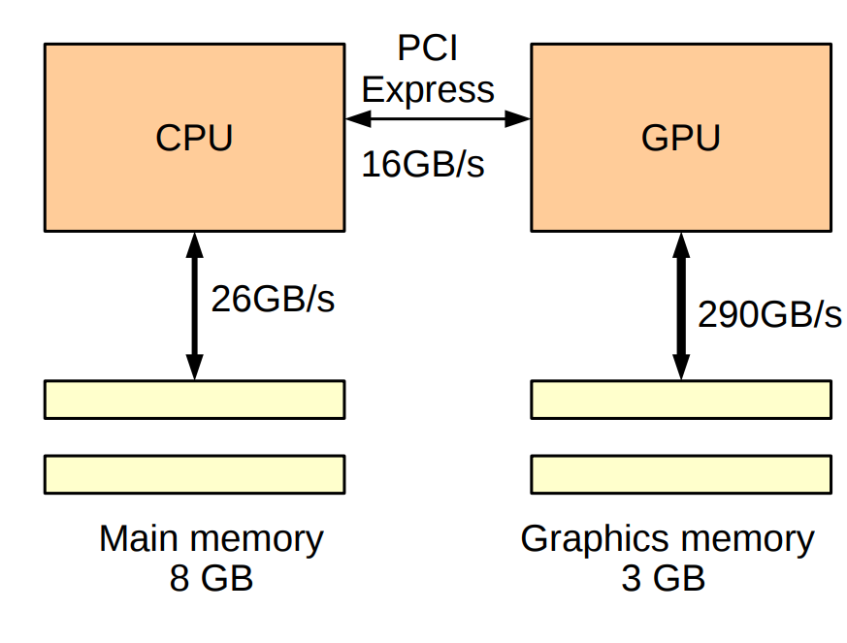
Consequences of CPU/GPU Integration
Software Managed Access:
  cuda_malloc – allocate device memory
  cuda_memcpy – transfer data back and forth
Unified Memory:
  cudaMallocManaged -- allocate transparently managed memory
  Page-faults cause data transfer
  Pre-Pascal: GPU could not page fault, so kernel invocation copies all memory
  Post-Pascal: GPU transfers CPU-GPU memory as it accesses it

Slide 88
SINGLE POINTER
CPU vs GPU
GPU code w/ Unified Memory
CPU code
void *data;
data = malloc(N);
cpu_func1(data, N); cpu_func2(data, N);
cpu_func3(data, N); free(data);
void *data;
data = malloc(N);
cpu_func1(data, N);
gpu_func2<<<...>>>(data, N);
cudaDeviceSynchronize();
cpu_func3(data, N);
free(data);

Slide 89
SINGLE POINTER
Explicit vs Unified Memory
Explicit Memory Management GPU code w/ Unified Memory
void *data, *d_data; data = malloc(N);
cpu_func1(data, N);
cpu_func3(data, N); free(data);
void *data;
data = malloc(N);
cpu_func1(data, N);
gpu_func2<<<...>>>(data, N); cudaDeviceSynchronize();
cpu_func3(data, N); free(data);
cudaMalloc(&d_data, N);
cudaMemcpy(d_data, data, N, ...)
gpu_func2<<<...>>>(d_data, N); cudaMemcpy(data, d_data, N, ...) cudaFree(d_data);

Slide 90
SINGLE POINTER
Full Control with Prefetching
Explicit Memory Management Unified Memory + Prefetching
void *data, *d_data;
data = malloc(N); cudaMalloc(&d_data, N); cpu_func1(data, N); cudaMemcpy(d_data, data, N, ...) gpu_func2<<<...>>>(d_data, N); cudaMemcpy(data, d_data, N, ...) cudaFree(d_data); cpu_func3(data, N);
free(data);
void *data; data = malloc(N); cpu_func1(data, N);
gpu_func2<<<...>>>(data, N);
cudaDeviceSynchronize(); cpu_func3(data, N); free(data);
cudaMemPrefetchAsync(data, N, GPU)
cudaMemPrefetchAsync(data, N, CPU)

Slide 91
SINGLE POINTER
Deep Copy
Explicit Memory Management GPU code w/ Unified Memory
char **data;
// allocate and initialize data on the CPU
char **data;
// allocate and initialize data on the CPU
gpu_func<<<...>>>(data, N);
char **d_data;
char **h_data = (char**)malloc(N*sizeof(char*)); for (int i = 0; i < N; i++) {
cudaMalloc(&h_data[i], N);
cudaMemcpy(h_data[i], data[i], N, ...);
}
cudaMalloc(&d_data, N*sizeof(char*)); cudaMemcpy(d_data, h_data, N*sizeof(char*), ...);
gpu_func<<<...>>>(d_data, N);

Slide 92
Why are GPUs so awesome for machine learning?
GPUs eliminate CPU overhead by:
Eliminating OOO execution
Forcing vector execution (SIMT)
Enabling explicit software-manged control of local access
These combined enable higher compute density!

Slide 95
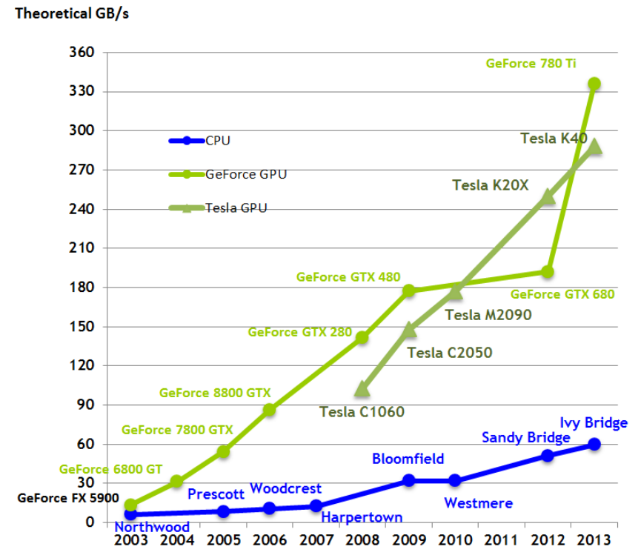

Slide 96
Why are GPUs not so awesome for machine learning?
(ie. why are there N different companies doing machine learning startups?)

Slide 97
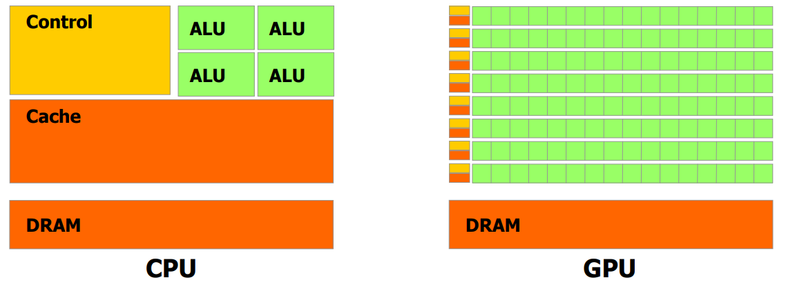
GPU’s are more computationally dense right?
Conventional Wisdom:
GPUs use less cache, so more dense
However, if you include register files….
GPU
Register files
+ caches
NVIDIA GM204 GPU
AMD Hawaii GPU
Intel Core i7 CPU
8.3 MB
15.8 MB
9.3 MB
Did we really need that many threads???

Slide 98
GPU Still have a lot of Overheads
Memory Access:
  Dynamic coalescing energy overheads
  Cache thrashing from many threads
  Data needs to be laid out correctly (bank conflicts, communication, etc)
Control Flow:
  Hardware structures to track thread divergence
Operand Communication:
  All communication between instructions goes through register files
Scheduling Warps/Threads:
  Dynamically decide which wards to execute
Register File due to Multithreading
  Each thread needs space in the register file for live values!

Slide 99
GPU Still have a lot of Overheads
Memory Access:
  Heavily rely on caches (vs. specialized memories), even though we have low hit-rates! Difficult to make use of cache when 100s of threads are sharing it!
  Dynamically coalesce memory requests in order to make requests efficient, as well as collect their operands in arbitrary patterns when requests return
Control Flow:
  Hardware structures to track thread divergence (even though in matrix-multiply-like kernels we will never diverge!)
Operand Communication:
  All communication between instructions goes through register files! (contrast this with DianNao which can forward operands from instruction to instruction)
Scheduling Warps/Threads:
  Dynamically decide which wards to execute
Register File due to Multithreading
  Each thread needs space in the register file for live values!

Slide 100
GPU’s are more computationally dense right?
Conventional Wisdom:
GPUs use less cache, so more dense
However, if you include register files….
GPU
Register files
+ caches
NVIDIA GM204 GPU
AMD Hawaii GPU
Intel Core i7 CPU
8.3 MB
15.8 MB
9.3 MB

Slide 102
Specialization Spectrum
Fixed
Accelerator
1000
Free Lunch Zone
DianNao
100
???
Performance or Energy Benefit
10
GPGPU
Multicore
OOO,
In-order
Core
“I’d rather not build that” Zone
1
General
Purpose
Special
Purpose
Degree of Specialization

Slide 103
Specialization Pain Spectrum
Fixed
Accelerator
1000
Architecture and
Compiler Pain/
Programmer Pain
DianNao
100
???
Performance or Energy Benefit
10
GPGPU
Multicore
OOO,
In-order
Core
Microarchitecture
Pain Only
1
General
Purpose
Special
Purpose
Degree of Specialization

Slide 104
Specialization Spectrum
Fixed
Accelerator
1000
DianNao
100
???
Performance or Energy Benefit
Fixed-func
GPU
10
GPGPU
Multicore
OOO,
In-order
Core
1
General
Purpose
Special
Purpose
Degree of Specialization

Slide 105
Specialization Spectrum
Fixed
Accelerator
1000
DianNao
100
ML-GPGPU
Performance or Energy Benefit
10
GPGPU
What to add:
Low-precision (fp16)
Special instructions?
Multicore
OOO,
In-order
Core
1
General
Purpose
Special
Purpose
Degree of Specialization

Slide 106
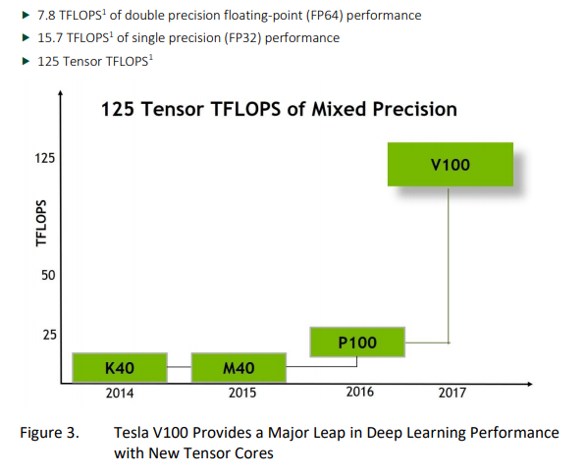
ML-GPGPU = GPGPU + Tensor Cores

Slide 107
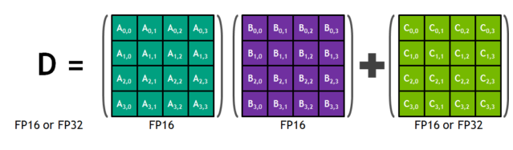
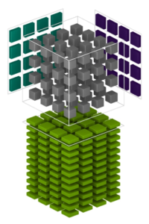
Tensor Cores:
Idea: decompose many linear algebra routines into 4x4 by 4x4 Matrix multiplies
wmma::fragment<wmma::matrix_a, WMMA_M, WMMA_N, WMMA_K, half, wmma::col_major> a_frag;
https://devblogs.nvidia.com/programming-tensor-cores-cuda-9/

Slide 108
How should we parallelize our kernels on the GPUs?

Slide 109
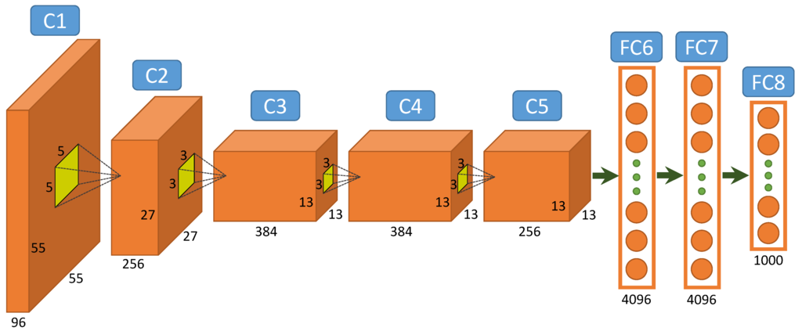
AlexNet (Imagenet Winner 2012)
Max Pooling

Slide 110
Pooling
Each pixel in output volume reduces:
( Kx * Ky ) pixels from Neuron In
First o/p Pixel Creation
Nx
Ox
Ny
Oy
Ni
Nn
“Channels” or
“Feature Maps”
Neuron out
Neuron in
Nn=Ni
Oy=Ny/sy, Ox=Nx/sx

Slide 111
Convolution Kernel, Next Layer
Kx
Second o/p channel creation, Nn = 1
Ky
Ox
Nx
Ni
Ny
Oy
Ni
Nn
×Nn
Ni
Ni
Neuron out
Neuron in
Synapses

Slide 112
Convolution Kernel
Kx
Each pixel in output volume requires dot product between unique:
( Kx * Ky * Ni ) pixels from Neuron In
( Kx * Ky * Ni ) pixels from Synapses
Ky
First o/p Pixel Creation
Ox
Nx
Ni
Ny
Oy
Ni
Nn
×Nn
Ni
Neuron out
Neuron in
Ni
Synapses

Slide 113
Convolution Kernel, Next Pixel
Kx
Ky
Ox
Nx
Ni
Ny
Oy
Ni
Nn
×Nn
Ni
Neuron out
Neuron in
Ni
Synapses

Slide 114
Sources
CUDA C/C++ BASICS (2013)
Parallel programming: Introduction to GPU architecture Sylvain Collange Inria Rennes – Bretagne Atlantique
CUDA Programming Guide
GPU Performance Analysis and Optimization
  http://on-demand.gputechconf.com/gtc/2012/presentations/S0514-GTC2012-GPU-Performance-Analysis.pdf

