Slide 1
Kernel Computation
Thanks to Joel Emer, Vivienne Sze, Yu-Hsin Chen
1

Slide 2

Fully-Connected (FC) Layer
filters
input fmaps
output fmaps
C
C
…
…
…
…
M
…
…
H
H
…
1
1
…
1
…
1
…
W
W
1
…
C
H
…
…
…
M
…
W

Slide 3
Fully-Connected (FC) Layer
filters
input fmaps
output fmaps
C
C
…
…
…
…
M
…
…
H
H
…
1
1
…
1
…
1
…
W
W
1
…
C
H
…
…
…
M
…
W

Slide 4
Flattened 2D Dot Product
Input Fmap
Output Fmap
Flattened Filter
Flattened Input Fmap
Output Fmap
Filter
1 | 2
3 | 4
●
1 | 2
4 | 5
=
1
1 | 2 | 3 | 4
●
1
2
4
5
=
1
2D dot Product
1D dot Product

Slide 5
Fully-Connected (FC) Layer
Matrix–Vector Multiply:
Multiply all inputs in all channels by a weight and sum
Filters
CHW
Input fmaps
Output fmaps
1
1
×
=
CHW
M
M

Slide 6
Fully-Connected (FC) Layer
Matrix–Vector Multiply:
Multiply all inputs in all channels by a weight and sum
Filters
CHW
Input fmaps
Output fmaps
1
1
×
=
CHW
M
M

Slide 7
Fully-Connected (FC) Layer
Matrix–Vector Multiply:
Multiply all inputs in all channels by a weight and sum
Filters
CHW
Input fmaps
Output fmaps
1
1
●
●
●
●
●
●
●
●
×
=
CHW
M
M

Slide 8
Fully-Connected (FC) Layer
filters
input fmaps
output fmaps
C
C
…
…
…
…
M
…
…
H
H
1
1
…
1
…
1
…
W
W
1
…
…
…
C
…
…
C
…
…
…
…
H
…
…
1
H
N
N
…
M
…
…
1
W
W

Slide 9
Flattened Fully-Connected Layer
Filters
CHW
Input fmaps
N
Output fmaps
N
CHW
×
=
M
M
After flattening, having a batch size of N turns the matrix-vector operation into a matrix-matrix multiply

Slide 10
Fully-Connected (FC) Layer
Filters
CHW
Input fmaps
N
Output fmaps
N
CHW
×
=
M
M
After flattening, having a batch size of N turns the matrix-vector operation into a matrix-matrix multiply

Slide 11
Fully-Connected (FC) Layer
Filters
CHW
Input fmaps
N
Output fmaps
N
 |  | ●●●●
●●●●
CHW
×
=
M
M
After flattening, having a batch size of N turns the matrix-vector operation into a matrix-matrix multiply

Slide 12
Fully-Connected (FC) Layer
Filters
CHW
Input fmaps
N
Output fmaps
N
CHW
×
=
M
M
After flattening, having a batch size of N turns the matrix-vector operation into a matrix-matrix multiply

Slide 13
Fully-Connected (FC) Layer
Filters
CHW
Input fmaps
N
Output fmaps
N
 |  | ●●●●
●●●●
●
●
●
●
●
●
●
●
CHW
×
=
M
M
After flattening, having a batch size of N turns the matrix-vector operation into a matrix-matrix multiply
How much temporal locality for naïve implementation? None

Slide 14
Tiled Fully-Connected (FC) Layer
Filters
CHW
Input fmaps
N
Output fmaps
N
^{F}0,0 | ^{F}0,1
^{F}1,0 | ^{F}1,1
^{I}0,0 | ^{I}0,1
^{I}1,0 | ^{I}1,1
F0,0I0,0 + F0,1I1,0 | F0,0I0,1 + F0,1I1,1
F1,0I0,0 + F1,1I1,0 | F1,0I0,1 + F1,1I1,1
CHW
×
=
M
M
Matrix multiply tiled to fit in cache
and computation ordered to maximize reuse of data in cache

Slide 15
Tiled Fully-Connected (FC) Layer
Filters
CHW
Input fmaps
N
Output fmaps
N
^{F}0,0 | ^{F}0,1
^{F}1,0 | ^{F}1,1
^{I}0,0 | ^{I}0,1
^{I}1,0 | ^{I}1,1
F0,0I0,0 + F0,1I1,0 | F0,0I0,1 + F0,1I1,1
F1,0I0,0 + F1,1I1,0 | F1,0I0,1 + F1,1I1,1
CHW
×
=
M
M
Matrix multiply tiled to fit in cache
and computation ordered to maximize reuse of data in cache

Slide 16
Fully-Connected (FC) Layer
Implementation: Matrix Multiplication (GEMM)
CPU: OpenBLAS, Intel MKL, etc
GPU: cuBLAS, cuDNN, etc
Library will note shape of the matrix multiply and select implementation optimized for that shape.
Optimization usually involves proper tiling to storage hierarchy

Slide 17
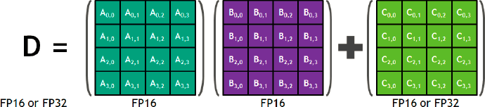
GV100 – “Tensor Core”
New opcodes – Matrix Multiply Accumulate (HMMA)
FP16 operands? Multiplies?
Adds?
Inputs 48 / Outputs 16
64
64
Tensor Core….
120 TFLOPS (FP16)
400 GFLOPS/W (FP16)

Slide 18
Convolution (CONV) Layer
Many Input fmaps (N)
Many Output fmaps (N)
filters
C
…
…
M
…
…
C
…
…
H
R
E
…
1
…
1
…
S
W
F
…
…
…
C
C
…
…
…
…
…
…
…
…
R
…
E
…
H
N
N
…
S
…
F
W
Batch Size (N)
19

Slide 19
CONV Layer Implementation
Naïve 7-layer for-loop implementation:
for (n=0; n<N; n++) {
for (m=0; m<M; m++) {
for (x=0; x<F; x++) {
for (y=0; y<E; y++) {
for each output fmap value
O[n][m][x][y] = B[m];
for (i=0; i<R; i++) {
for (j=0; j<S; j++) {
for (k=0; k<C; k++) {
O[n][m][x][y] += I[n][k][Ux+i][Uy+j] × W[m][k][i][j];
}
}
}
convolve a window and apply activation
O[n][m][x][y] = Activation(O[n][m][x][y]);
}
}
}
}
20

Slide 20
Convolution (CONV) Layer
Filter
Input Fmap Output Fmap
1 | 2
3 | 4
*
1 | 2 | 3
4 | 5 | 6
7 | 8 | 9
=
1 | 2
3 | 4
1D dot Product
2D dot Product
1 2
Filtering steps
Flattened
●
1 | 2
4 | 5
=
1
1 | 2 | 3 | 4
●
1
2
4
5
=
1
3
4
1 | 2
3 | 4
●
2 | 3
5 | 6
=
2
1 | 2 | 3 | 4
●
2
3
5
6
=
 | 2
1 | 2
3 | 4
●
4 | 5
7 | 8
=
3
1 | 2
3 | 4
●
5 | 6
8 | 9
=
.
.
.
4
21

Slide 21
Convolution (CONV) Layer
Filter
Input Fmap
Output Fmap
1 | 2
3 | 4
*
1 | 2 | 3
4 | 5 | 6
7 | 8 | 9
=
1 | 2
3 | 4
Convolution:
Flattened
1 | 2 | 3 | 4
●
1
2
4
5
=
1
1 | 2 | 3 | 4
●
2
3
5
6
=
 | 2
. . .

Slide 22
Convolution (CONV) Layer
Filter
Input Fmap
Output Fmap
1 | 2
3 | 4
*
1 | 2 | 3
4 | 5 | 6
7 | 8 | 9
=
1 | 2
3 | 4
Convolution:
Flattened
1 | 2 | 3 | 4
●
1
2
4
5
=
1
1 | 2 | 3 | 4
●
2
3
5
6
=
 | 2
. . .

Slide 23
Convolution (CONV) Layer
● ● =
. . .
1 | 2 | 3 | 4
1
2
4
5
=
1 | 2 | 3 | 4
2
3
5
6
 | 2
1
1
1
2
3
4
2
2
1
2
3
4
1
2
3
4
5
5
6
Flattened
Matrix Multiply (by Toeplitz Matrix)
1 | 2 | 3 | 4
×
1 | 2 | 4 | 5
2 | 3 | 5 | 6
4 | 5 | 7 | 8
5 | 6 | 8 | 9
=
1 | 2 | 3 | 4

Slide 24
Convolution (CONV) Layer
Filter Input Fmap Output Fmap
1 | 2
3 | 4
*
1 | 2 | 3
4 | 5 | 6
7 | 8 | 9
=
1 | 2
3 | 4
Convolution:
Matrix Multiply (by Toeplitz Matrix)
1 | 2 | 3 | 4
×
1 | 2 | 4 | 5
2 | 3 | 5 | 6
4 | 5 | 7 | 8
5 | 6 | 8 | 9
=
1 | 2 | 3 | 4
Convert to matrix multiply using the Toeplitz Matrix

Slide 25
Convolution (CONV) Layer
Filter Input Fmap Output Fmap
1 | 2
3 | 4
*
1 | 2 | 3
4 | 5 | 6
7 | 8 | 9
=
1 | 2
3 | 4
Convolution:
Matrix Multiply (by Toeplitz Matrix)
1 | 2 | 3 | 4
×
1 | 2 | 4 | 5
2 | 3 | 5 | 6
4 | 5 | 7 | 8
5 | 6 | 8 | 9
=
1 | 2 | 3 | 4
Data is repeated

Slide 26
Convolution (CONV) Layer
Multiple Input Channels
Filter
Input Fmap
Output Fmap
C
C
1 | 2
3 | 4
1 | 2
3 | 4
*
1 | 2 | 3
4 | 5 | 6
7 | 8 | 9
1 | 2 | 3
4 | 5 | 6
7 | 8 | 9
=
1 | 2
3 | 4
Chnl 1
Filter 1
Chnl 1 Chnl 2
Chnl 1
Chnl 2
Key:
Black: Input channel 1 Yellow: Input channel 2
3D Stacks…

Slide 27
Convolution (CONV) Layer
Multiple Input Channels
Filter
Input Fmap as Toeplitz matrix
Output Fmap
Chnl 1
Chnl 2
Filter 1
1 | 2 | 3 | 4 | 1 | 2 | 3 | 4
×
1 | 2 | 4 | 5
2 | 3 | 5 | 6
4 | 5 | 7 | 8
5 | 6 | 8 | 9
1 | 2 | 4 | 5
2 | 3 | 5 | 6
4 | 5 | 7 | 8
5 | 6 | 8 | 9
=
1 | 2 | 3 | 4
Chnl 1
Chnl 1
Toeplitz converted inputs
Chnl 2

Slide 28
Convolution (CONV) Layer
Multiple Input Channels and Output Channels
Filter
Input Fmap Output Fmap
C
C
1 | 2
3 | 4
1 | 2
3 | 4
*
1 | 2 | 3
4 | 5 | 6
7 | 8 | 9
1 | 2 | 3
4 | 5 | 6
7 | 8 | 9
=
1 | 2
3 | 4
Chnl 1
Filter 1
Filter 2
1 | 2
3 | 4
1 | 2
3 | 4
Chnl 1
Chnl 2
1 | 2
3 | 4
Chnl 2
Chnl 1 Chnl 2
Key:
Black: Input channel 1 Yellow: Input channel 2 Underlined: Output channel 2

Slide 29
Convolution (CONV) Layer
Multiple Input Channels and Output Channels
Filter
Input Fmap as Output Fmap Toeplitz matrix
Chnl 1
Chnl 2
Filter 1
Filter 2
1 | 2 | 3 | 4 | 1 | 2 | 3 | 4
1 | 2 | 3 | 4 | 1 | 2 | 3 | 4
1 | 2 | 4 | 5
2 | 3 | 5 | 6
4 | 5 | 7 | 8
5 | 6 | 8 | 9
1 | 2 | 4 | 5
2 | 3 | 5 | 6
4 | 5 | 7 | 8
5 | 6 | 8 | 9
1 | 2 | 3 | 4
1 | 2 | 3 | 4
Chnl 1
Chnl 2
×
=
Chnl 1
Chnl 2

Slide 30
Convolution (CONV) Layer
Dimensions of matrices for matrix multiply in convolution layers with batch size N
Output fmaps
(H-R+1)(W-S+1)N
Filters
Input fmaps
(H-R+1)(W-S+1)N
CRS
CRS
×
=
M
M
N=2 in example
31

Slide 31
Computational Transforms

Slide 32
Computation Transformations
Goal: Bitwise same result, but reduce number of operations
Focuses mostly on compute

Slide 33
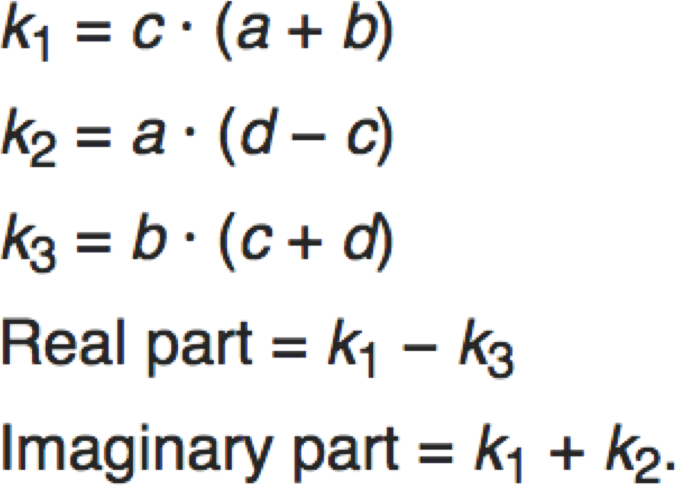
Gauss’s Multiplication Algorithm
4 multiplications + 3 additions
3 multiplications + 5 additions

Slide 34
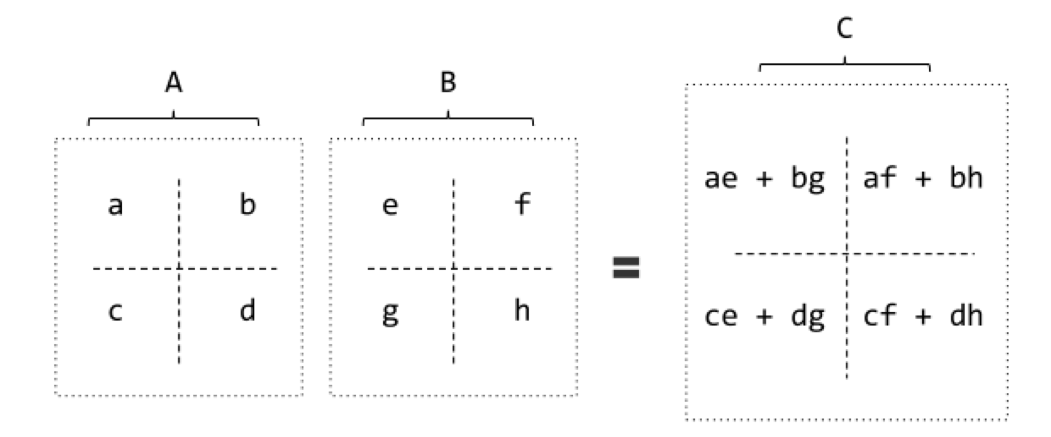
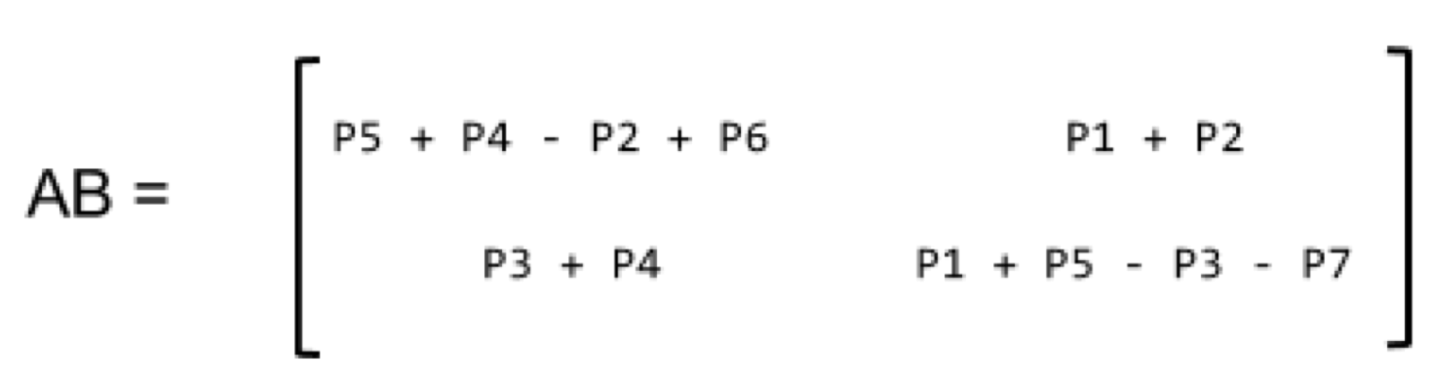
Strassen
8 multiplications + 4 additions
P1 = a(f – h) P2 = (a + b)h P3 = (c + d)e P4 = d(g – e)
P5 = (a + d)(e + h)
P6 = (b - d)(g + h)
P7 = (a – c)(e + f)
7 multiplications + 18 additions
7 multiplications + 13 additions (for constant B matrix – weights)
[Cong et al., ICANN, 2014]

Slide 35
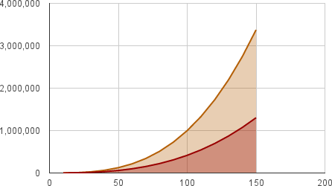
Strassen
Reduce the complexity of matrix multiplication from Θ(N³) to Θ(N^{2.807}) by reducing multiplications
Complexity
Naïve
Strassen
N
Comes at the price of reduced numerical stability and requires significantly more memory
Image Source: http://www.stoimen.com/blog/2012/11/26/computer-algorithms-strassens-matrix-multiplication/

Slide 36
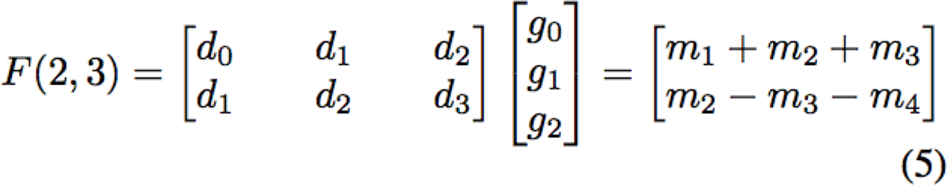
Winograd 1D – F(2,3)
Targeting convolutions instead of matrix multiply
Notation: F(size of output, filter size)
input
filter
₌ "₀
"₁
6 multiplications + 4 additions
[Lavin et al., CVPR 2016]

Slide 37
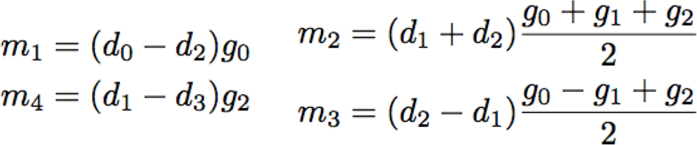
Winograd 1D – F(2,3)
Targeting convolutions instead of matrix multiply
Notation: F(size of output, filter size)
input
filter
4 multiplications + 12 additions + 2 shifts
4 multiplications + 8 additions (for constant weights)
[Lavin et al., CVPR 2016]

Slide 38
Winograd 2D - F(2x2, 3x3)
1D Winograd is nested to make 2D Winograd
Filter Input Fmap Output Fmap
g00 | g01 | g02
g10 | g11 | g12
g20 | g21 | g22
*
d00 | d01 | d02 | d03
d10 | d11 | d12 | d13
d20 | d21 | d22 | d23
d30 | d31 | d32 | d33
=
y00 | y01
y10 | y11
Original: Winograd:
36 multiplications
16 multiplications → 2.25 times reduction

Slide 39
Winograd Halos
Winograd works on a small region of output at a time, and therefore uses inputs repeatedly
Filter
Input Fmap
Output Fmap
g00 | g01 | g02
g10 | g11 | g12
g20 | g21 | g22
d00 | d01 | d02 | d03 | d04 | d05
d10 | d11 | d12 | d13 | d14 | d15
d20 | d21 | d22 | d23 | d24 | d25
d30 | d31 | d32 | d33 | d34 | d35
y00 | y01 | y02 | y03
y10 | y11 | y12 | y12
Halo columns

Slide 40
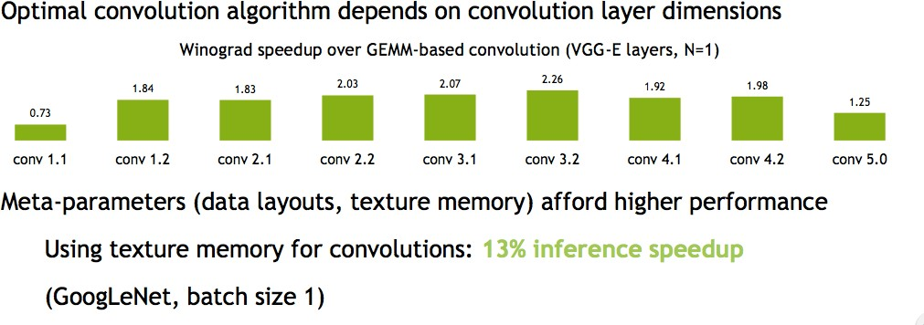
Winograd Performance Varies
Source: Nvidia

Slide 41
Winograd Summary
Winograd is an optimized computation for convolutions
It can significantly reduce multiplies
– For example, for 3x3 filter by 2.25X
But, each filter size (and output size) is a different computation.

Slide 42
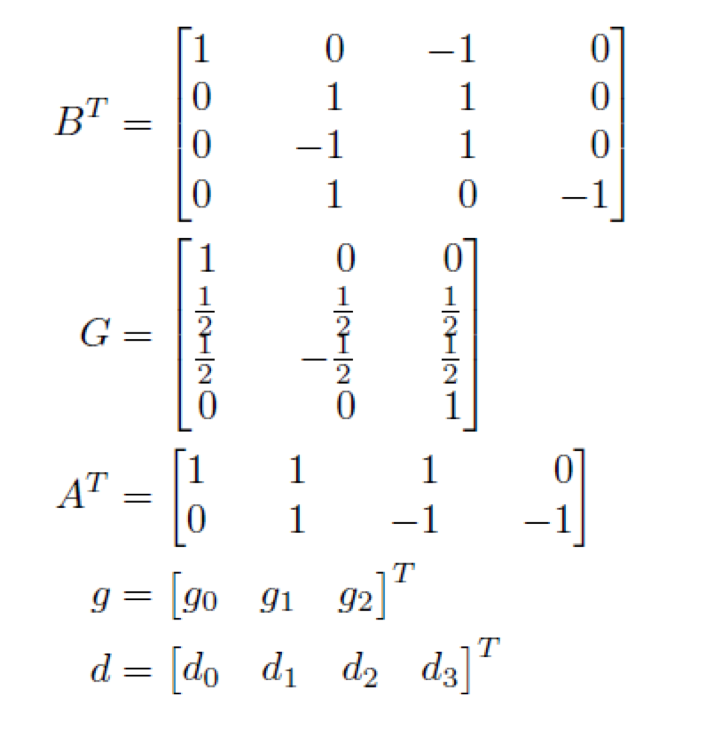
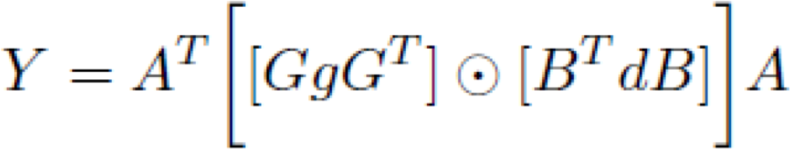

Winograd as a Transform
Transform inputs
Element-wise Multiplication
filter input
Transform output
GgG^{T} can be precomputed
[Lavin et al., CVPR 2016]

Slide 43
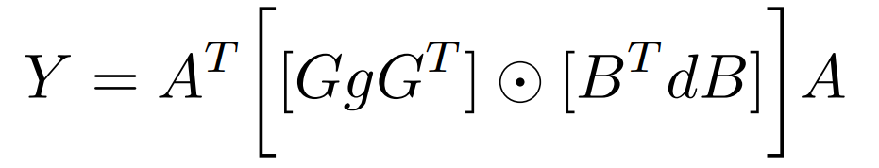
Winograd 2D - F(2x2, 3x3)
1D Winograd is nested to make 2D Winograd
Filter Input Fmap Output Fmap
^{g}00 | ^{g}01 | ^{g}02
^{g}10 | ^{g}11 | ^{g}12
^{g}20 | ^{g}21 | ^{g}22
*
^{d}00 | ^{d}01 | ^{d}02 | ^{d}03
^{d}10 | ^{d}11 | ^{d}12 | ^{d}13
^{d}20 | ^{d}21 | ^{d}22 | ^{d}23
^{d}30 | ^{d}31 | ^{d}32 | ^{d}33
=
^{y}00 | ^{y}01
^{y}10 | ^{y}11
Transform
28 Additions
Transform
32 Additions
24 Additions
=
+ 16 Additions
Original: Winograd:
36 multiplications
16 multiplications → 2.25 times reduction
+ 36 Additions
Notes:
32 additions, the filter transform uses 28 floating point instructions, and the inverse transform uses 24 additions.

Slide 44
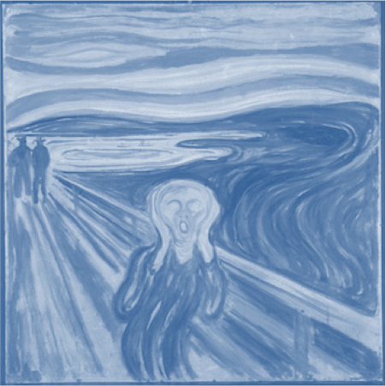
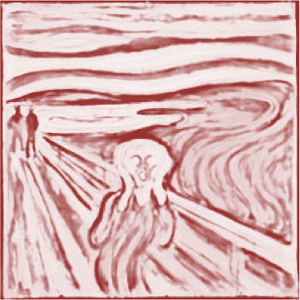




Fast Fourier Transform (FFT) Flow
output fmap
an output
input fmap
filter (weights)
activation
H
=
R
*
E
S
W
F
F F T
F F T
I F F T
FFT(W)
FFT(I)
FFT(O)
X
=

Slide 45
FFT Overview
Convert filter and input to frequency domain to make convolution a simple multiply then convert back to space domain.
Convert direct convolution O(N_{o}²N ²)
f
computation to O(N_{o}²log₂N_{o})
So note that computational benefit of FFT decreases with decreasing size of filter
[Mathieu et al., ArXiv 2013, Vasilache et al., ArXiv 2014]

Slide 46
FFT Costs
Input and Filter matrices are ‘0-completed’,
– i.e., expanded to size E+R-1 x F+S-1
Frequency domain matrices are same dimensions as input, but complex.
FFT often reduces computation, but requires much more memory space and bandwidth

Slide 47
Optimization opportunities
FFT of real matrix is symmetric allowing one to save ½ the computes
Filters can be pre-computed and stored, but convolutional filter in frequency domain is much larger than in space domain
Can reuse frequency domain version of input for creating different output channels to avoid FFT re-computations
Can accumulate across channels before performing inverse transform to reduce number of IFFT

Slide 48
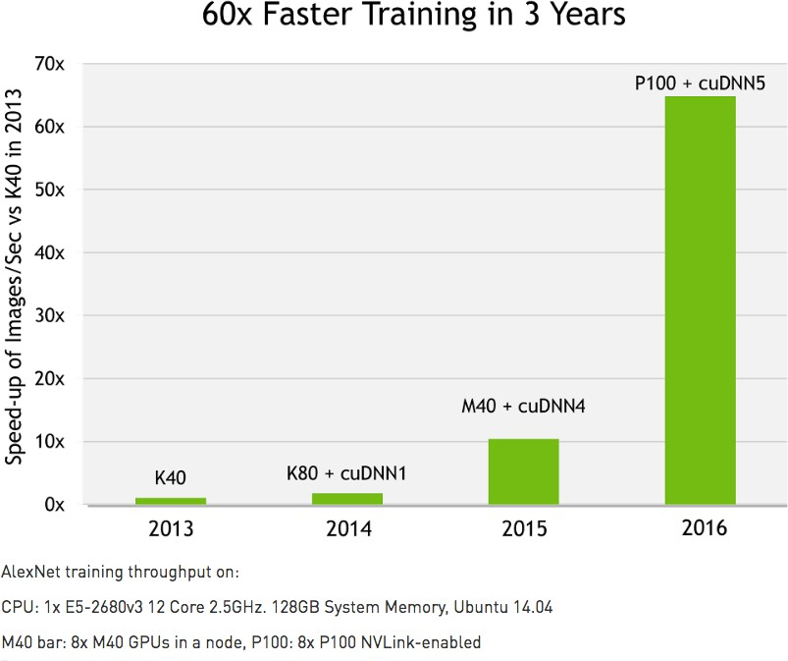
cuDNN: Speed up with Transformations
Source: Nvidia

Slide 49
Optimization Tools
Halide
TVM
Timeloop
….

