Slide 1
CMPT 706 - Algorithms for Big Data
Igor Shinkar
Introduction
January 9, 2020

Slide 2
Course Info
Instructor:
  Igor Shinkar
  Email: ishinkar@sfu.ca
  Room: TASC 9017
  Office hours: Tuesdays 14:30 – 15:30
TAs:
  Amirhossein Mozafari Khameneh amozafar@sfu.ca
  Mehak Parashar mehak_parashar@sfu.ca
  Office hours / Discussion sessions: TBA
Course Webpage
  https://www.cs.sfu.ca/~ishinkar/ → teaching → CMPT 706
  Piazza - Discussion forum for questions / announcements
  you will receive an invitation.

Slide 3
Course Info
Course Objectives:
introduce the basic algorithmic techniques and methods of algorithm analysis, and to demonstrate how these techniques are used in big data algorithms

Slide 4
Course Syllabus (Tentative)
Algorithmic techniques:
  Unit 1: Introduction and Algorithms with Numbers
  Unit 2: Divide-and-Conquer
  Unit 3: Graphs and Graph Algorithms
  Unit 4: Greedy Algorithms
  Unit 5: Dynamic Programming
  Unit 6: Approximation and Randomized algorithms
Big Data Topics:
  Algorithm Design for Map-Reduce: Analysis and trade-offs
  Algorithms for Large-Scale Graphs: Vertex-centric/Edge-centric approaches
  Consistency in Large Distributed Systems: Paxos consensus, CAP theorem
  Algorithms for Large Datasets: Time-accuracy trade-offs
  Streaming Algorithms

Slide 5
Textbook
Dasgupta, Papadimitriou, Vazirani,
Algorithms, McGraw-Hill Higher Education, 2008.
Errata for the textbook
http://cseweb.ucsd.edu/~dasgupta/book/errata.pdf

Slide 6
Additional references
Kleinberg, Tardos,
Algorithm Design
Cormen, Leiserson, Rivest, Stein,
Introduction to Algorithms
D. E. Knuth,
The Art of Computer Programming. Vol. 1,2,3,4,
V. V. Vazirani,
Approximation Algorithms
M. Mitzenmacher and E. Upfal,
Probability and Computing: Randomized Algorithms
and Probabilistic Analysis

Slide 7
Grading scheme
5 assignments 4 x 5% (best 4 out of 5)
5 quizzes – 4 x 10% (best 4 out of 5)
Final exam – 40%
Participation/piazza – 5%

Slide 8
Prerequisites
Some general CS knowledge.
  Binary representation of numbers
Basic math erudition
  Can plot function x , x² , x³ , ln(x) , ln₂(x) , 2^{x} , etc
  Sum of arithmetic/geometric progression
Some experience in programming
  Able to write a program in any programming language
  If/else, for/while, functions
  Recursion

Slide 9
Algorithms vs Heuristics
Algorithms | Heuristics
Problem is well defined: we know what the right output is for each input | Problem is not necessarily well defined: we know what the output is for regular inputs
Correctness is provable | Method is `usually correct’ for `interesting’ inputs
Some performance guarantees can be proved | Performance is measured on test or benchmark inputs
Example: given two numbers compute their sum | Example: given a picture distinguish between a cat and a dog

Slide 10
Algorithmic Paradigms
Greedy algorithms
Divide-and-Conquer
Dynamic Programming
Network Flow
Linear/Integer/Convex Programming
Approximation Algorithms
Randomized Algorithms
Streaming Algorithms
Quantum Algorithms

Slide 11
Computing the sum of two numbers
Input: two positive integers x, y
Output: x+y
Example: x = 1265, y=762
Algorithm:
1
1
+
1 | 2 | 6 | 5
 | 7 | 6 | 2
2
0
2
7

Slide 12
Computing the product of two numbers
Input: two positive integers x, y
Output: x*y
Example: x = 65, y=26
Algorithm:
6 | 5
2 | 6
x
 | 3 | 9 | 0
1 | 3 | 0
+
1 | 6 | 9 | 0

Slide 13
Factoring an integer into a product of two numbers
Input: a positive integers N
Output: two numbers x,y >1 such that x*y = N (or say that N is prime)
Example: N = 561
A possible solution 11, 51
A naïve algorithm:
For x=2…N-1
if N is divisible by x
Compute y = N/x
Output x,y

Slide 14
Factoring an integer into a product of two numbers
Input: a positive integers N
Output: two numbers x,y >1 such that x*y = N (or say that N is prime)
Example: N = 561
A possible solution 11, 51
A slightly better algorithm:
For x=2…N^{1/2}
if N is divisible by x
Compute y = N/x
Output x,y
Suffices to check up to N^{1/2} because either x or y are at most than N^{1/2}

Slide 15

The closest pair problem
Input: A collection of $n$ points in the plane
Goal: Find a pair of points that are closest to each other
min

Slide 16
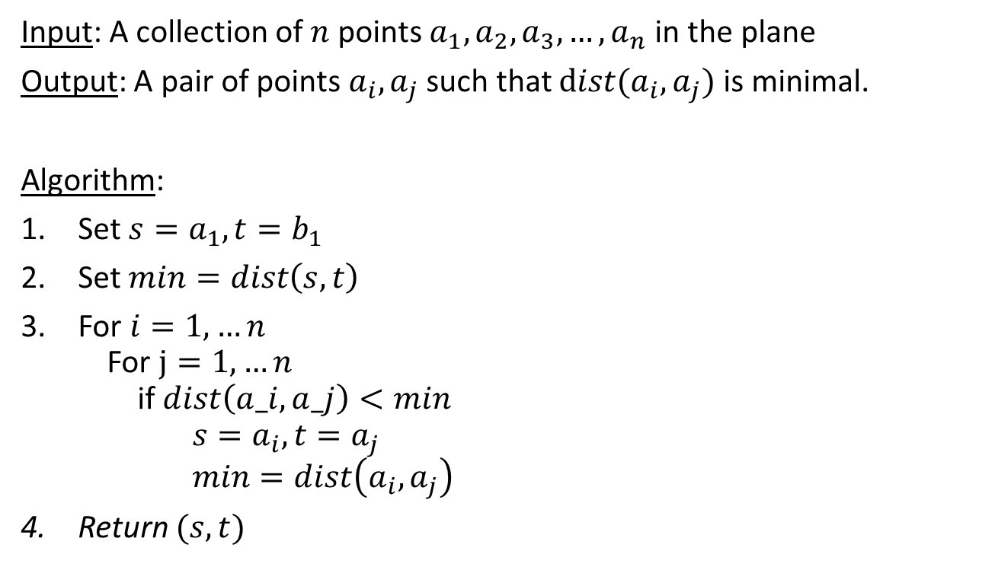
The closest pair problem
Input: A collection of $n$ points $a_{1},a_{2},a_{3},…,a_{n}$ in the plane
Output: A pair of points $a_{i},a_{j}$ such that $dist(a_{i},a_{j})$ is minimal.
Algorithm:
Set $s=a_{1}, t=b_{1}$
Set $min=dist\left(s,t\right)$
For $i=1,…n$
For $j=1,…n$
if $dist\left(a_i,a_j\right)<min$
$s=a_{i}, t=a_{j}$
$min=dist\left(a_{i},a_{j}\right)$
Return $(s,t)$
Is the algorithm correct?
Is the algorithm correct?
min

Slide 17
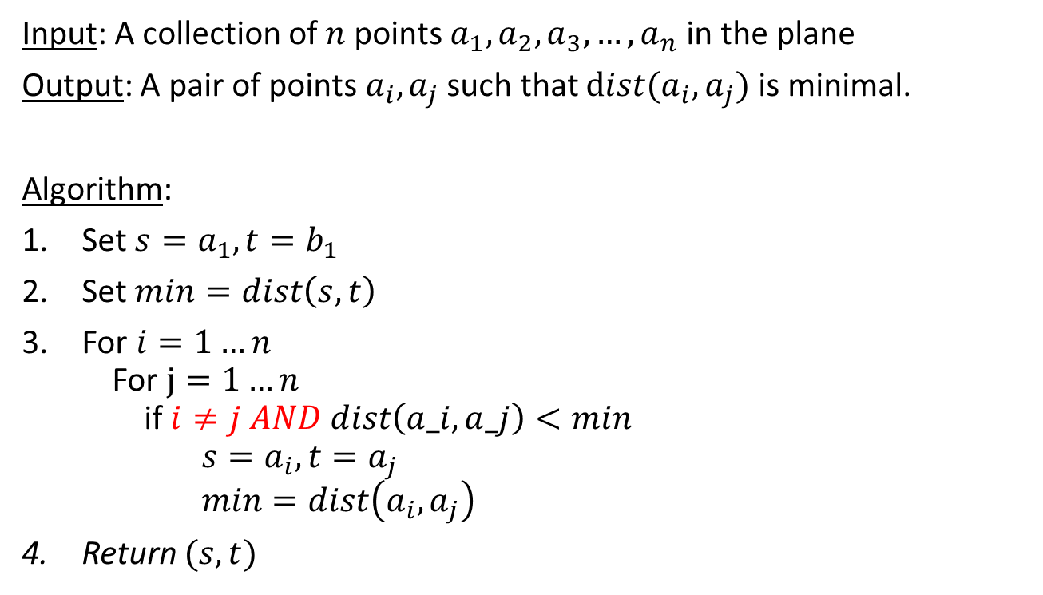
The closest pair problem
Input: A collection of $n$ points $a_{1},a_{2},a_{3},…,a_{n}$ in the plane
Output: A pair of points $a_{i},a_{j}$ such that $dist(a_{i},a_{j})$ is minimal.
Algorithm:
Set $s=a_{1}, t=b_{1}$
Set $min=dist\left(s,t\right)$
For $i=1…n$
For $j=1…n$
if $i≠j AND dist\left(a_i,a_j\right)<min$
$s=a_{i}, t=a_{j}$
$min=dist\left(a_{i},a_{j}\right)$
Return $(s,t)$
Can we make it a bit more efficient?
min

Slide 18
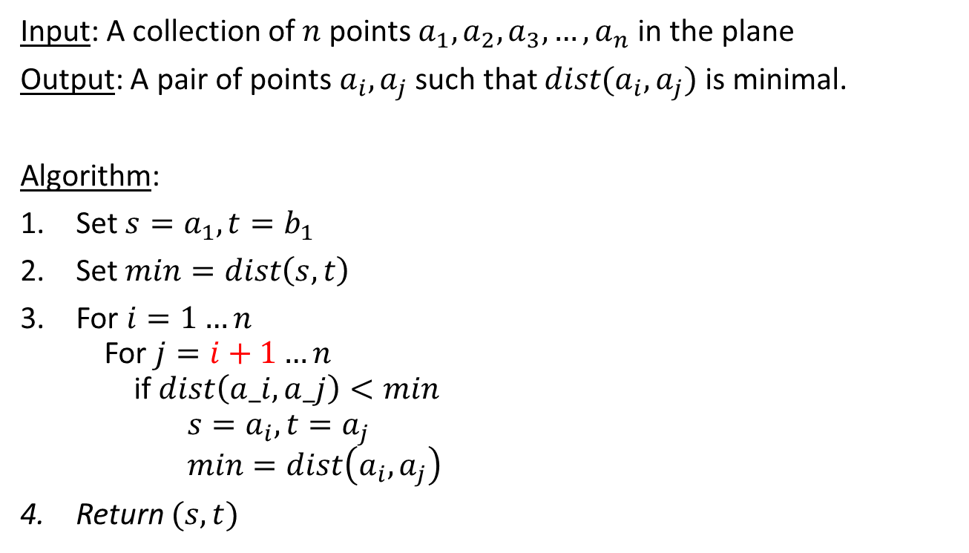
The closest pair problem
Input: A collection of $n$ points $a_{1},a_{2},a_{3},…,a_{n}$ in the plane
Output: A pair of points $a_{i},a_{j}$ such that $dist(a_{i},a_{j})$ is minimal.
Algorithm:
Set $s=a_{1}, t=b_{1}$
Set $min=dist\left(s,t\right)$
For $i=1…n$
For $j=i+1…n$
if $dist\left(a_i,a_j\right)<min$
$s=a_{i}, t=a_{j}$
$min=dist\left(a_{i},a_{j}\right)$
Return $(s,t)$
Is the algorithm correct now?
min
What is the running time
of the algorithm?

Slide 19
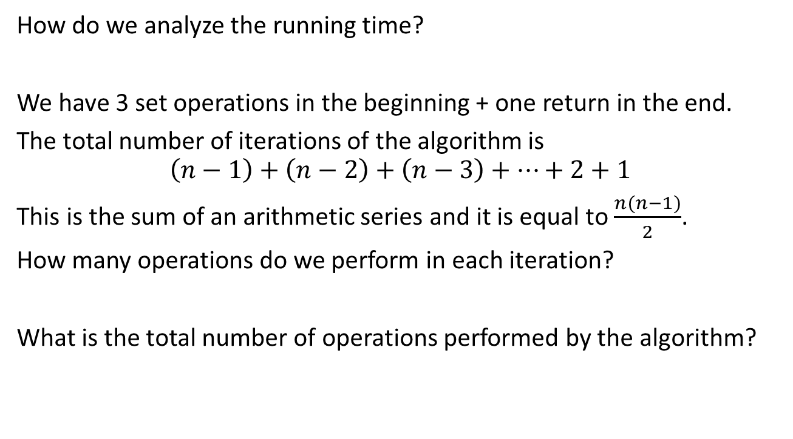
Running time of algorithm
How do we analyze the running time?
We have 3 set operations in the beginning + one return in the end.
The total number of iterations of the algorithm is
$$\left(n−1\right)+\left(n−2\right)+\left(n−3\right)+…+2+1$$
This is the sum of an arithmetic series and it is equal to $\frac{n(n−1)}{2}$.
How many operations do we perform in each iteration?
What is the total number of operations performed by the algorithm?

Slide 20
Running time of algorithm
What is the running time of the algorithm that computes the sum of two numbers?
What is the running time of the algorithm that computes the product of two numbers?
Q: How should we express the runtime?
Naïve A: it is some function of the input
We will usually measure the runtime as a function of the length of the input

Slide 21
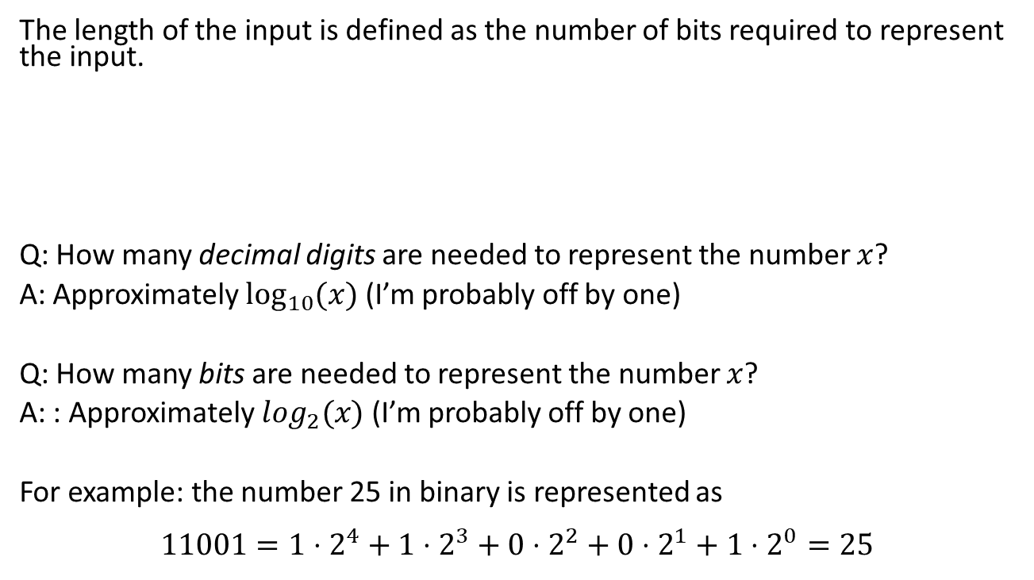
Running time of algorithm
The length of the input is defined as the number of bits required to represent the input.
Q: How many decimal digits are needed to represent the number $x$?
A: Approximately $\log_{10}{(x)}$ (I’m probably off by one)
Q: How many bits are needed to represent the number $x$?
A: : Approximately $\log_{2}(x)$ (I’m probably off by one)
For example: the number 25 in binary is represented as
$$11001=1⋅2^{4}+1⋅2^{3}+0⋅2^{2}+0⋅2^{1}+1⋅2^{0}=25$$
What is the length of the input in the summation/multiplication problems?

Slide 22
Running time of algorithm
Q1: What is the running time of the algorithm that computes the sum of two numbers?
Q2: What is the running time of the algorithm that computes the product of two numbers?
Q3: What is the running time of the algorithm that factors a number into a product of two numbers?

Slide 23
Running time of algorithm
Q: What is the running time of the algorithm that computes the sum of two numbers?
A: On input x,y the runtime is approximately (log₂(x)+log₂(y)) * const
Comment: if x has more digits than y, then then runtime
is ~log₂(x) + const x log₂(y), because we only need to copy some digits of x, and not do any computation.

Slide 24
Reading for next time
Dasgupta, Papadimitriou, Vazirani,
Algorithms, McGraw-Hill Higher Education, 2008.
Chapter:
0
1.1,
1.2: 1.2.1, 1.2.2

