Slide 1
CMPT 706 - Algorithms for Big Data
Divide and Conquer Algorithms
February 6, 2020

Slide 2
Divide and Conquer Algorithms

Slide 3
Divide and Conquer Algorithms
Divide and Conquer Algorithms are a general paradigm:
Given an input we break it into smaller parts (divide)
Solve each part separately (conquer)
Use the small solutions in order to solve the original (bigger) problem (combine)
Example: Fast multiplication algorithm we saw
Given two n-bit numbers, we solved 3 sub-problems each on n/2 bit, and used these to multiply the inputs.
Runtime: Master Method allows us to analyze the runtime.

Slide 4
Finding Median

Slide 5
Finding Median
Input: an array of n integers
Goal: Find the n/2-nd element in the increasing order.
More general goal: Given an integer k, find the k element in the increasing order.
A naïve idea : Given an array: sort it and return the element in position k.
Runtime: O(n log(n))
Can we do better?

Slide 6
Finding k’th element in the increasing order
Input: an array A of n integers
Goal: Given an integer k, find the k element in the increasing order.
Idea: Given an array A
Choose some pivot – a random element from A
Rearrange all elements of A into two subarrays
  A_{≤pivot} – all elements ≤ pivot.
  A_{>pivot} – all elements > pivot.
If A_{≤pivot} has more than k elements, continue the search in A_{≤pivot} .
Otherwise, continue the search in A_{>pivot} .
Continue the search until A has 1 or 2 elements.

Slide 7
Finding k’th element in the increasing order
Example: A = [1,5,3,7,2,6,3,9,4,8] and k=5.
Choose pivot = 6.
Rearrange all elements of A into two subarrays
  A_{≤pivot} = [1,5,3,2,6,3,4]
  A_{>pivot} = [7,9,8]
A_{≤pivot} has 7 elements. 7>k, hence we should continue to A_{≤pivot}.
---------------------------------------------
Our new A = [1,5,3,2,6,3,4], k=5.
Let pivot =2
  A_{≤pivot} = [1,2]
  A_{>pivot} = [5,3,6,3,4]
A_{≤pivot} has 2 elements. 2<k hence we continue in A_{>pivot} with new k=5-2=3.
--------------------------------------------
A = [5,3,6,3,4], k=3
Return 4

Slide 8
Finding k’th element in the increasing order
Runtime: In general the runtime depends on the choice of pivots.
Let A₀ = A be the original array.
Let A₁ be the array after 1 iteration, and suppose that it contains n₁ elements
Let A₂ be the array after 2 iterations , and suppose that it contains n₂ elements
..
Let A_{i} be the array after i iterations , and suppose that it contains n_{i} elements
Then
T(n) = T(n₁) + O(n)
T(n₁) = T(n₂) + O(n₁)
…
T(n_{i-1}) = T(n_{i}) + O(n_{i-1})
Optimistic view:
Suppose that n_{i} < n_{i-1}/2 in each step
Then T(n) < T(n/2) + Cn.
By applying recursion we get
T(n) < T(n/2) + Cn
< T(n/4) + C(n/2) + C(n)
< T(n/8) + C(n/4) + C(n/2) + C(n)
= C(1 + 2 + 4 +…n/4 + n/2 + n) < 2Cn = Θ(n)

Slide 9
Finding k’th element in the increasing order
Runtime: In general the runtime depends on the choice of pivots.
Let A₀ = A be the original array.
Let A₁ be the array after 1 iteration, and suppose that it contains n₁ elements
Let A₂ be the array after 2 iterations , and suppose that it contains n₂ elements
..
Let A_{i} be the array after i iterations , and suppose that it contains n_{i} elements
Then
T(n) = T(n₁) + O(n)
T(n₁) = T(n₂) + O(n₁)
…
T(n_{i-1}) = T(n_{i}) + O(n_{i-1})
Pessimistic view:
What if n_{i} = n_{i-1}-1 in each step
Then T(n) = T(n-1) + Cn.
By applying recursion we get
T(n) < T(n-1) + Cn
< T(n-2) + C(n-1) + C(n)
< T(n-3) + C(n-2) + C(n-1) + C(n)
= C(1 + 2 + 3 + 4 +…+ n-1 + n) = Θ(n²)

Slide 10
Finding k’th element in the increasing order
Question: How should we choose a pivot so that in each step the number of elements decreases by some constant factor?
Exercise: Prove the if n_{i} < (2/3)*n_{i-1} in each step, then we are still in the Optimistic view,
i.e. T(n) < T(0.9n) + Cn implies that T(n)=O(n)
Ideas how to choose a pivot:
Choose a random element in the array
Choose 3 random elements in the array, and let pivot be their median
Choose 7 random elements in the array, and let pivot be their median
Choose √n random elements in the array, and let pivot be their median
  But how?
  Use sorting algorithm on the √n elements – it takes < n steps.
Does it work?
Should work with high probability…

Slide 11
Analyzing Median find for random pivod
Choosing a pivot:
Given an array of n elements choose √n random elements in the array
Let pivot be their median
Claim: Pr[pivot removes at least n/3 element] > 1 - e^{-c√n} for some constant c.
In simple words, is n is large, then with probability 0.9999 the pivot will remove at least n/3 elements.

Slide 12
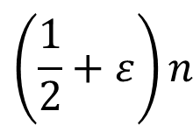
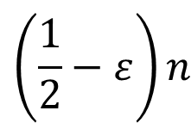


Deviation
Algorithms for Big Data – Median
Let $M$ denote the median of the list $a_{1},…,a_{n}$
Let X be the number of sampled elements above 2n/3.
In expectation only k/3 of the elements should be above 2n/3.
Failure: X > k/2
Then Pr[X > k/2] < δ, where δ=1/e^{Ω(k)}
median of sample
sample
1
$$n$$
$$\left(\frac{1}{2}−ε\right)n$$
$$\left(\frac{1}{2}+ε\right)n$$
median

Slide 13
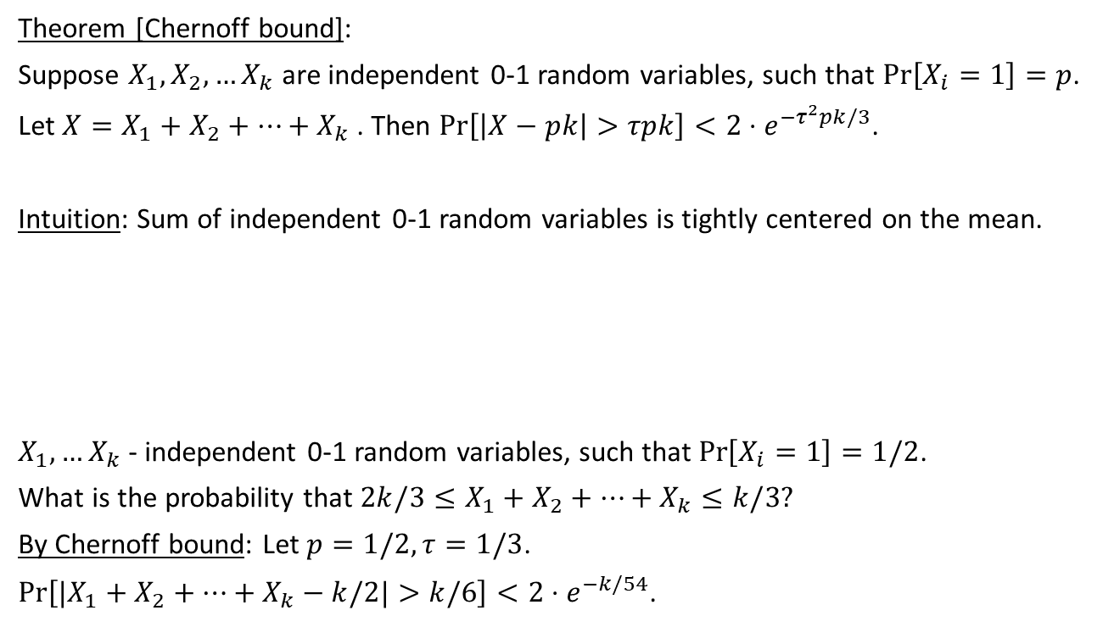
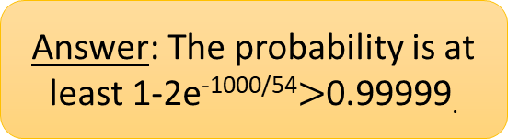
Chernoff bound
Theorem [Chernoff bound]:
Suppose $X_{1},X_{2},…X_{k}$ are independent 0-1 random variables, such that $\operatorname{Pr}\left[X_{i}=1\right]=p$.
Let $X=X_{1}+X_{2}+…+X_{k}$ . Then $\operatorname{Pr}\left[\left|X−pk\right|>τpk\right]<2⋅e^{{−τ}^{2}pk/3}$.
Intuition: Sum of independent 0-1 random variables is tightly centered on the mean.
$X_{1},…X_{k}$ - independent 0-1 random variables, such that $\operatorname{Pr}\left[X_{i}=1\right]=1/2$.
What is the probability that ${2k/3≤X}_{1}+X_{2}+…+X_{k}≤k/3?$
By Chernoff bound: Let $p=1/2,τ=1/3$.
$\operatorname{Pr}\left[|X_{1}+X_{2}+…+X_{k}−k/2|>k/6\right]<2⋅e^{−k/54}$.
Question: if you toss a fair coin k= 1000 times, what is the probability that the number of heads is between 333 and 666?
Answer: The probability is at least 1-2e^{-1000/54}$>$0.99999.

Slide 14
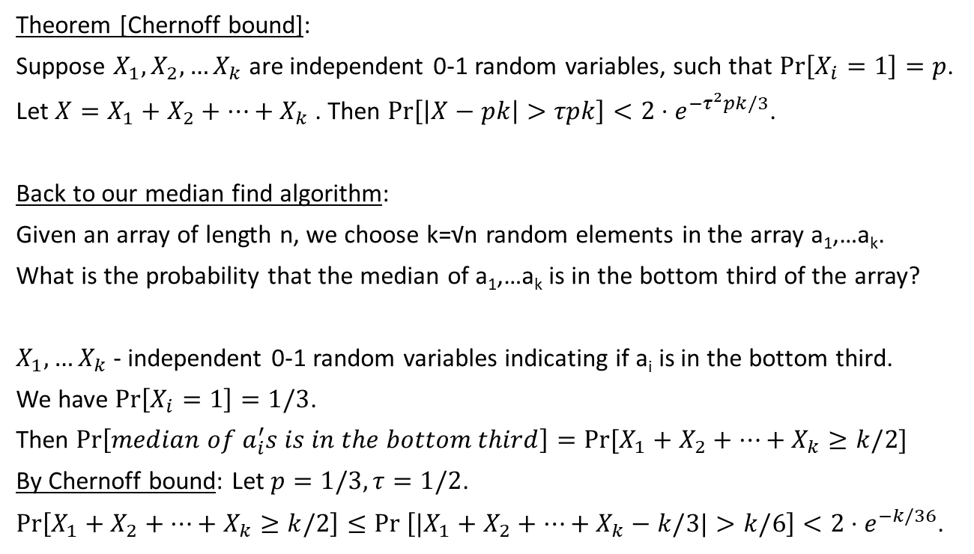
Chernoff bound
Ex: Prove that Pr[median of a_{i}’s is in the top third]<2e^{-k/36}
Theorem [Chernoff bound]:
Suppose $X_{1},X_{2},…X_{k}$ are independent 0-1 random variables, such that $\operatorname{Pr}\left[X_{i}=1\right]=p$.
Let $X=X_{1}+X_{2}+…+X_{k}$ . Then $\operatorname{Pr}\left[\left|X−pk\right|>τpk\right]<2⋅e^{{−τ}^{2}pk/3}$.
Back to our median find algorithm:
Given an array of length n, we choose k=√n random elements in the array a₁,…a_{k}.
What is the probability that the median of a₁,…a_{k} is in the bottom third of the array?
$X_{1},…X_{k}$ - independent 0-1 random variables indicating if a_{i} is in the bottom third.
We have $\operatorname{Pr}\left[X_{i}=1\right]=1/3$.
Then $\operatorname{Pr}\left[median of a_{i}^{′}s is in the bottom third\right]=Pr⁡[X_{1}+X_{2}+…+X_{k}≥k/2]$
By Chernoff bound: Let $p=1/3,τ=1/2$.
$\operatorname{Pr}\left[X_{1}+X_{2}+…+X_{k}≥k/2\right]{≤Pr \left[|X_{1}+X_{2}+…+X_{k}−k/3|>k/6\right]}<2⋅e^{−k/36}$.

Slide 15
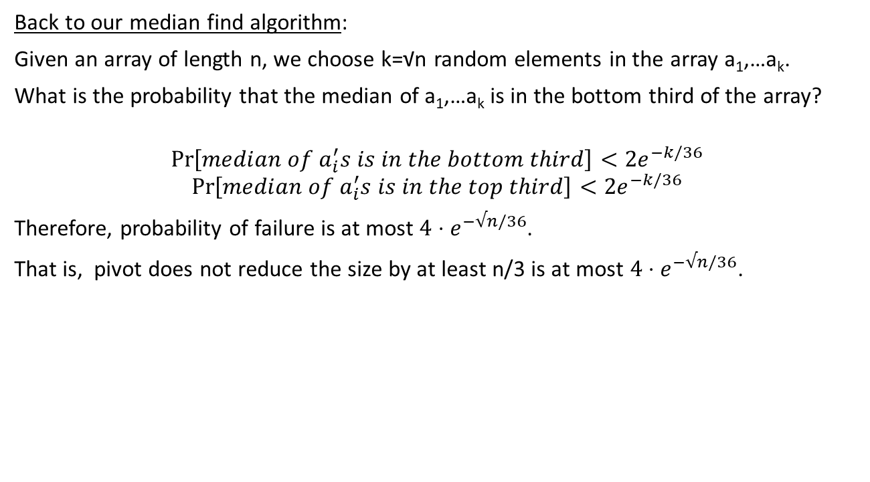
Chernoff bound
Back to our median find algorithm:
Given an array of length n, we choose k=√n random elements in the array a₁,…a_{k}.
What is the probability that the median of a₁,…a_{k} is in the bottom third of the array?
$$\operatorname{Pr}\left[median of a_{i}^{′}s is in the bottom third\right]<{2e}^{−k/36}$$
$$\operatorname{Pr}\left[median of a_{i}^{′}s is in the top third\right]<{2e}^{−k/36}$$
Therefore, probability of failure is at most ${4⋅e}^{−√n/36}$.
That is, pivot does not reduce the size by at least n/3 is at most ${4⋅e}^{−√n/36}$.

Slide 16
Quick Sort

Slide 17
Quick Sort
Input: an array of n integers
Goal: sort its elements in the non-decreasing order.
Assumption: each element is short.
Each element can be read in O(1) time,
Can compare two elements in O(1) time
Quick sort algorithm: it is a divide and conquer algorithm
Given an array A[1…n]
Choose a pivot p
Rearrange all a_{i} < p are to the left of p,
and all a_{i} >= p are to the right of p.
Sort the elements that are <p (using recursion)
Sort the elements that are >=p (using recursion)

Slide 18
Quick Sort
Example: Input: [4, 1, 8, 7, 10, 3]
Let pivot =7
Rearrange to get [4,1,3] and [7, 10, 8]
Sort [4, 1, 3] → [1, 3, 4]
Sort [7, 10, 8] → [7, 8, 10]
Correctness: it is clear: If each of the two halves is sorted, the it suffices to push the elements from right to left to their correct position.

Slide 19
Quick Sort
Runtime: Denote the runtime on array of length n by T(n).
Rearranging takes O(n) time
Then we need to sort each of the two parts separately.
Suppose one part has 2n/3 elements and the other n/3 in each step.
T(n) = O(n) + T(n/3) + T(2n/3).
What is the runtime here?
By Master Method: T(n) < 2T(2n/3) + O(n).
a = 2, b = 3/2, d=1
log_{b}(a) = log_{1.5}(2) = 1.709…
Therefore, T(n)= O(n^{1.709}).
A more careful analysis gives O(n log(n))
Q: How can we choose such a pivot?
A: Choose random elements, and find a median among them

Slide 20
Finding median deterministically
Q: Can we find the k’th element of an array using a deterministic algorithm?
Q: Can we get rid of randomness?

Slide 21
Finding the k’th element deterministically
Idea: Given an array A of length n, and an integer k
Partition A into n/5 arrays each of size 5
Let B = [b₁…b_{n/5}] be the medians of each of the sub arrays.
Let pivot be the median of B = [b₁…b_{n/5}] – can be computed using recursion
Let pivot be the median of B
Rearrange all elements of A into two subarrays
  A_{≤pivot} – all elements ≤ pivot.
  A_{>pivot} – all elements > pivot.
If A_{≤pivot} has more than k elements, continue the search in A_{≤pivot}.
Otherwise, continue the search in A_{>pivot}.
Correctness: Obvious.

Slide 22
Finding the k’th element deterministically
Idea: Given an array A of length n, and an integer k
Partition A into n/5 arrays each of size 5
Let B = [b₁…b_{n/5}] be the medians of each of the sub arrays.
Let pivot be the median of B = [b₁…b_{n/5}] – can be computed using recursion
Rearrange all elements of A into two subarrays
  A_{≤pivot} – all elements ≤ pivot.
  A_{>pivot} – all elements > pivot.
If A_{≤pivot} has more than k elements, continue the search in A_{≤pivot}.
Otherwise, continue the search in A_{>pivot}.
Runtime: T(n) <= T(n/5) + T(7n/10) + O(n) -- why?
Because there are:
(1) at least 3n/10 elements >= pivot and (2) at least 3n/10 elements <= pivot
Ex: Prove that T(n) = O(n).

Slide 23
Matrix Multiplication

Slide 24
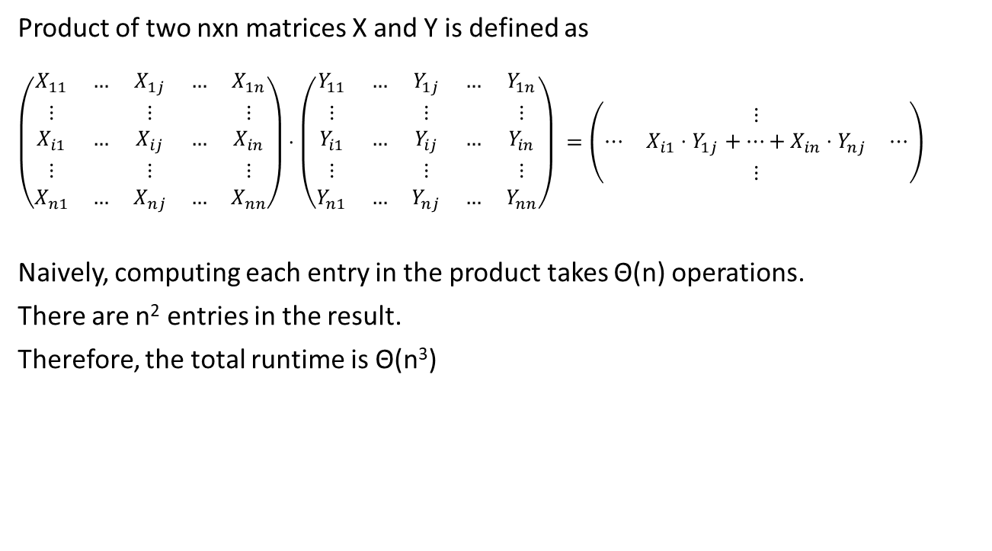
Matrix Multiplication
Product of two nxn matrices X and Y is defined as
$$\left(\begin{matrix}X_{11} & … & X_{1j} & … & X_{1n} \\ ⋮ & & ⋮ & & ⋮ \\ X_{i1} & … & X_{ij} & … & X_{in} \\ ⋮ & & ⋮ & & ⋮ \\ X_{n1} & … & X_{nj} & … & X_{nn}\end{matrix}\right)⋅\left(\begin{matrix}Y_{11} & … & Y_{1j} & … & Y_{1n} \\ ⋮ & & ⋮ & & ⋮ \\ Y_{i1} & … & Y_{ij} & … & Y_{in} \\ ⋮ & & ⋮ & & ⋮ \\ Y_{n1} & … & Y_{nj} & … & Y_{nn}\end{matrix}\right) =\left(\begin{matrix} & ⋮ & \\ ⋯ & X_{i1}⋅Y_{1j}+…+X_{in}⋅Y_{nj} & ⋯ \\ & ⋮ & \end{matrix}\right)$$
Naively, computing each entry in the product takes Θ(n) operations.
There are n² entries in the result.
Therefore, the total runtime is Θ(n³)
Can we do better?

Slide 25
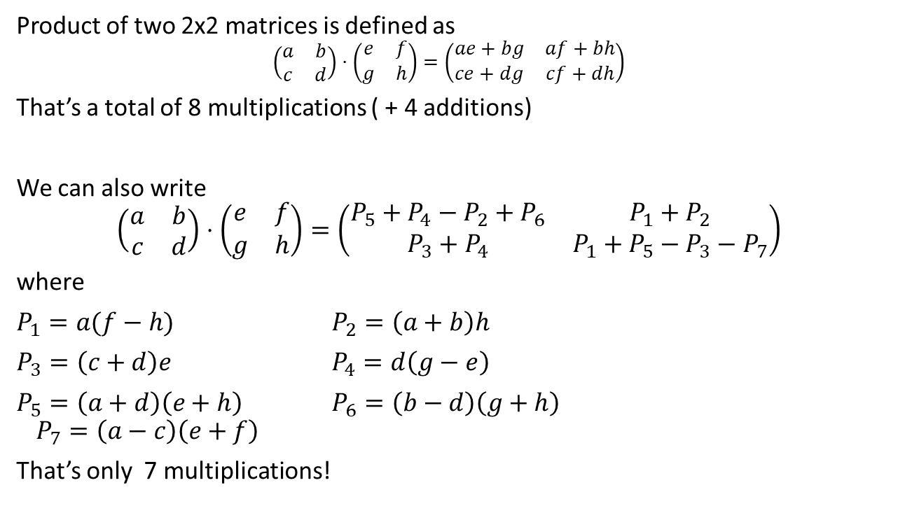
Strassen’s Algorithm
Product of two 2x2 matrices is defined as
$$\left(\begin{matrix}a & b \\ c & d\end{matrix}\right)⋅\left(\begin{matrix}e & f \\ g & h\end{matrix}\right)=\left(\begin{matrix}ae+bg & af+bh \\ ce+dg & cf+dh\end{matrix}\right)$$
That’s a total of 8 multiplications ( + 4 additions)
We can also write
$$\left(\begin{matrix}a & b \\ c & d\end{matrix}\right)⋅\left(\begin{matrix}e & f \\ g & h\end{matrix}\right)=\left(\begin{matrix}P_{5}+P_{4}−P_{2}+P_{6} & P_{1}+P_{2} \\ P_{3}+P_{4} & P_{1}+P_{5}−P_{3}−P_{7}\end{matrix}\right)$$
where
$P_{1}=a(f−h)$ $P_{2}=\left(a+b\right)h$
$P_{3}=\left(c+d\right)e$ $P_{4}=d\left(g−e\right)$
$P_{5}=\left(a+d\right)\left(e+h\right)$ $P_{6}=\left(b−d\right)\left(g+h\right)$
$$P_{7}=\left(a−c\right)\left(e+f\right)$$
That’s only 7 multiplications!
Can we use it to multiply nxn matrices faster?

Slide 26
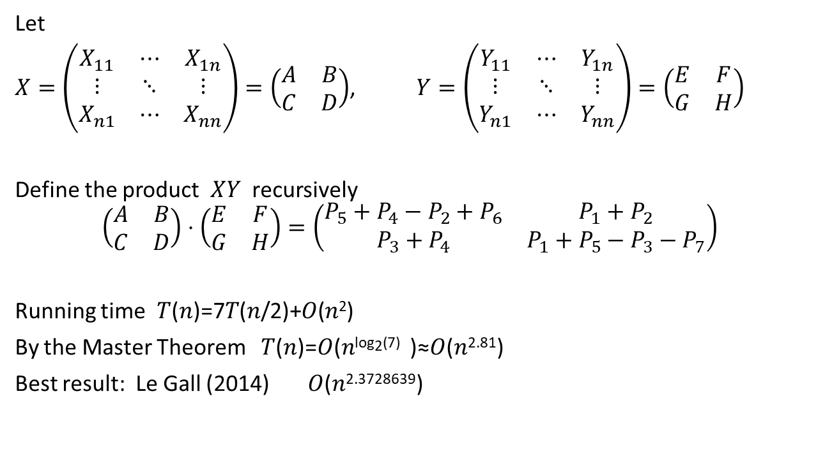
Strassen’s Algorithm
Let
$X=\left(\begin{matrix}X_{11} & ⋯ & X_{1n} \\ ⋮ & ⋱ & ⋮ \\ X_{n1} & ⋯ & X_{nn}\end{matrix}\right)=\left(\begin{matrix}A & B \\ C & D\end{matrix}\right)$, $Y=\left(\begin{matrix}Y_{11} & ⋯ & Y_{1n} \\ ⋮ & ⋱ & ⋮ \\ Y_{n1} & ⋯ & Y_{nn}\end{matrix}\right)=\left(\begin{matrix}E & F \\ G & H\end{matrix}\right)$
Define the product $XY$ recursively
$$\left(\begin{matrix}A & B \\ C & D\end{matrix}\right)⋅\left(\begin{matrix}E & F \\ G & H\end{matrix}\right)=\left(\begin{matrix}P_{5}+P_{4}−P_{2}+P_{6} & P_{1}+P_{2} \\ P_{3}+P_{4} & P_{1}+P_{5}−P_{3}−P_{7}\end{matrix}\right)$$
Running time 𝑇(𝑛)=7𝑇(𝑛/2)+𝑂(𝑛²)
By the Master Theorem 𝑇(𝑛)=𝑂(𝑛^{log2⁡(7)} )≈𝑂(𝑛^{2.81})
Best result: Le Gall (2014) 𝑂(𝑛^{2.3728639})

Slide 27
Homework and Reading for next time
Exercises from the Book:
2.15, 2.17, 2.22, 2.24, 2.27, 2.28
Reading
3.1, 3.2, 3.3, 3.4

