Slide 1
CMPT 706 - Algorithms for Big Data
Graphs
February 13, 2020

Slide 2
Graphs

Slide 3
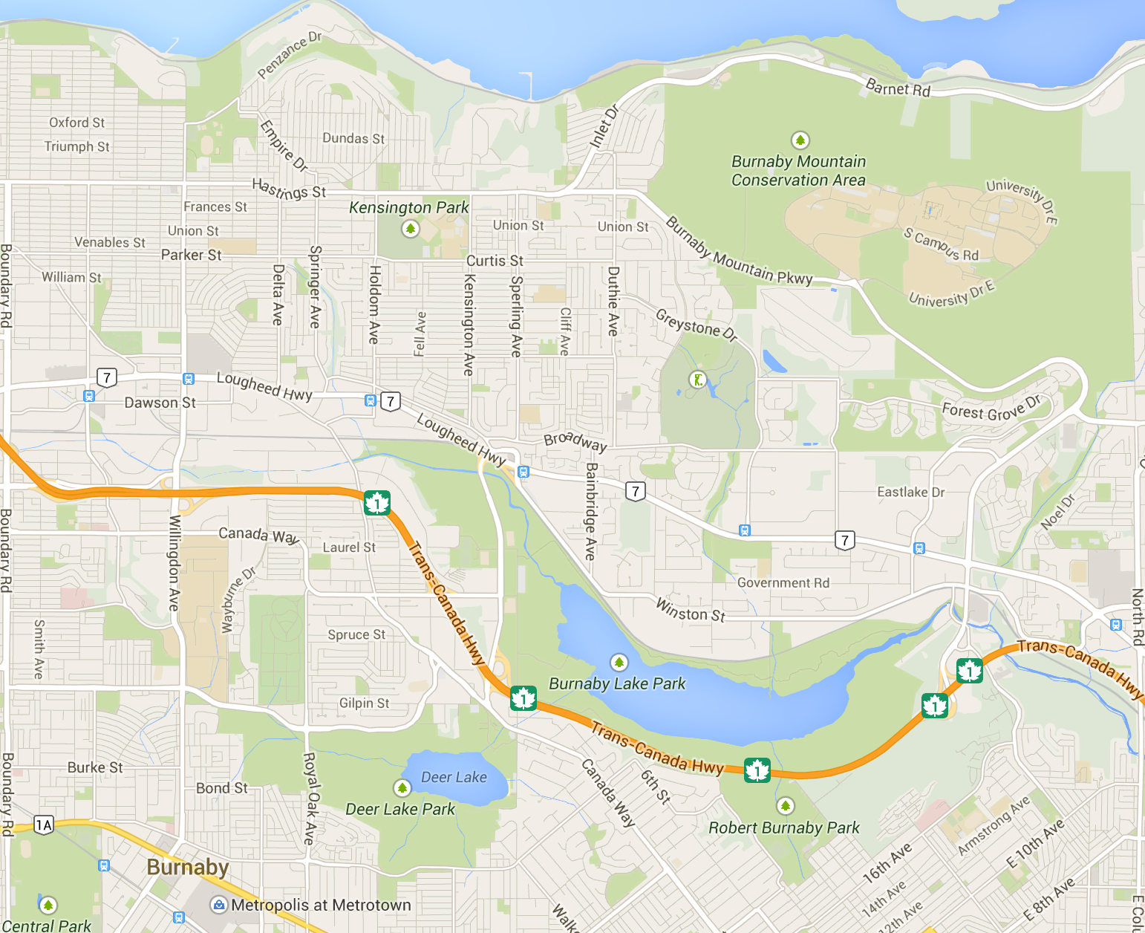
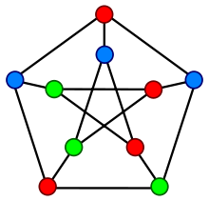

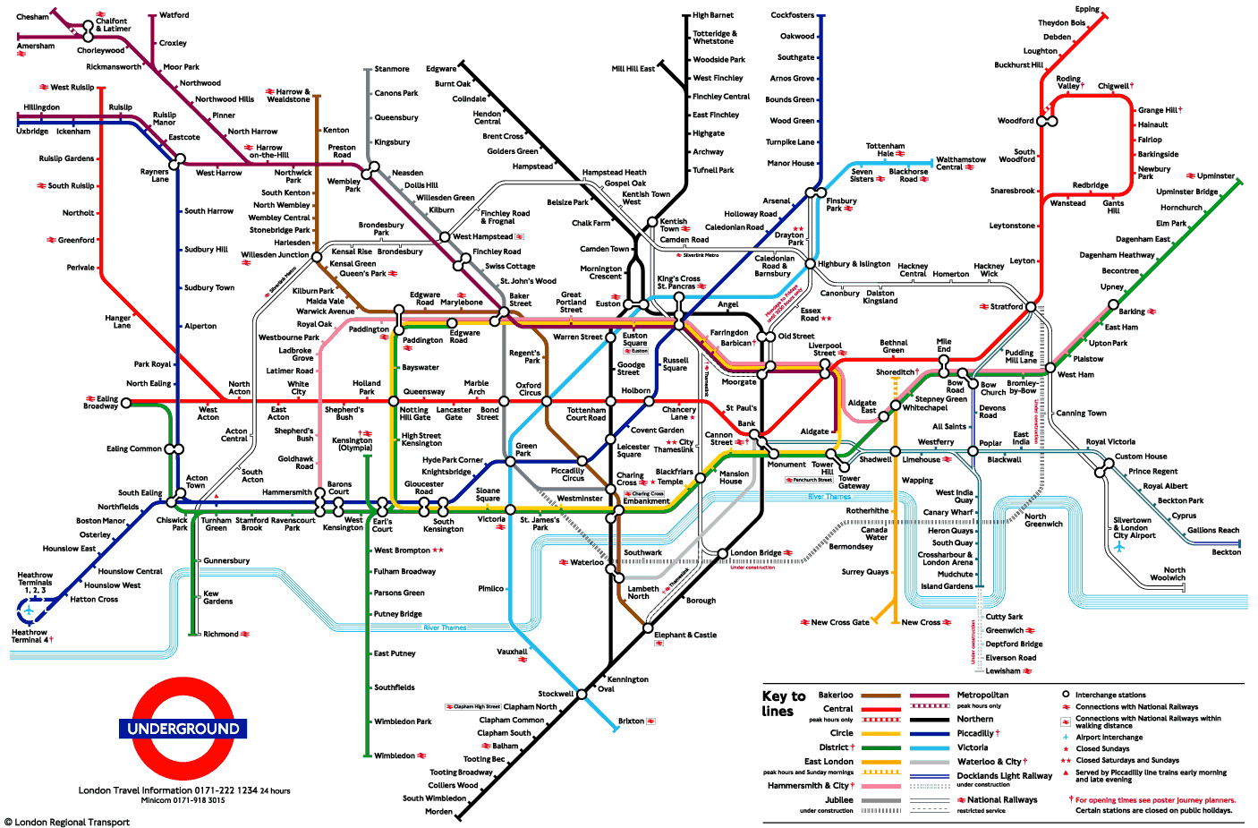
Graphs
A graph describes relationships among items in a collection
- the items are the vertices (depicted by dots or junctions)
- the relations are the edges (depicted by lines between dots)
What are the vertices and edges in these common graphs?
Vertices - stations
Edges - pipes
Vertices - intersections
Edges - roadways
Vertices - people
Edges - friendships

Slide 4
Trees

Slide 5
Trees
A tree is a minimally connected graph.
all vertices connected
no cycles

Slide 6
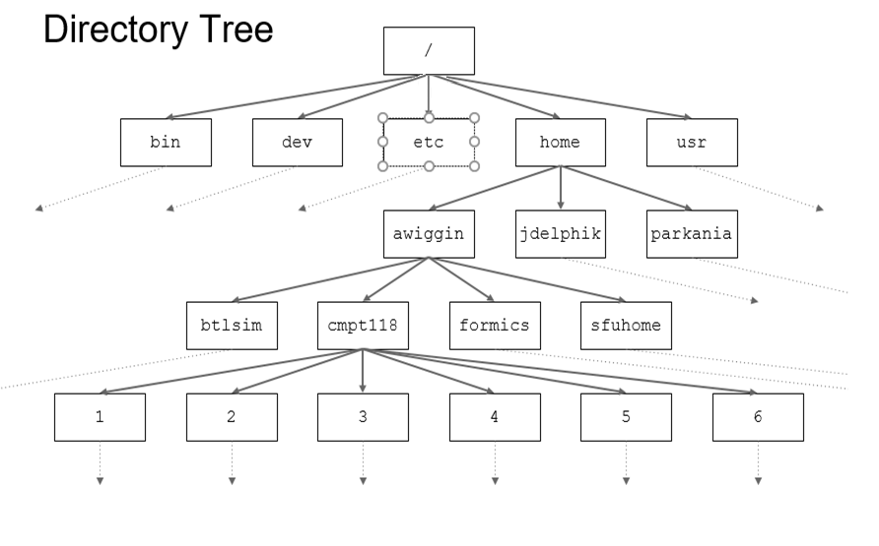
Trees

Slide 7
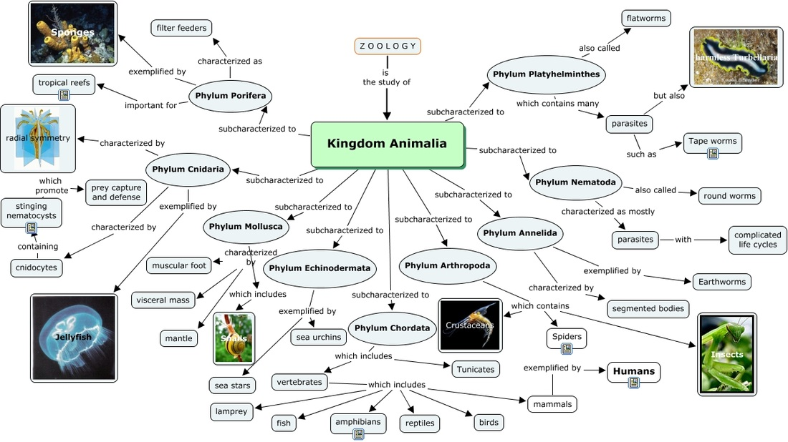
Trees

Slide 8
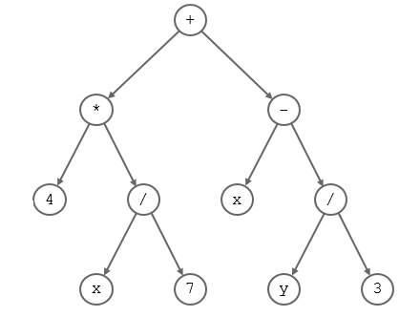
A tree

Slide 9
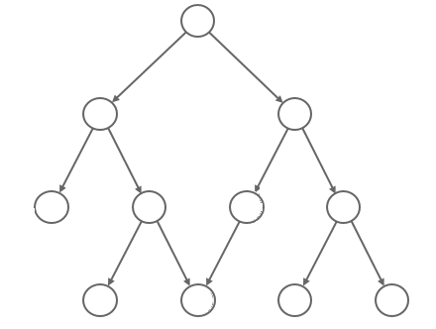
Not a tree

Slide 10
More trees
Each of the connected components below is a tree

Slide 11
A forest
A forest is a simple graph with no cycles (not necessarily connected).

Slide 12
Properties of trees
For a connected graph G=(V,E) the following are equivalent
G is a tree
for any two vertices a≠b there is a unique path from a to b.
|E|=|V|-1

Slide 13
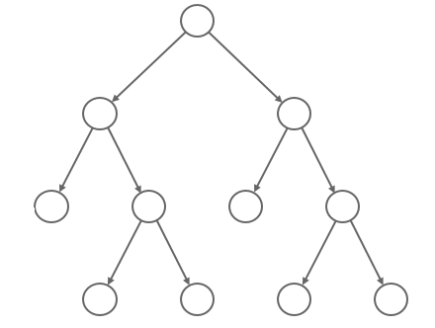
Structure of rooted trees
Root
Leaves

Slide 14
Structure of rooted trees
Parent
Vertex/node
Children

Slide 15
Rooted vs Unrooted trees
An unrooted tree can be turned into a rooted tree by choosing a root, and directing all edges away from the root.
f
g
a
e
c
a
b
c
f
g
c
a
d
b
d
e
d
e
b
f
g
a is the root
e is the root

Slide 16
More terminology
Let T=(V,E) be a rooted tree with root r.
Fix some vertex u
Any vertex on the path from the root to u is an ancestor of u.
Any vertex below (child or child of a child…) u is a descendant of u.
An internal vertex is a vertex that has at least one child.
A subtree rooted at the subgraph of a tree induced by u and all its descendants.

Slide 17
More terminology
For the tree below find:
All children of c?
Parent of b?
Ancestors of f?
All descendant of a?
All leaves/Terminal vertices?
All internal vertices?
a
b
c
d
f
g
e

Slide 18
Exploring graphs

Slide 19
Exploring a tree
Input: A tree T=(V,E) and a vertex v
Goal: explore all vertices reachable from v
Explore(T, root)
pre_visit(root) // e.g. print(“visited” root)
for each child of u, i.e., every edge (root,u) do
  Explore (T, u)
post_visit(root) // e.g. print(“done with” root)
Q: What is the runtime of the algorithm?
What about traversing a general graph?

Slide 20
Depth First Search (DFS)
Create clock starting with 0.
Input: A graph G=(V,E) and a vertex v
Goal: explore all vertices reachable from v
Explore(G, v)
set v.visited=true
pre_visit(v) // e.g. print(“done with” v)
for all neighbours u of v do
  3.1 If u.visited = false
  Explore (G, u)
post_visit(v) // e.g. print(“done with” v)
pre_visit(v):
clock++
v.pre = clock
post_visit(v):
clock++
v.post = clock
Q: What is the runtime of the algorithm?

Slide 21
Depth First Search (DFS)
1
/16
a
a
2
/15
b
c
10
/11
b
c
6
/9
3
/14
d
e
f
d
e
f
5
/12
7
4
/ 13
g
h
/8
g
h
previsit
Explore(G,a)
DFS tree
postvisit

Slide 22
DFS – finding connected components
Types of edges of a graph for a given DFS:
Given a directed graph G=(V,E) we have 4 types of edges
Tree edges – the edges that belong to the DFS tree
Forward edges – edges going from a node in DFS tree to its descendant
Back edges - edges going from a node in DFS tree to its ancestor
Cross edges – all other edges.

Slide 23
DFS – finding connected components
Input: An undirected graph G=(V,E)
Goal: find all connected components of G
DFS(G, v)
For all vertices v
set v.visited = false
set v.CC = 0 // v.CC=5: v belongs to the 5th connected component
C = 1; // counter for connected components
For all vertices v
if v.visited = false
explore(G,v,C)
C = C+1
Explore: inside previsit set v.CC=C

Slide 24
Strongly connected components in directed graphs

Slide 25
Strongly connected components
Let G=(V,E) be a directed graph.
Two vertices u,v are connected if there a path from u to v and from v to u.
Equivalently there is a cycle containing both u and v.
A directed graph is said to be strongly connected
if there is a path from any vertex to any other vertex.
A set W of vertices is a strongly connected component
if it is a maximal subset of the vertices such that
any two of them are connected.

Slide 26
Strongly connected components
Let G=(V,E) be a directed graph.
The meta-graph of G is the directed graph of strongly connected components.
Observation: the meta-graph is a DAG –directed acyclic graph

Slide 27
Directed Acyclic Graphs (DAG)
Consider a DFS for a DAG.
Observation 1: A DAG contains no cycles ➔ its DFS has no back edges.
Observation 2: for every edge u->v we have u.post > v.post
Observation 3: Sorting the vertices according to their post number gives a topological order – order where all edges are left to right.

Slide 28
Finding strongly connected components
Let G=(V,E) be a directed graph.
The meta-graph of G is the directed graph of strongly connected components.
Claim 1. When running DFS from any node v, DFS visits exactly all vertices reachable from v.
Claim 2. The node that receives the highest post number in DFS belongs to a source of the meta-graph.
Claim 3. Let 𝐶 and 𝐷 be strongly connected components.
If there is an edge from a vertex from 𝐶 to a vertex from 𝐷, then the highest post number in 𝐶 is higher than the highest post number in 𝐷.

Slide 29
Finding strongly connected components
Input: A directed graph G=(V,E)
Output: All strongly connected components of G.
Algorithm(G)
Run DFS on G^{R}, and sort the vertices by their post number
Take v with the highest post number and run DFS(G, v)
All vertices reachable from v are the connected component of v.
Remove CC(v) from G, and return to step 2
G^{R} – the graph G
with all edges reversed

Slide 30
Homework and Reading for next time
Exercises from the Book:
3.1, 3.2, 3.3, 3.4
Reading
3.1, 3.2, 3.3, 3.4

