Slide 1
CMPT 706 - Algorithms for Big Data
Graphs
March 3, 2020

Slide 2
Minimum Spanning Trees

Slide 3
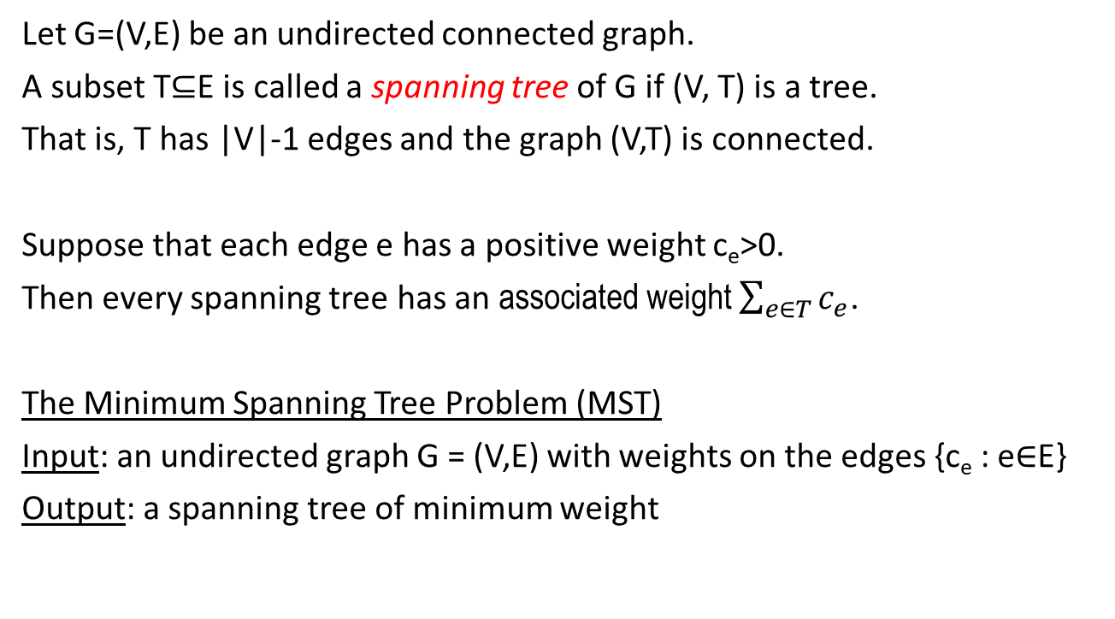
Minimum Spanning Tree (MST)
Let G=(V,E) be an undirected connected graph.
A subset T⊆E is called a spanning tree of G if (V, T) is a tree.
That is, T has |V|-1 edges and the graph (V,T) is connected.
Suppose that each edge e has a positive weight c_{e}>0.
Then every spanning tree has an associated weight $\sum_{e∈T}{c_{e}}$.
The Minimum Spanning Tree Problem (MST)
Input: an undirected graph G = (V,E) with weights on the edges {c_{e} : e∈E}
Output: a spanning tree of minimum weight

Slide 4
Minimum Spanning Tree (MST)
a
a
2
1
MST:
2
1
b
3
c
b
c
1
2
1
3
8
2
3
5
d
e
f
d
e
3
f
2
1
1
g
7
h
g
h

Slide 5
Two Greedy Algorithms

Slide 6
Kruskal’s Algorithm
Input: an undirected graph G = (V,E) with weights on the edges {c_{e} : e∈E}
Output: a spanning tree of minimum weight
Set T = empty set
While |T| < |V|-1 do
    Pick an edge e∈E\T with minimum weight
    such that T∪{e} does not contain a cycle.
    Add e to T

Slide 7
Kruskal’s Algorithm - example
a
a
2
1
MST:
2
1
b
3
c
b
c
1
2
1
3
8
2
3
5
d
e
f
d
e
3
f
2
1
1
g
7
h
g
h

Slide 8
Kruskal’s Algorithm: Correctness
Lemma (the Cut Property): Suppose that set X of edges is a part of a minimum spanning tree.
Let S be a nonempty subset of vertices, S≠V, such that 𝑋 does not cross between S and V\S.
Let e be the minimum weight edge connecting S to V\S.
Then X∪{e} is contained in a minimum spanning tree.
Proof: [exchange argument]
Fix a spanning tree T that contains the edges X, and suppose that e∉T.
Let’s add e to T. This will create cycle in T
This means that we can remove another edge e’ from T such that
1) e’ is an edge from S to V\S
2) c_{e} <= c_{e’}
2) Removing e’ turns T into a tree again

Slide 9
Kruskal’s Algorithm: Correctness
e’
t
u
v
e
w
r
V\S
S
q
e’’

Slide 10
Kruskal’s Algorithm: Correctness
Theorem: Kruskal’s algorithm produces a minimum spanning tree.
Proof:
1) The output T is a spanning tree because
T contains no cycles
T has |V|-1 edges
2) T has minimum weight. This is because
Claim: In every step all edges added by Kruskal’s algorithm so far must belong to some minimum spanning tree.
Proof of claim: By induction on the steps of the algorithm.
Let T be a tree so far, and consider the next added edge (v,w).
Let S be the vertices reachable in T from v. Clearly v ∈ S, and w ∉ S.
The edge (v,w) is the lightest edge connecting S to V\S.
Therefore, but the cut property S ∪ { (v,w) } belongs to some spanning tree

Slide 11
Kruskal’s Algorithm: Runtime
Runtime: Suppose G has n vertices and m edges.
Straightforward analysis: We add n-1 edges, each time looking for the lightest edge that does not close a cycle.
Kruskal’s algorithm runs in time at most < n * m * (m+n) = O(m²n)
Using a good data structure that efficiently stores connected components we can construct a MST in time O(m log(n)).
See Section 5.1.4 A data structure for disjoint sets in the book

Slide 12
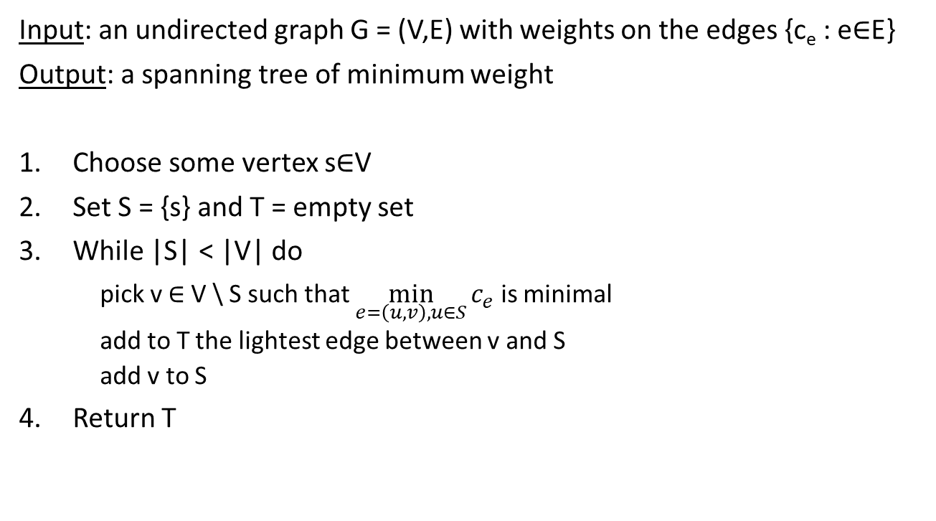
Prim’s Algorithm
Input: an undirected graph G = (V,E) with weights on the edges {c_{e} : e∈E}
Output: a spanning tree of minimum weight
Choose some vertex s∈V
Set S = {s} and T = empty set
While |S| < |V| do
pick v ∈ V \ S such that $\min_{e=\left(u,v\right), u∈S}{c_{e}}$ is minimal
  add to T the lightest edge between v and S
  add v to S
Return T

Slide 13
Prim’s Algorithm - example
a
a
2
1
MST:
2
1
b
3
c
b
c
1
2
1
3
8
2
3
5
d
e
f
d
e
3
f
2
1
1
g
7
h
g
h

Slide 14
Prim’s Algorithm: Correctness
Theorem: Prim’s algorithm produces a minimum spanning tree.
Proof:
1) The output T is a spanning tree because
T contains no cycles
T has |V|-1 edges
2) T has minimum weight. Skip for today

Slide 15
Prim’s Algorithm: Runtime
Runtime: For a graph G with n vertices and m edges
Naïvely we have n iterations, and in each iteration we add a vertex of minimal “cost”.
Therefore, the runtime is O(nm)
This can be improved to O(n log(n) + m log(n)).

Slide 16
Homework and Reading for next time
Exercises from the Book:
5.1, 5.2, 5.3, 5.4, 5.8, 5.9
Reading
5.1.4, 5.2,

