Slide 1
CMPT 706 - Algorithms for Big Data
Dynamic Programming
March 24, 2020

Slide 2
Dynamic Programming
A general paradigm that in which a problem is solved by
breaking it into smaller subproblems
tackling them one by one, smallest first
using the answers to small subproblems solve the larger problem
Similar to the divide-and-conquer paradigm using recursion
However, instead of recursive calls we use memorization.

Slide 3
A simple example Fibonacci sequence

Slide 4
Fibonacci sequence
Fibonacci sequence:
F₀ = 0, F₁ = 1
F_{n} = F_{n-1} + F_{n-2} for all n>1.
That is, the sequence is: 0, 1, 1, 2, 3, 5, 8, 13, 21, 34, 55, 89, 144…
Write an algorithm for the following problem
Input: A positive integer n
Output: F_{n}

Slide 5
Fibonacci sequence
What is the runtime of the algorithm?
Input: A positive integer n
Output: F_{n}
Recursive algorithm:
Fib(n)
If n = 0 or n = 1
return n
Otherwise
Let x = Fib(n-1)
Let y = Fib(n-2)
return x+y
Denote by T(n) the runtime of Fib(n)
Then
T(n) = T(n-1) + T(n-2) + O(1) > 2*T(n-2)
T(n) > 2*T(n-2) > 4*T(n-4) > 8*T(n-6)…
T(n) > 2^{n/2}=1.4^{n}

Slide 6
Fibonacci sequence
What is the runtime of the algorithm?
Input: A positive integer n
Output: F_{n}
A “dynamic programming approach” :
Fib(n)
Create an array A[0…n] of length n+1
Set A[0] = 0
Set A[1] = 1
For i=2…n
A[i] = A[i-1] + A[i-2]
Return A[n]
Clearly the runtime is O(n) operations on numbers
We used “memorization”
to save on runtime

Slide 7
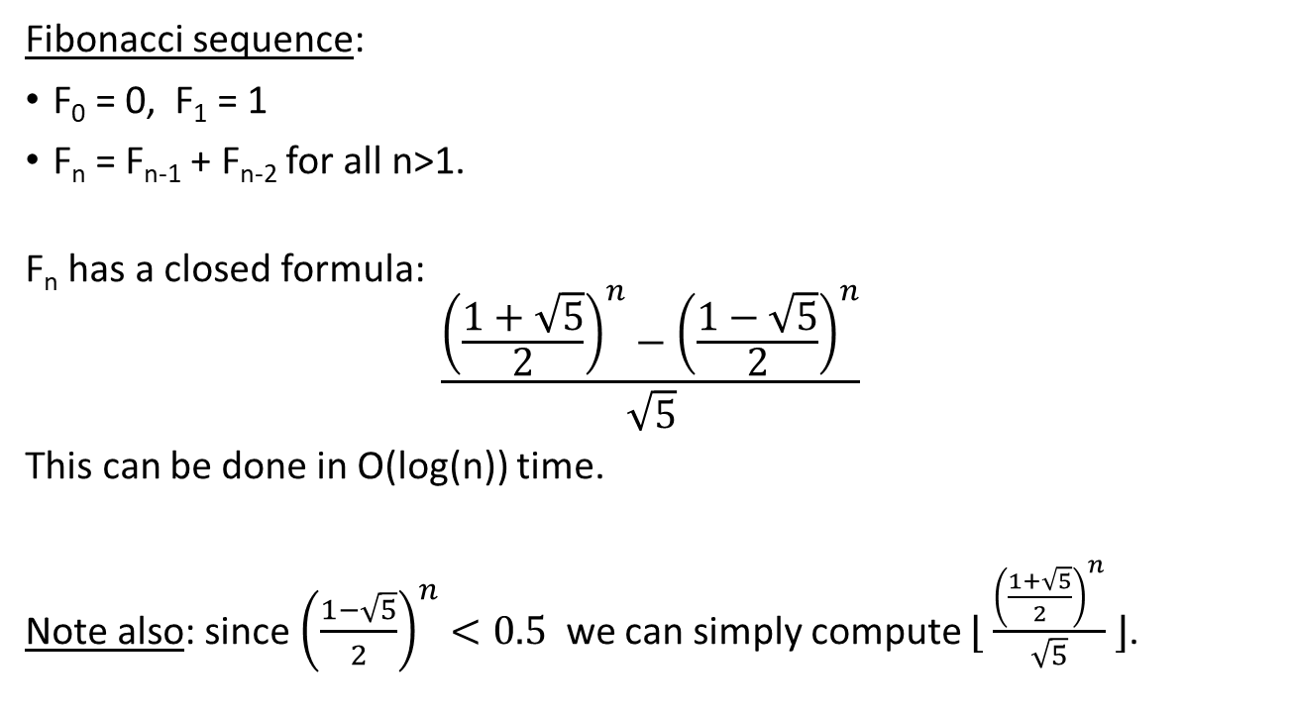
Fun facts about Fibonacci sequence
Fibonacci sequence:
F₀ = 0, F₁ = 1
F_{n} = F_{n-1} + F_{n-2} for all n>1.
F_{n} has a closed formula:
$$\frac{{\left(\frac{1+\sqrt{5}}{2}\right)}^{n}−{\left(\frac{1−\sqrt{5}}{2}\right)}^{n}}{\sqrt{5}}$$
This can be done in O(log(n)) time.
Note also: since ${\left(\frac{1−\sqrt{5}}{2}\right)}^{n}<0.5$ we can simply compute $⌊ \frac{{\left(\frac{1+\sqrt{5}}{2}\right)}^{n}}{\sqrt{5}} ⌋$.

Slide 8
The shortest path problem (again)

Slide 9
The shortest path problem
Input: G= (V,E) with distances {c(e) : e∈E} on edges, and two vertices s,t∈V.
Output: Shortest path from s to t.
Denote by dist(v,i) the shortest path from s to v that uses at most i edges.
Observation1: dist(v,i) is either dist(v,i-1) or min _{(u,v)∈E} { dist(u,i-1) + c_{(u,v)} }
Observation2: the shortest path uses at most n-1 edges.
u
s
t
v

Slide 10
The shortest path problem
What would be the runtime
if we used recursion?
Input: G= (V,E) with distances {c(e) : e∈E} on edges, and two vertices s,t∈V.
Output: Shortest path from s to t.
Algorithm:
Create a matrix dist of dimensions V x n // n = |V|
Set dist(s,0) = 0 and dist(v,0) = ∞ for all v∈V\ {s}
For i=1…n
  For each v∈V
  Set d₁ = min _{(u,v)∈E} { dist(u,i-1) + c_{(u,v)} }
  Set d₂ = dist(v,i-1)
  Set dist(v,i) = min(d₁, d₂)
Return dist(t,n-1)
What is the runtime of the algorithm?
n*n iterations
n steps in each iteration
Total runtime is O(n³)

Slide 11
The Knapsack problem

Slide 12
The Knapsack problem
Input: A set of n objects each having values {v_{i}}_{i=1…n} and weight {w_{i}}_{i=1…n}
A weight limit W. - all w_{i}’s and W are positive integers.
Output: Select objects of total weight at most W such that the sum of values is maximized.
Idea: Suppose we decided on all objects except for the last one.
Should we add the last object?
Two cases:
Take a solution that does not involve the last object.
If there is room for the last object, i.e., total weight is less than W-w_{n}, then we can add it to the solution– this adds value v_{n} .

Slide 13
The Knapsack problem
What is the runtime of the algorithm?
Input: A set of n objects each having values {v_{i}}_{i=1…n} and weight {w_{i}}_{i=1…n}
A weight limit W - all w_{i}’s and W are positive integers
Output: Select objects of total weight at most W such that the sum of values is maximized.
Algorithm:
Create a matrix of dimensions n x W
  M[ i, w ] will have the optimal value up to weight w using items 1…i
For w = 1…W
  Set M[ 0 , w ] = 0 // no items used
For i=1…n
  For each w = 1…W
  Set M[ i , w ] = max ( M[i-1, w], M[i-1, w - w_{i} ] + v_{i} )
Return M[n ,W]
n*W iterations
O(1) steps in each iteration
Total runtime is O(n W)

Slide 14
The Knapsack problem
Example:
Let the values be 1,3,4,2, the weights 1,1,3,2, and W = 5
W i | 0 | 1 | 2 | 3 | 4 | 5
0 | 0 | 0 | 0 | 0 | 0 | 0
1 (w=1,v=1) | 0 | 1 | 1 | 1 | 1 | 1
2 (w=1,v=3) | 0 | 3 | 4 | 4 | 4 | 4
3 (w=3,v=4) | 0 | 3 | 4 | 4 | 7 | 8
4 (w=2,v=2) | 0 | 3 | 4 | 5 | 7 | 8

Slide 15
Reading for next time
Exercises from the Book:
6.2, 6.3, 6.6
Reading
6.2, 6.3

