Slide 1

CMPT 405/705
Design & Analysis of Algorithms
March 28, 2022

Slide 2
Plan for today
More on Linear Programming:
2-approximation for weighted vertex cover
O(ln(n))-approximation for weighted set-cover
Integrality gaps

Slide 3
Linear Programming

Slide 4
Linear Programming – an example
Goal: minimize 2x+3y
Subject to:
x+y ≥ 6
y-2x ≤ 2
x-2y ≤ 0
0 ≤ x ≤ 10
0 ≤ y ≤ 10
Solution is: 14 attained at (x,y) = (4,2)
y-2x ≤ 2
x=0
x=10
Feasible area
y=10
y=0
x+y ≥ 6
x-2y ≤ 0
(4,2)
2x+3y=14
2x+3y=7
2x+3y=0

Slide 5
Linear Programming – an example
Goal: maximize 2x+y
Subject to:
x+y ≥ 6
y-2x ≤ 2
x-2y ≤ 0
0 ≤ x
0 ≤ y
Maximum is infinity
y-2x ≤ 2
x=0
Feasible area
y=0
x+y ≥ 6
x-2y ≤ 0

Slide 6
Linear Programming – feasibility version
We saw last time two (essentially) equivalent problems:
optimization LP
LP_{FEAS} –given of linear constraints decide if it has a feasible solution.

Slide 7
Fourier-Motzkin Elimination
Q: How can we solve an LP_{FEAS}?
If all constraints are equalities, we can solve the system of linear equations using Gaussian elimination.
For inequalities, we can run the following (inefficient) procedure.
Fourier-Motzkin Elimination:
Choose some x_{i} and isolate it in each equation and then eliminate. For example:
Note that in general each step converts m constraints into up to (m/2)² constraints.
Therefore, the total running time may be up to m^{2n}
x – y + 2z ≤ 3
2x + y ≥ 4
-2x + 3z ≤ 8
x + y ≤ 7
x ≤ 3 + y – 2z
x ≥ 2 – y/2
x ≥ 1.5z-4
x ≤ 7-y
2 – y/2 ≤ 3 + y – 2z
1.5z - 4 ≤ 3 + y – 2z
2 – y/2 ≤ 7-y
1.5z - 4 ≤ 7-y

Slide 8
Linear Programming – feasibility version
Q: We have an LP with n variables and m constraints, with -M ≤ x_{i} ≤ M for M=poly(n).
Write an algorithm that solves a given LP up to ±ε.
A: We can try all possible solutions up to ±ε.
For each x_{i} try all possible values: {-M+ε, -M+2ε,…,-ε,0,ε,2ε,…M}
Check if the solution it is feasible,
Find the one maximizing the objective function.
Conclusion: We can find opt(LP) up to ±ε in time (2M/ε)^{n}
This is better than Fourier-Motzkin that works in time m^{2n}
Theorem: Given an LP instance, we can find an optimal±ε feasible solution in time poly(n).
The algorithms: Ellipsoid Algorithm, Interior Point Method…
Out of scope for this course

Slide 9
2-approximation for weighted vertex cover

Slide 10
Weighted minimum vertex cover
We saw a combinatorial algorithm for 2-approximation for vertex cover.
Let’s consider the weighted version of the min vertex cover problem.
Input: a graph G=(V,E) , and weights w_{v}≥0
Goal: find a vertex cover C⊂V of G such that ∑_{v∈C} w_{v} is minimized.
It is not clear how to solve it combinatorially.
1
1
1
1
1
1
1
1
100
8
1
1
1
1
1
1
1
1
1

Slide 11
Weighted minimum vertex cover
Input: a graph G=(V,E) , and weights w_{v}≥0
Goal: find a vertex cover C⊂V of G such that ∑_{v∈C} w_{v} is minimized.
Algorithm: Consider the following LP:
The variables are x_{v} for each v∈V
minimize ∑_{v∈V} w_{v}x_{v}
subject to x_{u}+x_{v} ≥1 for all (u,v) ∈E
0 ≤ x_{v} ≤1 for all v∈V
Intention: if C is a vertex cover, then we can set x_{v}=1 if v∈C and x_{v}=0 if v∈V\C.
Therefore, OPT(LP)≤minVC(G)
Another trivial solution: x_{v}=1/2 for all v∈V (this is not very meaningful)

Slide 12
Weighted minimum vertex cover
Input: a graph G=(V,E) , and weights w_{v}≥0
Goal: find a vertex cover C⊂V of G such that ∑_{v∈C} w_{v} is minimized.
Algorithm: Consider the following LP:
The variables are x_{v} for each v∈V
minimize ∑_{v∈V} w_{v}x_{v}
subject to x_{u}+x_{v} ≥1 for all (u,v) ∈E
0 ≤ x_{v} ≤1 for all v∈V
Run the LP solver – this gives fractional solutions, and not necessarily 0/1
Let S = {v∈V : x_{v}≥0.5}
Output S

Slide 13
Weighted minimum vertex cover
Algorithm: Consider the following LP:
The variables are x_{v} for each v∈V
minimize ∑_{v∈V} w_{v}x_{v}
subject to x_{u}+x_{v} ≥1 for all (u,v) ∈E
0 ≤ x_{v} ≤1 for all v∈V
Before we continue let’s make the following observation:
Observation: OPT(LP) ≤ minVC(G).
Proof: Let C be a min vertex cover of G.
Set x_{v}=1 if v∈C and x_{v}=0 if v∈V\C (x is a feasible solution)
Therefore, OPT(LP) ≤ ∑_{v∈V} w_{v}x_{v} = minVC(G)

Slide 14
Weighted minimum vertex cover
minimize ∑_{v∈V} w_{v}x_{v}
subject to x_{u}+x_{v} ≥1 for all (u,v) ∈E
0 ≤ x_{v} ≤1 for all v∈V
Solve the LP.
Let S = {v∈V : x_{v}≥0.5}.
Output S
Claim1: S is vertex cover.
Proof: Let x be a feasible solution returned by the LP solver.
Then for any (u,v) ∈E we have x_{u}+x_{v} ≥1.
Therefore, either x_{u} or x_{v} are at least ½, and hence one of them is in S.

Slide 15
Weighted minimum vertex cover
minimize ∑_{v∈V} w_{v}x_{v}
subject to x_{u}+x_{v} ≥1 for all (u,v) ∈E
0 ≤ x_{v} ≤1 for all v∈V
Solve the LP, and get an optimal solution x*.
Let S = {v∈V : x*_{v}≥0.5}.
Output S
Claim2: w(S) ≤ 2OPT(LP) ≤ 2minVC(G).
Proof: Let x* be a solution returned by the LP solver.
OPT(LP) = ∑_{v∈V} w_{v}x*_{v} ≥ ∑_{v∈S} w_{v}x*_{v} ≥ 0.5*∑_{v∈S} w_{v} = 0.5*w(S)
Therefore, w(S) ≤ 2OPT(LP) ≤ 2 minVC(G).
Where the second inequality is the observation from before.

Slide 16
Weighted minimum vertex cover
Algorithm: Consider the following LP:
minimize ∑_{v∈V} w_{v}x_{v}
subject to x_{u}+x_{v} ≥1 for all (u,v) ∈E
0 ≤ x_{v} ≤1 for all v∈V
Solve the LP, and let x* be the returned optimal value.
Let S = {v∈V : x*_{v}≥0.5}.
Output S
We proved: (1) S is a vertex cover of G and (2) w(S) ≤ 2OPT(G).
Therefore, the algorithm is a 2-approximation for the weighted minVC problem.

Slide 17
Integrality gaps
Example: vertex cover

Slide 18
Weighted minimum vertex cover
Input: a graph G=(V,E) , and weights w_{v}>=0
Goal: find a vertex cover C⊂V of G such that ∑_{v∈C} w_{v} is minimized.
Algorithm: Consider the following LP:
The variables are x_{v} for each v∈V
minimize ∑_{v∈V} w_{v}x_{v}
subject to x_{u}+x_{v} >=1 for all (u,v) ∈E
0 <= x_{v} <=1 for all v∈V
Intention: if C is a vertex cover, then we can set x_{v}=1 if v∈C and x_{v}=0 if v∈V\C.
Therefore, OPT(LP)<=minVC(G)
Another trivial solution: x_{v}=1/2 for all v∈V (this is not very meaningful)

Slide 19
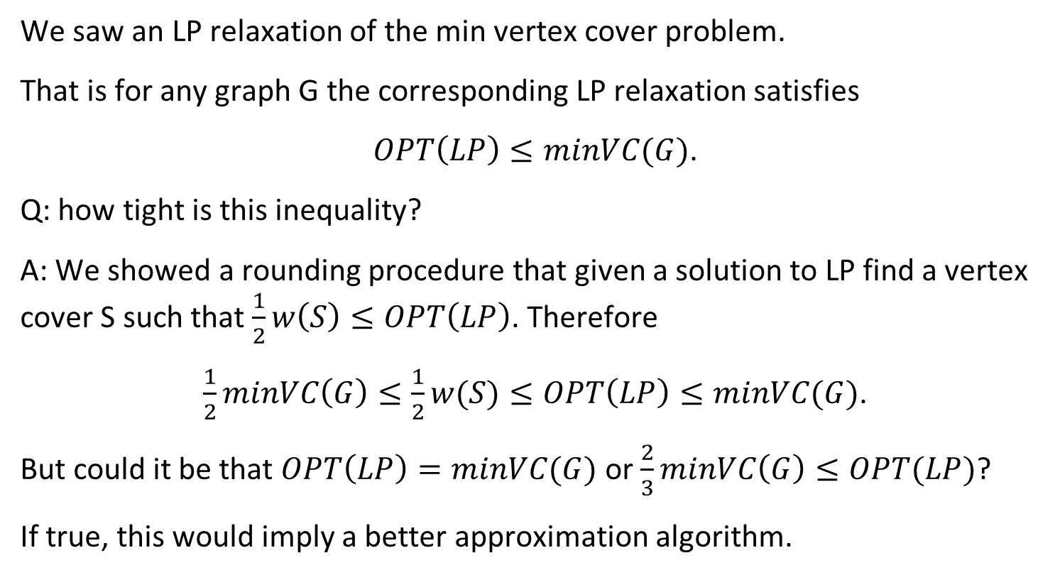
Integrality Gaps
We saw an LP relaxation of the min vertex cover problem.
That is for any graph G the corresponding LP relaxation satisfies
$OPT\left(LP\right)≤minVC(G)$.
Q: how tight is this inequality?
A: We showed a rounding procedure that given a solution to LP find a vertex cover S such that $\frac{1}{2}w\left(S\right)≤OPT\left(LP\right)$. Therefore
$\frac{1}{2}minVC\left(G\right)≤\frac{1}{2}w(S)≤OPT\left(LP\right)≤minVC(G)$.
But could it be that $OPT\left(LP\right)=minVC(G)$ or $\frac{2}{3}minVC\left(G\right)≤OPT(LP)$?
If true, this would imply a better approximation algorithm.

Slide 20
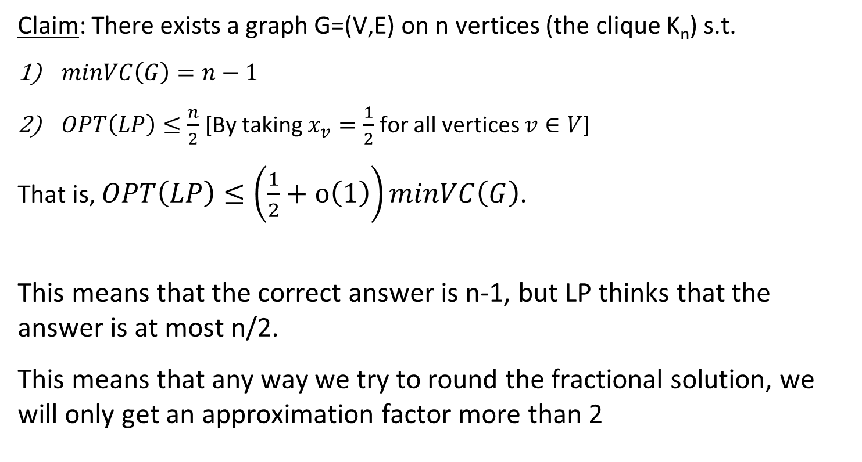
Integrality Gaps
Claim: There exists a graph G=(V,E) on n vertices (the clique K_{n}) s.t.
$minVC\left(G\right)=n−1$
$OPT\left(LP\right)≤\frac{n}{2}$ [By taking $x_{v}=\frac{1}{2}$ for all vertices $v∈V$]
That is, $OPT\left(LP\right)≤\left(\frac{1}{2}+o\left(1\right)\right)minVC\left(G\right)$.
This means that the correct answer is n-1, but LP thinks that the answer is at most n/2.
This means that any way we try to round the fractional solution, we will only get an approximation factor more than 2

Slide 21
O(ln(n))-approximation for weighted set-cover

Slide 22
O(ln(n)) approximation for weighted Set Cover
Input: A universe U = {a₁…a_{n}}, and S₁…S_{m} - m subsets of U with costs w_{i}>0
Output: Find a cheapest collection of sets that cover all elements {a₁…a_{n}}

Slide 23
O(ln(n)) approximation for weighted Set Cover
We saw a ln(n)-approximation for the min Set Cover problem.
Next, we will see an O(ln(n))-approximation for the weighted min Set Cover.
In your homework you will improve it to 1.001 ln(n) approximation

Slide 24
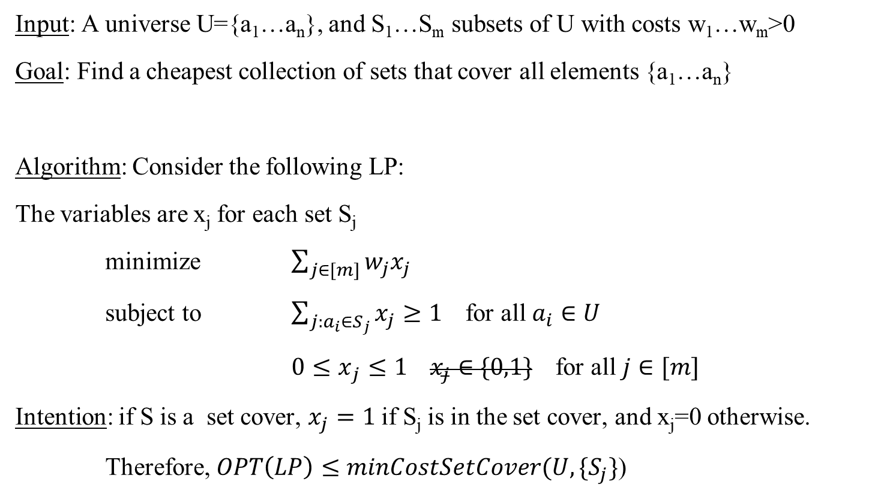
O(ln(n)) approximation for weighted Set Cover
Input: A universe U={a₁…a_{n}}, and S₁…S_{m} subsets of U with costs w₁…w_{m}>0
Goal: Find a cheapest collection of sets that cover all elements {a₁…a_{n}}
Algorithm: Consider the following LP:
The variables are x_{j} for each set S_{j}
minimize $\sum_{j∈[m]}{w_{j}x_{j}}$
subject to $\sum_{j:a_{i}∈S_{j}}{x_{j}}≥1$ for all $a_{i}∈U$
${0≤x}_{j}≤1 x_{j}∈\{0,1\}$ for all $j∈[m]$
Intention: if S is a set cover, $x_{j}=1$if S_{j} is in the set cover, and x_{j}=0 otherwise.
Therefore, $OPT\left(LP\right)≤minCostSetCover(U,\{S_{j}\}$)

Slide 25
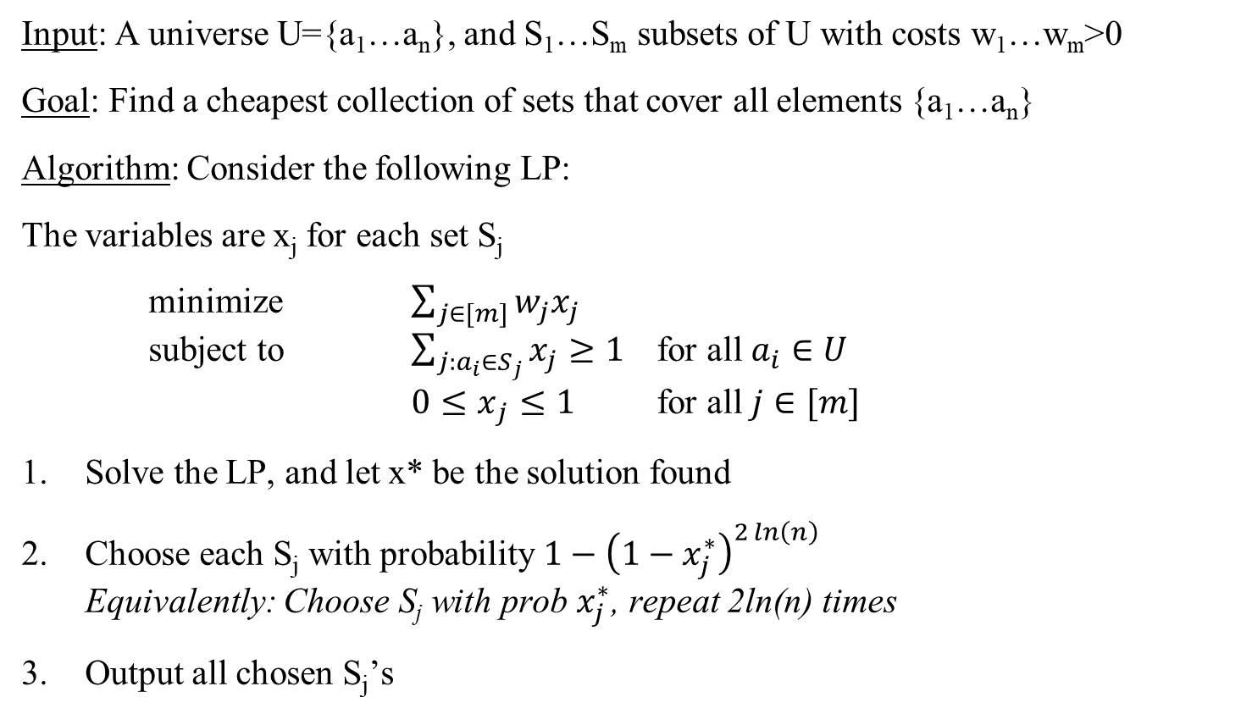
O(ln(n)) approximation for weighted Set Cover
Input: A universe U={a₁…a_{n}}, and S₁…S_{m} subsets of U with costs w₁…w_{m}>0
Goal: Find a cheapest collection of sets that cover all elements {a₁…a_{n}}
Algorithm: Consider the following LP:
The variables are x_{j} for each set S_{j}
minimize $\sum_{j∈[m]}{w_{j}x_{j}}$
subject to $\sum_{j:a_{i}∈S_{j}}{x_{j}}≥1$ for all $a_{i}∈U$
${0≤x}_{j}≤1$ for all $j∈[m]$
Solve the LP, and let x* be the solution found
Choose each S_{j} with probability $1−{\left(1−x_{j}^{∗}\right)}^{2\ln\left(n\right)}$
Equivalently: Choose S_{j} with prob $x_{j}^{∗}$, repeat 2ln(n) times
Output all chosen S_{j}’s

Slide 26
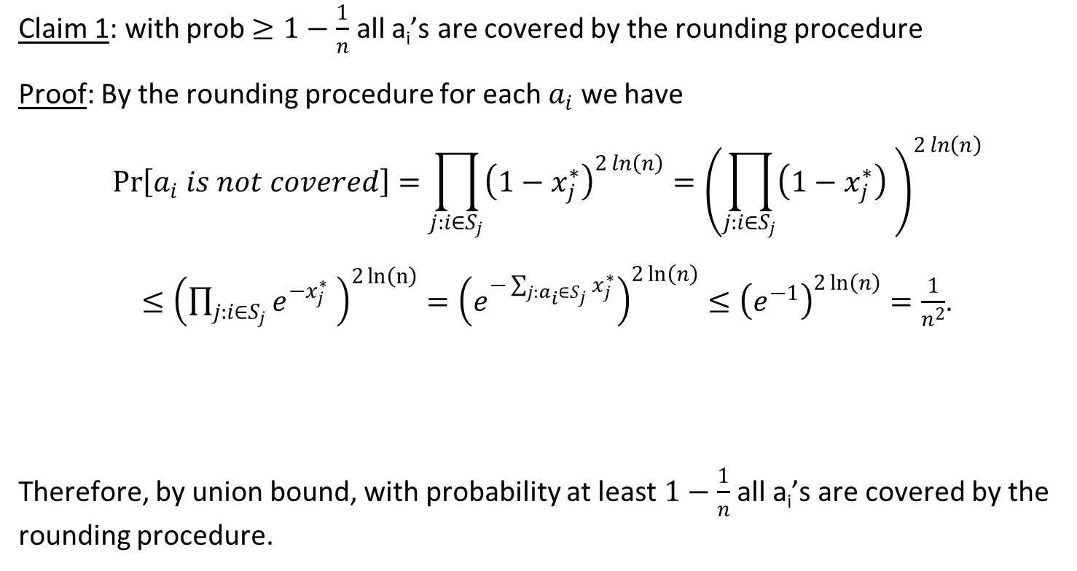

O(ln(n)) approximation for weighted Set Cover
Claim 1: with prob $≥1−\frac{1}{n}$ all a_{i}’s are covered by the rounding procedure
Proof: By the rounding procedure for each $a_{i}$we have
$$\operatorname{Pr}\left[a_{i} is not covered\right]=\prod_{j:i∈S_{j}}{{\left(1−x_{j}^{∗}\right)}^{2\ln\left(n\right)}}={\left(\prod_{j:i∈S_{j}}{\left(1−x_{j}^{∗}\right)} \right)}^{2\ln\left(n\right)}$$
$≤{\left(\prod_{j:i∈S_{j}}{e^{{−x}_{j}^{∗}}} \right)}^{2\ln\left(n\right)}={\left(e^{−\sum_{j:a_{i}∈S_{j}}{x_{j}^{∗}}}\right)}^{2\ln\left(n\right)}≤{\left(e^{−1}\right)}^{2\ln\left(n\right)}=\frac{1}{n^{2}}$.
Therefore, by union bound, with probability at least $1−\frac{1}{n}$ all a_{i}’s are covered by the rounding procedure.
$$\sum_{j:i∈S_{j}}{x_{j}}≥1$$

Slide 27
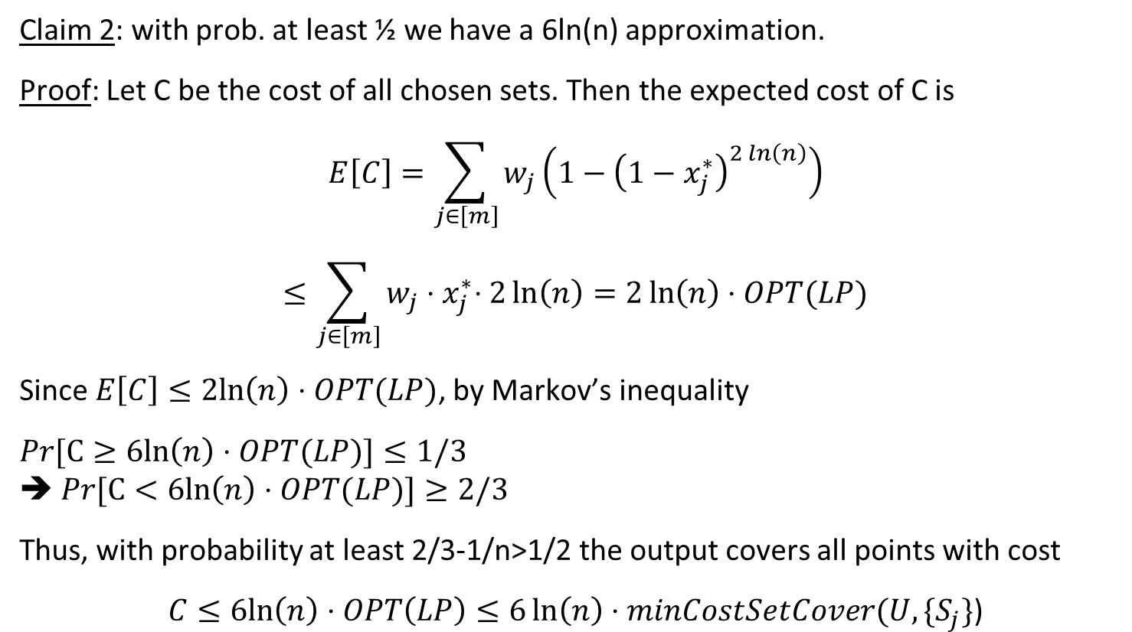
O(ln(n)) approximation for weighted Set Cover
Claim 2: with prob. at least ½ we have a 6ln(n) approximation.
Proof: Let C be the cost of all chosen sets. Then the expected cost of C is
$$E\left[C\right]=\sum_{j∈\left[m\right]}{w_{j}}\left(1−{\left(1−x_{j}^{∗}\right)}^{2\ln\left(n\right)}\right)$$
$$≤\sum_{j∈\left[m\right]}{w_{j}{⋅x}_{j}^{∗}⋅2\ln\left(n\right)}=2\ln\left(n\right)⋅OPT(LP)$$
Since $E\left[C\right]≤2ln\left(n\right)⋅OPT(LP)$, by Markov’s inequality
$Pr[C≥6ln\left(n\right)⋅OPT(LP)]≤1/3$
➔ $Pr[C<6ln\left(n\right)⋅OPT(LP)]≥2/3$
Thus, with probability at least 2/3-1/n>1/2 the output covers all points with cost
$$C≤6ln\left(n\right)⋅OPT\left(LP\right)≤6\ln\left(n\right)⋅minCostSetCover(U,\{S_{j}\}\text{)}$$
Bernoulli inequality:
(1-x)^{k} ≥ 1-kx
--example: (1-x)² ≥ 1-2x

Slide 28
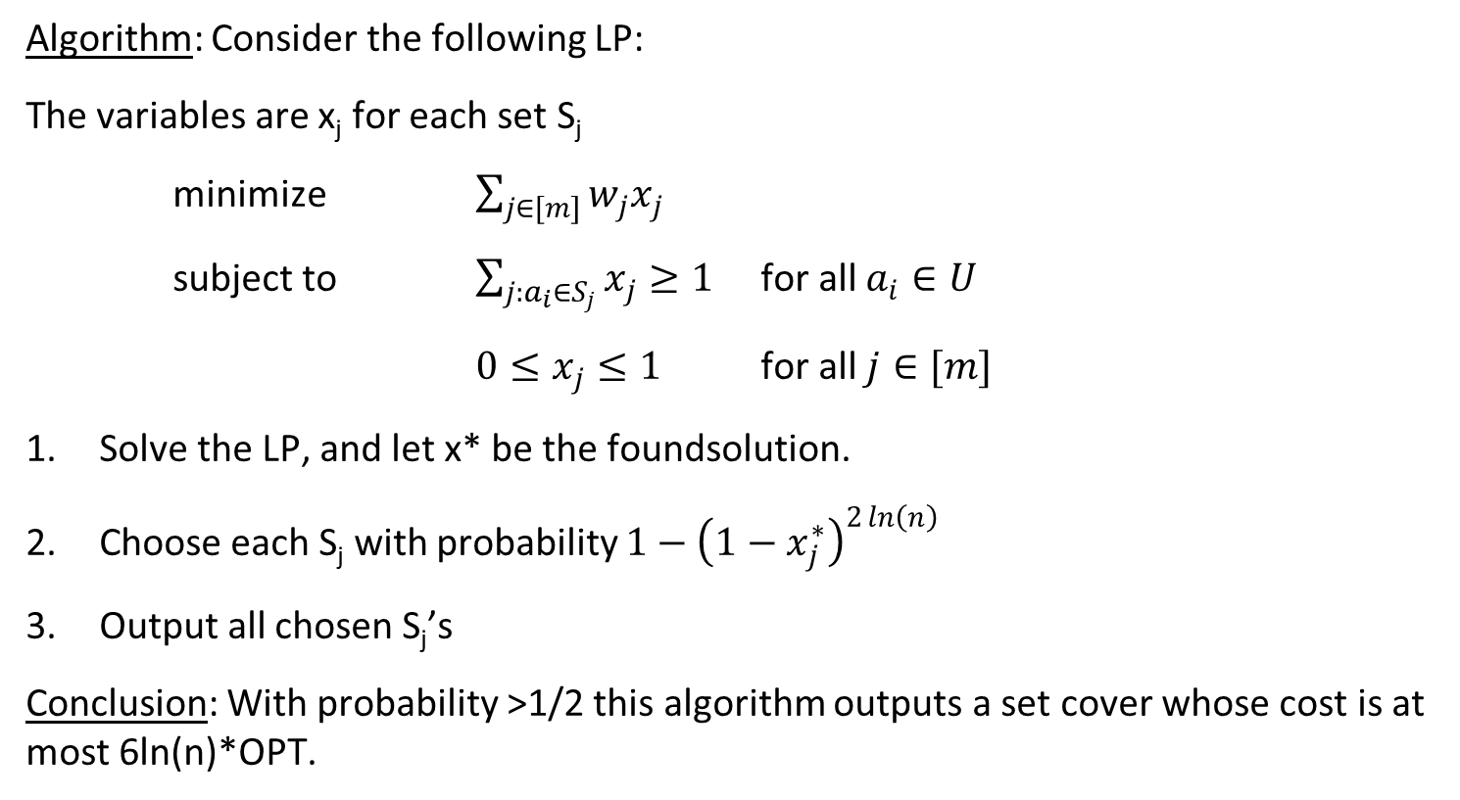
O(ln(n)) approximation for weighted Set Cover
Algorithm: Consider the following LP:
The variables are x_{j} for each set S_{j}
minimize $\sum_{j∈[m]}{w_{j}x_{j}}$
subject to $\sum_{j:a_{i}∈S_{j}}{x_{j}}≥1$ for all $a_{i}∈U$
${0≤x}_{j}≤1$ for all $j∈[m]$
Solve the LP, and let x* be the foundsolution.
Choose each S_{j} with probability $1−{\left(1−x_{j}^{∗}\right)}^{2\ln\left(n\right)}$
Output all chosen S_{j}’s
Conclusion: With probability >1/2 this algorithm outputs a set cover whose cost is at most 6ln(n)*OPT.

Slide 29
Questions?
Comments?

