Slide 1

CMPT 405/705
Design & Analysis of Algorithms
April 6, 2022

Slide 2
Plan for today
Semidefinite Programming:
0.878-approximation for Max-Cut

Slide 3
Semi-definite
Programming
*This topic is hard, and I don’t understand it, so don’t ask me questions
**That was a joke

Slide 4
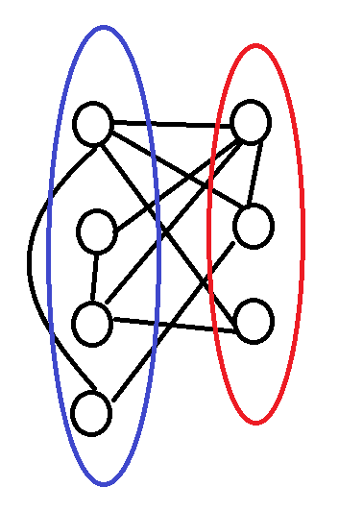
Semidefinite programming
Consider the max-cut problem:
Input: A graph G = (V,E)
Output: A cut (S,V\S) in G that maximizes the number of edges E[S,V\S].

Slide 5
Semidefinite programming
Consider the max-cut problem:
Input: A graph G = (V,E)
Output: A cut (S,V\S) in G that maximizes the number of edges E[S,V\S].
Let’s try to write an LP.
x_{v}∈{0,1} for all v ∈ V
y_{uv}∈{0,1} for all (u,v) ∈ E
Maximize Σ_{e ∈ E} y_{e}
Subject to 0 ≤ x_{v} ≤ 1 for all v ∈ V
0 ≤ y_{e} ≤ 1 for all e ∈ E
y_{u,v} = |x_{u}-x_{v}| for all (u,v) ∈ E
We can’t implement the constraints y_{u,v} = |x_{u}-x_{v}|

Slide 6
Semidefinite programming
Input: A graph G = (V,E)
Output: A cut (S,V\S) in G that maximizes the number of edges E[S,V\S].
Let’s try to write not-an-LP.
Intention:
x_{v}∈{-1,1} for all v ∈ V
y_{uv} = x_{v}x_{u} for all u,v ∈ V
LP:
Maximize Σ_{(u,v) ∈ E} ½(1-y_{u,v}) // =1 if y_{u,v=}-1
// =0 if y_{u,v}=-1
Subject to y_{u,v} = y_{v,u} for all (u,v) ∈ E
y_{v,v} = 1 for all v ∈ V
If x_{u}=x_{v} then y_{uv}=1
Otherwise, y_{uv}=-1
This really captures max-cut.
But x_{u}‘s are not really part of the LP

Slide 7
Semidefinite programming
Input: A graph G = (V,E)
Output: A cut (S,V\S) in G that maximizes the number of edges E[S,V\S].
LP: variables {y_{u,v} : u,v ∈ V}
Maximize Σ_{(u,v) ∈ E} ½(1-y_{u,v})
Subject to y_{u,v} = y_{v,u} for all (u,v) ∈ E
y_{v,v} = 1 for all v ∈ V
The LP can return a solution y_{u,v} = -1000000 for all (u,v) ∈ E, and y_{v,v} = 1 for v∈V
That gives a huge LP value, but this is not very informative
x_{v}∈{-1,1} for all v ∈ V
y_{uv} = x_{v}x_{u} for all (u,v) ∈ E

Slide 8
Semidefinite programming
Input: A graph G = (V,E)
Output: A cut (S,V\S) in G that maximizes the number of edges E[S,V\S].
LP: variables {y_{u,v} : u,v ∈ V}
Maximize Σ_{(u,v) ∈ E} ½(1-y_{u,v})
Subject to y_{u,v} = y_{v,u} for all (u,v) ∈ E
y_{v,v} = 1 for all v ∈ V
How can we avoid the solution y_{u,v} = -1000000 for all (u,v) ∈ E, and y_{v,v} = 1 for v∈V
To avoid this we can add a constraint
Σ_{u,v} y_{uv}≥0
Why? Because Σ_{u,v} y_{uv} = Σ_{u,v} x_{u}x_{v} = (Σ_{u∈V} x_{u}) (Σ_{v∈V} x_{v})= (Σ_{v∈V} x_{v})² ≥0
x_{v}∈{-1,1} for all v ∈ V
y_{uv} = x_{v}x_{u} for all (u,v) ∈ E

Slide 9
Semidefinite programming
x_{v}∈{-1,1} for all v ∈ V
y_{uv} = x_{v}x_{u} for all (u,v) ∈ E
LP: variables {y_{u,v} : u,v ∈ V}
Maximize Σ_{(u,v) ∈ E} ½(1-y_{u,v})
Subject to y_{u,v} = y_{v,u} for all (u,v) ∈ E
y_{v,v} = 1 for all v ∈ V
Σ_{u,v∈VxV} y_{uv}≥0
Can we add more constraints?
For example, we avoid the solution with y_{1,2}=y_{1,2}=-1,000,000, and y_{u,v}=1 otherwise?
We can add the constraint
(y_{1,1} + y_{1,2} + y_{2,1} + y_{2,2}) ≥0
Why? Because y_{1,1} + y_{1,2} + y_{2,1} + y_{2,2} = (x₁x₁ + x₁x₂ + x₂x₁ + x₂x₂)= (x₁+x₂)² ≥0
This implies that y₁₂ ≥ -1
Because y₁₁=y₂₂=1
and y₁₂= y₂₁

Slide 10
Semidefinite programming
x_{v}∈{-1,1} for all v ∈ V
y_{uv} = x_{v}x_{u} for all (u,v) ∈ E
LP: variables {-1 ≤ y_{u,v} ≤ 1: u,v ∈ V}
Maximize Σ_{(u,v) ∈ E} ½(1-y_{u,v})
Subject to y_{u,v} = y_{v,u} for all (u,v) ∈ E
y_{v,v} = 1 for all v ∈ V
Σ_{u,v∈VxV} y_{uv}≥0
y_{i,i} – y_{i,j} – y_{j,i} + y_{j,j} ≥0
And we can add more constraints of the form (c₁x₁+c₂x₂+…c_{n}x_{n})²≥0
This corresponds to Σ_{i,j∈VxV} c_{i}c_{j}y_{i,j}=(c₁x₁+c₂x₂+…c_{n}x_{n})²≥0
In fact, we can add all such constraints for all {c_{i} : i∈V} ∈R^{|V|}

Slide 11
Semidefinite programming
x_{v}∈{-1,1} for all v ∈ V
y_{uv} = x_{v}x_{u} for all (u,v) ∈ E
LP: variables {-1 ≤ y_{u,v} ≤ 1: u,v ∈ V}
Maximize Σ_{(u,v) ∈ E} ½(1-y_{u,v})
Subject to y_{u,v} = y_{v,u} for all (u,v) ∈ E
y_{v,v} = 1 for all v ∈ V
Σ_{u,v∈VxV} c_{u}c_{v}y_{uv}≥0 (*)
(*) is equivalent to {yu,v} being a matrix Y∈R^{VxV}, such that
c^{T}Yc ≥0 for all c∈R^{V}
Fact: this (infinite) LP can be solved in poly(n) time

Slide 12
Semidefinite programming
x_{v}∈{-1,1} for all v ∈ V
y_{uv} = x_{v}x_{u} for all (u,v) ∈ E
LP: variables {-1 ≤ y_{u,v} ≤ 1: u,v ∈ V}
Maximize Σ_{(u,v) ∈ E} ½(1-y_{u,v})
Subject to y_{u,v} = y_{v,u} for all (u,v) ∈ E
y_{v,v} = 1 for all v ∈ V
Σ_{u,v∈VxV} c_{u}c_{v}y_{uv}≥0 (*)
(*) is equivalent to {yu,v} being a matrix Y∈R^{VxV}, such that
c^{T}Yc ≥0 for all c∈R^{V}
y₁₁ | y₁₂ | y₁₃ | y₁₄
y₂₁ | y₂₂ | y₂₃ | y₂₄
y₃₁ | y₃₂ | y₃₃ | y₃₄
y₄₁ | y₄₂ | y₄₃ | y₄₄
c₁
c₂
c₃
c₄
c₁ | c₂ | c₃ | c₄

Slide 13
Semidefinite programming
Definition: A symmetric matrix Y∈R^{nxn} is called positive semi-definite (Y≽0) if
c^{T}Yc ≥0 for all c∈R^{n}.
Facts: Fix a symmetric matrix Y∈R^{nxn}. The following are equivalent
Y is positive semi-definite, i.e., c^{T}Yc ≥0 for all c∈R^{n}.
All eigenvalues of Y are non-negative
There is a matrix U ∈ R^{nxn} such that Y=U^{T}U.
There are x₁…x_{n} ∈ R^{n} such that Y_{i,j} = <x_{i},x_{j}> (inner product of the vectors)
Theorem: Any LP over n² variables arranged in a matrix
with the (infinitely many) SDP constraints can be solved efficiently.
Furthermore, we can efficiently find x_{i}∈R^{n} as in 4) satisfying the constraints.

Slide 14
Semidefinite programming
Theorem: An LP over n² variables arranged in a nxn matrix
with the (infinitely many) SDP constraints can be solved efficiently.
Furthermore, we can efficiently find x_{i}∈R^{n} such that {y_{i,j} = <x_{i},x_{j}>} satisfy the LP.
Fine print: SDPs can be solved up to additive error of ε in time poly(n*log(1/ε))

Slide 15
0.878-approximation for Max-Cut
Our goal for today:
Theorem[Goemans-Williamson ‘94]: Max-Cut admits a 0.878 approximation algorithm.
In HW4 you saw a 0.5-approximation by taking a random cut.

Slide 16
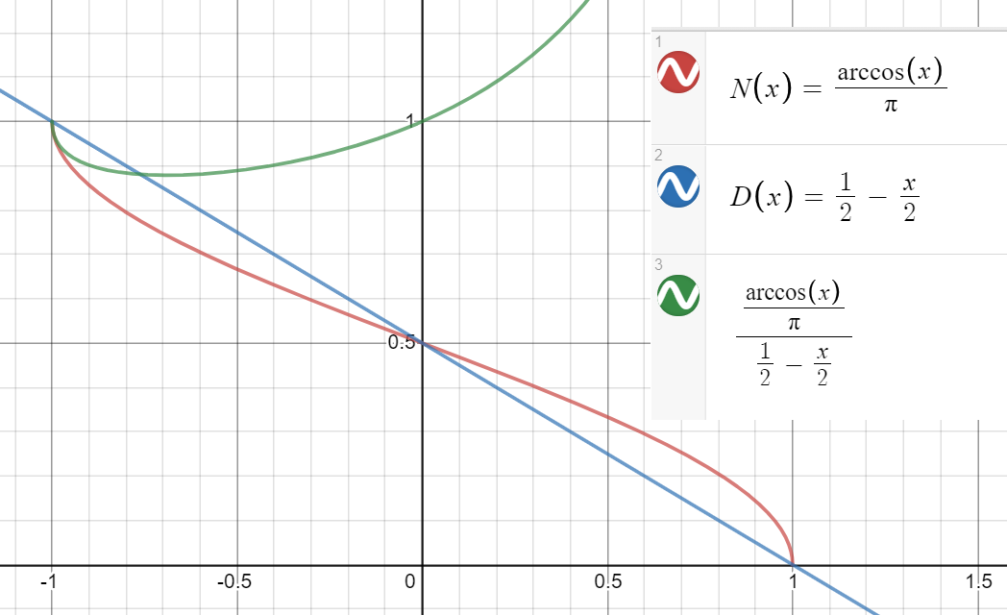
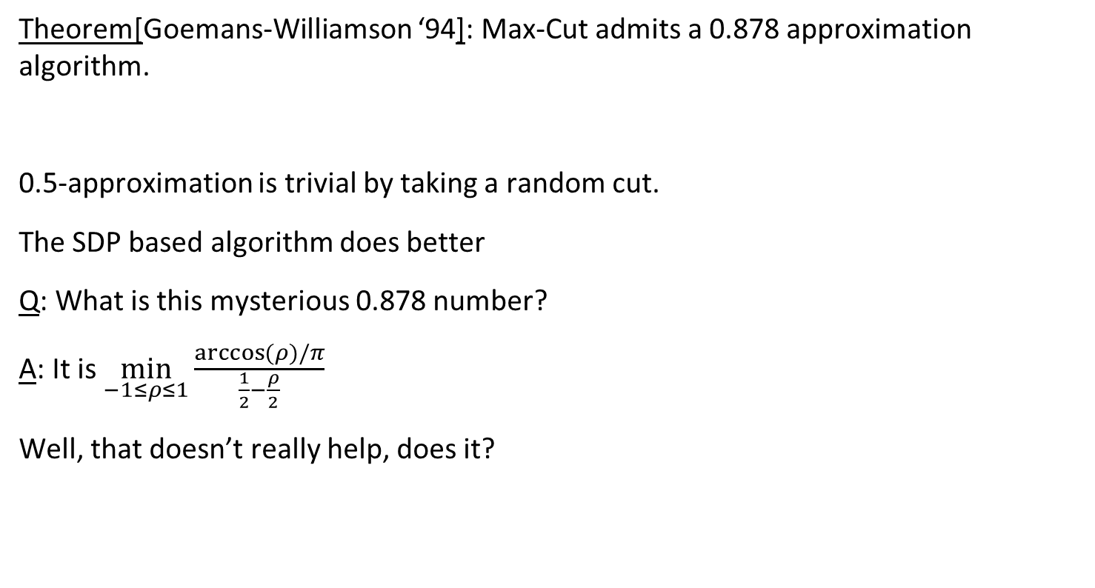
0.878-approximation for Max-Cut
Theorem[Goemans-Williamson ‘94]: Max-Cut admits a 0.878 approximation algorithm.
0.5-approximation is trivial by taking a random cut.
The SDP based algorithm does better
Q: What is this mysterious 0.878 number?
A: It is $\min_{−1≤ρ≤1}{\frac{\arccos{(ρ)/π}}{\frac{1}{2}−\frac{ρ}{2}}}$
Well, that doesn’t really help, does it?

Slide 17
0.878-approximation for Max-Cut
Input: A graph G = (V,E)
Output: A cut (S,V\S) in G that maximizes the number of edges E[S,V\S].
Let’s try to write an SDP. Variables: x_{v} ∈ R^{n} for all v ∈ V
Maximize Σ_{(u,v) ∈ E} ½(1 - <x_{u},x_{v}>)
Subject to ||x_{v}||=1 for all v ∈ V
We get an SDP solution.
Observation: SDP-value ≥max-cut(G)
Proof: For any integral solution S, V\S
define the SDP solution by setting x_{v}=e₁ for all v∈S, and.
x_{v}=-e₁ for all v∈V\S, and.

Slide 18
0.878-approximation for Max-Cut
Input: A graph G = (V,E)
Output: A cut (S,V\S) in G that maximizes the number of edges E[S,V\S].
Let’s try to write an SDP. Variables: x_{v} ∈ R^{n} for all v ∈ V
Maximize Σ_{(u,v) ∈ E} ½(1 - <x_{u},x_{v}>)
Subject to ||x_{v}||=1 for all v ∈ V
We get an SDP solution.
The intention is
Then, we can set S to be the orange vertices, and V\S the blue vertices.

Slide 19
0.878-approximation for Max-Cut
Input: A graph G = (V,E)
Output: A cut (S,V\S) in G that maximizes the number of edges E[S,V\S].
Let’s try to write an SDP. Variables: x_{v} ∈ R^{n} for all v ∈ V
Maximize Σ_{(u,v) ∈ E} ½(1 - <x_{u},x_{v}>)
Subject to ||x_{v}||=1 for all v ∈ V
We get an SDP solution.
How should we round this SDP solution?

Slide 20
0.878-approximation for Max-Cut
Maximize Σ_{(u,v) ∈ E} ½(1-<x_{u},x_{v}>)
Subject to ||x_{v}||=1 for all v∈V
We get an SDP solution.
Rounding procedure:
Choose a random hyperplane
Partition the vertices by letting
S = {v∈V : x_{v} is above the hyperplane}
V\S = {v∈V : x_{v} is below the hyperplane}

Slide 21
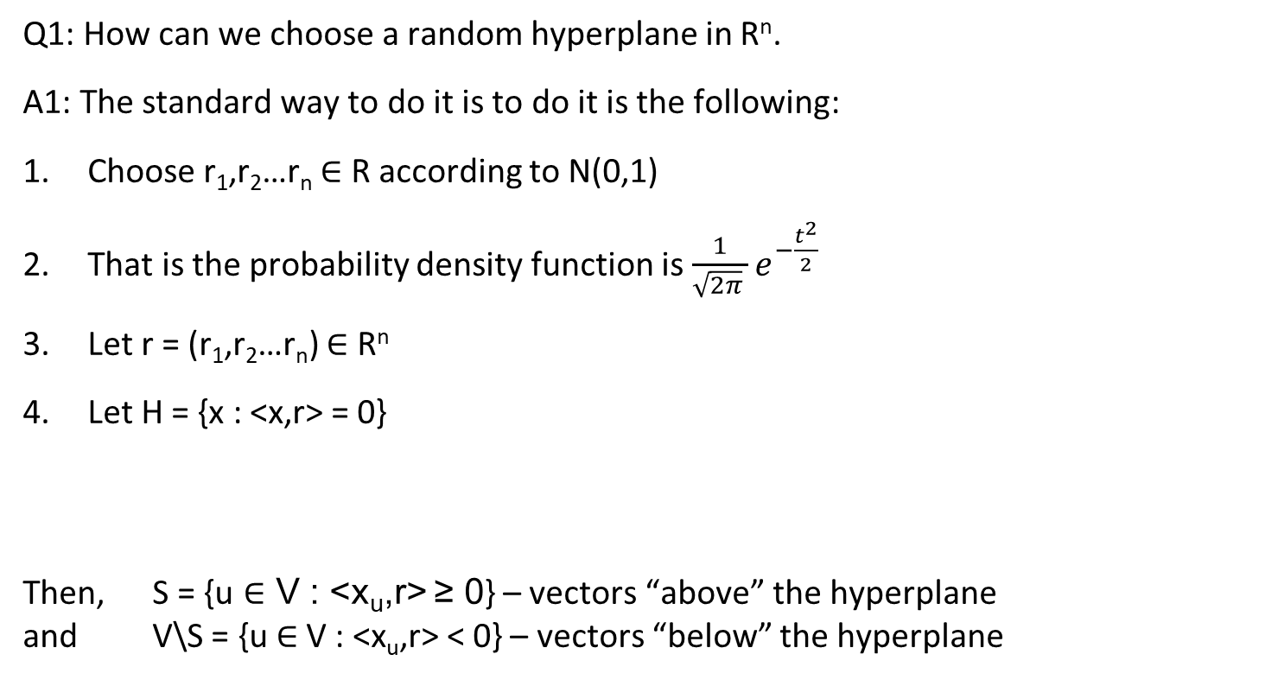
0.878-approximation for Max-Cut
Q1: How can we choose a random hyperplane in R^{n}.
A1: The standard way to do it is to do it is the following:
Choose r₁,r₂…r_{n} ∈ R according to N(0,1)
That is the probability density function is $\frac{1}{\sqrt{2π} }e^{−\frac{t^{2}}{2}}$
Let r = (r₁,r₂…r_{n}) ∈ R^{n}
Let H = {x : <x,r> = 0}
Then, S = {u ∈ V : <x_{u},r> ≥ 0} – vectors “above” the hyperplane
and V\S = {u ∈ V : <x_{u},r> < 0} – vectors “below” the hyperplane
Fact: The distribution of r is spherically symmetric.

Slide 22
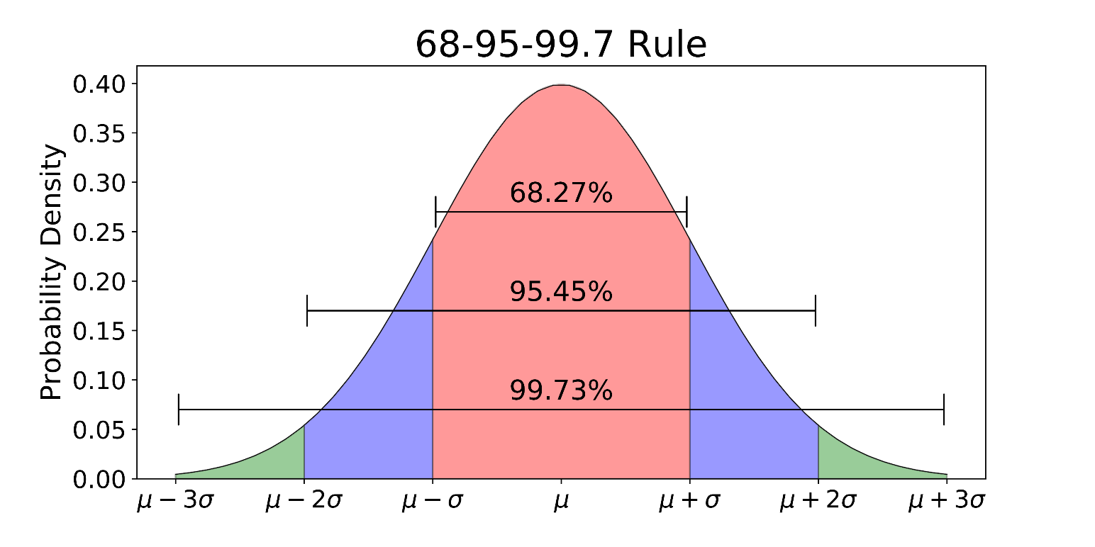

0.878-approximation for Max-Cut
Q: How can we sample r₁,r₂…r_{n} ∈ R according to N(0,1)?
That is the probability density function is $\frac{1}{\sqrt{2π} }e^{−\frac{t^{2}}{2}}$
Choose a uniform s∈[0,1], and output r_{i} such that Pr[N(0,1) ≤ r] = s.

Slide 23
0.878-approximation for Max-Cut
Maximize Σ_{(u,v) ∈ E} ½(1-<x_{u},x_{v}>)
Subject to ||x_{v}||=1 for all v∈V
Solve the SDP
Round the SDP solution using a random hyperplane
Let us compute the expected value of the cut
E[value of the cut] = Σ_{(u,v)∈E}E[1_{(u,v) is in the cut}]= Σ_{(u,v)∈E}Pr[(u,v) is in the cut]
We want to compare it to the SDP value, which is
Σ_{(u,v)∈E}½(1 - <x_{u},x_{v}>)
We want to show that E[value of the cut] ≥ 0.878*(Σ_{(u,v)∈E}½(1 - <x_{u},x_{v}>))

Slide 24
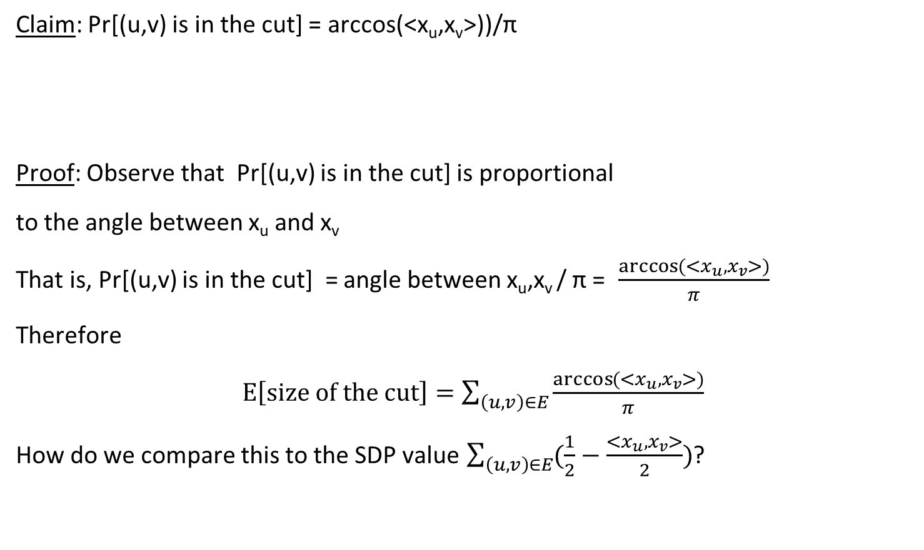
0.878-approximation for Max-Cut
Claim: Pr[(u,v) is in the cut] = arccos(<x_{u},x_{v}>))/π
Proof: Observe that Pr[(u,v) is in the cut] is proportional
to the angle between x_{u} and x_{v}
That is, Pr[(u,v) is in the cut] = angle between x_{u},x_{v} / π = $\frac{\arccos{(<x_{u},x_{v}>)}}{π}$
Therefore
$E\left[size of the cut\right]=\sum_{\left(u,v\right)∈E}{\frac{\arccos{(<x_{u},x_{v}>)}}{π}}$
How do we compare this to the SDP value $\sum_{\left(u,v\right)∈E}{(\frac{1}{2}−\frac{<x_{u}, x_{v}>}{2})}$?

Slide 25

0.878-approximation for Max-Cut
We have $E\left[size of the cut\right]=\sum_{\left(u,v\right)∈E}{\frac{\arccos{(<x_{u},x_{v}>)}}{π}}$
SDP value $\sum_{\left(u,v\right)∈E}{(\frac{1}{2}−\frac{<x_{u}, x_{v}>}{2})}$.
Let $α_{GW}:=\min_{−1≤ρ≤1}{\frac{\arccos{(ρ)/π}}{\frac{1}{2}−\frac{ρ}{2}}}=0.878$
Then $E\left[size of the cut\right]≥α_{GW}⋅SDPvalue$
Since $SDP−value≥max−cut(G)$,
we conclude that the algorithms is a
0.878-approximation for max-cut,
i.e., $\frac{E\left[size of the cut\right]}{max−cut(G)}≥α_{GW}$.

Slide 26
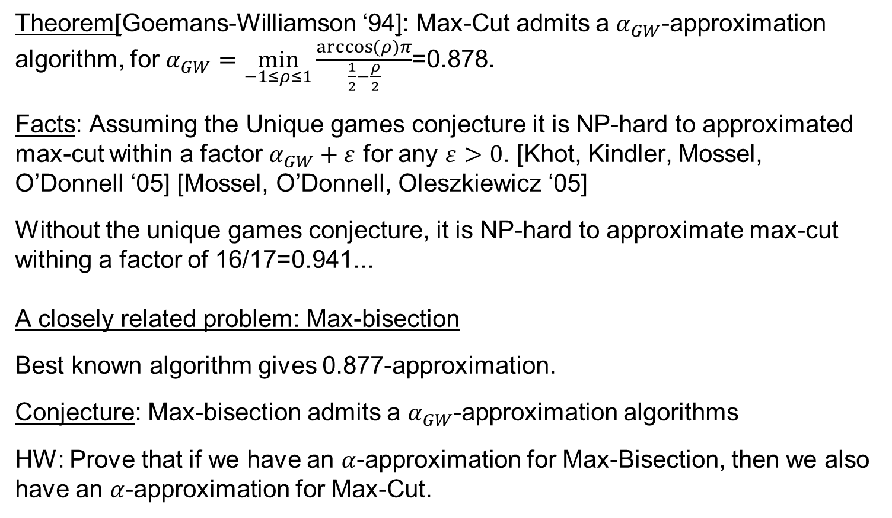
0.878-approximation for Max-Cut
Theorem[Goemans-Williamson ‘94]: Max-Cut admits a $α_{GW}$-approximation algorithm, for $α_{GW}=\min_{−1≤ρ≤1}{\frac{\arccos{(ρ)π}}{\frac{1}{2}−\frac{ρ}{2}}}$=0.878.
Facts: Assuming the Unique games conjecture it is NP-hard to approximated max-cut within a factor $α_{GW}+ε$ for any $ε>0$. [Khot, Kindler, Mossel, O’Donnell ‘05] [Mossel, O’Donnell, Oleszkiewicz ‘05]
Without the unique games conjecture, it is NP-hard to approximate max-cut withing a factor of 16/17=0.941...
A closely related problem: Max-bisection
Best known algorithm gives 0.877-approximation.
Conjecture: Max-bisection admits a $α_{GW}$-approximation algorithms
HW: Prove that if we have an $α$-approximation for Max-Bisection, then we also have an $α$-approximation for Max-Cut.

Slide 27
Questions?
Comments?

