Slide 1

CMPT 405/705
Design & Analysis of Algorithms
April 11, 2022

Slide 2
Final exam
Take-home exam: Apr 20, 6:30PM - Apr 21, 6:30PM
The questions will be posted on the course homepage on Apr 20
Submit the answers to coursys before Apr 21, 6:30PM
No late submissions
4 or 5 questions, some questions might have several items
Covers all the material we covered in the course
Good luck!

Slide 3
Plan for today
Semidefinite Programming:
0.878-approximation for Max-Cut – quick review
Approximation algorithms for graph coloring

Slide 4
Semi-definite
Programming

Slide 5
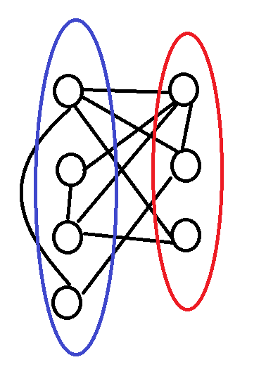
0.878-approximation for Max-Cut
Our goal for today:
Theorem[Goemans-Williamson ‘94]: Max-Cut admits a 0.878 approximation algorithm.
In HW4 you saw a 0.5-approximation by taking a random cut.

Slide 6
Semidefinite programming
SDP: an optimization problem with
variables x_{i}∈R^{n}
Constraints: Σ_{i,j} a_{i,j}<x_{i},x_{j}> ≥ b
Objective function: Σ_{i,j} c_{i,j}<x_{i}, x_{j}>
Theorem: SDP with n variables and n constraints can be solved in poly(n) time.
Furthermore, we can efficiently find x_{i}’s such that {y_{i,j} = <x_{i},x_{j}>} satisfy the LP.
Fine print: SDPs can be solved up to additive error of ε in time poly(n*log(1/ε))
For example:
Maximize <x₁,x₂> + 2<x₁,x₃> - 3<x₂,x₃>
Subject to ||x_{i}||=1
<x₂,x₃> ≥ -0.5

Slide 7
0.878-approximation for Max-Cut
Input: A graph G = (V,E)
Output: A cut (S,V\S) in G that maximizes the number of edges E[S,V\S].
Let’s try to write an SDP. Variables: x_{v} ∈ R^{n} for all v ∈ V
Maximize Σ_{(u,v) ∈ E} ½(1 - <x_{u},x_{v}>)
Subject to ||x_{v}||=1 for all v ∈ V
We get an SDP solution.
Observation: SDP-value ≥max-cut(G)
Proof: For any integral solution S, V\S
define the SDP solution by setting x_{v}=e₁ for all v∈S, and.
x_{v}=-e₁ for all v∈V\S, and.

Slide 8
0.878-approximation for Max-Cut
Input: A graph G = (V,E)
Output: A cut (S,V\S) in G that maximizes the number of edges E[S,V\S].
Let’s try to write an SDP. Variables: x_{v} ∈ R^{n} for all v ∈ V
Maximize Σ_{(u,v) ∈ E} ½(1 - <x_{u},x_{v}>)
Subject to ||x_{v}||=1 for all v ∈ V
We get an SDP solution.
The intention is
Then, we can set S to be the orange vertices, and V\S the blue vertices.

Slide 9
0.878-approximation for Max-Cut
Input: A graph G = (V,E)
Output: A cut (S,V\S) in G that maximizes the number of edges E[S,V\S].
Let’s try to write an SDP. Variables: x_{v} ∈ R^{n} for all v ∈ V
Maximize Σ_{(u,v) ∈ E} ½(1 - <x_{u},x_{v}>)
Subject to ||x_{v}||=1 for all v ∈ V
We get an SDP solution.
How should we round this SDP solution?

Slide 10
0.878-approximation for Max-Cut
Maximize Σ_{(u,v) ∈ E} ½(1-<x_{u},x_{v}>)
Subject to ||x_{v}||=1 for all v∈V
We get an SDP solution.
Rounding procedure:
Choose a random hyperplane
Partition the vertices by letting
S = {v∈V : x_{v} is above the hyperplane}
V\S = {v∈V : x_{v} is below the hyperplane}

Slide 11
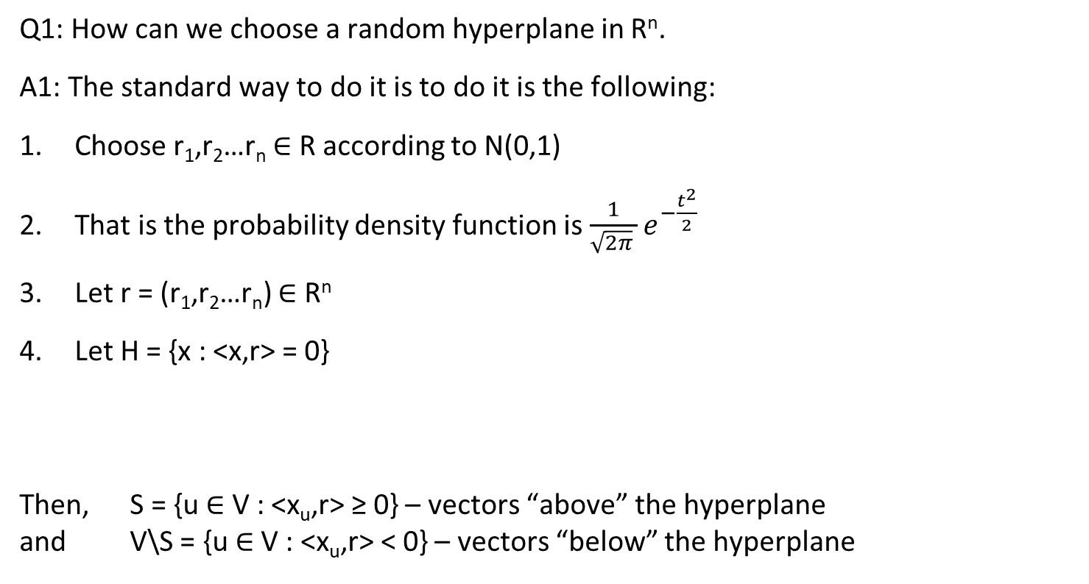
0.878-approximation for Max-Cut
Q1: How can we choose a random hyperplane in R^{n}.
A1: The standard way to do it is to do it is the following:
Choose r₁,r₂…r_{n} ∈ R according to N(0,1)
That is the probability density function is $\frac{1}{\sqrt{2π} }e^{−\frac{t^{2}}{2}}$
Let r = (r₁,r₂…r_{n}) ∈ R^{n}
Let H = {x : <x,r> = 0}
Then, S = {u ∈ V : <x_{u},r> ≥ 0} – vectors “above” the hyperplane
and V\S = {u ∈ V : <x_{u},r> < 0} – vectors “below” the hyperplane
Fact: The distribution of r is spherically symmetric.

Slide 12
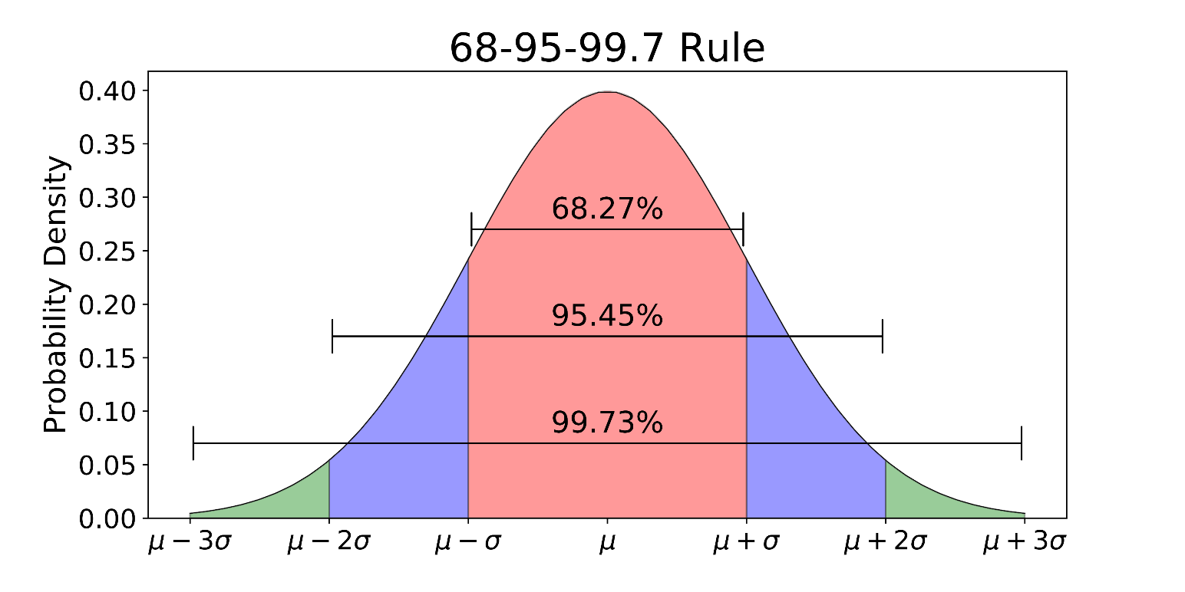

0.878-approximation for Max-Cut
Q: How can we sample r₁,r₂…r_{n} ∈ R according to N(0,1)?
That is the probability density function is $\frac{1}{\sqrt{2π} }e^{−\frac{t^{2}}{2}}$
Choose a uniform s∈[0,1], and output r_{i} such that Pr[N(0,1) ≤ r] = s.

Slide 13
0.878-approximation for Max-Cut
Maximize Σ_{(u,v) ∈ E} ½(1-<x_{u},x_{v}>)
Subject to ||x_{v}||=1 for all v∈V
Solve the SDP
Round the SDP solution using a random hyperplane
Let us compute the expected value of the cut
E[value of the cut] = Σ_{(u,v)∈E}E[1_{(u,v) is in the cut}]= Σ_{(u,v)∈E}Pr[(u,v) is in the cut]
We want to compare it to the SDP value, which is
Σ_{(u,v)∈E}½(1 - <x_{u},x_{v}>)
We want to show that E[value of the cut] ≥ 0.878*(Σ_{(u,v)∈E}½(1 - <x_{u},x_{v}>))

Slide 14
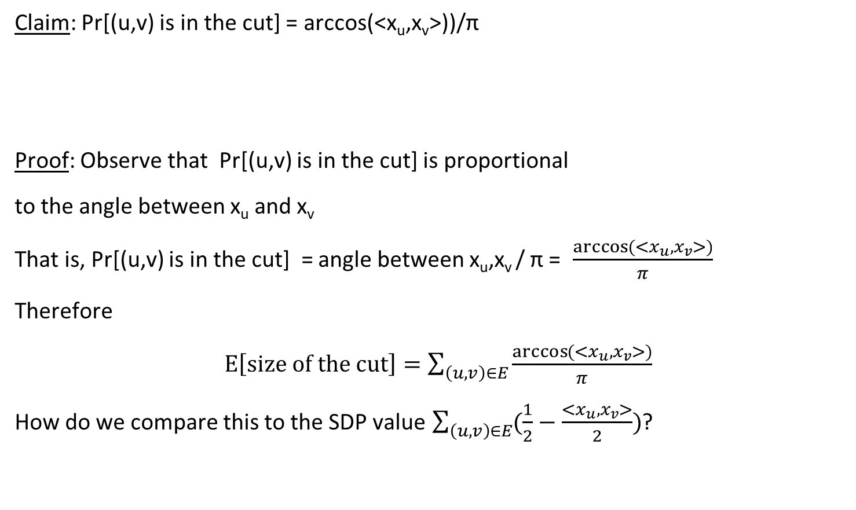
0.878-approximation for Max-Cut
Claim: Pr[(u,v) is in the cut] = arccos(<x_{u},x_{v}>))/π
Proof: Observe that Pr[(u,v) is in the cut] is proportional
to the angle between x_{u} and x_{v}
That is, Pr[(u,v) is in the cut] = angle between x_{u},x_{v} / π = $\frac{\arccos{(<x_{u},x_{v}>)}}{π}$
Therefore
$E\left[size of the cut\right]=\sum_{\left(u,v\right)∈E}{\frac{\arccos{(<x_{u},x_{v}>)}}{π}}$
How do we compare this to the SDP value $\sum_{\left(u,v\right)∈E}{(\frac{1}{2}−\frac{<x_{u}, x_{v}>}{2})}$?

Slide 15
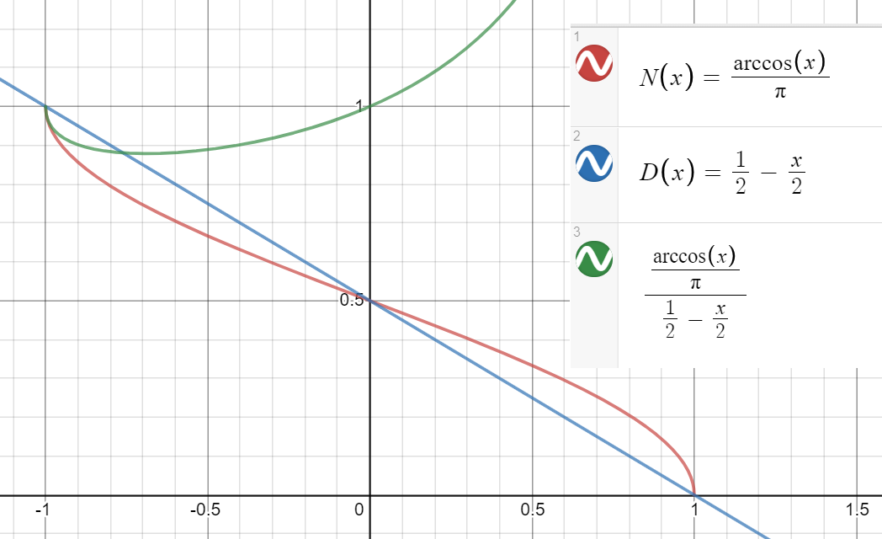

0.878-approximation for Max-Cut
We have $E\left[size of the cut\right]=\sum_{\left(u,v\right)∈E}{\frac{\arccos{(<x_{u},x_{v}>)}}{π}}$
SDP value $\sum_{\left(u,v\right)∈E}{(\frac{1}{2}−\frac{<x_{u}, x_{v}>}{2})}$.
Let $α_{GW}:=\min_{−1≤ρ≤1}{\frac{\arccos{(ρ)/π}}{\frac{1}{2}−\frac{ρ}{2}}}=0.878$
Then $E\left[size of the cut\right]≥α_{GW}⋅SDPvalue$
Since $SDPvalue≥MaxCut(G)$,
we conclude that the algorithms is a
0.878-approximation for max-cut,
i.e., $\frac{E\left[size of the cut\right]}{max−cut(G)}≥α_{GW}$.

Slide 16
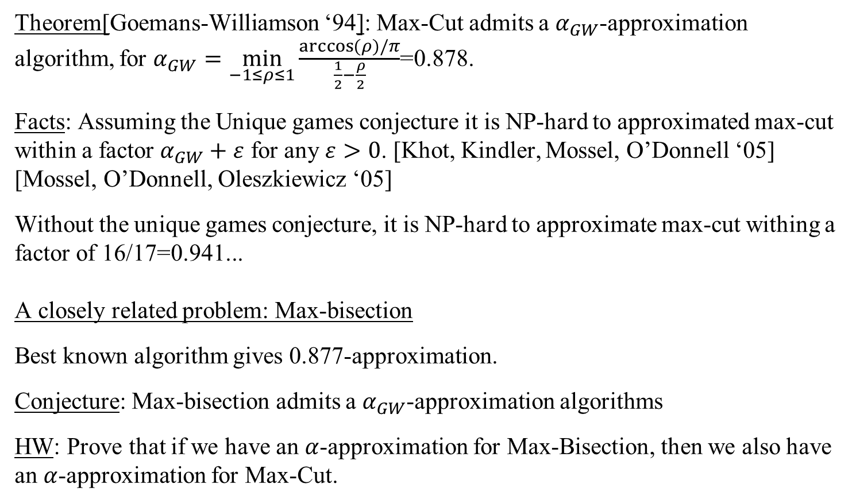
0.878-approximation for Max-Cut
Theorem[Goemans-Williamson ‘94]: Max-Cut admits a $α_{GW}$-approximation algorithm, for $α_{GW}=\min_{−1≤ρ≤1}{\frac{\arccos{(ρ)/π}}{\frac{1}{2}−\frac{ρ}{2}}}$=0.878.
Facts: Assuming the Unique games conjecture it is NP-hard to approximated max-cut within a factor $α_{GW}+ε$ for any $ε>0$. [Khot, Kindler, Mossel, O’Donnell ‘05] [Mossel, O’Donnell, Oleszkiewicz ‘05]
Without the unique games conjecture, it is NP-hard to approximate max-cut withing a factor of 16/17=0.941...
A closely related problem: Max-bisection
Best known algorithm gives 0.877-approximation.
Conjecture: Max-bisection admits a $α_{GW}$-approximation algorithms
HW: Prove that if we have an $α$-approximation for Max-Bisection, then we also have an $α$-approximation for Max-Cut.

Slide 17
Graph Coloring

Slide 18
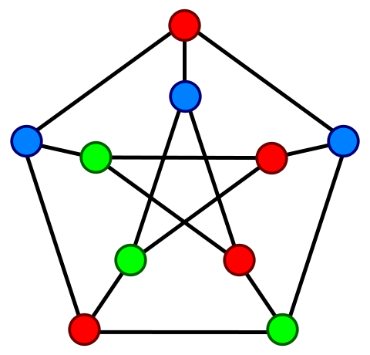
Coloring 3-colorable graphs
Input: A graph G = (V,E) that is 3-colorable
Output: Find a legal 3 coloring of G.
Facts:
The problem is NP-hard.
Even coloring with 4 colors is NP-hard
Best known algorithms uses ~n^{0.2} colors
It is conjectured (?) that finding a legal n^{0.001} coloring is NP-hard.
Today, we will two or three poly-time algorithms (depends on our pace)
They use n^{0.5} colors, n^{0.387} colors, n^{0.25} colors.

Slide 19
Coloring 3-colorable graphs
Input: A graph G = (V,E) that is 3-colorable
Output: Find a legal O(n^{0.5}) coloring of G.
The algorithm relies on the following observation:
* If G is 3-colorable,then N(v) is bipartite for every v∈V
Algorithm:
While G has a vertex v with deg(v) ≥ n^{0.5},
  a. Color N(v) with 2 colors remove it from G
  b. Never use these colors again.
Here all vertices have degree ≤d<n^{0.5}, color the graph using ≤ d+1 colors.
Claim 1: the while loop will have
≤ n^{0.5} iterations.
Therefore, will use ≤ 2n^{0.5} colors
The last step uses additional
≤ n^{0.5} colors

Slide 20
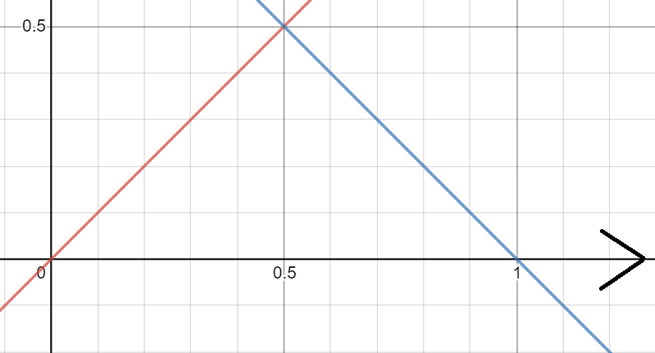
Coloring 3-colorable graphs
Intuitively, we have two algorithms.
If max-deg(G) is large, then we use the algorithm that colors N(v) – blue line
If max-deg(G) is small, then we use the greedy algorithm
with max-deg(G) colors – red line
The plot is the runtime as a function of c where c is such that max-deg(G)=n^{c}.

Slide 21
Coloring 3-colorable graphs
SDP based algorithms

Slide 22
Coloring 3-colorable graphs
Input: A graph G = (V,E) that is 3-colorable
Goal: Find a coloring of G with minimal possible number of colors.
Theorem1: There exists a polynomial time algorithm that given 3-colorable graph G finds a legal coloring of G using O(n^{0.387}) colors.
Theorem2: There exists a polynomial time algorithm that given 3-colorable graph G finds a legal coloring of G using O(n^{0.25}) colors.

Slide 23
An SDP for coloring 3-colorable graphs
Input: A graph G = (V,E) that is 3-colorable
Goal: Find a coloring of G with minimal possible number of colors.
Idea: Let’s try to write an SDP for 3-coloring.
Let’s have a vector x_{v}∈R^{n} for each vertex v∈V.
The intention is: all vectors are unit vectors: ||x_{v}||₂=1
Colors are arranged at 120º angle in R², as in the sketch below.

Slide 24
An SDP for coloring 3-colorable graphs
Input: A graph G = (V,E) that is 3-colorable
Goal: Find a coloring of G with minimal possible number of colors.
SDP: We have a vector x_{v}∈R^{n} for each vertex v∈V.
The constraints are
||x_{v}||₂=<x_{v},x_{v}>=1 for each vertex v∈V.
<x_{v},x_{u}> = -0.5 for each edge (u,v)∈E.
Q: Why can’t we just run the SDP algorithm and find a legal 3-coloring?
A: Because we cannot force the solution to be in R².
The SDP solver may give us a solution in R^{n} that is not embeddable in R².
Observation: If G is 3-colorable, then the SDP is feasible.

Slide 25
An SDP for coloring 3-colorable graphs
SDP: We have a vector x_{v}∈R^{n} for each vertex v∈V.
The constraints are
||x_{v}||₂=1 for each vertex v∈V.
<x_{v},x_{u}> = -0.5 for each vertex (u,v)∈E.
Definition: Any feasible solution to the SDP is called a vector-3-coloring of G.
A graph G is said to be vector 3-colorable if the SDP has a feasible solution.
Observation: If G is 3-colorable, then the SDP is feasible.

Slide 26
An SDP for coloring 3-colorable graphs
SDP: We have a vector x_{v}∈R^{n} for each vertex v∈V.
The constraints are
||x_{v}||₂=1 for each vertex v∈V.
<x_{v},x_{u}> = -0.5 for each vertex (u,v)∈E.
So we run the SDP solver and get a feasible solution.
Q: What do we do about it?
How can we find a legal coloring of G using the vector coloring?
Observation: If G is 3-colorable, then the SDP is feasible.

Slide 27
Idea 1: semi-coloring

Slide 28
Semi-Coloring 3-colorable graphs
Input: A graph G = (V,E) on n vertices that is 3-colorable
A relaxed goal: Find a k-semi-coloring of G. This is a coloring of the vertices with k colors such that at most n/4 edges are monochromatic.
Claim: Suppose there is an algorithm that
Gets a 3-colorable graph G
Returns a k-semi-coloring of G in polynomial time.
Then there is a polytime algorithm that finds a proper coloring with k*log(n) colors.

Slide 29
Semi-Coloring 3-colorable graphs
Claim: Suppose there is an algorithm that given a 3-colorable graph G finds a k-semi-coloring of G in polynomial time.
Then we can find in polytime a legal (proper) coloring of G using k*log(n) colors.
Algorithm: Given a graph G=(V,E) on n vertices,
Run the algorithm on G, and let C:V->[k] be the produced k-semi-coloring.
Let E_{mon} be the monochromatic edges
Let V₁ be all vertices touching E_{mon}. Then |V₁| ≤ 2|E_{mon}| ≤ |V|/2.
Let G₁= G[V₁] be the subgraph induced by V₁ with all edges between them.
Keep the colors of the vertices in V\V₁ and never use them again.
Repeat the algorithm on G₁.
…

Slide 30
Semi-Coloring 3-colorable graphs
Claim: Suppose we can find a k-semi-coloring of G in polynomial time.
Then we can find a legal (proper) coloring of G using k*log(n) colors.
Algorithm: Given a graph G=(V,E) on n vertices,
Set i=0, and define G₀ = (V₀,E₀) = (V,E)
While G_{i} is not empty
Run the algorithm on G_{i}, and let C:V_{i}->[k] be the produced k-semi-coloring.
Let E_{mon} be the monochromatic edges
Let V_{i+1} be all vertices touching E_{mon}. Then |V_{i+1}| ≤ 2|E_{mon}| ≤ |V_{i}|/2.
Let G_{i+1}= G[V_{i+1}] be the subgraph induced by V_{i+1} with all edges between them.
Keep the colors of the vertices in V_{i}\V_{i+1} and never use them again.
i =i+1
Key property: the while loop makes
at most log(n) iterations.
Therefore, the number of colors used is at most k*log(n)

Slide 31
Using a vector 3-coloring of G
to find a semi-coloring

Slide 32
Semi-Coloring 3-colorable graphs
SDP: We have a vector x_{v}∈R^{n} for each vertex v∈V.
The constraints are
||x_{v}||₂=1 for each vertex v∈V.
<x_{v},x_{u}> = -0.5 for each vertex (u,v)∈E.
Run the SDP solver, get a feasible solution.
How do we use it to find a semi-coloring of G?
Idea (inspired by the max-cut rounding):
Choose t independent uniform hyperplanes.
Color the vertices using 2^{t} colors according to the 2^{t} different regions defined by the hyperplanes.

Slide 33
Semi-Coloring 3-colorable graphs
SDP: We have a vector x_{v}∈R^{n} for each vertex v∈V.
The constraints are
||x_{v}||₂=1 for each vertex v∈V.
<x_{v},x_{u}> = -0.5 for each vertex (u,v)∈E.
Idea (inspired by the max-cut rounding):
Choose t independent uniform hyperplanes.
Color the vertices using 2^{t} colors according to the 2^{t} different regions defined by the hyperplanes.
Example with t=2 in the plane

Slide 34
Semi-Coloring 3-colorable graphs
SDP: ||x_{v}||₂=1 for each vertex v∈V.
<x_{v},x_{u}> = -0.5 for each vertex (u,v)∈E.
Choose t independent uniform hyperplanes.
Color the vertices using 2^{t} colors according
to the 2^{t} different regions defined by the hyperplanes.
Claim: Fix an edge (u,v)∈E. Then Pr[(u,v) is monochromatic]=1/3^{t}.
Proof: For each hyperplane, the probability that this hyperplane puts both u and v on the same side is 1/3 (the angle between them is 120º out of 180º).
Since the t hyperplanes are independent, we conclude that
Pr[(u,v) is monochromatic]=1/3^{t}.

Slide 35
Semi-Coloring 3-colorable graphs
SDP: ||x_{v}||₂=1 for each vertex v∈V.
<x_{v},x_{u}> = -0.5 for each vertex (u,v)∈E.
Choose t independent uniform hyperplanes.
Color the vertices using 2^{t} colors according
to the 2^{t} different regions defined by the hyperplanes.
Claim: Fix an edge (u,v)∈E. Then Pr[(u,v) is monochromatic]=1/3^{t}.
If ∆=max-deg(G), and we choose t = 1 + log₃(∆), then
Pr[(u,v) is monochromatic]=1/3^{t} < 1/(3∆).
Therefore, E[number of monochromatic edges] < |E|/(3∆) < n/6.

Slide 36
Semi-Coloring 3-colorable graphs
SDP: ||x_{v}||₂=1 for each vertex v∈V.
<x_{v},x_{u}> = -0.5 for each vertex (u,v)∈E.
Choose t independent uniform hyperplanes.
Color the vertices using 2^{t} colors according
to the 2^{t} different regions defined by the hyperplanes.
Conclusion so far: If ∆=max-deg(G), and t=1 + log₃(∆), then
1) we use 2^{t}= 2∆^{log3(2)} =O(∆^{0.631}) colors; and
2) E[number of monochromatic edges] < |E|/(3∆) < n/6.
Therefore, by Markov’s inequality
(3) Pr[number of monochromatic edges > n/4] < (n/6)/(n/4) = 2/3.
This is a k-semi coloring of G using k= O(∆^{0.631}) colors
So if ∆=max-deg(G) is small,
we use a small number of colors.

Slide 37
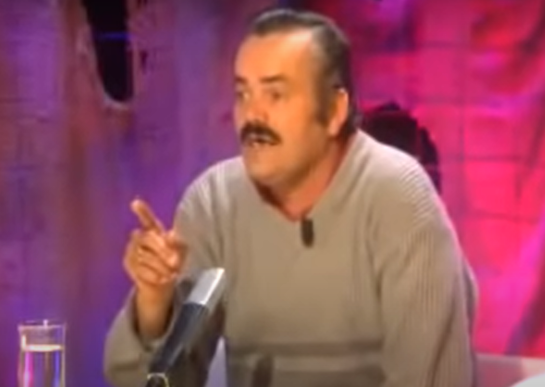
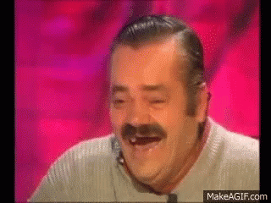
Back to coloring 3-colorable graphs
So far: We have an algorithm that given a 3-colorable graph G finds a legal ∆^{0.63}-semi-coloring of G.
Conclusion: we can find a proper coloring of G using O(∆^{0.63} log(n)) colors.
Q: But what if G has vertices of degree >n/10?
A: if G has a vertex of high degree, we can use the combinatorial algorithm:
Choose a vertex v ∈V of deg(v)= ∆, and color N(v) using only 2 colors.
So as long as G has a vertex of high degree, we 2-color its neighborhood.
When G has only vertices of low degree, we can use O(∆^{0.631} log(n)) coloring.
So if ∆=max-deg(G) is small,
we use a small number of colors.
This gives (n^{0.631} log(n))-coloring. That’s >>O(n^{0.5}) we saw before.

Slide 38
Coloring 3-colorable graphs with O(n^{0.387}) colors
The algorithm: set a threshold T = n^{0.613}
While G has a vertex v with deg(v) ≥ T,
  a. Color N(v) with 2 colors remove it from G
  b. Never use these colors again.
Here all vertices have degree ≤T.
Use the SDP based algorithm to color the graph using ≤ O(T^{0.631}) colors.
Analysis: the while loop will have ≤ n/T iterations.
Therefore, will use ≤ 2n/T colors
The last step uses ≤ T^{0.63} colors.
Choose the threshold T=n^{0.613} such that (n/T) = T^{0.631}.
This gives us a coloring using 2n/T+T^{0.631}=n^{0.387} colors

Slide 39
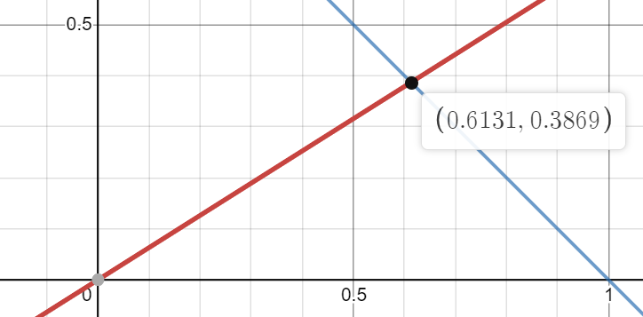
Coloring 3-colorable graphs
Intuitively, we have two algorithms.
If max-deg(G) is large, the we use the algorithm that colors N(v) – blue line
If max-deg(G) is small, the we use the ∆^{0.63} algorithm – red line
The plot is the runtime as a function of c where c is such that max-deg(G)=n^{c}.

Slide 40
Idea 2: finding a large independent set

Slide 41
Coloring 3-colorable graphs
Input: A graph G = (V,E) that is 3-colorable
Goal: Find a coloring of G with minimal possible number of colors.
Theorem: There exists a polynomial time algorithm that given 3-colorable graph G finds a legal coloring of G using O(n^{0.25}) colors.

Slide 42
Finding a large independent set
Input: A graph G = (V,E) on n vertices that is 3-colorable
A relaxed goal: Find an independent set of size 𝜸n for some constant 𝜸 >0.
Claim: Suppose there is an algorithm that given a 3-colorable graph G finds an independent set of size 𝜸n in polynomial time. Then there exists a polytime algorithm that finds a legal (proper) coloring of G using ln(n)/𝜸 colors.

Slide 43
Finding a large independent set
Claim: Suppose there is an algorithm that given a 3-colorable graph G finds an independent set of size 𝜸n in polynomial time. Then there exists a polytime algorithm that finds a legal (proper) coloring of G using ln(n)/𝜸 colors.
Proof: Consider the following algorithm:
Find an independent set of size 𝜸n.
Color it with the first color, remove it from the graph
Repeat on the remaining graph.
For the analysis note that if G had n’ vertices in the beginning of an iteration, then in the end it will have at most (1- 𝜸)n’ vertices.
Therefore, after ln(n)/𝜸 iterations, the number of vertices will be at most
n*(1- 𝜸)^{ln(n)/𝜸} < n*(1/e)^{ln(n)} = 1.
And hence all vertices have already been colored using ln(n)/𝜸 colors.

Slide 44
Finding a large independent set
Claim: Suppose there is an algorithm that given a 3-colorable graph G finds in polynomial time k disjoint independent sets that cover together >n/2 vertices.
Then there exists a polytime algorithm that finds a legal (proper) coloring of G using k log₂(n) colors.
Proof: Same idea as before:
We find k independent sets covering n/2 vertices.
We remove the from the graph, and never use these colors again.
Repeat on the remaining graph.
For the analysis since we remove n/2 vertices in each iteration, we will have at most log₂(n) iterations before we color all vertices.
Therefore, all vertices are colored using at most k lg₂(n) colors.

Slide 45
Finding a large independent set
Claim: Suppose there is an algorithm that given a 3-colorable graph G finds an independent set of size nª in polynomial time for some constant a>0.
Then there exists a polytime algorithm that finds a legal (proper) coloring of G using O(log(n)*n^{1-a}) colors.
Proof: Consider the following algorithm:
Use the algorithm in the assumption to find a large independent set in G.
Color it with some color, remove it from the graph. Never use this color again.
Repeat on the remaining graph.
For the analysis note that as long as G has more than n/2 vertices, we remove at least (n/2)ª ≥ nª/2ª vertices in each iteration.
Hence, in the first k=(n/2)/(nª/2ª)=n^{1-a}/2^{1-a} iterations we color ≥ n/2 vertices.
Hence, we will color the entire graph using ≤ k log₂(n) = O(log(n)*n^{1-a}) colors.

Slide 46
Using a vector 3-coloring of G
to find a large independent set

Slide 47
Coloring 3-colorable graphs
Theorem: There is a polynomial time (SDP based) algorithm that given a 3-colorable graph G with max-deg=∆, finds a legal coloring of G using
O(∆^{1/3} polylog(n)) colors
Exercise (in HW4): Use this theorem to design a poly-time algorithm that given a 3-colorable graph G finds a legal O(n^{1/4}*polylog(n)) coloring.
Key Lemma: There is a polynomial time (SDP based) algorithm that given a
3-colorable graph G with max-deg=∆, finds an independent set IS in G of size
|IS| ≥ n/(∆^{1/3}polylog(∆))
Now we have ∆^{1/3} coloring,
which is better than ∆^{log3(2)}=∆^{0.631}

Slide 48
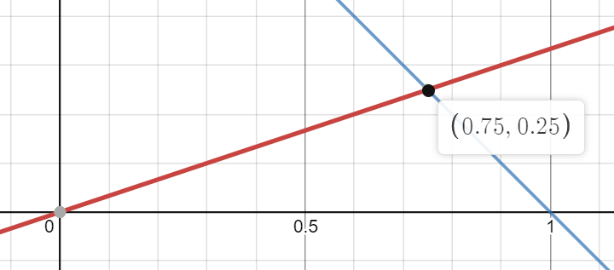
Coloring 3-colorable graphs
Intuitively, we have two algorithms.
If max-deg(G) is large, the we use the algorithm that colors N(v) – blue line
If max-deg(G) is small, the we use the ∆^{1/3} algorithm – red line
The plot is the runtime as a function of c where c is such that max-deg(G)=n^{c}.

Slide 49
Finding a large independent set
Key Lemma: There is a polynomial time (SDP based) algorithm that given a 3-colorable graph G with max-deg=∆, finds an independent set IS in G of size
|IS| ≥ n/(∆^{1/3}polylog(∆))

Slide 50
Finding a large independent set
SDP: We have a vector x_{v}∈R^{n} for each vertex v∈V.
The constraints are
||x_{v}||₂=1 for each vertex v∈V.
<x_{v},x_{u}> = -0.5 for each vertex (u,v)∈E.
Run the SDP solver, get a feasible solution.
How do we use it to find a large independent set in G?
Idea:
Choose a random vector r∈R^{n}.
Take all vectors that have large inner product with r.
Intuition, if x_{v} and x_{u} are both close to r, then the angle between them is small, and hence they share no edge.
r

Slide 51
Finding a large independent set
SDP: We have a vector x_{v}∈R^{n} for each vertex v∈V.
The constraints are
||x_{v}||₂=1 for each vertex v∈V.
<x_{v},x_{u}> = -0.5 for each vertex (u,v)∈E.
Rounding procedure:
Set a threshold t > 0
Choose a random vector r∈R^{n} according to (N(0,1))^{n}
Let S’ = {v ∈V : <r,x_{v}> ≥ t}
Let S = {v ∈ S’ : v has no neighbors in S’}
r
How should we choose t?
If t is too large, then S’ will be empty
If t is too small, then vertices in S’ will have may neighbors
Clearly S is an independent set
We need to choose t that is just right

Slide 52
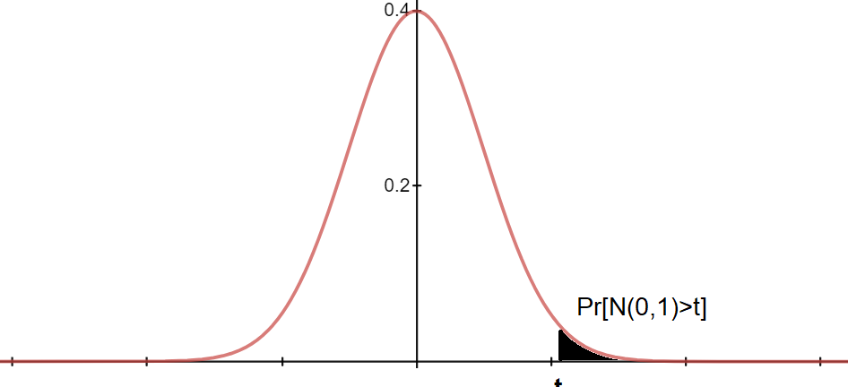
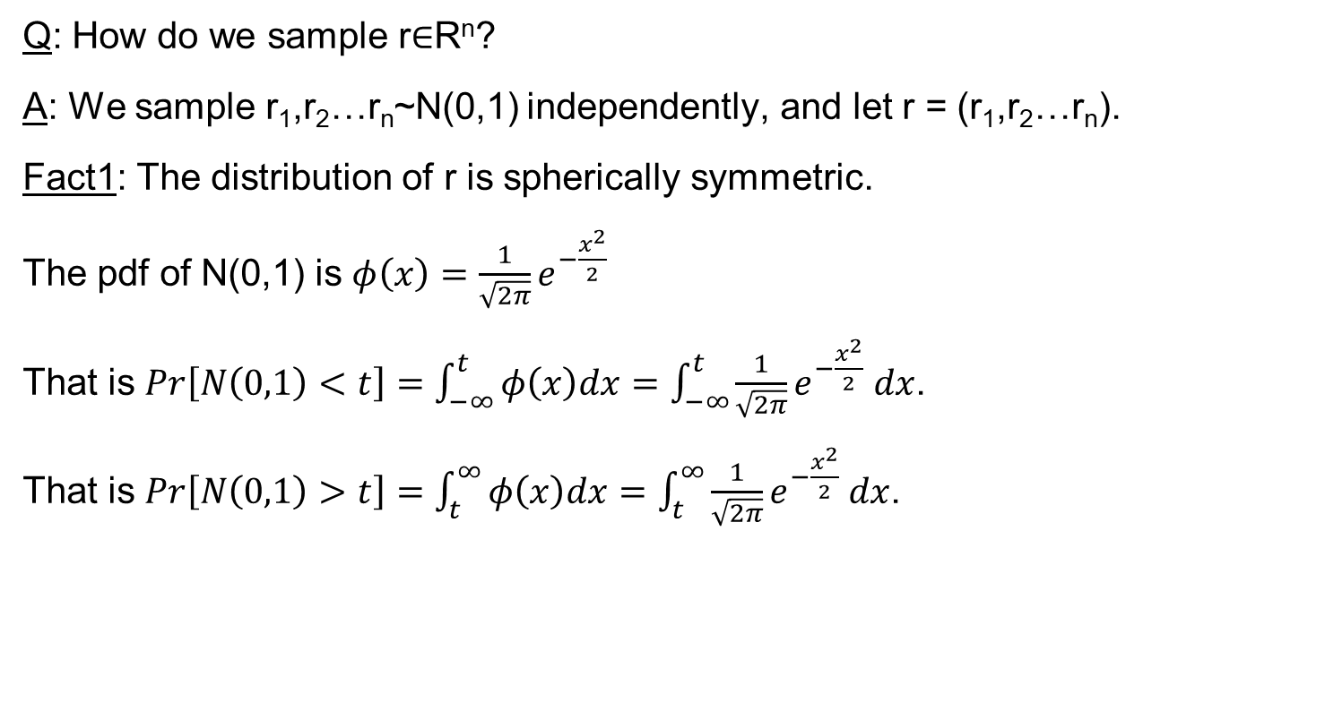
Detour to Normal distribution
Q: How do we sample r∈R^{n}?
A: We sample r₁,r₂…r_{n}~N(0,1) independently, and let r = (r₁,r₂…r_{n}).
Fact1: The distribution of r is spherically symmetric.
The pdf of N(0,1) is $φ\left(x\right)=$ $\frac{1}{\sqrt{2π}}e^{−\frac{x^{2}}{2}}$
That is $Pr\left[N\left(0,1\right)<t\right]=\int_{−∞}^{t}{φ\left(x\right)dx}=$ $\int_{−∞}^{t}{\frac{1}{\sqrt{2π}}e^{−\frac{x^{2}}{2}} dx}$.
That is $Pr\left[N\left(0,1\right)>t\right]=\int_{t}^{∞}{φ\left(x\right)dx}=$ $\int_{t}^{∞}{\frac{1}{\sqrt{2π}}e^{−\frac{x^{2}}{2}} dx}$.

Slide 53
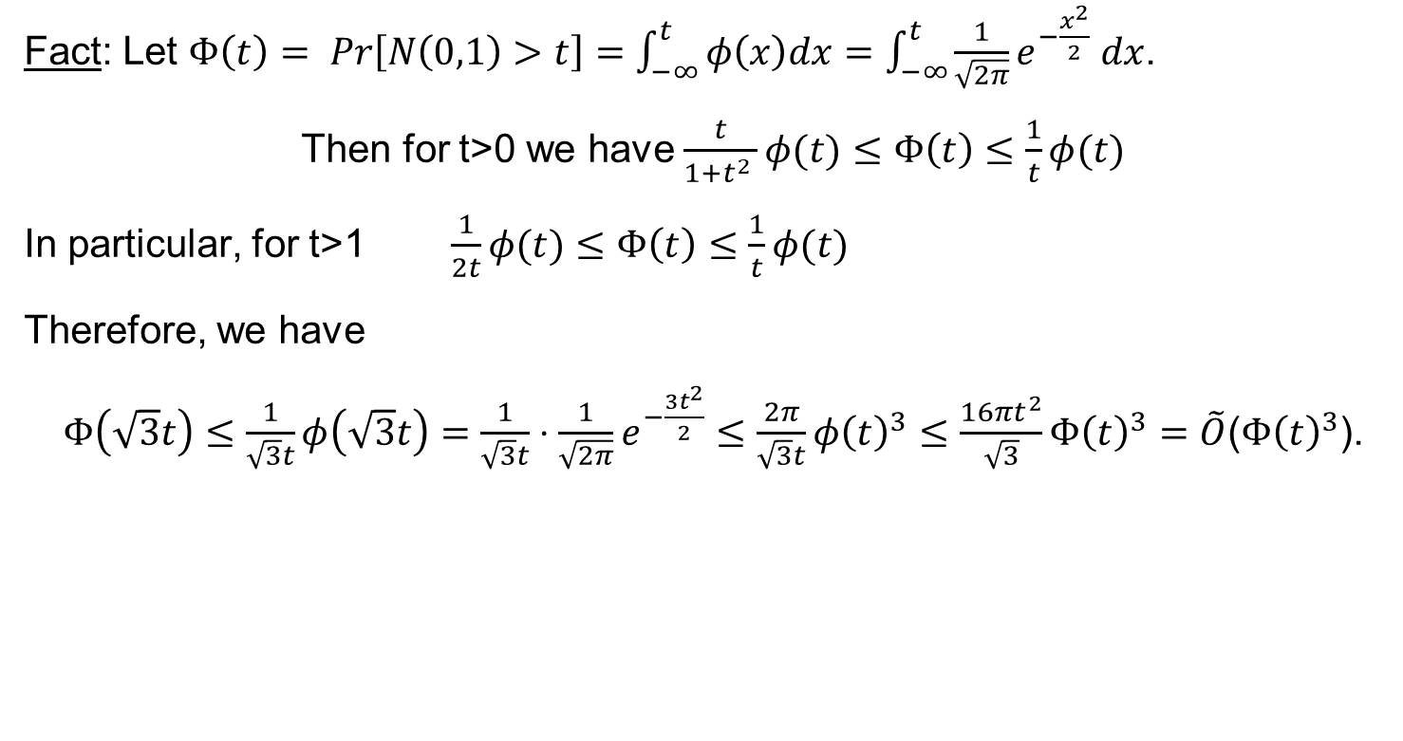
Detour to Normal distribution
Fact: Let $Φ\left(t\right)= Pr\left[N\left(0,1\right)>t\right]=\int_{−∞}^{t}{φ\left(x\right)dx}=$ $\int_{−∞}^{t}{\frac{1}{\sqrt{2π}}e^{−\frac{x^{2}}{2}} dx}$.
Then for t>0 we have $\frac{t}{1+t^{2} }φ(t)≤Φ\left(t\right)≤\frac{1}{t}φ(t)$
In particular, for t>1 $\frac{1}{2t}φ(t)≤Φ\left(t\right)≤\frac{1}{t}φ(t)$
Therefore, we have
$Φ\left(\sqrt{3}t\right)≤\frac{1}{\sqrt{3}t}φ\left(\sqrt{3}t\right)=\frac{1}{\sqrt{3}t}⋅\frac{1}{\sqrt{2π}}e^{−\frac{3t^{2}}{2}}≤\frac{2π}{\sqrt{3}t}{φ\left(t\right)}^{3}≤\frac{{16πt}^{2}}{\sqrt{3}}Φ{\left(t\right)}^{3}=\tilde{O}$($Φ{\left(t\right)}^{3}$).

Slide 54
Back to finding a large independent set
SDP: We have a vector x_{v}∈R^{n} for each vertex v∈V.
The constraints are
||x_{v}||₂=1 for each vertex v∈V.
<x_{v},x_{u}> = -0.5 for each vertex (u,v)∈E.
Rounding procedure:
Set a threshold t > 0
Choose a random vector r∈R^{n} according to (N(0,1))^{n}
Let S’ = {v ∈V : <r,x_{v}> ≥ t}
Let S = {v ∈ S’ : v has no neighbors in S’}
r
How should we choose t?
If t is too large, then S’ will be empty
If t is too small, then vertices in S’ will have may neighbors
Clearly S is an independent set
We need to choose t that is just right

Slide 55
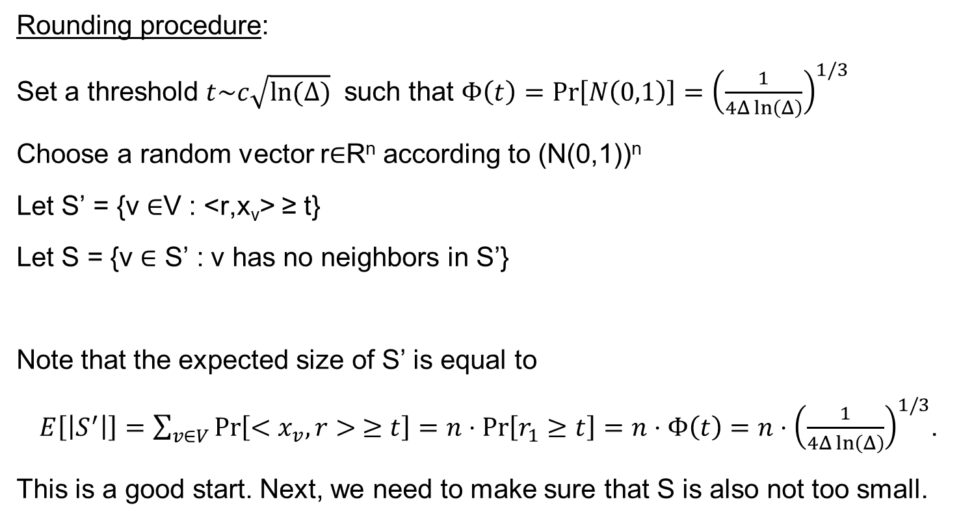
Back to finding a large independent set
Rounding procedure:
Set a threshold $t\sim c\sqrt{ln(Δ)}$ such that $Φ\left(t\right)=Pr\left[N\left(0,1\right)\right]={\left(\frac{1}{4Δ\ln\left(Δ\right)}\right)}^{1/3}$
Choose a random vector r∈R^{n} according to (N(0,1))^{n}
Let S’ = {v ∈V : <r,x_{v}> ≥ t}
Let S = {v ∈ S’ : v has no neighbors in S’}
Note that the expected size of S’ is equal to
$E\left[\left|S^{′}\right|\right]=\sum_{v∈V}{\operatorname{Pr}\left[<x_{v},r> ≥t\right]}=n⋅\operatorname{Pr}\left[r_{1}≥t\right]=n⋅Φ\left(t\right)=n⋅{\left(\frac{1}{4Δ\ln\left(Δ\right)}\right)}^{1/3}$.
This is a good start. Next, we need to make sure that S is also not too small.
r
By symmetry of r, we may assume that x_{v}=e₁

Slide 56
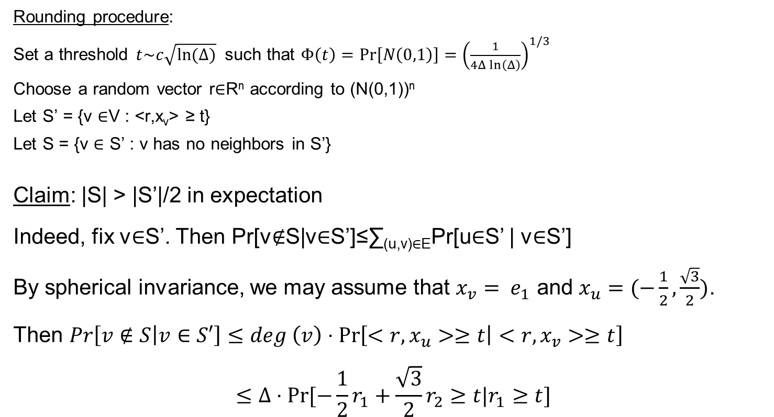
Back to finding a large independent set
r
Rounding procedure:
Set a threshold $t\sim c\sqrt{ln(Δ)}$ such that $Φ\left(t\right)=Pr\left[N\left(0,1\right)\right]=$ ${\left(\frac{1}{4Δ\ln\left(Δ\right)}\right)}^{1/3}$
Choose a random vector r∈R^{n} according to (N(0,1))^{n}
Let S’ = {v ∈V : <r,x_{v}> ≥ t}
Let S = {v ∈ S’ : v has no neighbors in S’}
Claim: |S| > |S’|/2 in expectation
Indeed, fix v∈S’. Then Pr[v∉S|v∈S’]≤∑_{(u,v)∈E}Pr[u∈S’ | v∈S’]
By spherical invariance, we may assume that $x_{v}= e_{1}$ and $x_{u}=(−\frac{1}{2},\frac{\sqrt{3}}{2})$.
Then $Pr\left[v∉S | v∈S′\right]≤deg \left(v\right)⋅\operatorname{Pr}\left[<r,x_{u}>≥t | <r,x_{v}>≥t\right]$
$$≤Δ⋅Pr⁡[−\frac{1}{2}r_{1}+\frac{\sqrt{3}}{2}r_{2}≥t|r_{1}≥t]$$

Slide 57
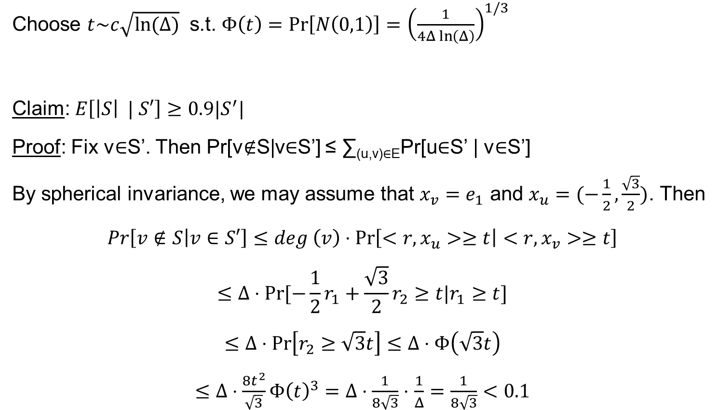
Back to finding a large independent set
r
Choose $t\sim c\sqrt{ln(Δ)}$ s.t. $Φ\left(t\right)=Pr\left[N\left(0,1\right)\right]=$ ${\left(\frac{1}{4Δ\ln\left(Δ\right)}\right)}^{1/3}$
Claim: $E\left[\left|S\right| | S′\right]≥0.9|S^{′}|$
Proof: Fix v∈S’. Then Pr[v∉S|v∈S’] ≤ ∑_{(u,v)∈E}Pr[u∈S’ | v∈S’]
By spherical invariance, we may assume that $x_{v}=e_{1}$ and $x_{u}=(−\frac{1}{2},\frac{\sqrt{3}}{2})$. Then
$$Pr\left[v∉S | v∈S′\right]≤deg \left(v\right)⋅\operatorname{Pr}\left[<r,x_{u}>≥t | <r,x_{v}>≥t\right]$$
$$≤Δ⋅Pr⁡[−\frac{1}{2}r_{1}+\frac{\sqrt{3}}{2}r_{2}≥t|r_{1}≥t]$$
$$≤Δ⋅\operatorname{Pr}\left[r_{2}≥\sqrt{3}t\right]≤Δ⋅Φ\left(\sqrt{3}t\right)$$
$≤Δ⋅\frac{8t^{2}}{\sqrt{3}}Φ{\left(t\right)}^{3}=Δ⋅\frac{1}{8\sqrt{3}}⋅$ $\frac{1}{Δ}=\frac{1}{8\sqrt{3}}<0.1$

Slide 58
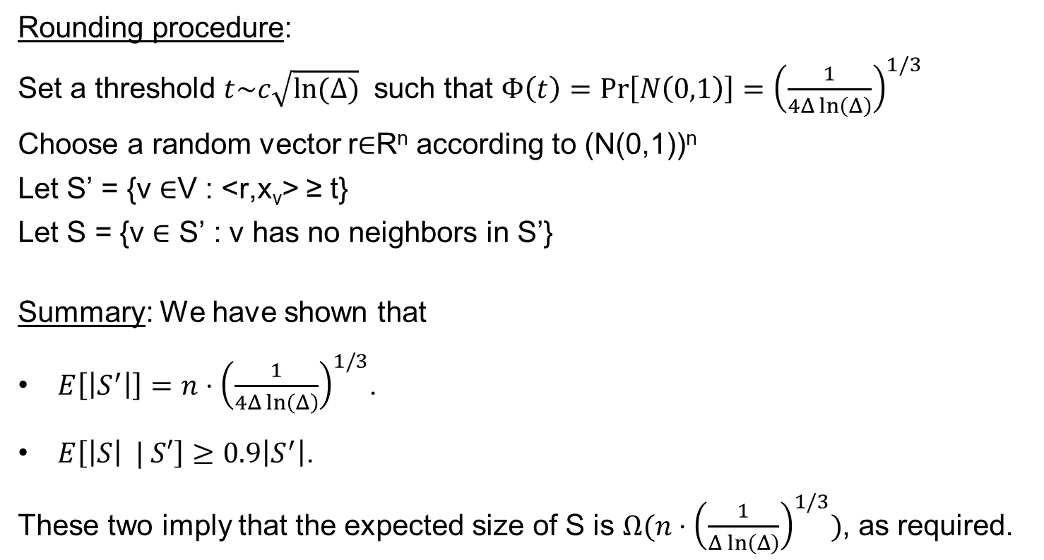
Back to finding a large independent set
Rounding procedure:
Set a threshold $t\sim c\sqrt{ln(Δ)}$ such that $Φ\left(t\right)=Pr\left[N\left(0,1\right)\right]=$ ${\left(\frac{1}{4Δ\ln\left(Δ\right)}\right)}^{1/3}$
Choose a random vector r∈R^{n} according to (N(0,1))^{n}
Let S’ = {v ∈V : <r,x_{v}> ≥ t}
Let S = {v ∈ S’ : v has no neighbors in S’}
Summary: We have shown that
$E\left[\left|S^{′}\right|\right]=n⋅{\left(\frac{1}{4Δ\ln\left(Δ\right)}\right)}^{1/3}$.
$E\left[\left|S\right| | S′\right]≥0.9\left|S^{′}\right|$.
These two imply that the expected size of S is $Ω(n⋅{\left(\frac{1}{Δ\ln\left(Δ\right)}\right)}^{1/3})$, as required.
The proof is only in expectation,
this is the main idea.

Slide 59
Coloring 3-colorable graphs
Key Lemma: There is a polynomial time (SDP based) algorithm that given a 3-colorable graph G with max-deg=∆, finds an independent set IS in G of size
|IS| ≥ n/∆^{1/3}.
Theorem: There is a polynomial time (SDP based) algorithm that given a 3-colorable graph G with max-deg=∆, finds a legal coloring of G using
|IS| ≤ O(∆^{1/3} log(n)) colors
Conclusion (in HW4): There is a poly-time algorithm that given a 3-colorable graph G finds a legal O(n^{1/4}*log(n)) coloring.
Now we have ∆^{1/3} coloring,
which is better than ∆^{log3(2)}=∆^{0.631}

Slide 60
On integrality gaps for graph coloring
Facts: There is a pretty large integrality gap for coloring 3-colorable graphs.
Specifically, there is a graph G on n vertices such that
G is vector-3-colorables (i.e. the SDP has a feasible solution)
i.e., SDP “thinks it is 3-colorable”
But the chromatic number of G is >n^{0.1}.
You will show a weaker integrality gap in HW4

Slide 61
Questions?
Comments?

