Slide 1





Can We Beat the Prefix Filtering?
An Adaptive Framework for Similarity Join and Search
Jiannan Wang (Tsinghua University)
Guoliang Li (Tsinghua University)
Jianhua Feng (Tsinghua University)

Slide 2


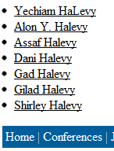

Data Integration

Slide 3

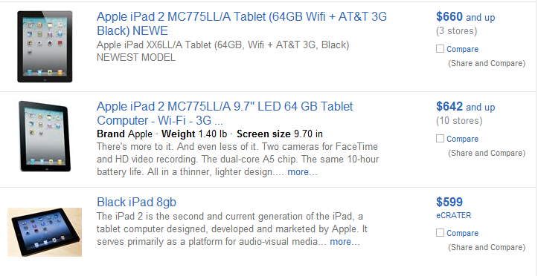
Data Cleaning

Slide 4
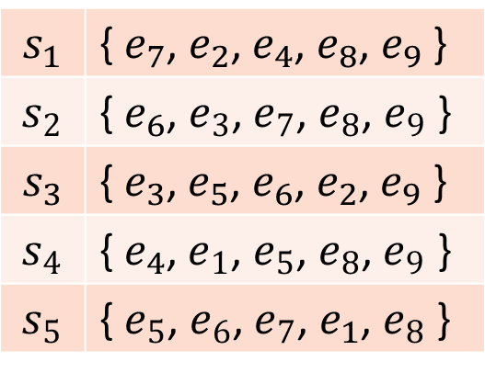

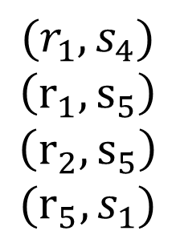
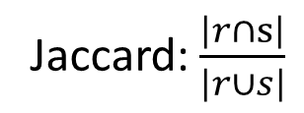

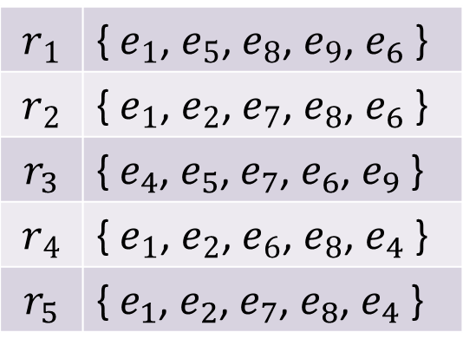
Similarity Join
$$r_{1}$$ | { $e_{1}$, $e_{5}$, $e_{8}$, $e_{9}$, $e_{6}$ }
$$r_{2}$$ | { $e_{1}$, $e_{2}$, $e_{7}$, $e_{8}$, $e_{6}$ }
$$r_{3}$$ | { $e_{4}$, $e_{5}$, $e_{7}$, $e_{6}$, $e_{9}$ }
$$r_{4}$$ | { $e_{1}$, $e_{2}$, $e_{6}$, $e_{8}$, $e_{4}$ }
$$r_{5}$$ | { $e_{1}$, $e_{2}$, $e_{7}$, $e_{8}$, $e_{4}$ }
$$R$$
Jaccard:$\frac{\left|r∩s\right|}{\left|r∪s\right|}$
$${(r}_{1}, s_{4})$$
$$\left(r_{1},s_{5}\right)$$
$$\left(r_{2},s_{5}\right)$$
$$(r_{5},s_{1})$$
$$s_{1}$$ | { $e_{7}$, $e_{2}$, $e_{4}$, $e_{8}$, $e_{9}$ }
$$s_{2}$$ | { $e_{6}$, $e_{3}$, $e_{7}$, $e_{8}$, $e_{9}$ }
$$s_{3}$$ | {$e_{3}$, $e_{5}$, $e_{6}$, $e_{2}$, $e_{9}$ }
$$s_{4}$$ | {${ e}_{4}$, $e_{1}$, $e_{5}$, $e_{8}$, $e_{9}$ }
$$s_{5}$$ | { $e_{5}$, $e_{6}$, $e_{7}$, $e_{1}$, $e_{8}$ }
Threshold: 0.6
$$S$$

Slide 5

Challenge
Naïve Method
$$|R|×|S|$$
How to address?
Filtering and Verification

Slide 6
Prefix Filtering
[1] Chaudhuri et al. A primitive operator for similarity joins in data cleaning. ICDE 2006.
[2] Bayardo et al. Scaling up all pairs similarity search. WWW 2007.
[3] Xiao et al. Ed-join: an efficient algorithm for similarity joins with edit distance constraints. PVLDB 2008.
[4] Xiao et al. Efficient similarity joins for near duplicate detection. WWW 2008.
[5] Xiao et al. Top-k set similarity joins. ICDE 2009.
[6] Vernica et al. Efficient parallel set-similarity joins using MapReduce. SIGMOD 2010.
[7] Qin et al. Efficient exact edit similarity query processing with the asymmetric signature scheme. SIGMOD 2011

Slide 7
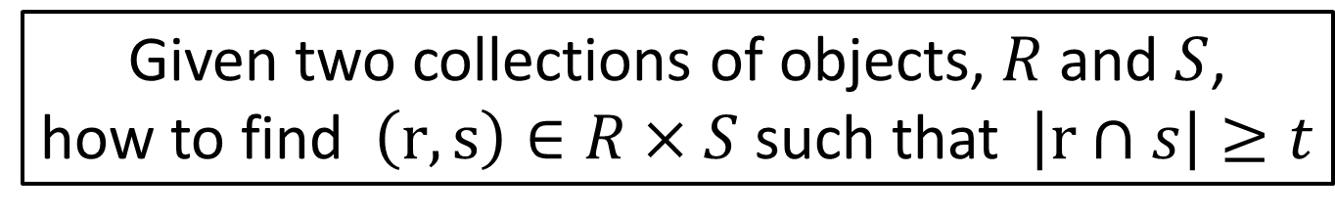
Overlap Similarity
Edit Distance
Cosine
Jaccard
Given two collections of objects, $R$ and $S$,
how to find $\left(r, s\right)∈R×S$ such that $\left|r∩s\right|≥t$
Edit Similarity
Dice
Overlap

Slide 8
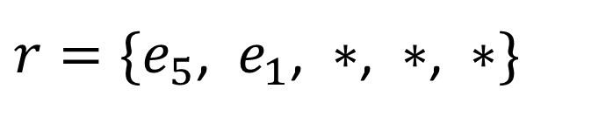

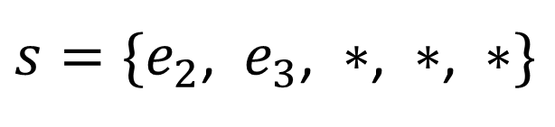
Prefix Filtering
$r=\{e_{5}$, $e_{1}$, $∗$, $∗$, $∗\}$
$s=\{e_{2}$, $e_{3}$, $∗$, $∗$, $∗\}$
$\left|r∩s\right|<4$ ?

Slide 9
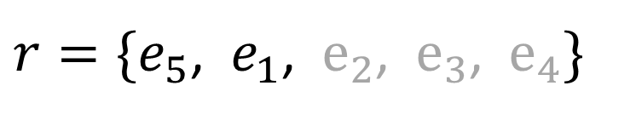

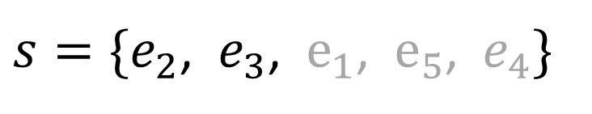
Prefix Filtering
$r=\{e_{5}$, $e_{1}$, $e_{2}$, $e_{3}$, $e_{4}\}$
$s=\{e_{2}$, $e_{3}$, $e_{1}$, $e_{5}$, $e_{4}\}$
$$\left|r∩s\right|=5$$

Slide 10
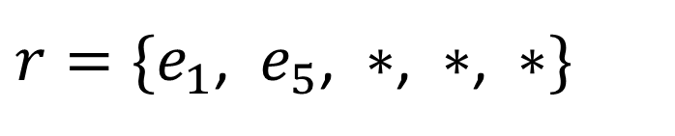
Prefix Filtering
Elements are sorted based on a global ordering
$r=\{e_{1}$, $e_{5}$, $∗$, $∗$, $∗\}$
$s=\{e_{2}$, $e_{3}$, $∗$, $∗$, $∗\}$
$\left|r∩s\right|<4$ ?

Slide 11

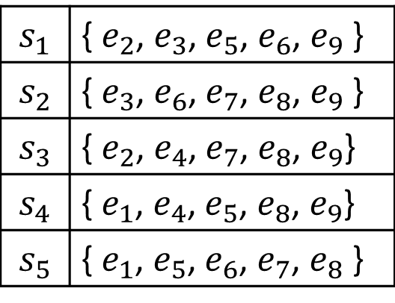
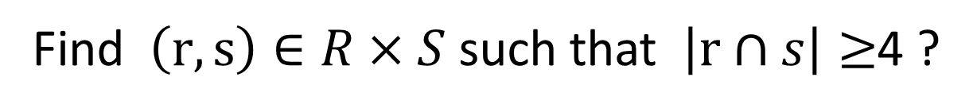


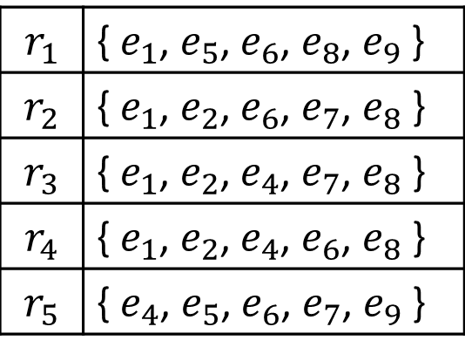
Prefix Filtering
Find $\left(r, s\right)∈R×S$ such that $\left|r∩s\right|≥$4 ?
Sort the elements of each set based on a global ordering
$$r_{1}$$ | { $e_{1}$, $e_{5}$, $e_{6}$, $e_{8}$, $e_{9}$ }
$$r_{2}$$ | { $e_{1}$, $e_{2}$, $e_{6}$, $e_{7}$, $e_{8}$ }
$$r_{3}$$ | { $e_{1}$, $e_{2}$, $e_{4}$, $e_{7}$, $e_{8}$ }
$$r_{4}$$ | { $e_{1}$, $e_{2}$, $e_{4}$, $e_{6}$, $e_{8}$ }
$$r_{5}$$ | { $e_{4}$, $e_{5}$, $e_{6}$, $e_{7}$, $e_{9}$ }
$$s_{1}$$ | { $e_{2}$, $e_{3}$, $e_{5}$, $e_{6}$, $e_{9}$ }
$$s_{2}$$ | { $e_{3}$, $e_{6}$, $e_{7}$, $e_{8}$, $e_{9}$ }
$$s_{3}$$ | { $e_{2}$, $e_{4}$, $e_{7}$, $e_{8}$, $e_{9}$}
$$s_{4}$$ | { $e_{1}$, $e_{4}$, $e_{5}$, $e_{8}$, $e_{9}$}
$$s_{5}$$ | { $e_{1}$, $e_{5}$, $e_{6}$, $e_{7}$, $e_{8}$ }
$$R$$
$$S$$

Slide 12
Prefix Filtering
Find $\left(r, s\right)∈R×S$ such that $\left|r∩s\right|≥$4 ?
Remove the last 3 elements in each set
$$r_{1}$$ | { $e_{1}$, $e_{5}$, $e_{6}$, $e_{8}$, $e_{9}$ }
$$r_{2}$$ | { $e_{1}$, $e_{2}$, $e_{6}$, $e_{7}$, $e_{8}$ }
$$r_{3}$$ | { $e_{1}$, $e_{2}$, $e_{4}$, $e_{7}$, $e_{8}$ }
$$r_{4}$$ | { $e_{1}$, $e_{2}$, $e_{4}$, $e_{6}$, $e_{8}$ }
$$r_{5}$$ | { $e_{4}$, $e_{5}$, $e_{6}$, $e_{7}$, $e_{9}$ }
$$s_{1}$$ | { $e_{2}$, $e_{3}$, $e_{5}$, $e_{6}$, $e_{9}$ }
$$s_{2}$$ | { $e_{3}$, $e_{6}$, $e_{7}$, $e_{8}$, $e_{9}$ }
$$s_{3}$$ | { $e_{2}$, $e_{4}$, $e_{7}$, $e_{8}$, $e_{9}$}
$$s_{4}$$ | { $e_{1}$, $e_{4}$, $e_{5}$, $e_{8}$, $e_{9}$}
$$s_{5}$$ | { $e_{1}$, $e_{5}$, $e_{6}$, $e_{7}$, $e_{8}$ }
$$R$$
$$S$$

Slide 13



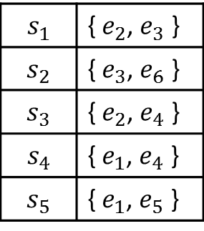












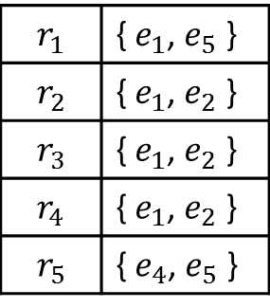


Inverted Index
Find $(r,s)$ such that $Prefix\left(r\right)∩Prefix\left(s\right)≠φ$ ?
$$Prefix(R)$$
$$Prefix(S)$$
$$r_{1}$$ | { $e_{1}$, $e_{5}$ }
$$r_{2}$$ | { $e_{1}$, $e_{2}$ }
$$r_{3}$$ | { $e_{1}$, $e_{2}$ }
$$r_{4}$$ | { $e_{1}$, $e_{2}$ }
$$r_{5}$$ | { $e_{4}$, $e_{5}$ }
$$s_{1}$$ | { $e_{2}$, $e_{3}$ }
$$s_{2}$$ | { $e_{3}$, $e_{6}$ }
$$s_{3}$$ | { $e_{2}$, $e_{4}$ }
$$s_{4}$$ | { $e_{1}$, $e_{4}$ }
$$s_{5}$$ | { $e_{1}$, $e_{5}$ }
Candidates
$$\left(r_{1}, s_{4}\right), (r_{1}, s_{5})$$
$$\left(r_{2}, s_{1}\right), \left(r_{2}, s_{3}\right),\left(r_{2}, s_{4}\right), (r_{2}, s_{5})$$
$$\left(r_{3}, s_{1}\right), \left(r_{3}, s_{3}\right),\left(r_{3}, s_{4}\right), (r_{3}, s_{5})$$
$$\left(r_{4}, s_{1}\right), \left(r_{4}, s_{3}\right),\left(r_{4}, s_{4}\right), (r_{4}, s_{5})$$
$$\left(r_{5}, s_{3}\right),\left(r_{5}, s_{4}\right)$$
Build inverted index on $Prefix(S)$
$$e_{1}$$
$$e_{2}$$
$$e_{3}$$
$$e_{4}$$
$$e_{5}$$
$$e_{6}$$
$$s_{4}$$
$$s_{5}$$
$$s_{1}$$
$$s_{3}$$
$$s_{4}$$
$$s_{2}$$
$$s_{3}$$
$$s_{4}$$
$$s_{4}$$
$$s_{2}$$

Slide 14

Can we beat the prefix filtering?

Slide 15
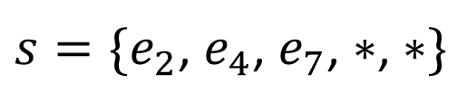
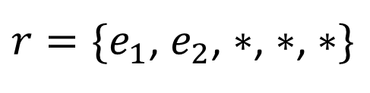
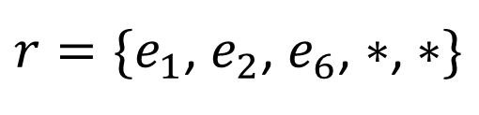
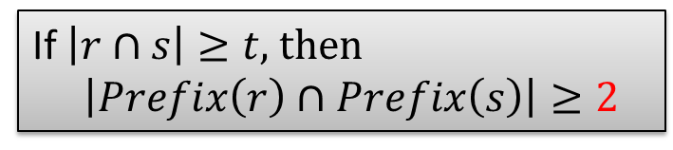
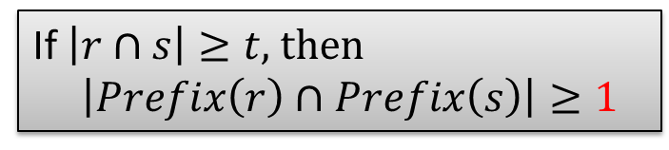

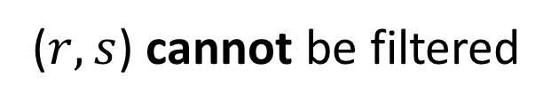

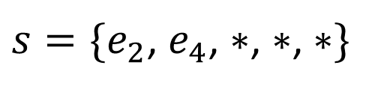
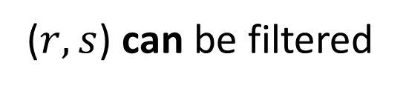
Prefix Scheme
1-prefix scheme
2-prefix scheme
If $\left|r∩s\right|≥t,$ then
$$\left|Prefix\left(r\right)∩Prefix\left(s\right)\right|≥1$$
If $\left|r∩s\right|≥t,$ then
$$\left|Prefix\left(r\right)∩Prefix\left(s\right)\right|≥2$$
$$t=4$$
$$t=4$$
$r=\{e_{1}$, $e_{2}$, $∗$, $∗$, $∗\}$
$r=\{e_{1}$, $e_{2}$, $e_{6}$, $∗$, $∗\}$
$s=\{e_{2}$, $e_{4}$, $∗$, $∗$, $∗\}$
$s=\{e_{2}$, $e_{4}$, $e_{7}$, $∗$, $∗\}$
($r,s$) cannot be filtered
($r,s$) can be filtered

Slide 16

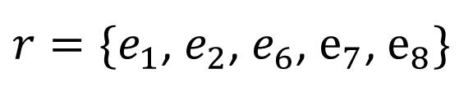

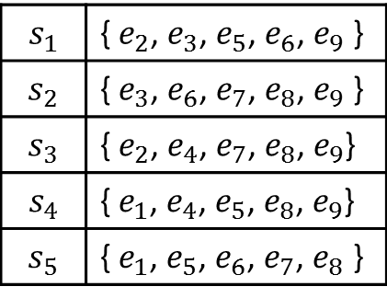
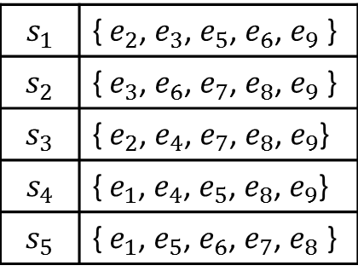
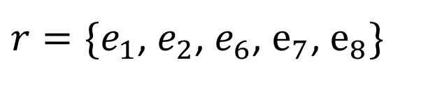
Cost Analysis
1-prefix scheme
2-prefix scheme
$r=\{e_{1}$, $e_{2}$, $e_{6}$, $e_{7}$, $e_{8}\}$
$r=\{e_{1}$, $e_{2}$, $e_{6}$, $e_{7}$, $e_{8}\}$
$$s_{1}$$ | { $e_{2}$, $e_{3}$, $e_{5}$, $e_{6}$, $e_{9}$ }
$$s_{2}$$ | { $e_{3}$, $e_{6}$, $e_{7}$, $e_{8}$, $e_{9}$ }
$$s_{3}$$ | { $e_{2}$, $e_{4}$, $e_{7}$, $e_{8}$, $e_{9}$}
$$s_{4}$$ | { $e_{1}$, $e_{4}$, $e_{5}$, $e_{8}$, $e_{9}$}
$$s_{5}$$ | { $e_{1}$, $e_{5}$, $e_{6}$, $e_{7}$, $e_{8}$ }
$$s_{1}$$ | { $e_{2}$, $e_{3}$, $e_{5}$, $e_{6}$, $e_{9}$ }
$$s_{2}$$ | { $e_{3}$, $e_{6}$, $e_{7}$, $e_{8}$, $e_{9}$ }
$$s_{3}$$ | { $e_{2}$, $e_{4}$, $e_{7}$, $e_{8}$, $e_{9}$}
$$s_{4}$$ | { $e_{1}$, $e_{4}$, $e_{5}$, $e_{8}$, $e_{9}$}
$$s_{5}$$ | { $e_{1}$, $e_{5}$, $e_{6}$, $e_{7}$, $e_{8}$ }
$$S$$
$$S$$

Slide 17


























Cost Analysis
1-prefix scheme
2-prefix scheme
$r=\{e_{1}$, $e_{2}$, $e_{6}$, $e_{7}$, $e_{8}\}$
$r=\{e_{1}$, $e_{2}$, $e_{6}$, $e_{7}$, $e_{8}\}$
$$e_{1}$$
$$e_{2}$$
$$e_{3}$$
$$e_{4}$$
$$e_{5}$$
$$e_{6}$$
$$e_{7}$$
$$e_{1}$$
$$e_{2}$$
$$e_{3}$$
$$e_{4}$$
$$e_{5}$$
$$e_{6}$$
$$s_{4}$$
$$s_{5}$$
$$s_{1}$$
$$s_{3}$$
$$s_{4}$$
$$s_{2}$$
$$s_{3}$$
$$s_{4}$$
$$s_{1}$$
$$s_{4}$$
$$s_{5}$$
$$s_{2}$$
$$s_{5}$$
$$s_{2}$$
$$s_{3}$$
$$s_{4}$$
$$s_{5}$$
$$s_{1}$$
$$s_{3}$$
$$s_{4}$$
$$s_{2}$$
$$s_{3}$$
$$s_{4}$$
$$s_{5}$$
$$s_{2}$$
$$s_{1}$$ | { $e_{2}$, $e_{3}$, $e_{5}$, $e_{6}$, $e_{9}$ }
$$s_{2}$$ | { $e_{3}$, $e_{6}$, $e_{7}$, $e_{8}$, $e_{9}$ }
$$s_{3}$$ | { $e_{2}$, $e_{4}$, $e_{7}$, $e_{8}$, $e_{9}$}
$$s_{4}$$ | { $e_{1}$, $e_{4}$, $e_{5}$, $e_{8}$, $e_{9}$}
$$s_{5}$$ | { $e_{1}$, $e_{5}$, $e_{6}$, $e_{7}$, $e_{8}$ }
$$s_{1}$$ | { $e_{2}$, $e_{3}$, $e_{5}$, $e_{6}$, $e_{9}$ }
$$s_{2}$$ | { $e_{3}$, $e_{6}$, $e_{7}$, $e_{8}$, $e_{9}$ }
$$s_{3}$$ | { $e_{2}$, $e_{4}$, $e_{7}$, $e_{8}$, $e_{9}$}
$$s_{4}$$ | { $e_{1}$, $e_{4}$, $e_{5}$, $e_{8}$, $e_{9}$}
$$s_{5}$$ | { $e_{1}$, $e_{5}$, $e_{6}$, $e_{7}$, $e_{8}$ }
$$S$$
$$S$$

Slide 18




Cost Analysis
1-prefix scheme
2-prefix scheme
$r=\{e_{1}$, $e_{2}$, $e_{6}$, $e_{7}$, $e_{8}\}$
$r=\{e_{1}$, $e_{2}$, $e_{6}$, $e_{7}$, $e_{8}\}$
$$e_{1}$$
$$e_{2}$$
$$e_{3}$$
$$e_{4}$$
$$e_{5}$$
$$e_{6}$$
$$e_{7}$$
$$e_{1}$$
$$e_{2}$$
$$e_{3}$$
$$e_{4}$$
$$e_{5}$$
$$e_{6}$$
$$s_{4}$$
$$s_{5}$$
$$s_{1}$$
$$s_{3}$$
$$s_{4}$$
$$s_{2}$$
$$s_{3}$$
$$s_{4}$$
$$s_{1}$$
$$s_{4}$$
$$s_{5}$$
$$s_{2}$$
$$s_{5}$$
$$s_{2}$$
$$s_{3}$$
$$s_{4}$$
$$s_{5}$$
$$s_{1}$$
$$s_{3}$$
$$s_{4}$$
$$s_{2}$$
$$s_{3}$$
$$s_{4}$$
$$s_{5}$$
$$s_{2}$$
Filtering: 2+2
Verification: 4*10
Total: 44
Filtering: 2+2+2
Verification: 1*10
Total: 16

Slide 19
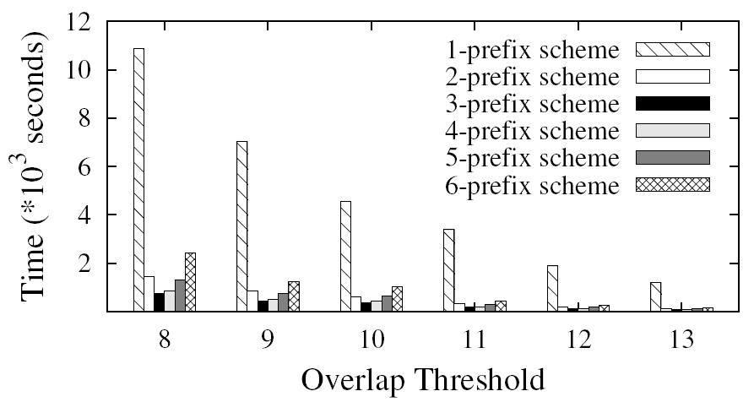
Experimental Analysis
DBLP

Slide 20
An adaptive framework for similarity Join and Search

Slide 21

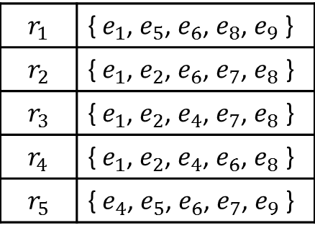
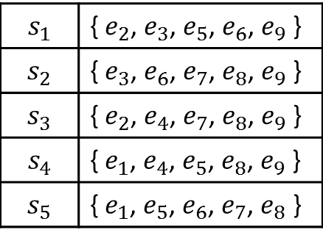



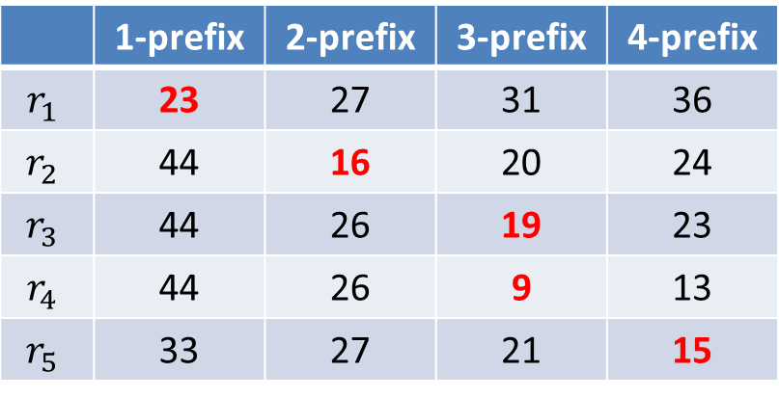
Variable-Length Prefix Scheme
Find $\left(r, s\right)∈R×S$ such that $\left|r∩s\right|≥$4 ?
$$R$$
$$S$$
Cost analysis
 | 1-prefix | 2-prefix | 3-prefix | 4-prefix
$$r_{1}$$ | 23 | 27 | 31 | 36
$$r_{2}$$ | 44 | 16 | 20 | 24
$$r_{3}$$ | 44 | 26 | 19 | 23
$$r_{4}$$ | 44 | 26 | 9 | 13
$$r_{5}$$ | 33 | 27 | 21 | 15

Slide 22
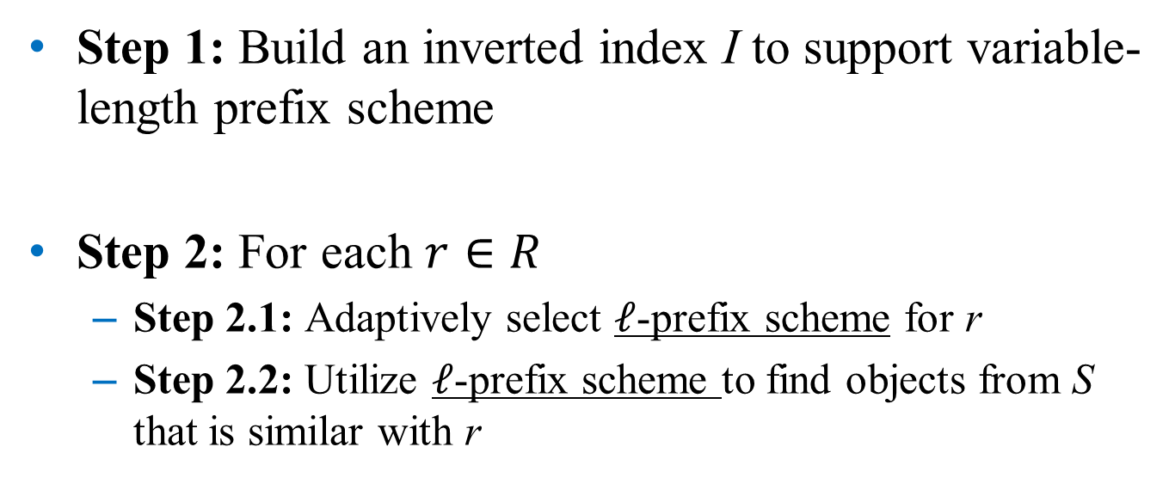
Adaptive Framework
Challenge 1
Step 1: Build an inverted index I to support variable-length prefix scheme
Step 2: For each $r∈R$
  Step 2.1: Adaptively select $ℓ$-prefix scheme for r
  Step 2.2: Utilize $ℓ$-prefix scheme to find objects from S that is similar with r
Challenge 2

Slide 23

















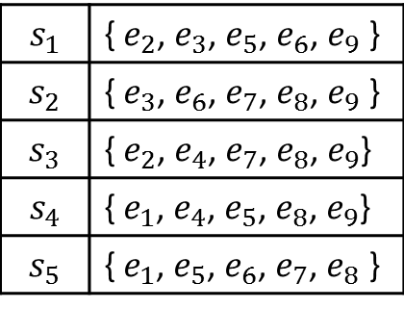









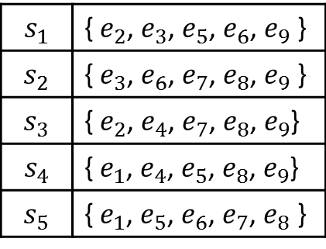













Challenge 1: Delta Inverted Index
1-prefix scheme
2-prefix scheme
. . .
$$s_{1}$$ | { $e_{2}$, $e_{3}$, $e_{5}$, $e_{6}$, $e_{9}$ }
$$s_{2}$$ | { $e_{3}$, $e_{6}$, $e_{7}$, $e_{8}$, $e_{9}$ }
$$s_{3}$$ | { $e_{2}$, $e_{4}$, $e_{7}$, $e_{8}$, $e_{9}$}
$$s_{4}$$ | { $e_{1}$, $e_{4}$, $e_{5}$, $e_{8}$, $e_{9}$}
$$s_{5}$$ | { $e_{1}$, $e_{5}$, $e_{6}$, $e_{7}$, $e_{8}$ }
$$s_{1}$$ | { $e_{2}$, $e_{3}$, $e_{5}$, $e_{6}$, $e_{9}$ }
$$s_{2}$$ | { $e_{3}$, $e_{6}$, $e_{7}$, $e_{8}$, $e_{9}$ }
$$s_{3}$$ | { $e_{2}$, $e_{4}$, $e_{7}$, $e_{8}$, $e_{9}$}
$$s_{4}$$ | { $e_{1}$, $e_{4}$, $e_{5}$, $e_{8}$, $e_{9}$}
$$s_{5}$$ | { $e_{1}$, $e_{5}$, $e_{6}$, $e_{7}$, $e_{8}$ }
$$e_{1}$$
$$e_{1}$$
$$e_{2}$$
$$e_{2}$$
$$e_{3}$$
$$e_{3}$$
$$e_{4}$$
$$e_{4}$$
$$e_{5}$$
$$e_{5}$$
$$e_{6}$$
$$e_{6}$$
$$e_{7}$$
$$e_{5}$$
$$e_{6}$$
$$e_{7}$$
$$e_{1}$$
$$e_{2}$$
$$e_{3}$$
$$e_{4}$$
$$e_{5}$$
$$e_{6}$$
$$e_{7}$$
$$s_{2}$$
$$s_{5}$$
$$s_{2}$$
$$s_{5}$$
$$s_{2}$$
$$s_{3}$$
$$s_{4}$$
$$s_{5}$$
$$s_{2}$$
$$s_{3}$$
$$s_{4}$$
$$s_{5}$$
$$s_{1}$$
$$s_{3}$$
$$s_{1}$$
$$s_{3}$$
$$s_{4}$$
$$s_{2}$$
$$s_{4}$$
$$s_{2}$$
$$s_{3}$$
$$s_{4}$$
$$s_{3}$$
$$s_{4}$$
$$s_{1}$$
$$s_{4}$$
$$s_{5}$$
$$s_{5}$$
$$s_{1}$$
$$s_{4}$$
$$s_{5}$$
$$s_{2}$$
$$s_{3}$$
$$s_{4}$$
$$s_{5}$$
$$s_{1}$$
$$s_{3}$$
$$s_{4}$$
$$s_{2}$$
$$s_{3}$$
$$s_{4}$$
$$s_{5}$$
$$s_{2}$$
$$s_{1}$$
$$s_{4}$$
$$I_{2}$$
$$I_{1}$$
$${∆I}_{2}=I_{2}−I_{1}$$

Slide 24
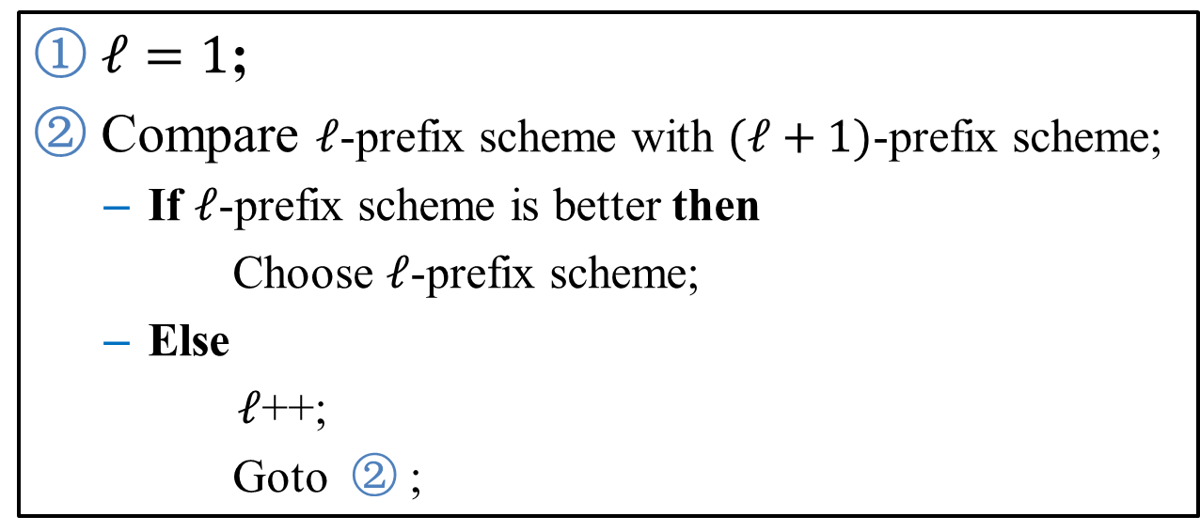
Challenge 2: Adaptively Selecting Prefix Scheme
How
①$ℓ=1$;
② Compare $ℓ$-prefix scheme with $(ℓ+1)$-prefix scheme;
  If $ℓ$-prefix scheme is better then
  Choose $ℓ$-prefix scheme;
  Else
  $ℓ$++;
  Goto ② ;

Slide 25

















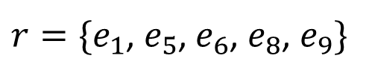









Challenge 2: Adaptively Selecting Prefix Scheme
$$I_{1}$$
$${∆I}_{2}$$
$$e_{1}$$
$$e_{1}$$
$$e_{2}$$
$$e_{2}$$
$$e_{3}$$
$$e_{3}$$
$$e_{4}$$
$$e_{4}$$
$$e_{5}$$
$$e_{5}$$
$$e_{6}$$
$$e_{6}$$
$$e_{5}$$
$$e_{6}$$
$$e_{7}$$
$$s_{2}$$
$$s_{4}$$
$$s_{5}$$
$$s_{2}$$
$$s_{4}$$
$$s_{5}$$
$$s_{1}$$
$$s_{3}$$
$$s_{1}$$
$$s_{3}$$
$$s_{4}$$
$$s_{2}$$
$$s_{4}$$
$$s_{2}$$
$$s_{3}$$
$$s_{4}$$
$$s_{3}$$
$$s_{4}$$
$$s_{4}$$
$$s_{4}$$
$$s_{1}$$
$$s_{4}$$
$$s_{5}$$
$$s_{2}$$
$$s_{3}$$
$r=\{e_{1}$, $e_{5}$, $e_{6}$, $e_{8}$, $e_{9}\}$
 | Filter | Verify
1-prefix
2-prefix
$${|I}_{1}\left(e_{1}\right)|+{|I}_{1}\left(e_{5}\right)|$$
$${|C}_{1}|⋅cost(r)$$

Slide 26





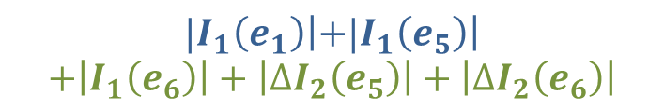


Challenge 2: Adaptively Selecting Prefix Scheme
$$I_{1}$$
$${∆I}_{2}$$
$$e_{1}$$
$$e_{1}$$
$$e_{1}$$
$$e_{2}$$
$$e_{2}$$
$$e_{2}$$
$$e_{3}$$
$$e_{3}$$
$$e_{3}$$
$$e_{4}$$
$$e_{4}$$
$$e_{4}$$
$$e_{5}$$
$$e_{5}$$
$$e_{5}$$
$$e_{6}$$
$$e_{6}$$
$$e_{6}$$
$$e_{5}$$
$$e_{5}$$
$$e_{6}$$
$$e_{6}$$
$$e_{7}$$
$$e_{7}$$
$$s_{2}$$
$$s_{2}$$
$$s_{4}$$
$$s_{5}$$
$$s_{2}$$
$$s_{4}$$
$$s_{5}$$
$$s_{4}$$
$$s_{5}$$
$$s_{1}$$
$$s_{3}$$
$$s_{1}$$
$$s_{3}$$
$$s_{1}$$
$$s_{3}$$
$$s_{4}$$
$$s_{2}$$
$$s_{4}$$
$$s_{2}$$
$$s_{4}$$
$$s_{2}$$
$$s_{3}$$
$$s_{4}$$
$$s_{3}$$
$$s_{4}$$
$$s_{3}$$
$$s_{4}$$
$$s_{4}$$
$$s_{4}$$
$$s_{4}$$
$$s_{1}$$
$$s_{4}$$
$$s_{1}$$
$$s_{4}$$
$$s_{5}$$
$$s_{5}$$
$$s_{2}$$
$$s_{3}$$
$$s_{2}$$
$$s_{3}$$
$r=\{e_{1}$, $e_{5}$, $e_{6}$, $e_{8}$, $e_{9}\}$
 | Filter | Verify
1-prefix
2-prefix
$${|I}_{1}\left(e_{1}\right)|+{|I}_{1}\left(e_{5}\right)|$$
$${|C}_{1}|⋅cost(r)$$
$${|I}_{1}\left(e_{1}\right)\left|+{|I}_{1}\left(e_{5}\right)\right|$$
$$+\left|I_{1}\left(e_{6}\right)\right|+\left|∆I_{2}\left(e_{5}\right)\right|+\left|∆I_{2}\left(e_{6}\right)\right|$$
$${|C}_{2}|⋅cost(r)$$

Slide 27













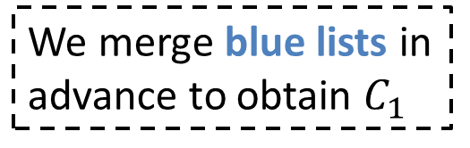



Estimate ${|C}_{1}|$
${|C}_{1}|$: the #candidates for 1-prefix scheme
${|C}_{2}|$: the #candidates for 2-prefix scheme
$$e_{1}$$
$$e_{5}$$
We merge blue lists in advance to obtain $C_{1}$
$$s_{4}$$
$$s_{5}$$
$$s_{4}$$
$$e_{1}$$
$$e_{5}$$
$$e_{6}$$
$$e_{5}$$
$$e_{6}$$
$$s_{4}$$
$$s_{5}$$
$$s_{4}$$
$$s_{2}$$
$$s_{1}$$
$$s_{4}$$
$$s_{5}$$

Slide 28








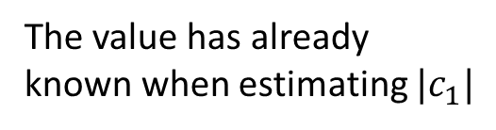



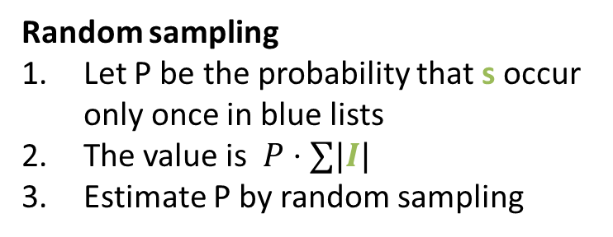
Estimate ${|C}_{2}|$
$$e_{1}$$
$$e_{5}$$
$$e_{6}$$
$$e_{5}$$
$$e_{6}$$
Occur at least twice in blue lists and green lists
$$s_{4}$$
$$s_{5}$$
$$s_{4}$$
$$s_{2}$$
$$s_{1}$$
$$s_{4}$$
$$s_{5}$$
Occur at least twice in blue lists
+
Occur only once in blue lists and at least once in green lists
The value has already known when estimating $|c_{1}|$
Random sampling
Let P be the probability that s occur only once in blue lists
The value is $P⋅∑|I|$
Estimate P by random sampling

Slide 29
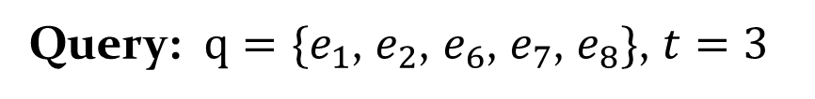
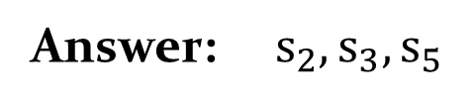
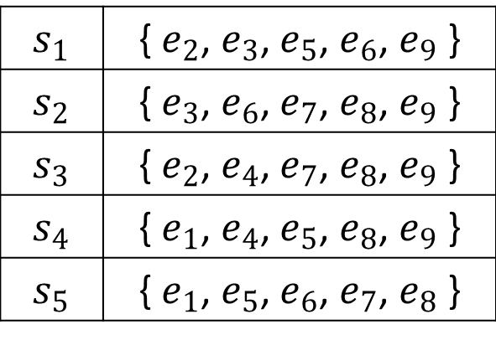
Similarity Search
Different from Similarity Join
  A threshold is not specified when building an index from data
Query: $q=\{e_{1}$, $e_{2}$, $e_{6}$, $e_{7}$, $e_{8}\}$, $t=3$
$$s_{1}$$ | { $e_{2}$, $e_{3}$, $e_{5}$, $e_{6}$, $e_{9}$ }
$$s_{2}$$ | { $e_{3}$, $e_{6}$, $e_{7}$, $e_{8}$, $e_{9}$ }
$$s_{3}$$ | { $e_{2}$, $e_{4}$, $e_{7}$, $e_{8}$, $e_{9}$ }
$$s_{4}$$ | { $e_{1}$, $e_{4}$, $e_{5}$, $e_{8}$, $e_{9}$ }
$$s_{5}$$ | { $e_{1}$, $e_{5}$, $e_{6}$, $e_{7}$, $e_{8}$ }
Data:
Answer: $s_{2}, s_{3},s_{5}$

Slide 30
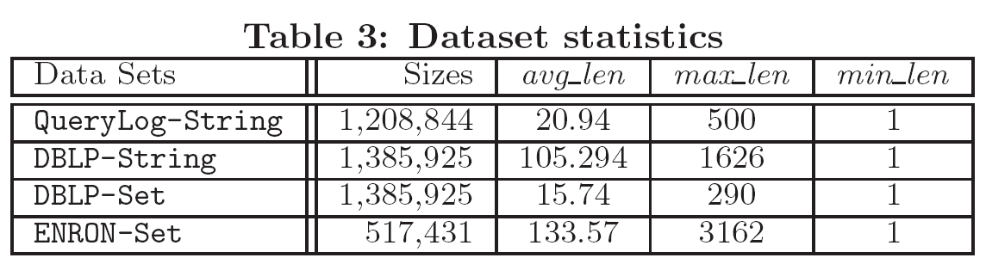
Experiment Setup
Dataset statistics
Existing techniques
 | String | Set
SimJoin | Trie-Join [VLDB’10], ChunkGram [SIGMOD’11] | ppjoin, ppjoin+ [WWW’08]
SimSearch | Flamingo [ICDE’08], ChunkGram [SIGMOD’11] | Flamingo [ICDE’08]

Slide 31
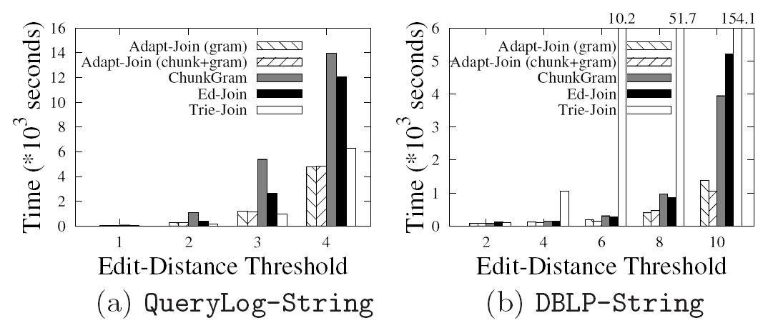
Similarity Join

Slide 32
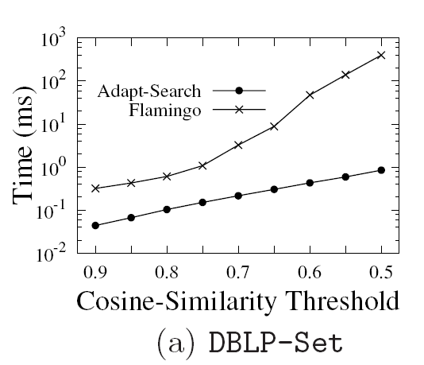
Similarity Search

Slide 33
Conclusion
Different prefix schemes lead to significantly different performance, and prefix filtering (1-prefix scheme) did not always achieve high performance
An adaptive framework for similarity join and similarity search
Experimental results show that our adaptive framework outperforms the prefix-filtering framework and achieves higher performance than the state-of-the-art methods
Future Work

Slide 34
Thanks!
Q&A
http://dbgroup.cs.tsinghua.edu.cn/wangjn/projects/adapt/

