Slide 1




Reliability Assurance for Deep Neural Network Architectures Against Numerical Defects
Linyi Li
University of Illinois Urbana-Champaign
Yuhao Zhang
University of Wisconsin-Madison
Luyao Ren
Peking University
Yingfei Xiong
Peking University
Tao Xie
Peking University
Notes:
Hello, everyone, good morning!
I’m Linyi Li from UIUC, and I’m here to introduce our work on
reliability assurance for deep neural network architectures, in other words, DNN architectures, against numerical defects.
This is joint work with Yuhao Zhang from Wisconsin, and Luyao Ren, Yingfei Xiong, and Tao Xie, the corresponding author, from Peking University.

Slide 2
Background DNN Architectures Defined by Python Programs
Define DNN architecture
with Python libraries (e.g., PyTorch, Tensorflow)
1
2
3
4
5
6
7
8
9
10
11
12
13
input_data = tf.placeholder("float", [32, 784], name='x-input') input_labels = tf.placeholder("float", [32, 10], name='y-input’)
self.W_ = tf.Variable(tf.zeros([n_features, n_classes]),
name='weights') self.b_ = tf.Variable(tf.zeros([n_classes]),
name='biases') model_output = tf.nn.softmax(tf.matmul(self.input_data, self.W_) +
self.b_)
cost = -tf.reduce_mean(ref_input * tf.log(model_output) + (1 - ref_input) * tf.log(1 - model_output),
name='cost') self.obj_function = tf.reduce_min(tf.abs(model_output),
name='obj_function')
Initialize weights from random
DNN model = architecture + weights
weights = random_init()
model = architecture(·, weights)
Training phase:
Feed in training dataset to update weights
weights = architecture(training_data, weights)
DL program defines DNN architecture
Inference phase:
Feed in test data instance to get prediction
result = architecture(test_data, weights)
Notes:
This work focuses on ensuring the numerical reliability of DNN architectures.
In deep learning, users define DNN architectures with Python libraries like PyTorch and TensorFlow, as shown in the left figure.
Then, users usually use the same code to
initialize DNN weights,
feed in training data,
train the weights to get model,
and use the model to make predictions for the test data.

Slide 3
Numerical Defects
Define DNN architecture
with Python libraries (e.g., PyTorch, Tensorflow)
result = architecture(test_data, weights)
print(result)
>> inf / nan
When numerical defect triggered,
DNN model outputs inf or nan
rather than meaningful numbers
Initialize weights from random
DNN model = architecture + weights
weights = random_init()
model = architecture(·, weights)
Training phase:
Feed in training dataset to update weights
weights = architecture(training_data, weights)
Inference phase:
Feed in test data instance to get prediction
result = architecture(test_data, weights)
Notes:
However, one commonly seen defect is the numerical defect.
If the trained DNN model outputs inf or nan for legal test data, the numerical defect is triggered, and no meaningful prediction is given from the DNN model.

Slide 4

Numerical Defects are Widespread & Disastrous
Widely exist:
One of most common issues in DL programs [1,2]
At architecture level
All models sharing same architecture inherit the defects
→ Affect lots of developers & users
Serious consequence:
Output inf or nan, result in system crashes
Disastrous in high availability scenarios
Example: DL for threat monitoring, DL for system controlling
Wastes massive time and resource to fix
Hours, Days, Weeks, Months, …
[1] An empirical study on tensorflow program bugs. ISSTA 2018
[2] DeepStability: A study of unstable numerical methods and their solutions in deep learning. ICSE 2022
Notes:
Numerical defects widely exist and have serious consequences.
As identified by existing empirical studies, numerical defects are one of the most common issues in deep learning programs.
What’s even worse, numerical defects exist at the architecture level, so all models sharing the same architecture will inherit the defects.
At the same time, numerical defects can lead to serious consequences.
When numerical defects are triggered, model outputs inf or nan instead of any meaningful numerical value, which may result in system crashes.
So numerical defects are quite disastrous in high availability scenarios, like deep learning for threat monitoring and system controlling.
Moreover, numerical defects reveal at the deployment stage, so they would need massive time and resources to fix.

Slide 5
We propose RANUM First Holistic Framework for Assuring Numerical Reliability
Input: DNN Architecture
Solved Open Problems
Key Technique
Solve:
How to support generic architectures, including dynamic ones?
① Potential-Defect Detection
Locate Nodes with Numerical Defects
Static Analysis with
adaptive block merging
② Feasibility Confirmation
Step a: Generate Failure-Exhibiting Unit Tests
Step b: Generate Failure-Exhibiting System Tests
Solve:
How to generate training data to confirm feasibility?
DLG Attack
Solve:
How to fix or bypass numerical defects automatically?
Abstraction Optimization with differentiable abstraction
③ Fix Suggestion
Suggest to Add Clipping Operators
Notes:
To mitigate the numerical defects, we propose RANUM.
RANUM is the first holistic framework for assuring the numerical reliability of DNN architectures.
In RANUM, for a given DNN architecture, we summarized three-stage tasks to assure numerical reliability.
First, we need to detect potential numerical defects.
Here, existing method only supports static architectures and RANUM supports generic architectures including dynamic ones.
Our main technique is static analysis with adaptive block merging.
Second, we need to confirm the feasibility of these detected potential defects.
Here, we confirm by generating system tests that trigger the defects, by a technique inspired by DLG attack from machine learning security research.
Third, we need to fix the numerical defects.
We fix the defects by generating preconditions that can be transformed to clip operators.
We generate preconditions by a new technique of abstract optimization with differentiable abstraction.

Slide 6
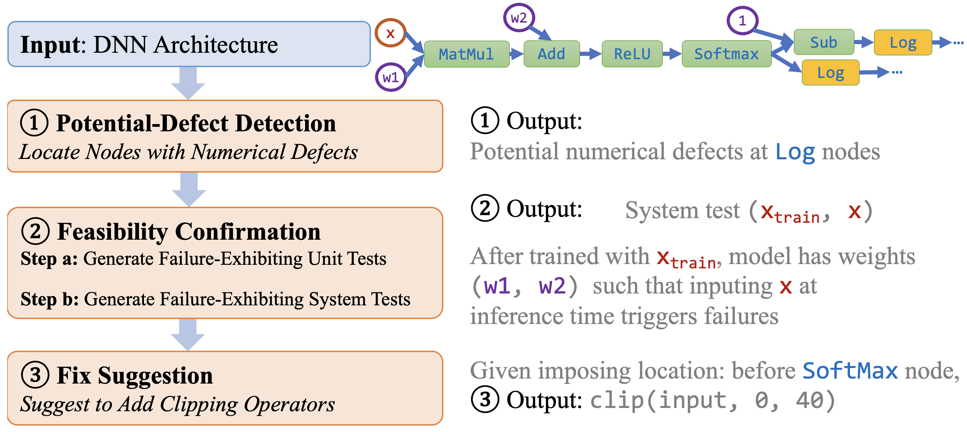
Running Example
(DNN architectures are auto-convertible to acyclic computational graphs)
Notes:
Here is a running example.
For a DNN architecture, we first automatically convert it to a computational graph.
In the first step, RANUM finds that the Log nodes may contain numerical defects since their inputs could be negative.
In the second step, RANUM generates a failure-exhibiting system test (xtrain, x) to confirm the defect feasibility.
The tuple (xtrain, x) satisfies that, after the model is trained with xtrain, the model will trigger numerical failure when the test input is x.
In the third step, RANUM suggests clipping operators to add to the DNN architecture, to fix the numerical defects.
Here, suppose the user requires the clipping operator to be added before the softmax node, then RANUM can generate a clipping interval at this place that verifiably fixes the numerical defects.
Now, let me briefly introduce RANUM approach for the first step and the third step.

Slide 7
Task: Detection of Potential Defects
Numerical defect triggered when vulnerable operator receives invalid input
E.g., negative input for Log operator
For all operators, detect whether its input can be invalid
Notes:
In the first step, our task is to detect potential numerical defects.
When numerical defects exist, the program outputs NaN or inf.
What causes this?
We found that it must be because some operators in the architecture takes invalid input.
For instance, negative input is invalid for a log operator.
Hence, to detect potential defects, we can detect whether the inputs for any operator in the architecture can be invalid.

Slide 8






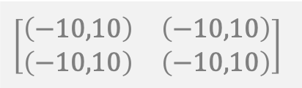

Approach Static Analysis based on Inteval Bound Propagation
Key idea: Propagating intervals of possible values through nodes
Starting from interval of input & weight nodes
Induce input interval of each operator
If interval overlaps invalid range, alert
$[\left(−10,10\right),\left(−10,10\right)]$
$$\left[\begin{matrix}\left(−10,10\right) & \left(−10,10\right) \\ \left(−10,10\right) & \left(−10,10\right)\end{matrix}\right]$$
1
x-input
weights
$$[\left(−200,200\right),\left(−200,200\right)]$$
3 MatMul
2
5 Add
4
$$[\left(−10,10\right),\left(−10,10\right)]$$
$$[\left(−210,210\right),\left(−210,210\right)]$$
biases
6 Softmax
$$[\left(0,1\right),\left(0,1\right)]$$
Const=1
7
8 Sub
$$[\left(0,1\right),\left(0,1\right)]$$
10 Log
17 Abs
$$[\left(0,1\right),\left(0,1\right)]$$
9 Log
!
!
Notes:
We propose to conduct static analysis through the architecure to detect invalid input.
At a high level, we propagate the intervals of possible inputs of each node through the architecture.
(click)
First, we start with the interval of input and weight node.
(click)
Second, we induce the input interval of each internal node.
(click)
Lastly, if some input intervals overlap the invalid range, we alert that there may be numerical defects.
(click)
As shown in this example, starting from initial intervals in gray boxes, we infer the intervals of internal nodes which are blue boxes. (click…)
For the last two log operators, we observe that their inputs could be 0, so we alert the existence of numerical defects.

Slide 9
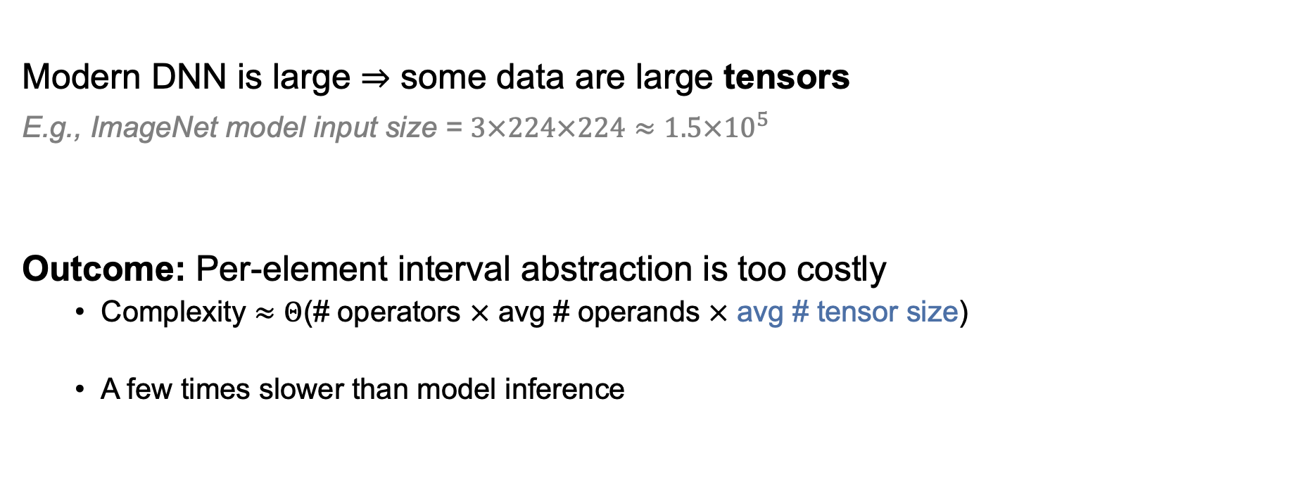
Too Costly!
Modern DNN is large $⇒$ some data are large tensors
E.g., ImageNet model input size = $3×224×224≈1.5×{10}^{5}$
Outcome: Per-element interval abstraction is too costly
Complexity $≈Θ$(# operators $×$ avg # operands $×$ avg # tensor size)
A few times slower than model inference
Large
Notes:
Though this technique itself is effective in terms of finding numerical defects,
It’s too costly.
The main reason is that, modern DNNs are large and
Some data are large tensors.
Hence, the conventional per-element interval abstraction is too expensive.
It shares at least the same time complexity as model inference, and it’s in practice a few times slower than model inference.

Slide 10

Optimization of Static Analysis
Observation: For large tensors, usually the same valid input interval across different elements
Solution: Merge blocks in a tensor (adaptively and selectively)
(1,9)
(3,9)
(2,8) | (4,5) | (3,8) | (4,6)
(1,9) | (2,9) | (3,9) | (3,9)
(3,7) | (3,6) | (4,7) | (4,8)
(4,8) | (5,8) | (1,9) | (2,9)
4 Blocks
(3,9)
(1,9)
Interval Bound $(lb, ub)$ for $4×4$ Tensor
Notes:
To accelerate the static analysis, we observe that,
For numerical defect detection, we care about the whole valid input space.
So, many large tensors have the same valid input interval across different elements.
This is a unique feature of static analysis for numerical defects.
So, we leverage this feature and merge blocks adaptively and selectively.
(click)
As shown here, for the original 4 by 4 tensor, we merge it at the level of 2 by 2 subblocks.
And only construct one interval abstraction for each subblock, to save both time and space.
(click) (click) This is our technique for potential defect detection. Thanks to our adaptive block merging, we can efficiently and precisely detect defects in large and generic DNN architectures.

Slide 11

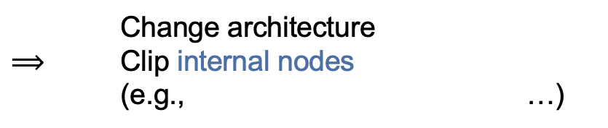
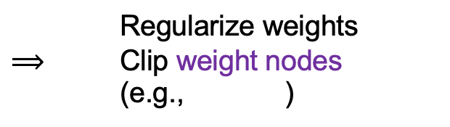
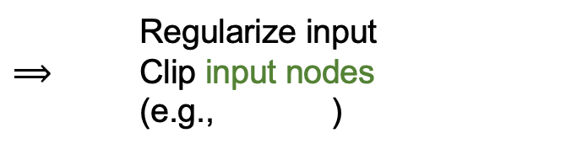
Task: Fix Suggestion via Input Clipping
Observation: developers fix numerical defects by clipping
Log(x) → Log(clip(x, min=1e-6))
1
x-input
Regularize input
$⟹$ Clip input nodes
(e.g., )
weights
Users:
3 MatMul
2
11
5 Add
4
1
biases
Const=1
6 Softmax
Model
Trainers:
Regularize weights
$⟹$ Clip weight nodes
(e.g., )
y-input
7
8 Sub
!
!
11
10 Log
17 Abs
9 Log
2
4
12
Const=1
15 Mul
18 ReduceMin
13 Sub
14 Mul
obj_function
Architecture
Designers:
Change architecture
$⟹$ Clip internal nodes
(e.g., …)
16 Add
cost
19 ReduceMin
3 MatMul
5 Add
6 Softmax
8 Sub
Notes:
In the third step, our task is to fix the detected numerical defects.
Before generating fixes, we first study how developers fix numerical defects.
From an empirical study,
(click)
Users regularize their input to fix, which corresponds to clipping the input nodes.
(click)
Model trainers regularize the model weights to fix, which corresponds to clipping the weight nodes.
(click)
And architecture designers directly clip the internal nodes.
So, people fix the defects by clipping the input for corresponding nodes.

Slide 12
Problem Formulation
Clip input nodes
(e.g., )
Given : nodes to clip,
generate clipping threshold for all nodes
such that
1
11
Clip weight nodes
(e.g., )
2
4
Clip internal nodes
(e.g., …)
3 MatMul
5 Add
6 Softmax
8 Sub
As long as inputs for specified nodes are clipped,
vulnerable operators always receive valid input
Notes:
Hence, we formalize the defect fix problem as:
Given a set of nodes to impose the fix,
Search for the clipping intervals,
Such that,
After the clip operation comes into effect,
All vulnerable operators always receive valid input.

Slide 13





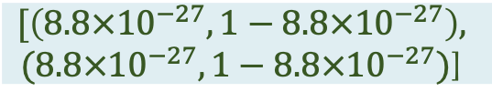

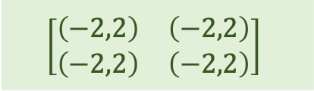

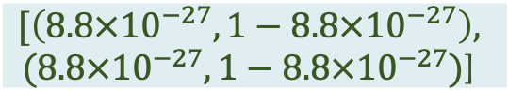

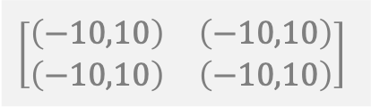

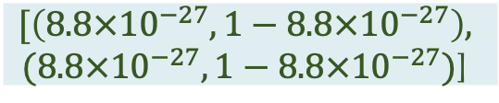
Example - A Successful Fix: Clip on weight node 2
$[\left(−10,10\right),\left(−10,10\right)]$
$$\left[\begin{matrix}\left(−10,10\right) & \left(−10,10\right) \\ \left(−10,10\right) & \left(−10,10\right)\end{matrix}\right]$$
1
x-input
$$\left[\begin{matrix}\left(−2,2\right) & \left(−2,2\right) \\ \left(−2,2\right) & \left(−2,2\right)\end{matrix}\right]$$
Fix @ here
weights
$$[\left(−20,20\right),\left(−20,20\right)]$$
3 MatMul
$$[\left(−200,200\right),\left(−200,200\right)]$$
2
5 Add
4
$$[\left(−10,10\right),\left(−10,10\right)]$$
$$[\left(−30,30\right),\left(−30,30\right)]$$
$$[\left(−210,210\right),\left(−210,210\right)]$$
biases
6 Softmax
$$[\left(8.8×{10}^{−27},1−8.8×{10}^{−27}\right),$$
$$(8.8×{10}^{−27},1−8.8×{10}^{−27})\text{]}$$
Const=1
$$[\left(0,1\right),\left(0,1\right)]$$
7
8 Sub
10 Log
17 Abs
$$[\left(8.8×{10}^{−27},1−8.8×{10}^{−27}\right),$$
$$(8.8×{10}^{−27},1−8.8×{10}^{−27})\text{]}$$
$$[\left(8.8×{10}^{−27},1−8.8×{10}^{−27}\right),$$
$$(8.8×{10}^{−27},1−8.8×{10}^{−27})\text{]}$$
$$[\left(0,1\right),\left(0,1\right)]$$
$$[\left(0,1\right),\left(0,1\right)]$$
9 Log
!
!
Notes:
Back to the running example before.
(click)
Suppose we clip the weights node here in green boxes.
We can propagate new intervals for each downstream nodes given the clipped interval.
(click...)
And then, we found both log operators are always receiving positive inputs.
So the numerical defects are fixed.

Slide 14

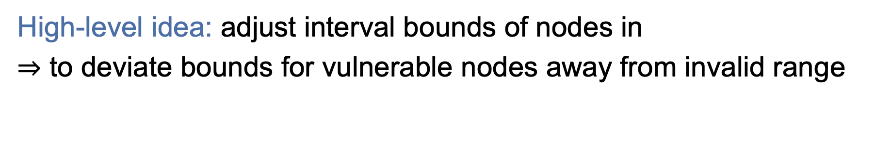







How to find fix? Abstraction Optimization
High-level idea: adjust interval bounds of nodes in
$⇒$ to deviate bounds for vulnerable nodes away from invalid range
$$l$$
$$u$$
$$l$$
$$u$$
1
2
$V_{fix}=\{$ , $\}$
1
2
Impose this fix on
2
…
…
(Vulnerable node Log needs positive input value)
$$l$$
$$u$$
Log
$$0$$
Notes:
Now, the problem is how to find nodes to clip and values to clip to.
Our high-level idea here is to adjust the interval bounds of upstream nodes,
We need to see which upstream node, and which adjusting direction, can make the interval bounds of vulnerable operators deviate away from the invalid range.
(click)
Suppose a log operator has two upstream nodes.
Purple node 1 and blue node 2.
If we adjust the purple node 1, and see the log operator’s input range is still possibly negative, which is still illegal for the log operator.
(click)
Then if we adjust the blue node 2, and see the log operator’s input range can be always positive.
(click)
Then we can conclude that the blue node is the one to impose fix.

Slide 15

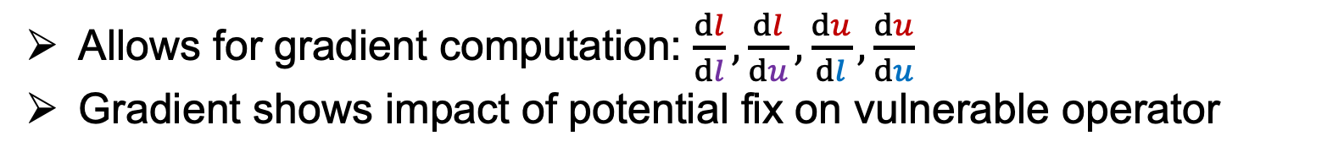
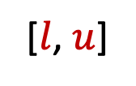
Abstraction Optimization: Optimizing differentiable interval bound
We construct symbolic interval bound
[$l$, $u$]
…
[$l$, $u$]
Symbolic
Linked
[$l$, $u$]
nodes’ interval bounds
vulnerable operator’s
interval bound
Allows for gradient computation: $\frac{dl}{dl},\frac{dl}{du},\frac{du}{dl},\frac{du}{du}$
Gradient shows impact of potential fix on vulnerable operator
Notes:
How to know which upstream node, and which adjusting direction, can make the interval bounds of vulnerable operators deviate away from the invalid range?
We construct symbolic interval bounds from upstream nodes to the vulnerable operators.
Then, we leverage the auto-differentiation functionality to compute the gradients of vulnerable operator’s input interval with respect to upstream operators.
The gradients show the impact of potential fix.

Slide 16
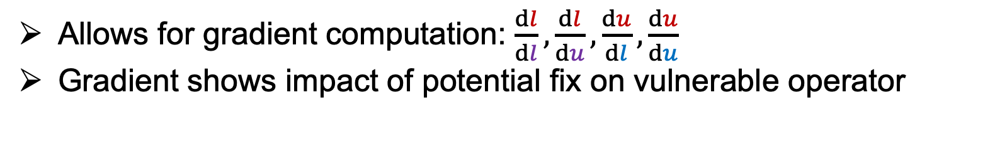
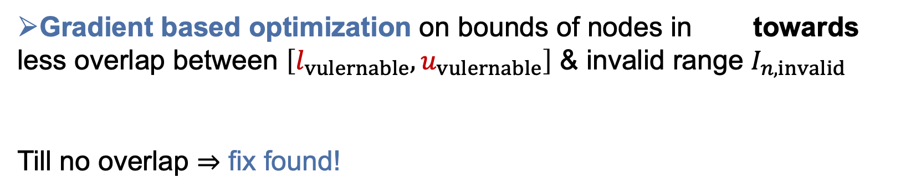
Abstraction Optimization: Optimizing differentiable interval bound
We construct symbolic interval bound
Allows for gradient computation: $\frac{dl}{dl},\frac{dl}{du},\frac{du}{dl},\frac{du}{du}$
Gradient shows impact of potential fix on vulnerable operator
Gradient based optimization on bounds of nodes in towards
less overlap between $\left[l_{vulernable},u_{vulernable}\right]$ & invalid range $I_{n,invalid}$
Till no overlap $⇒$ fix found!
Notes:
(click)
We use these gradients to guide the search of nodes, the search of directions, and the concrete values to clip.
We update the clipping intervals iteratively, until no overlap with the invalid range can be found.
More details are in our paper.

Slide 17
Result Highlights
① Potential-Defect Detection
# detected
defects
79
48
RANUM detects all 79 true defects in the benchmark in 3 seconds
Existing best tool DEBAR only detects 48 defects
Existing
Tool
(DEBAR)
Our Tool
(RANUM)
② Feasibility Confirmation
③ Fix Suggestion
Measure success rate on triggering numerical defects
Out of 790 runs,
RANUM succeeds in 733 runs
Avg time: 17.31s
Yes for most (30 out of 53) cases
Random succeeds in 649 runs
Avg time: 334.14s
13% success rate increase & 19.3X time saving
Notes:
How does RANUM perform in practice?
(click)
First, for potential defect detection, in a benchmark of 79 real-world defect programs, RANUM is able to detect all 79 defects within 3 seconds in total, whereas the existing tool can only detect 48 defects.
(click)
Second, for generating failure-exhibiting system tests, RANUM is the first approach.
When compared to the random baseline, RANUM has 13% success rate increase and 19 times runtime saving.
(click) Third, for generating defect fixes, RANUM is also the first automatic approach.
We conduct an empirical study to compare RANUM with human developers’ fixes.
We found that for most cases, namely 30 out of 53 cases, RANUM fixes are even better than human developers.

Slide 18
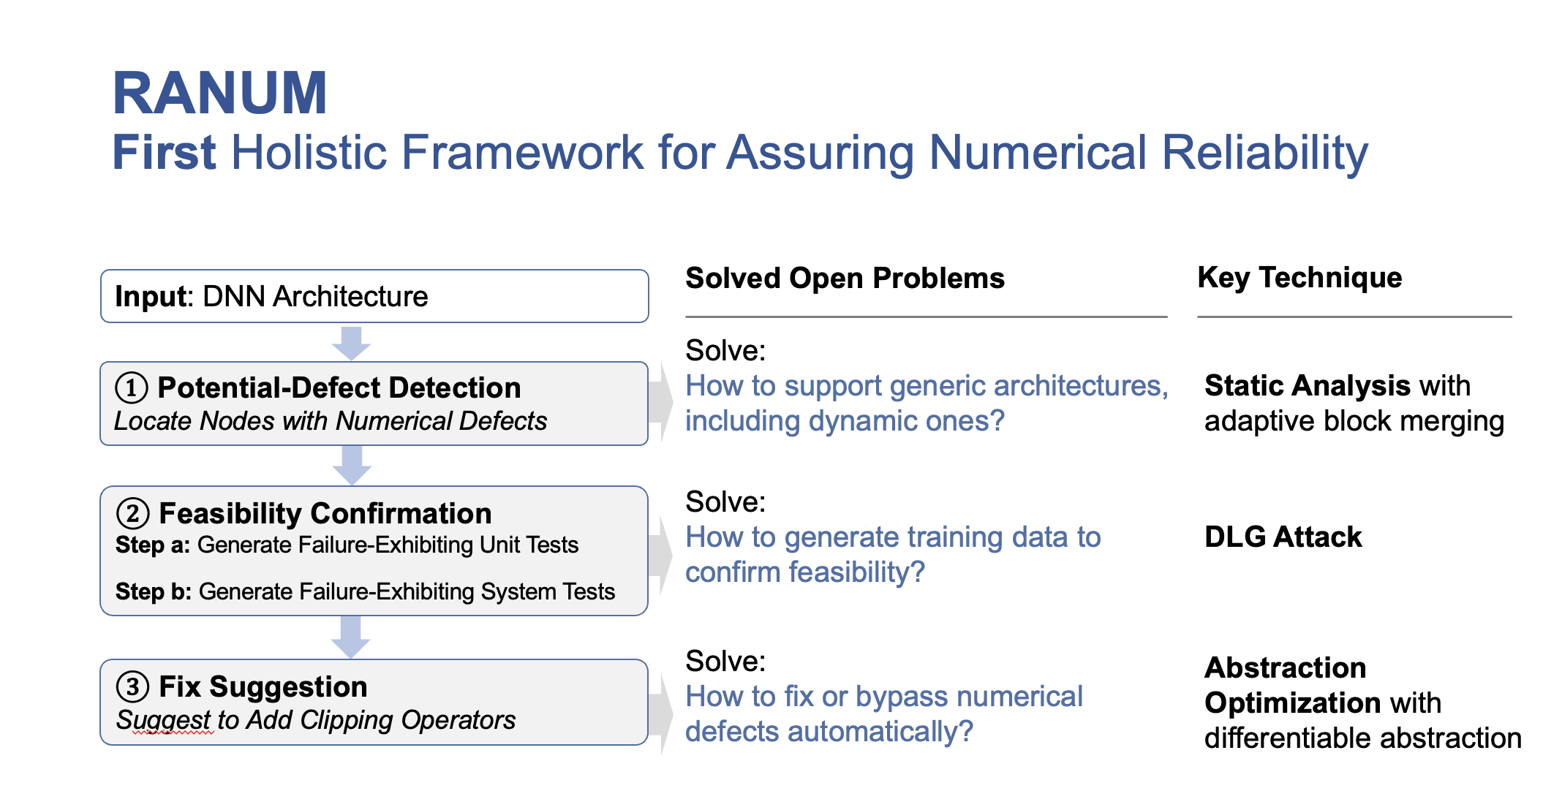
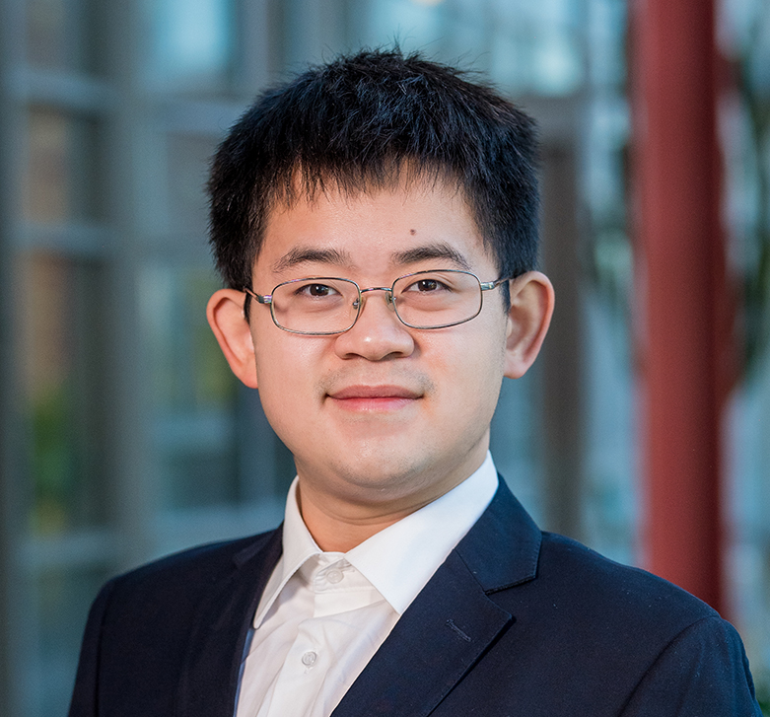


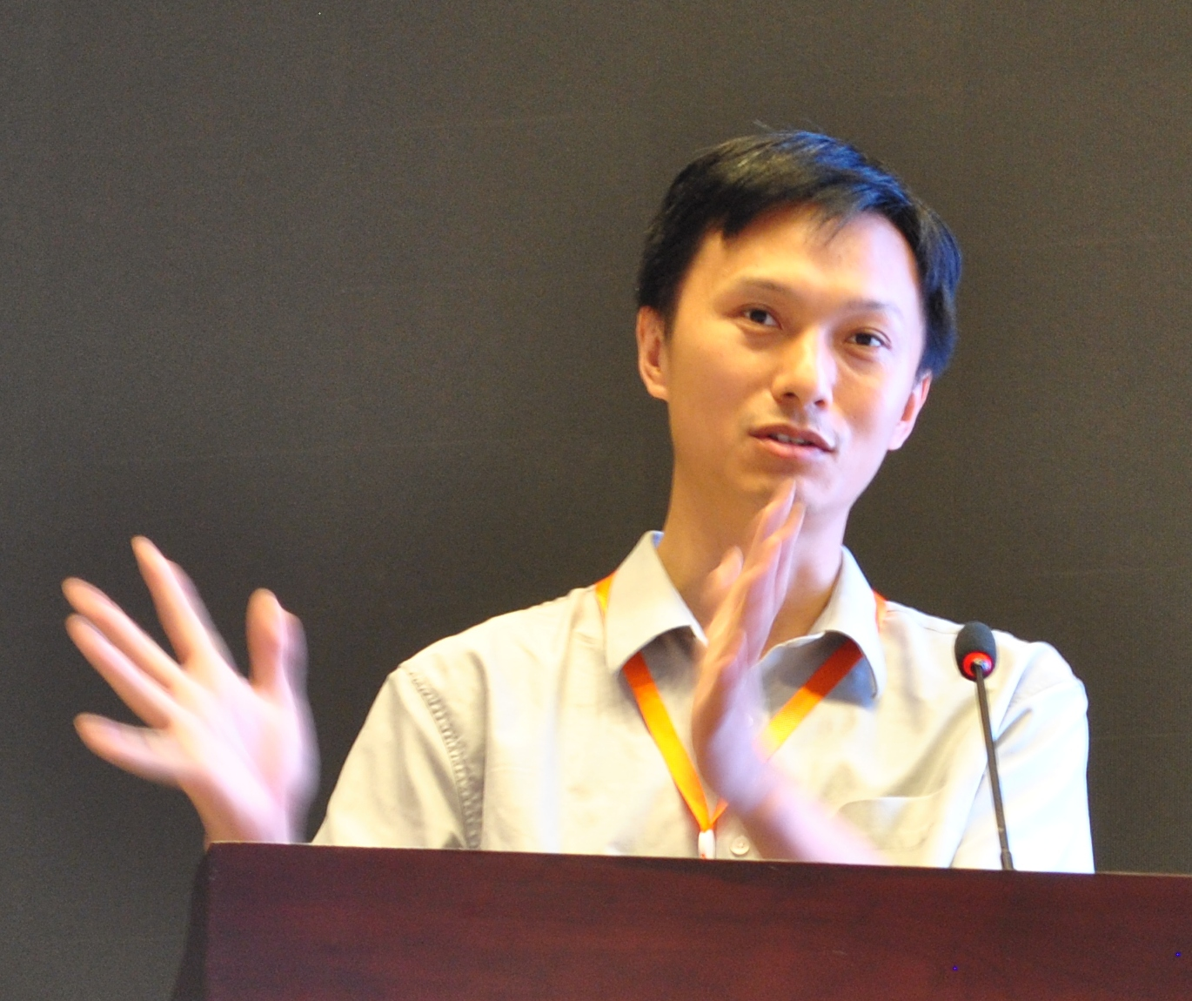


Thank you! Questions welcome!
Reliability Assurance for Deep Neural Network Architectures Against Numerical Defects
Linyi Li
University of Illinois Urbana-Champaign
Yuhao Zhang
University of Wisconsin-Madison
Luyao Ren
Peking University
Yingfei Xiong
Peking University
Tao Xie
Peking University
arxiv.org/abs/2302.06086
github.com/llylly/RANUM
Notes:
In summary, RANUM is the first holistic and automated framework for assuring numerical reliability.
RANUM can detect numerical defects, confirm their feasibility, and suggest fixes.
For more details, our paper is publicly available on ArXiv.
And our code is open source on GitHub.
Thank you! Any questions are welcome!

Slide 19
Appendix

Slide 20
Prior Work for DNN Numerical Reliability
Static Detection: DEBAR [1]
Label all operators with possible numerical defects
Limitation: supports only static architecture
How to support generic architectures, including dynamic ones?
Dynamic Detection: GRIST [2]
Generate failure-exhibiting weights & inference-phase inputs
Limitation: weights not attainable via training
How to generate training data to confirm feasibility?
No Debugging approach
How to fix numerical defects automatically?
[1] Detecting numerical bugs in neural network architectures. ESEC/FSE 2020
[2] Exposing numerical bugs in deep learning via gradient back-propagation. ESEC/FSE 2021
Notes:
Explain the relationship between detection and debugging
Static architecture:
No if/loop/while/repeat/… in the architecture
Instead, dynamic architecture is widely used in NLP, e.g., RNN and Transformer

Slide 21

Task 2: Feasibility Confirmation via Training Data Generation
Three Tasks $⟺$ Three Open Questions
Input: DNN Architecture
Key Technique
Solve:
How to support generic architectures, including dynamic ones?
① Potential-Defect Detection
Locate Nodes with Numerical Defects
Static Analysis with
adaptive block merging
② Feasibility Confirmation
Step a: Generate Failure-Exhibiting Unit Tests
Step b: Generate Failure-Exhibiting System Tests
Solve:
How to generate training data to confirm feasibility?
DLG Attack
Solve:
How to fix or bypass numerical defects automatically?
Abstraction Optimization with differentiable abstraction
③ Fix Suggestion
Suggest to Add Clipping Operators

Slide 22
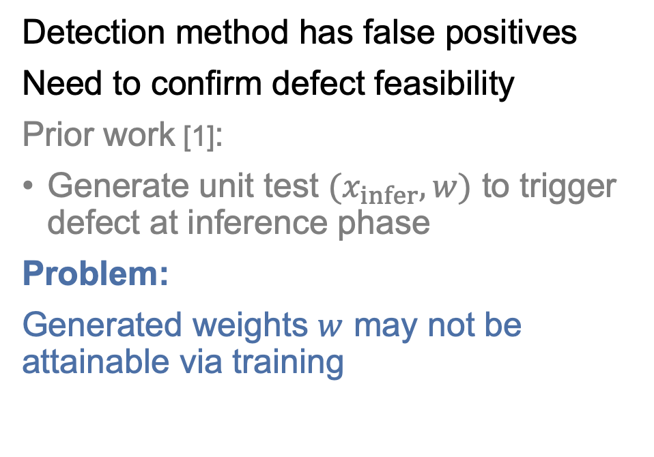
Generate Training Data to Confirm Feasibility
Define DNN architecture
with Python libraries (e.g., PyTorch, Tensorflow)
Initialize weights from random
DNN model = architecture + weights
weights = random_init()
model = architecture(·, weights)
Detection method has false positives
Need to confirm defect feasibility
Prior work [1]:
Generate unit test $(x_{infer}, w)$ to trigger defect at inference phase
Problem:
Generated weights $w$ may not be attainable via training
Training phase:
Feed in training dataset to update weights
weights = architecture(training_data, weights)
Inference phase:
Feed in test data instance to get prediction
result = architecture(test_data, weights)
[1] Exposing numerical bugs in deep learning via gradient back-propagation. ESEC/FSE 2021

Slide 23
Problem Formulation
Goal: Generate training data to trigger defect
Problem Formulation:
Given DNN architecture, weights , and initial weights ,
Find , such that after training, model weights
From existing unit test generation approach
Defined by architecture
Notes:
Weights come from training data
Given weights, generate inference data (not hard)
Go explicitly into training data generation
Explain intuition here

Slide 24
Connection to Deep Gradient Leakage Attack
(For ease of debugging, consider one-step training)
: learning rate
Notes:
Reduce equation
Separate Step 1 and Step 2. Mainly explain Step 2

Slide 25
Connection to Deep Gradient Leakage Attack
Find input sample to match the known gradient
Adapt Deep Gradient Leakage (DLG) Attack [1] to solve
[1] Deep Leakage from Gradients. NeurIPS 2019

Slide 26
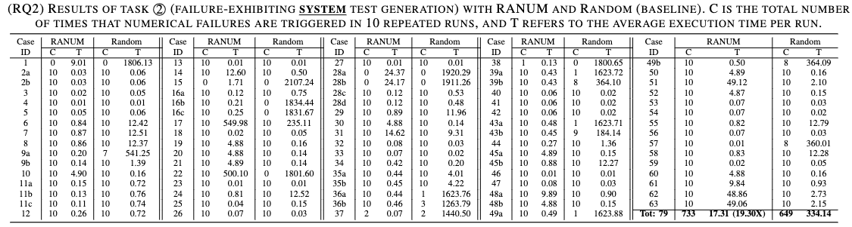
Results on Task 2: Generate Training Data
Measure success rate on triggering numerical defects
Out of 790 runs,
RANUM succeeds in 733 runs
Avg time: 17.31s
13% success rate increase & 19.3X time saving
Random succeeds in 649 runs
Avg time: 334.14s

