Slide 1

Deep Structured Models for Group Activities and Label Hierarchies
Greg Mori
Simon Fraser University

Slide 2
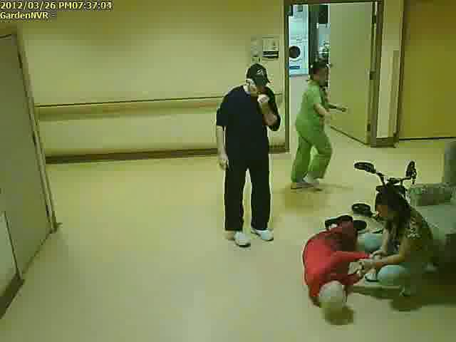
What does scene understanding involve?
Notes:
Most of my research is on understanding the content of images and videos. And in this talk, I will focus on understanding human activities. The overall goal of this line of research is, given an image (or maybe a video) such as this one, we want to extract semantic knowledge or descriptions about people in the image, such as what are the people doing in the image, where they are, and so on.
In computer vision, this general task is called human activity recognition. Now I will talk about what does activity recognition involve, when we put it down in terms of specific tasks for computers?
----- 会议笔记(3/15/13 14:49) -----
solution, much of work on the vision community on actions. and approach

Slide 3
Detection: are there people?
Notes:
Well, one thing we can do is find the persons in the image. This task is called person detection or localization. Here we localize persons by putting bounding boxes around them.

Slide 4
Image Tagging
people
indoor scene
nursing home
hallway
Notes:
After we find the persons, we can recognize their actions. This problem is very popular in the vision community, a variety of methods have been proposed to address the problem, such as bag-of-words, template based methods and so on. In the end, the goal is to let the computer to tell what each person is doing. My work goes beyond action recognition of a single person and focus on a higher level understanding of human activities, such as what is a group of people doing and how did a person interact with others. These questions requires understanding the structures inherent in human activities, in other words, the interactions among people.
For example, if we see a person falling in a room, then the group of people around her might be trying to help her stand up.

Slide 5
Action recognition
run
stand
squat
fall
Notes:
After we find the persons, we can recognize their actions. This problem is very popular in the vision community, a variety of methods have been proposed to address the problem, such as bag-of-words, template based methods and so on. In the end, the goal is to let the computer to tell what each person is doing. My work goes beyond action recognition of a single person and focus on a higher level understanding of human activities, such as what is a group of people doing and how did a person interact with others. These questions requires understanding the structures inherent in human activities, in other words, the interactions among people.
For example, if we see a person falling in a room, then the group of people around her might be trying to help her stand up.

Slide 6
Group activity recognition
help the fallen person
Notes:
So in terms of understanding structures among people, there are more tasks we can define. Such as group activity recognition. That is to recognize the activities performed by a group of people.

Slide 7
Structures
people
run
stand
indoor scene
hallway
nursing home
squat
fall
Structures
help the fallen person
Notes:
After we find the persons, we can recognize their actions. This problem is very popular in the vision community, a variety of methods have been proposed to address the problem, such as bag-of-words, template based methods and so on. In the end, the goal is to let the computer to tell what each person is doing. My work goes beyond action recognition of a single person and focus on a higher level understanding of human activities, such as what is a group of people doing and how did a person interact with others. These questions requires understanding the structures inherent in human activities, in other words, the interactions among people.
For example, if we see a person falling in a room, then the group of people around her might be trying to help her stand up.

Slide 8
Intention/social role
get help
watch
comfort
Notes:
We can also recognize the higher-level intentions/roles of people in the social activities, such as ... So we can see that these types of higher-level visual concepts are closely related to the understanding of human interactions. For example, if we didn’t see the person in read who fell to the ground, than we couldn’t tell the person next her is comforting. Probably she is just squatting there.

Slide 9
a nurse is trying to comfort a fallen resident, a person is watching, another nurse is running to get some help.
Notes:
So assuming that we can train the computer to fully understand the structures among people in the scene, then ideally it would be able to generate a short description of their activities – So this kind of descriptions close to human descriptions of the image. Of course, achieving human-level visual perception is probably AI-complete, but understanding the structures in human activities is one step towards it. And this is the main intuition and philosophy behind my work.

Slide 10
Advantages of Modeling Structures
Analyze levels of detail
  Body parts vs. whole
  Actions of individuals
  Relationships between individuals
  Overall scene-level understanding
Provide context for recognition
Notes:
Here I will summarize the advantages of modeling this kind of structures.

Slide 11
Outline
Temporal structured models for group activities
  Ibrahim et al. CVPR 2016
Message passing with deep structured networks
  Deng et al. BMVC 2015, CVPR 2016
Image annotation with label hierarchies
  Hu et al. CVPR 2016

Slide 12
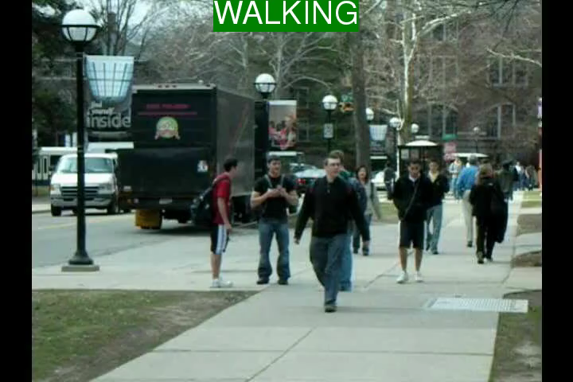
Example: surveillance scene
Notes:
We consider two types of scenarios. First is a surveillance scene. Here, in this example, most of the people are seen walking on a sidewalk, and therefore this video could be labelled as a walking scene.

Slide 13
It’s a walking scene.
Walking
Walking
Walking
Walking
Standing
Standing
Walking
Notes:
We consider two types of scenarios. First is a surveillance scene. Here, in this example, most of the people are seen walking on a sidewalk, and therefore this video could be labelled as a walking scene.

Slide 14
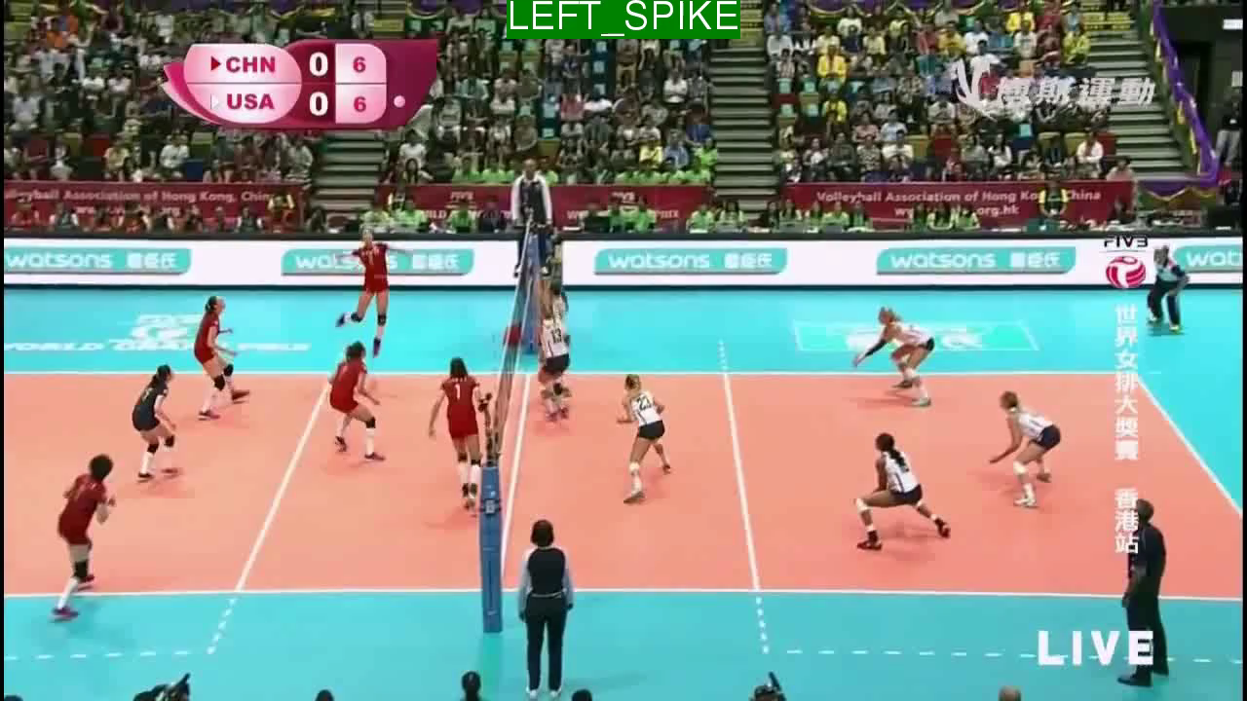
Example: Rally in a Volleyball Game
Notes:
The second example is a rally in volleyball scene. Here, the high level activity is determined by the main activity taking place, i.e. a player in the left side involved spiking. Therefore, we could label this scene as left_spike.

Slide 15
Left Spike
Spiking
Waiting
Standing
Waiting
Waiting
waiting
Moving
waiting
Waiting
Waiting
Standing
Notes:
The second example is a rally in volleyball scene. Here, the high level activity is determined by the main activity taking place, i.e. a player in the left side involved spiking. Therefore, we could label this scene as left_spike.

Slide 16
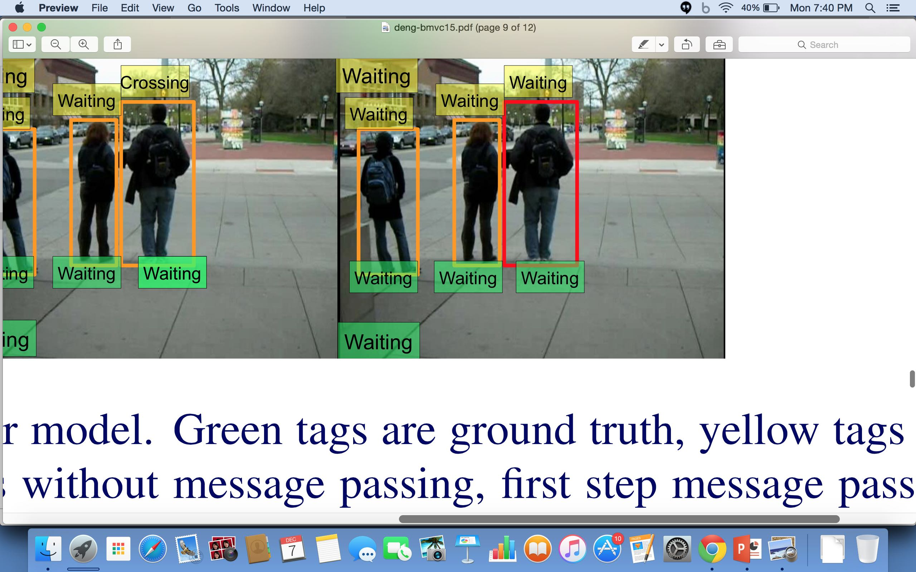
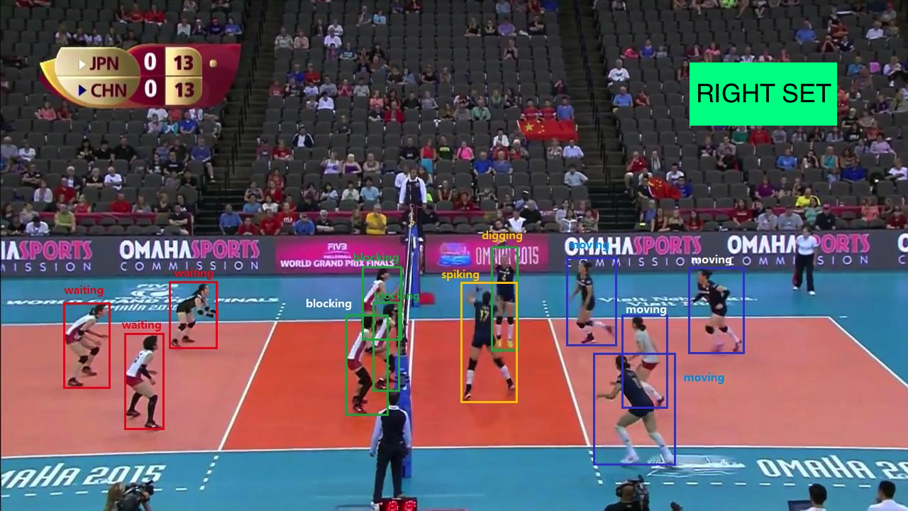
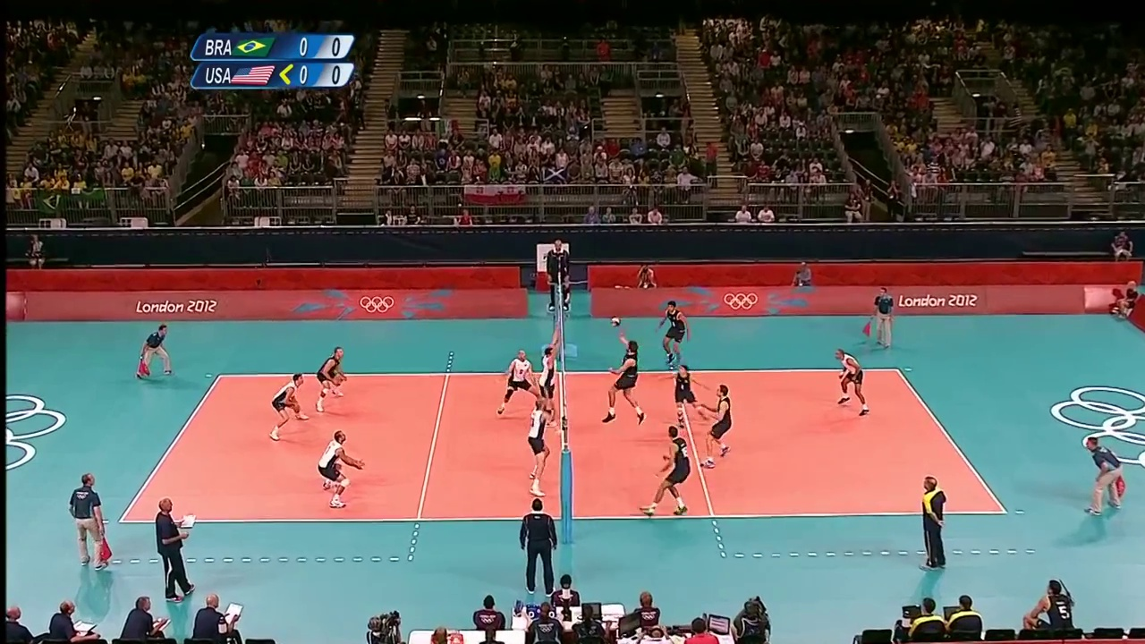
Group Activity = Majority’s Activity
Group Activity = Key Player’s Activity
Challenge 1: context dependency
Group Activity – Right spike
Challenge 2: high level description

Slide 17
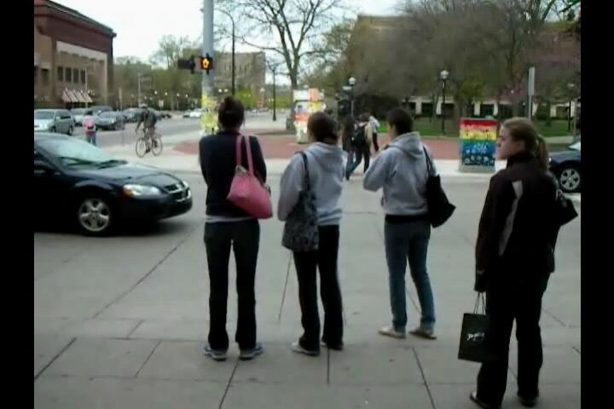
Image Classifier
Group activity label
Notes:
Be careful with the description!

Slide 18

Intuitive fix: Use only the foreground features
Notes:
Therefore, the intuitive fix is to use just the features obtained from foreground

Slide 19
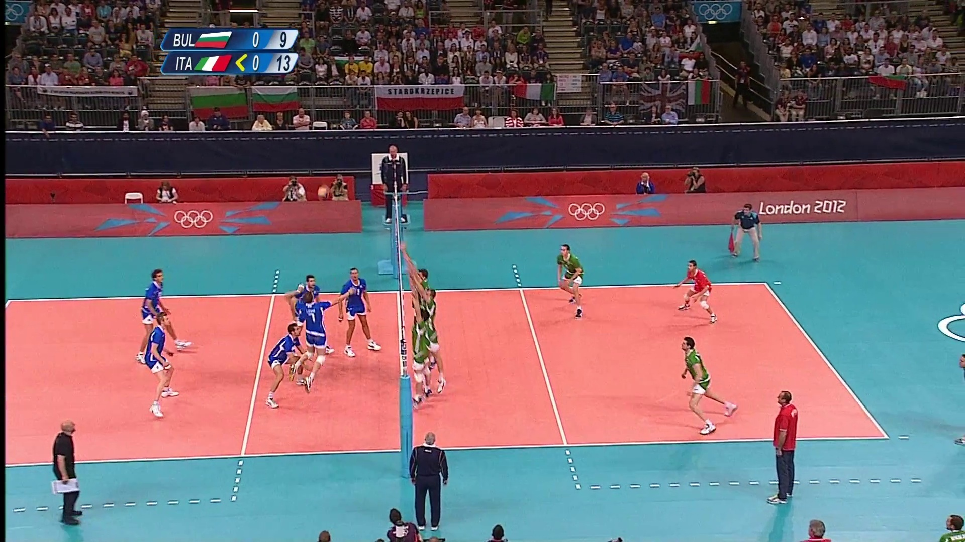
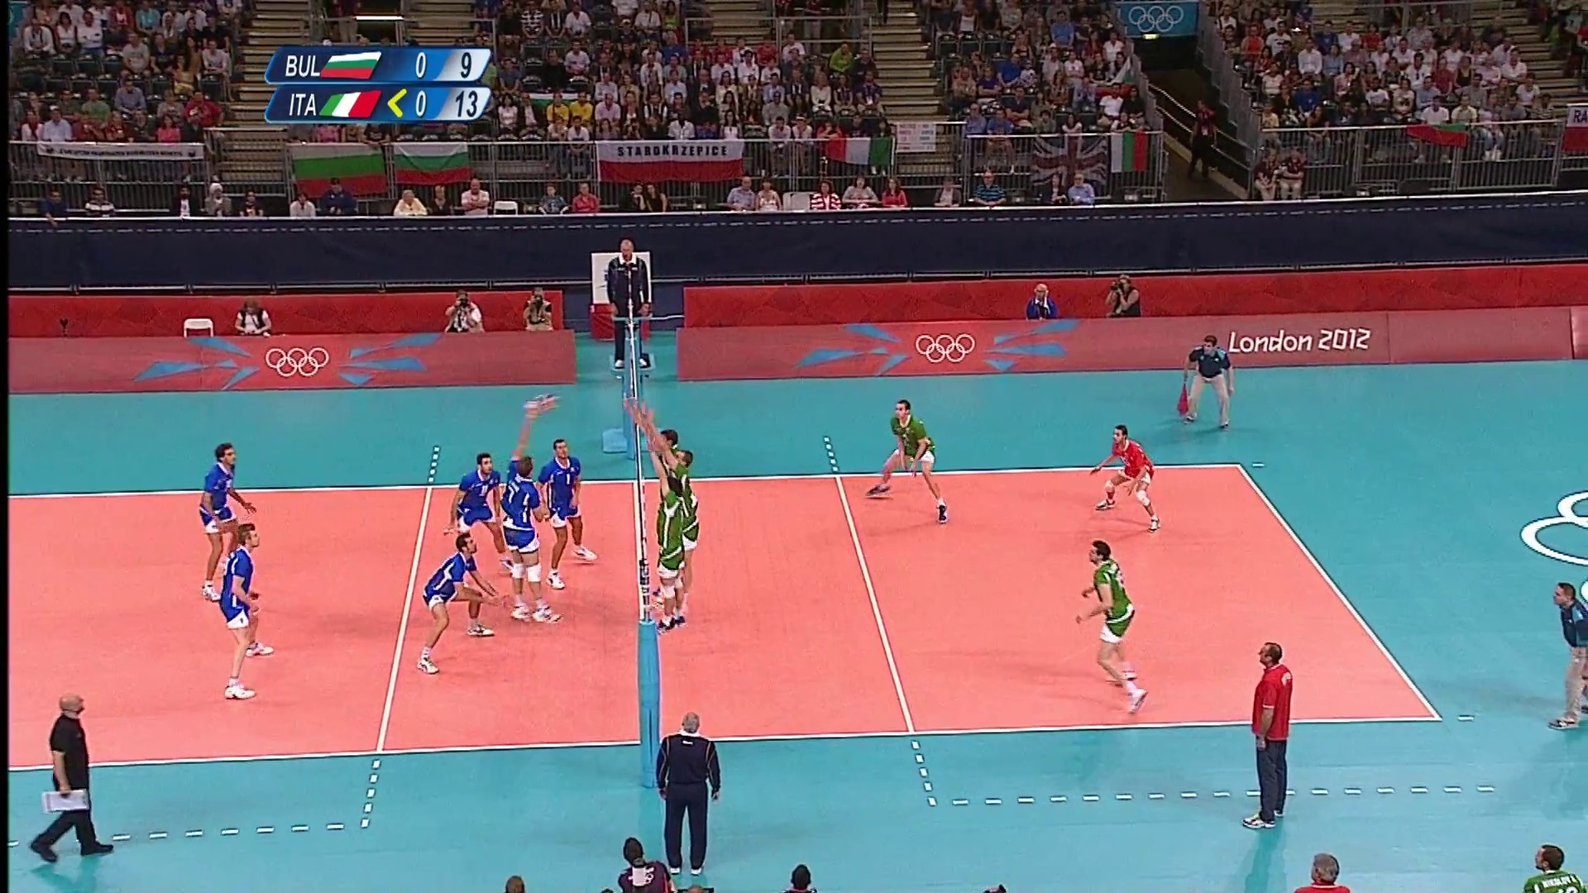
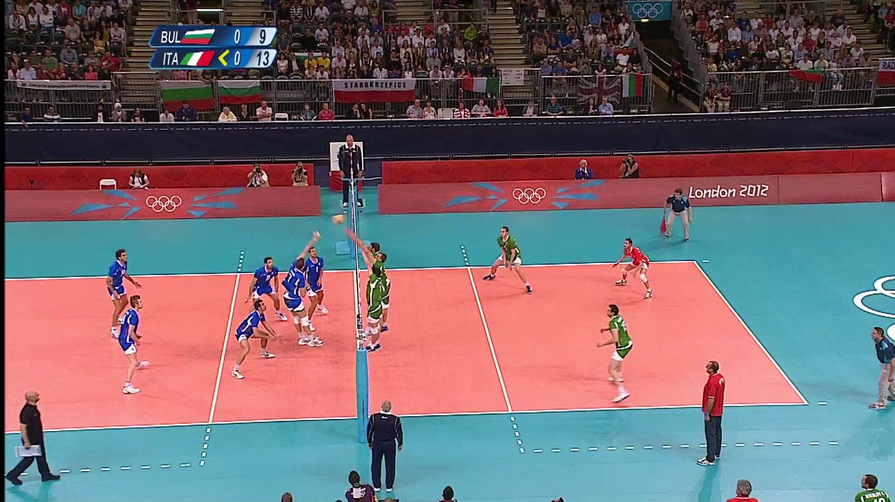

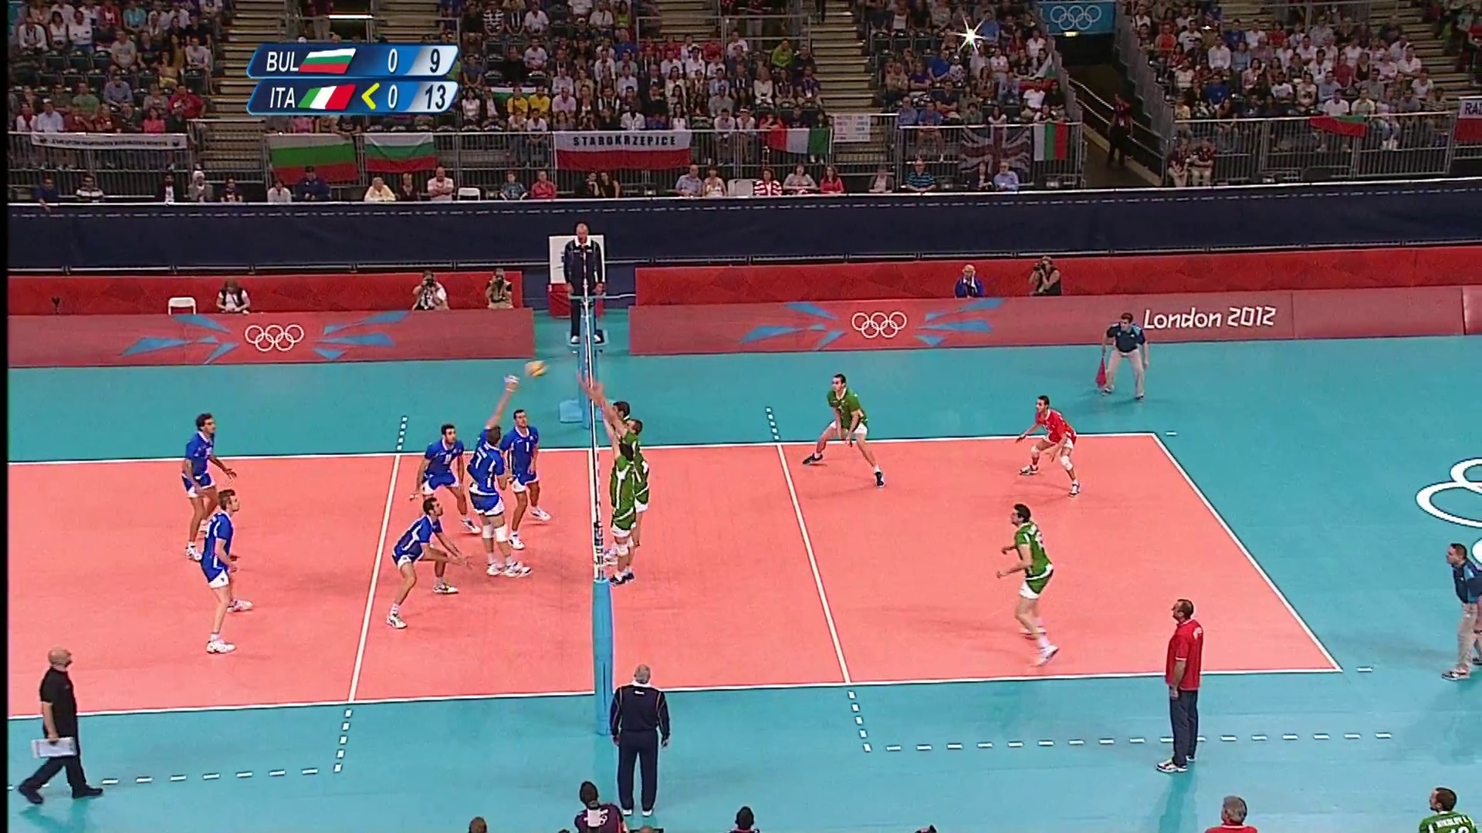





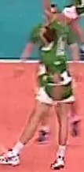
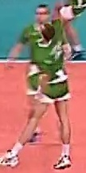
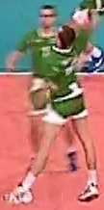
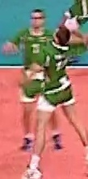
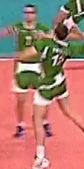
Person Tracks
  Extract trajectories by tracking each person forward/backward in time

Slide 20
Group Activity – ????
digging
waiting
waiting
spiking
waiting
Person classifier
Notes:
We cut out all the people, extract their feature representation

Slide 21
Hierarchical Model
Pool person features
digging
waiting
waiting
spiking
waiting
Stage 1 - Person feature extractor
Notes:
We cut out all the people, extract their feature representation

Slide 22
Pipeline Overview
Learn People Representations
Aggregate People Representations
Learn Group Representations

Slide 23
LSTM – An Introduction
Stands for Long Short Term Memory
Sequential Neural Network that learns from arbitrary length inputs

Slide 24
LSTM – An Introduction
Output
Output
Output
LSTM
LSTM
LSTM
x(t=T)
x(t=T+1)
x(t=T+2)

Slide 25
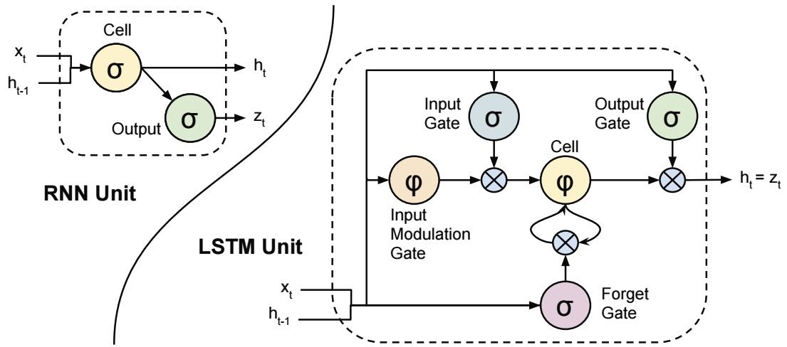
We use LSTMs for building person classification model and extracting person features
We construct an LSTM based frame classifier on top of pooled LSTM features

Slide 26



Stage1 : Learning Individual Activity Features
Walking
Walking
Walking
LSTM
LSTM
LSTM
Alexnet
Alexnet
Alexnet

Slide 27




Stage1 : Learning Individual Activity Features
Person 1
LSTM
Person 1 feature
Representation
LSTM
Person 2 feature
Representation
Person 2
LSTM
Person 3 feature
Representation
Person 3
.
.
.
.
.
.
.
.
.
.
.
.
.
LSTM
Person n feature
Representation
Person N

Slide 28
Stage 2: Learning Frame Representations
Person 1
LSTM
Person 1 feature
Representation
LSTM
Person 2 feature
Representation
Person 2
LSTM
Aggregate
LSTM
Person 3 feature
Representation
Person 3
.
.
.
.
.
.
.
.
.
.
.
.
.
LSTM
Person n feature
Representation
Person N

Slide 29
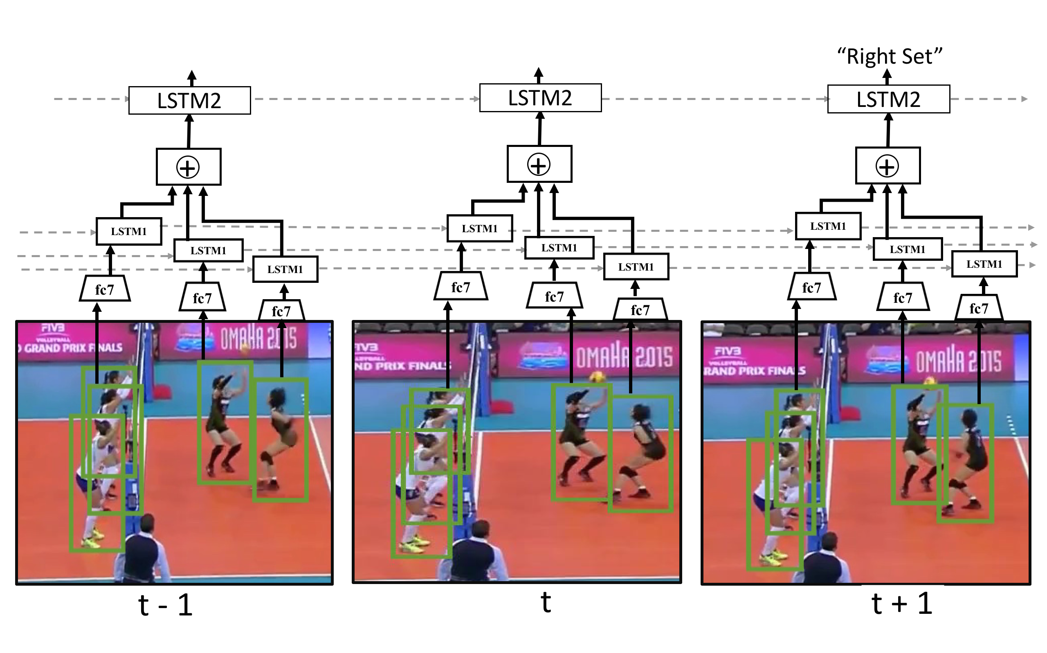
Summary

Slide 30
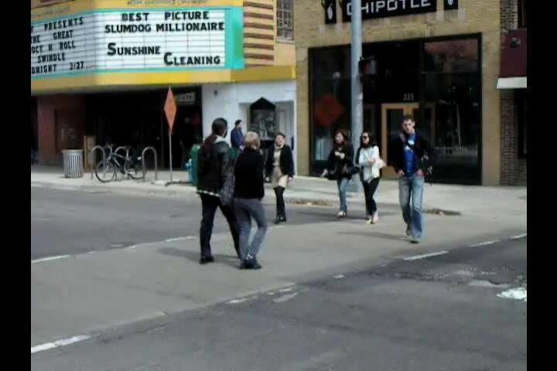
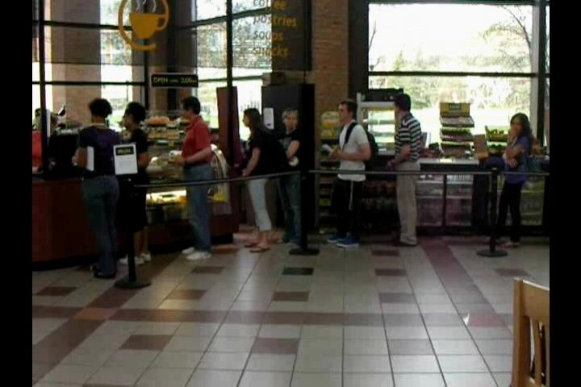
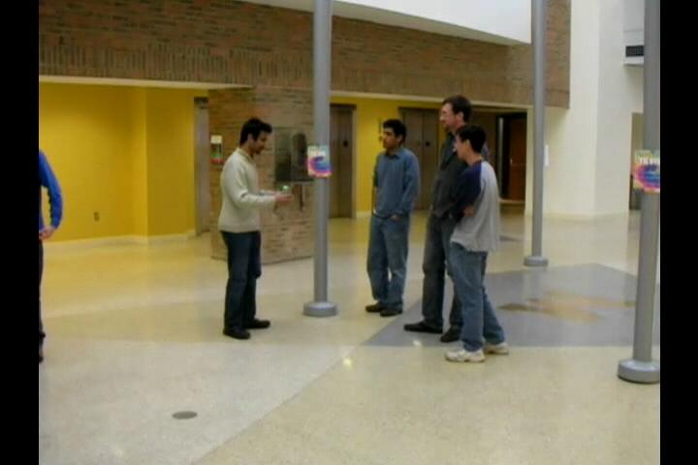
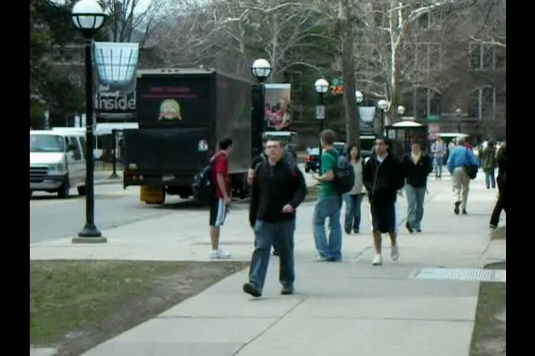
Collective Activity Dataset
  Same label set for people and group activities
  1925 video clips for training, 638 video clips for testing
1. Crossing
2. Queueing
3. Talking
4. Waiting
5. Walking

Slide 31
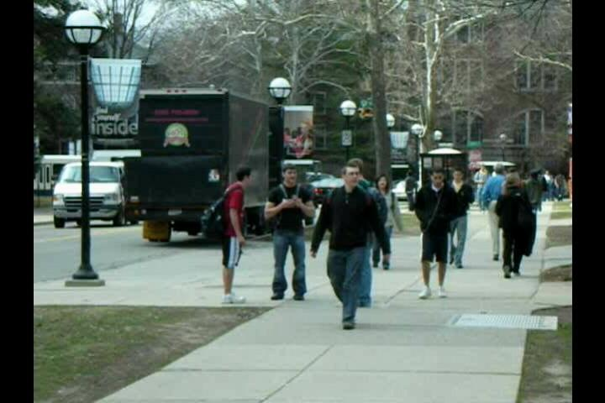
Collective Activity Dataset
Method | Accuracy
Image Classification | 63.0
Person Classification | 61.8
Person - Fine tuned | 66.3
Temp Model - Person | 62.2
Temp Model - Image | 64.2
Our Model w/o LSTM1 | 70.1
Our Model w/o LSTM2 | 76.8
Our Model | 81.5
LSTM
LSTM

Slide 32
Collective Activity Dataset
Method | Accuracy
Image Classification | 63.0
Person Classification | 61.8
Person - Fine tuned | 66.3
Temp Model - Person | 62.2
Temp Model - Image | 64.2
Our Model w/o LSTM1 | 70.1
Our Model w/o LSTM2 | 76.8
Our Model | 81.5
Method | Accuracy
Contextual Model [Lan NIPS’10] | 79.1
Deep Structured Model [Deng BMVC‘15] | 80.6
Our Model | 81.5
Cardinality Kernel [Hajimirsadeghi CVPR‘15] | 83.4

Slide 33
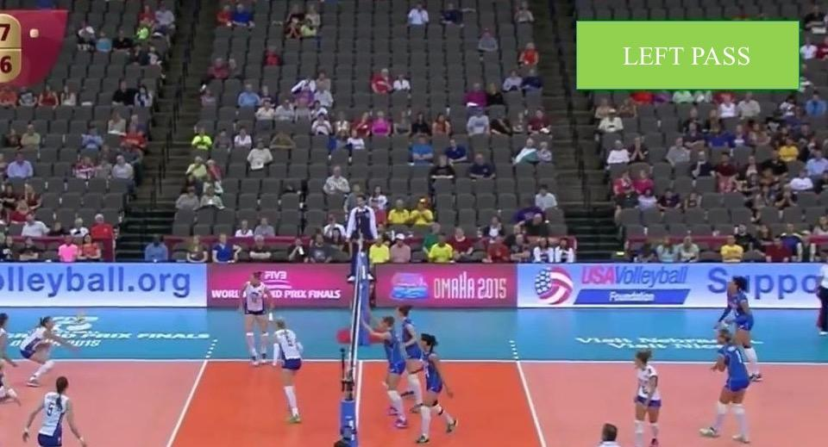
Volleyball Dataset – Frame Labels
  4830 frames annotated from 55 volleyball videos
  2/3 videos for training, 1/3 testing
  9 player action labels
  4 scene labels
Spiking
Setting
Passing
Win point
Left/right team variants

Slide 34
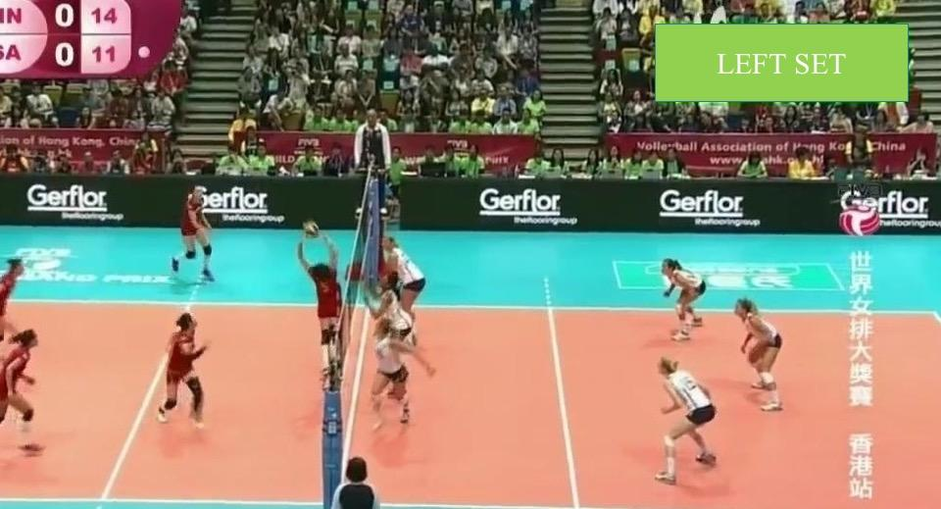

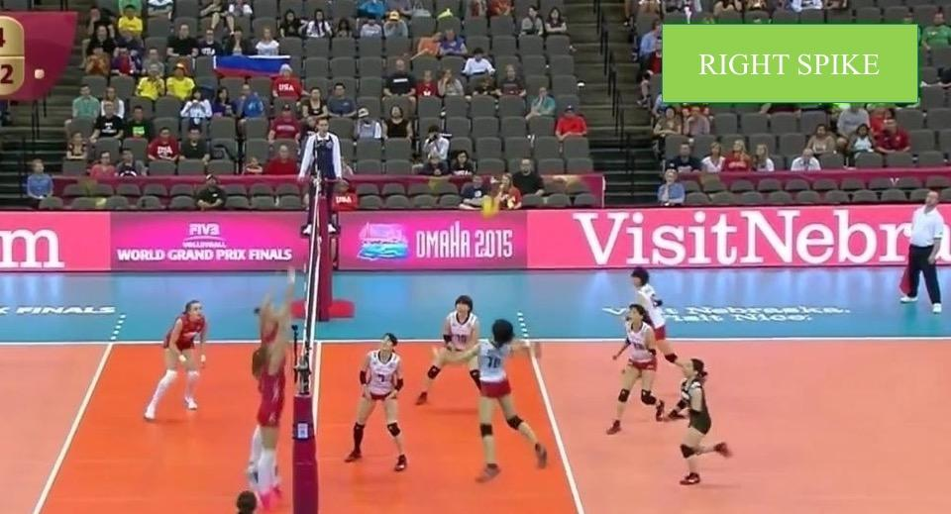
Volleyball Dataset – People Labels
Waiting
Digging
Setting
Spiking
Falling
Jumping
Moving
Standing
Blocking

Slide 35
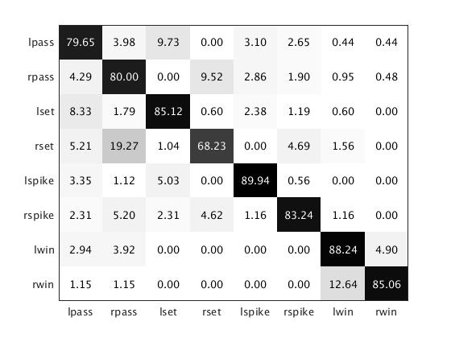
Experimental results on Volleyball Dataset
Method | Accuracy
Image Classification | 66.7
Person Classification | 64.5
Person - Fine tuned | 66.8
Temp Model - Person | 67.5
Temp Model - Image | 63.1
Our Model w/o LSTM1 | 73.3
Our Model w/o LSTM2 | 80.9
Our Model | 81.6
LSTM
LSTM
Dense trajectories: 73.4-78.7

Slide 36
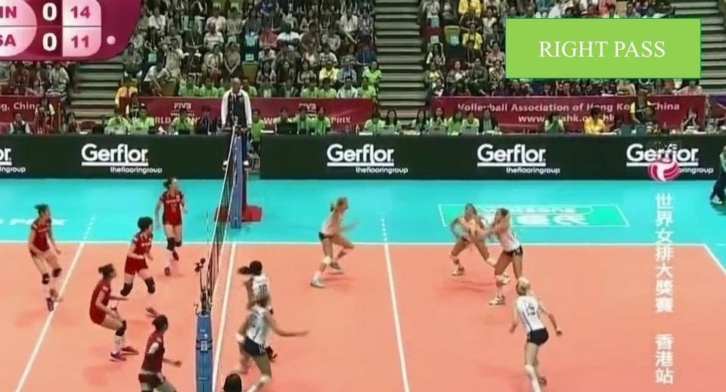
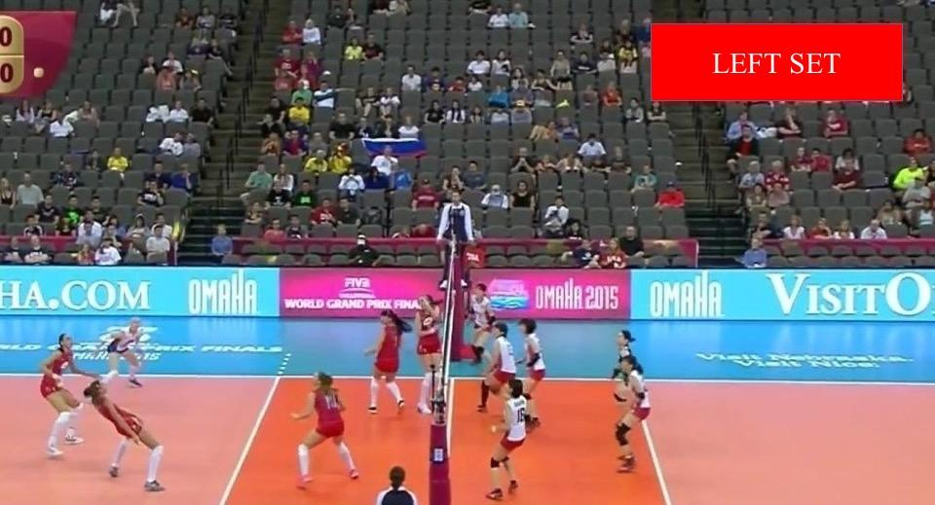
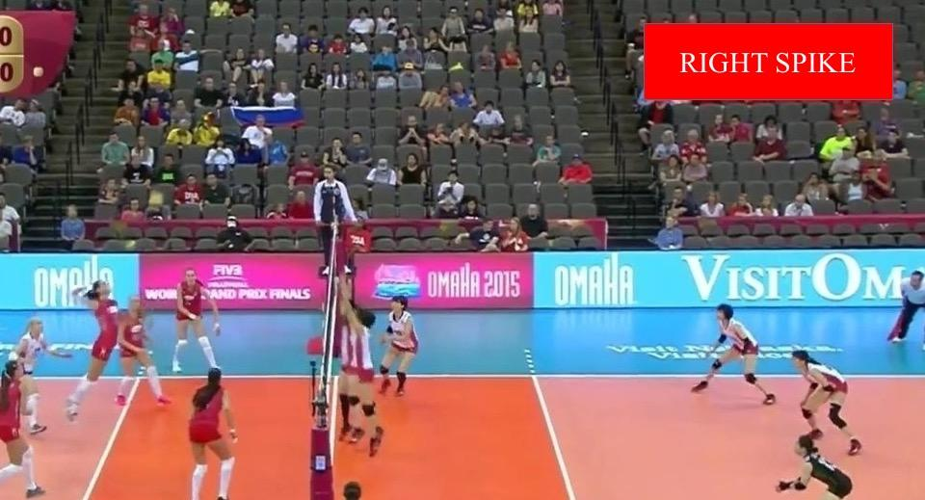
Visualization of results
Left set
Right pass
Right Spike
Left pass
Left spike (Left pass)
Right spike (Left spike)

Slide 37
Summary
A two stage hierarchical model for group activity recognition
LSTMs as a highly effective temporal model and temporal feature source
Decent people-relation modeling with simple pooling

Slide 38
Outline
Temporal structured models for group activities
  Ibrahim et al. CVPR 2016
Message passing with deep structured networks
  Deng et al. BMVC 2015, CVPR 2016
Image annotation with label hierarchies
  Hu et al. CVPR 2016

Slide 39
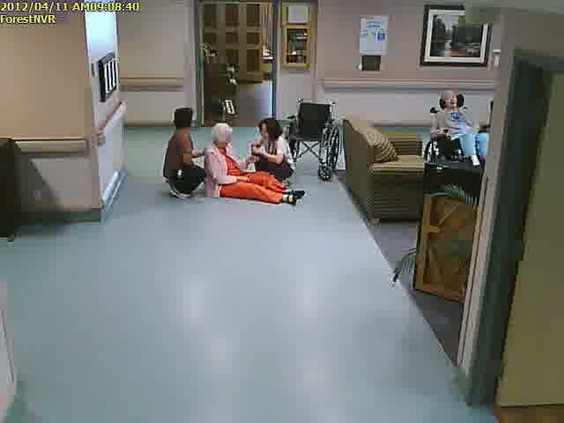
Overview
Group Activity Recognition: structures

Slide 40
Overview
Flexible Structure to adaptively capture discriminative dependencies [Lan et al. 10, Amer et al. 14]

Slide 41
Overview
Combine Graphical Models and Deep Learning, enable message passing
CNN

Slide 42
Overview
Combine Graphical Models and Deep Learning, enable message passing and structure learning
CNN

Slide 43
Method
Message Passing in Recurrent Neural Network (RNN)
Gating Function between nodes
Structure Learning of Graphical Model

Slide 44
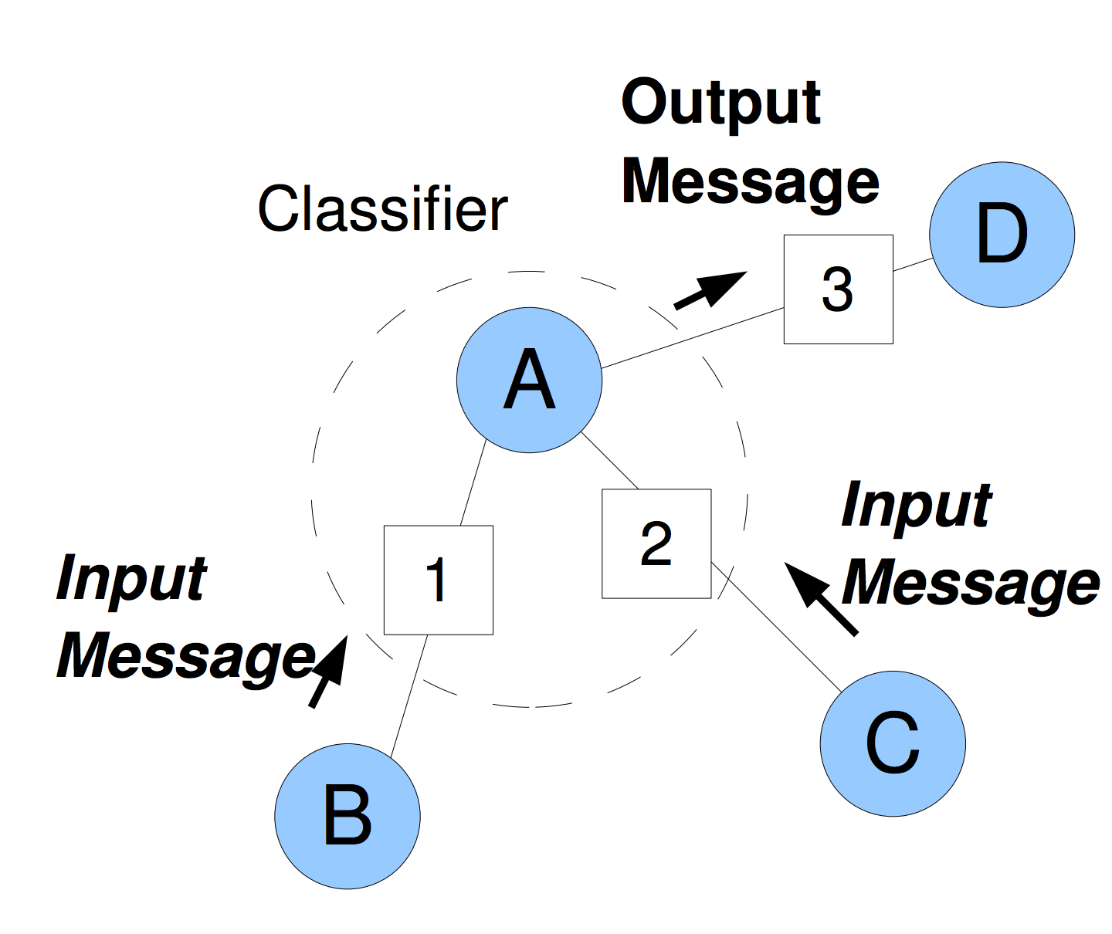
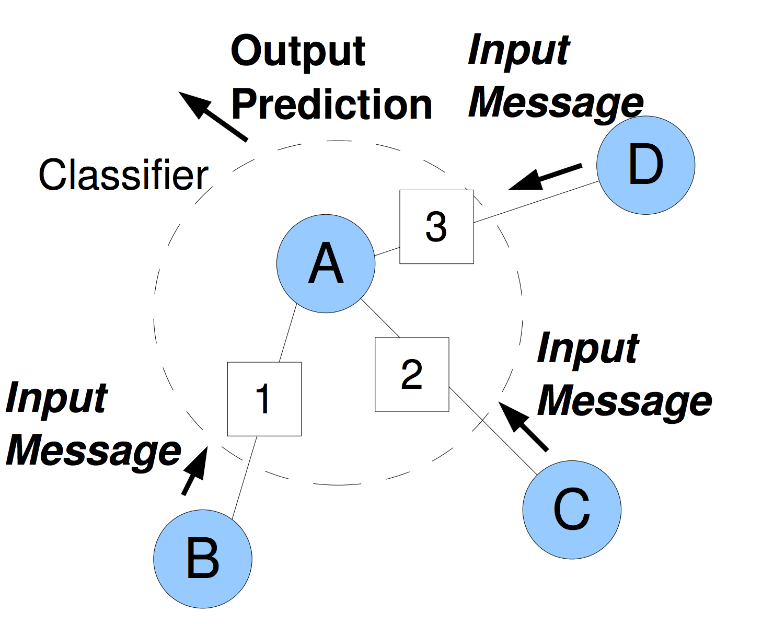
Method: Message Passing in RNN
Another view of belief propagation: Inference Machine, classify messages [Ross et al. CVPR’11]
Message Classification [Ross et al. CVPR’11]
Prediction [Ross et al. CVPR’11]

Slide 45
Method: Message Passing in RNN
Integrate into recurrent neural network
Prediction Layer
Prediction Layer
t
t+1
CNN
CNN

Slide 46
Method: Message Passing in RNN
Represent potential functions in message passing process:
The same potential function corresponds to the same message classifier
Weights are shared across all instances with same semantic meaning
The same with prediction layer
Prediction Layer
CNN

Slide 47
Method: Gating Function
C.f. Long Short-Term Memory (LSTM), Gated Recurrent Unit
Content(t-1)
Gate
Content(t)

Slide 48
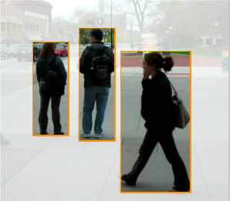
Method: Gating Function between Instances
We introduce instance level gates:
waiting
walking
waiting

Slide 49
Method: Gating Function between Instances
Comparing predictions based on messages, taken as input of gating functions
L1 regularization on gates to enforce sparsity and learn discriminative interactions

Slide 50
Method: Graphical Model Structure Learning
Use instance gates in inference machines:
Prediction Layer
Prediction Layer
t
t+1
Messages
Messages
CNN
CNN

Slide 51
Method: General Purpose Inference Machine
Untying weights between recurrent units
Prediction Layer
Prediction Layer
t
t+1
Messages
Messages
CNN
CNN

Slide 52
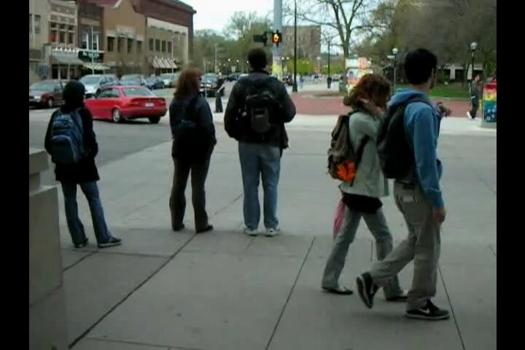
Method: Review of Pipeline
CNN
Scene
CNN
Person

Slide 53
Method: Review of Pipeline
Structure Inference Machine
Structure Inference Machine
Structure Inference Machine
Walking?
Waiting?
Waiting
Waiting
Waiting
Waiting
Walking
Walking
Walking
Waiting
Waiting
Waiting

Slide 54
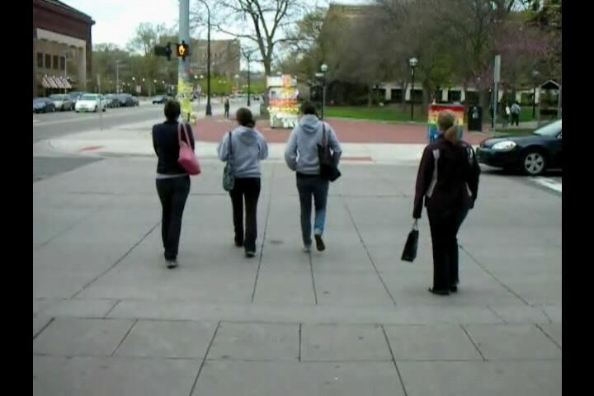
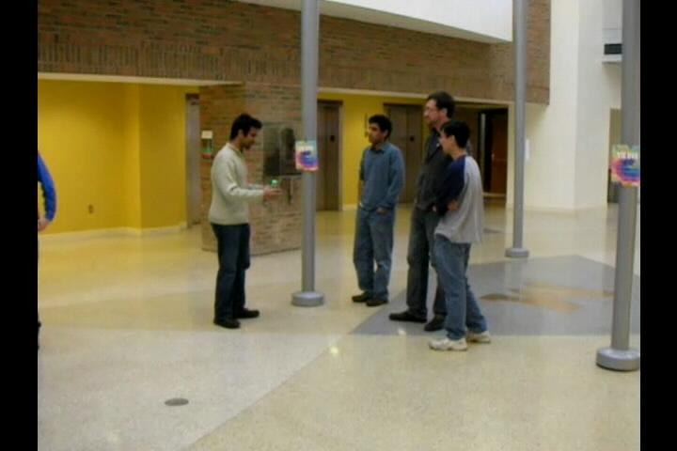
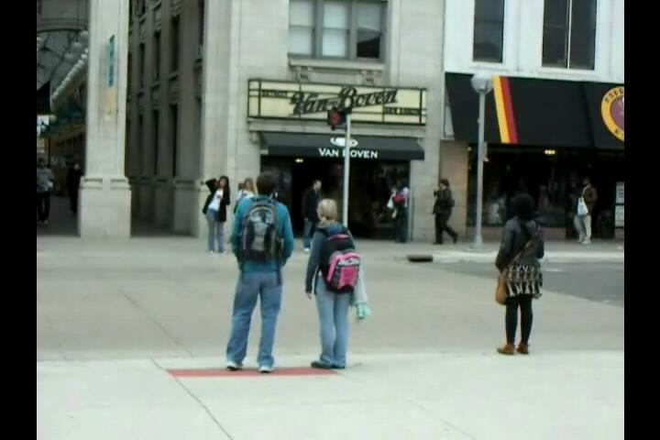
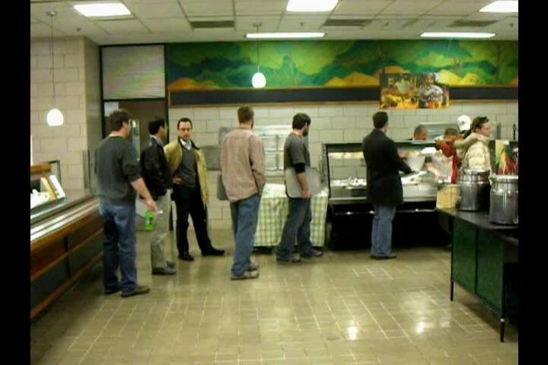
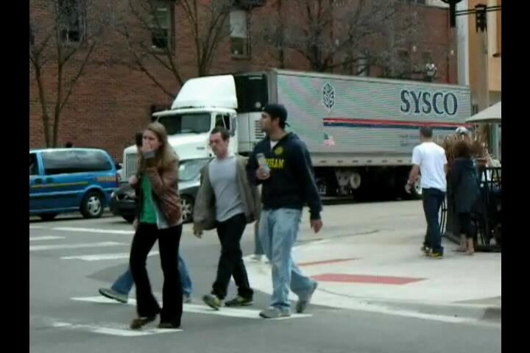
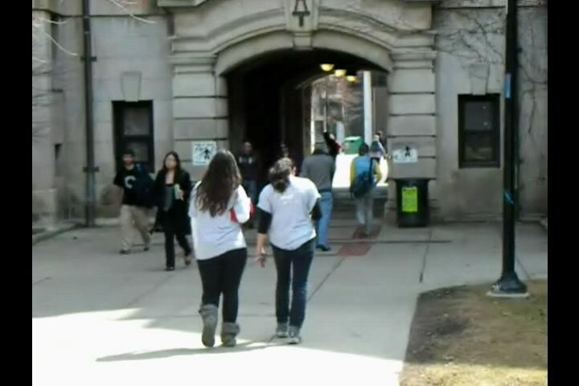
Experiment : Collective Activity Dataset
Contains 44 video clips
Action classes: others, crossing, waiting, queuing, walking, talking
Scene classes: crossing, waiting, queuing, walking, talking
Choi et al., VSWS 2009
Notes:
We use two datasets to evaluate the effectiveness of our method. The first one is Collective activity dataset, which contains 44 video clips. It has 6 action classes, and 5 scene classes.

Slide 55
Experiment: Collective Activity Dataset Extended
Contains 72 video clips
Action classes: others, crossing, waiting, queuing, talking, dancing, jogging
Scene classes: crossing, waiting, queuing, talking, dancing, jogging
Choi et al., CVPR 2011
Notes:
We use two datasets to evaluate the effectiveness of our method. The first one is Collective activity dataset, which contains 44 video clips. It has 6 action classes, and 5 scene classes.

Slide 56
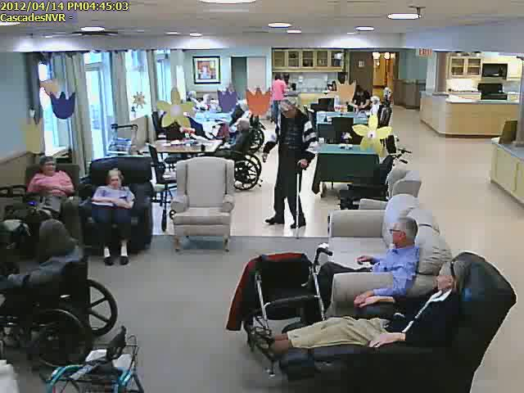
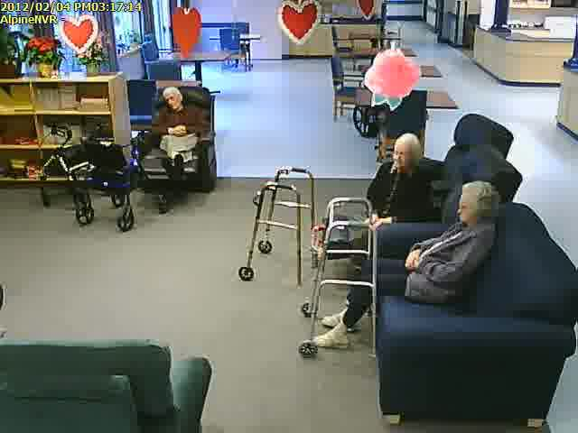
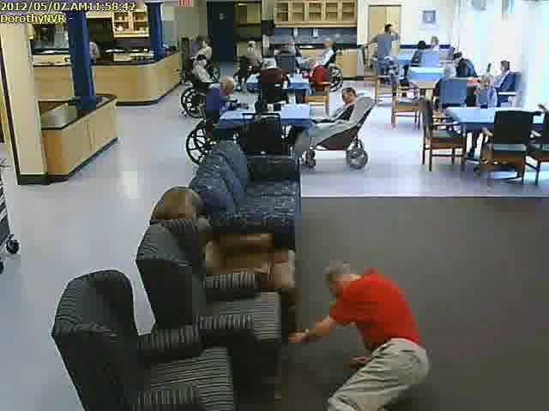
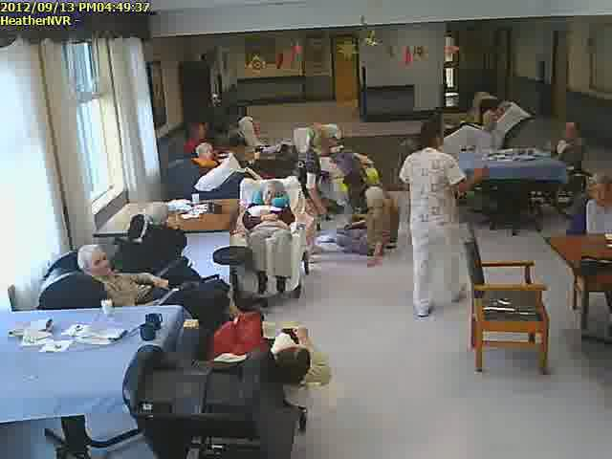
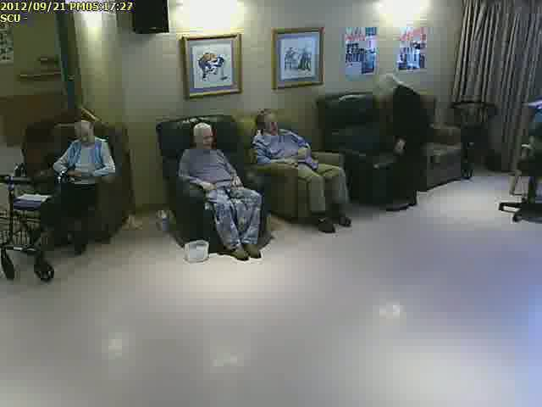
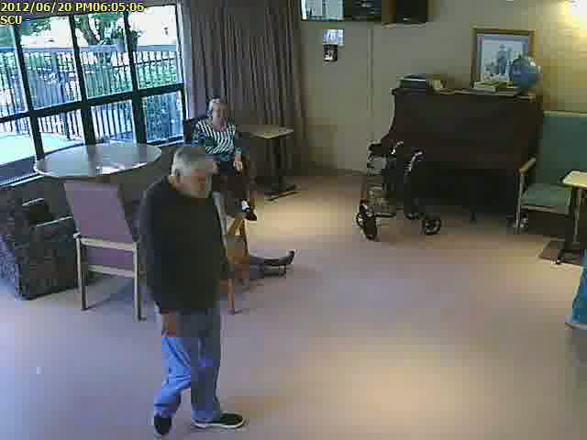
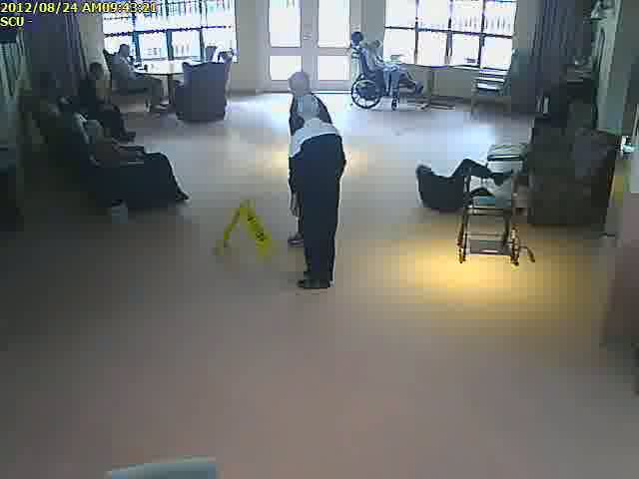
Experiment : Nursing Home Dataset
Contains 80 videos captured from a nursing home
Action classes: walking, standing, sitting, bending, squatting and falling
Scene classes: fall and non-fall
Deng et al., BMVC 2015
Notes:
For second dataset, we use nursing home dataset, which is surveillance videos recorded from a nursing home. It contains 80 videos, 6 action classes and 2 scene labels.

Slide 57
Quantitative Results
Iterations | 1 | 2 | 3
Tied | 73.86% | 74.02% | 74.02%
Gated Tied | 80.12% | 80.9% | 81.22%
Gated Untied | 80.12% | 81.06% | 81.22%
Table 1: Collective Activity Dataset
Iterations | 1 | 2 | 3
Tied | 84.45% | 87.97% | 87.97%
Gated Tied | 89.51% | 90.14% | 90.14%
Gated Untied | 89.51% | 90.14% | 90.23%
Table 1: Collective Activity Extended Dataset
Iterations | 1 | 2 | 3
Tied | 83.68% | 84.91% | 84.91%
Gated Tied | 84.46% | 85.32% | 85.32%
Gated Untied | 84.46% | 85.50% | 85.50%
Table 1: Nursing Home Dataset

Slide 58
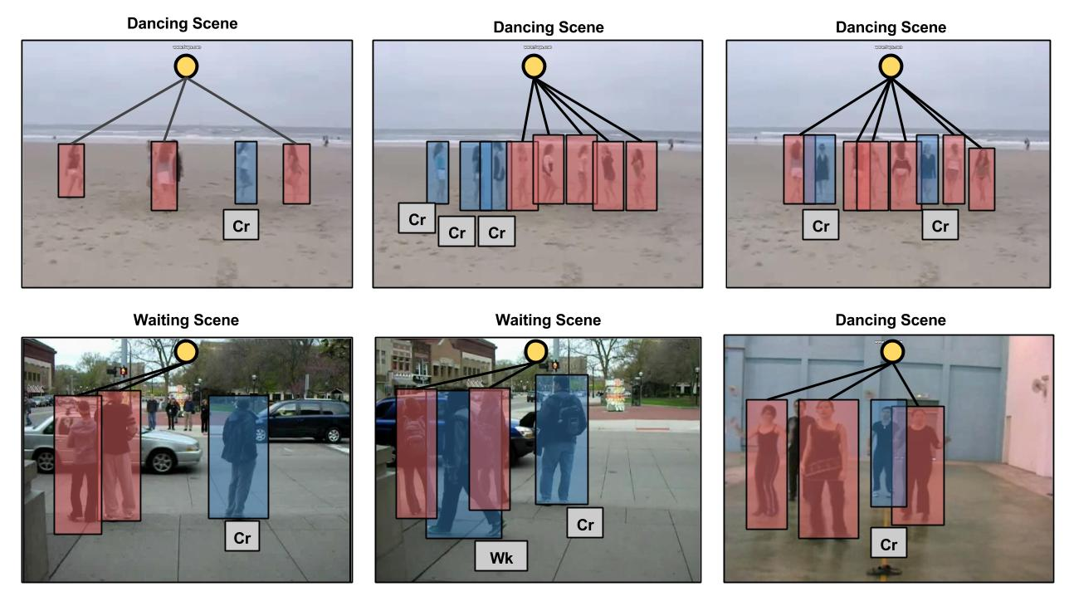
Qualitative Results
Gates between person-level node and group activity node:

Slide 59
Outline
Temporal structured models for group activities
  Ibrahim et al. CVPR 2016
Message passing with deep structured networks
  Deng et al. BMVC 2015, CVPR 2016
Image annotation with label hierarchies
  Hu et al. CVPR 2016

Slide 60
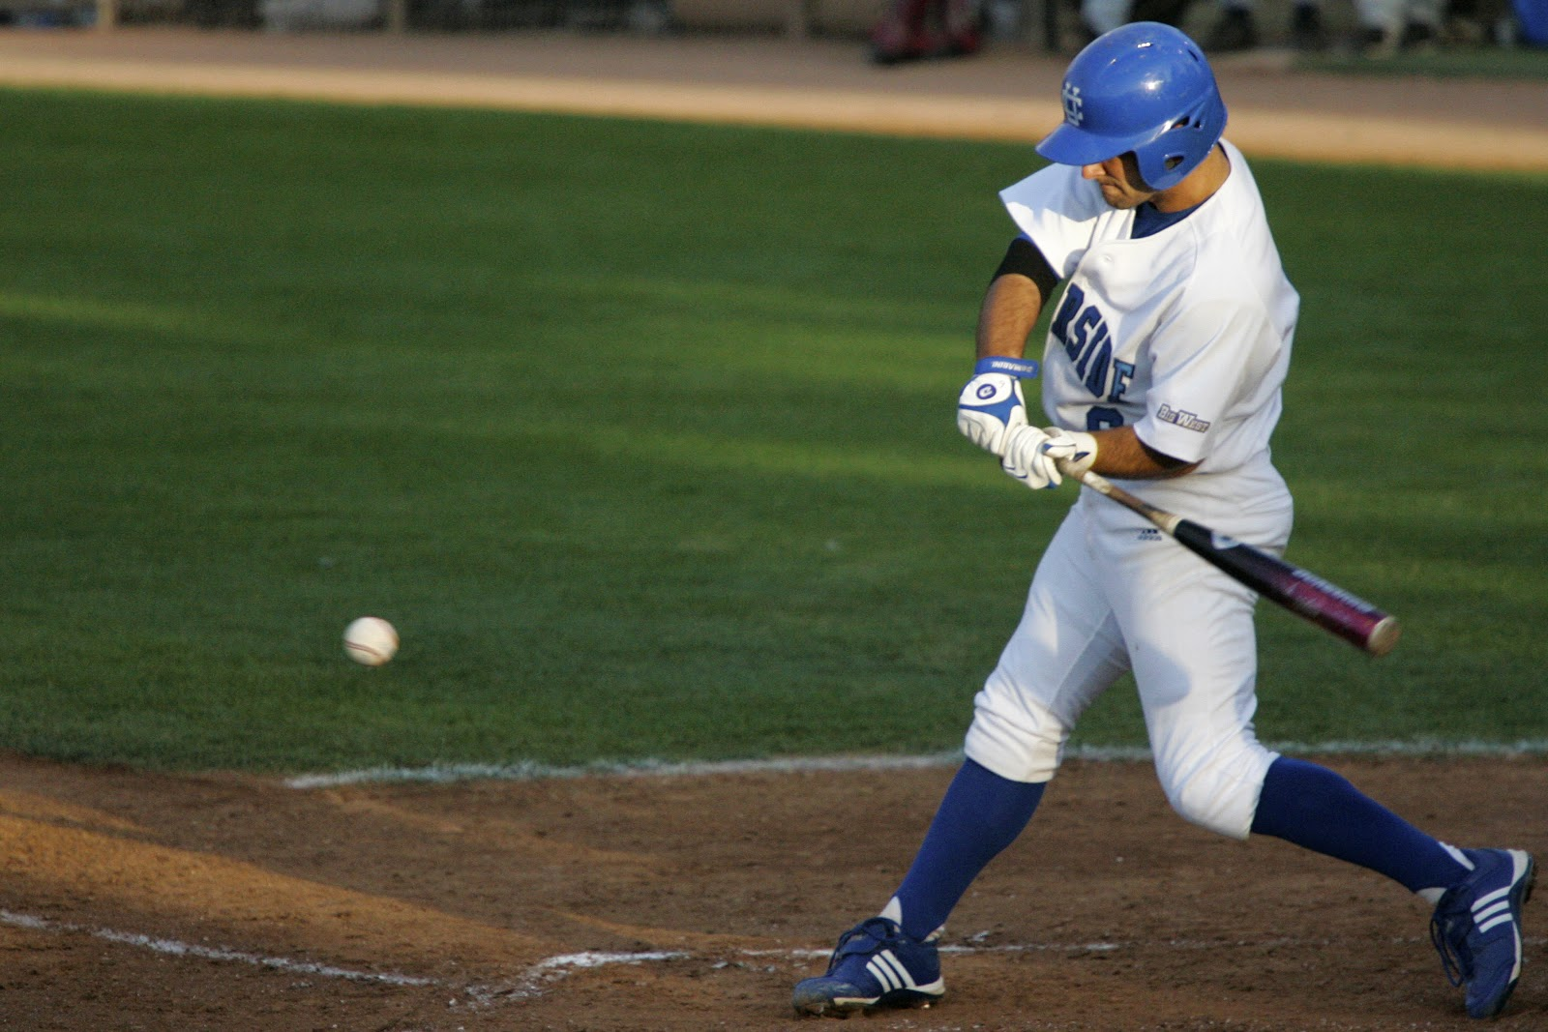
Image Classification
A natural image can be categorized with labels at different concept layers
Indoor
outdoor man-made
outdoor natural
leisure
sports
field
man-made
elements
cabins
houses
trench
pitcher
mound
batter
box
play-ground
barn
field
bat
base
ball
grass
person
building

Slide 61
Label Correlation Helps
Such categorization at different concept layers can be modeled with label graphs
It is natural and straightforward to leverage label correlation
Indoor
outdoor man-made
outdoor natural
leisure
sports
field
man-made
elements
cabins
houses
trench
pitcher
mound
batter
box
play-ground
barn
Positive correlation
field
bat
base
ball
grass
person
building
Negative correlation

Slide 62
Goal: A generic label relation model
Infer the entire label space from visual input
Infer missing labels given a few fixed provided labels
Inference
Machine on
Knowledge
Graph
Metadata
or
Partial Label
Prior
Activation
Refined
Probability
Visual
Architecture
An End-to-end Trainable System
Back-propagate Gradient from Loss Function

Slide 63
Top-down Inference Neural Network
Inspired from Recurrent Neural Network, represent concept layers as time series
Untie weights as each concept layer has different number of labels
Produce Visual Prior activation from CNN
Top-down inference
Visual
Architecture
Activation at current concept layer
Vertical weight propagates information across concept layers
Horizontal weight propagates information within concept layers
Activation at last concept layer

Slide 64
Bidirectional Inference Neural Network (BINN)
Bidirectional inference to make information propagate across entire label structure
Inference in each direction independently and blend results
Top down Inference
Bidirectional inference
Visual
Architecture
Bottom-up
Inference
Combine bidirectional inference result

Slide 65
Structured Inference Neural Network (SINN)
BINN is hard to train well
Regularize connections with prior knowledge about label correlations
Decompose connections into Positive correlation + Negative correlation

Slide 66
Structured Inference Neural Network (SINN)
Evolve BINN formulation with regularization in connections
Negative Component
Positive Component
Structured inference
Visual
Architecture
ReLU neuron is essential to keep positive/negative contribution

Slide 67
Prediction from Purely Visual Input
Visual architecture (e.g. Convolutional Neural Networks ) produces visual activation
SINN implements Information propagation bidirectionally and produces refined output activation

Slide 68
Prediction with Partially Observed Labels
Reverse Sigmoid neuron produces activation from Partial labels
SINN adapts both visual activation and activation from partial labels to infer the remaining labels

Slide 69
Reverse sigmoid: produce activation from label
Reverse the sigmoid function to produce sigmoid input
Inverse of sigmoid
Use a small epsilon to keep numerical stability (0.005)

Slide 70


Datasets
Evaluate method with two types of experiments on three datasets
Animals with Attributes
[Lampert et al. 2009]
NUS-WIDE
[Chua et al. 2009]
SUN 397
[Xiao et al. 2012]
Labels
Labels
Labels
698 image groups
81 concepts
1000 tags
3 coarse
16 general
397 fine-grained
28 taxonomy terms
50 animal classes
85 attributes
Task: predict 81 concepts with observing tags/image groups
Task 1: predict entire label set
Task: predict entire label set
Task 2: predict fine-grained scene given coarse scene category
Taxonomy terms are constructed from Word Net as [Hwang et al. 2012]
Knowledge graph constructed by combining class-attributes graph with taxonomy graph
Knowledge graph produced by Word Net using semantic similarity
698 image groups constructed from image meta data
Knowledge graph provided by dataset

Slide 71
Ex1: Inference from visual input
Produce predictions on entire label space
Evaluate on each concept layer (measured by mAP per class)
Consistent improvement over baselines on different concept layers

Slide 72




Ex2: Inference from partial labels (NUS-WIDE)
Produce predictions given partial 1k tags and 698 image groups
Ground Truth: railroad
CNN + Logistic: statue buildings person
Our Predictions: railroad person sky
Ground Truth: animal grass water dog
CNN + Logistic: grass person animal
Our Predictions: water animal dog
Ground Truth: rainbow clouds sky
CNN + Logistic: clouds water sky
Our Predictions: rainbow clouds sky
Ground Truth: food water
CNN + Logistic: food plants flower
Our Predictions: food plants water
Correct predictions are marked in blue while incorrect are marked in red

Slide 73
Ex2: Inference from partial labels (NUS-WIDE)
Evaluate on standard 81 ground truth classes of NUSWIDE
Outperform all baselines by large margin
1k tags + groups
+ CNN + SINN
1k tags + groups
+ Logistics
5k tags + Tag neighbors
[Johnson et. al. 2015]
1k tags + CNN +
SINN
1k tags + Logistics
5k tags + Logistics
[Johnson et. al. 2015]
1k tags + groups
+ CNN + Logistics
CNN + Logistics

Slide 74




Ex2: Inference with partial labels (SUN397)
Produce predictions given coarse-level labels (3 coarse categories)
CNN + Logistic: campus
Observed Label: outdoor/man-made
Our Predictions: abbey
Ground Truth: abbey
CNN + Logistic: building facade
Observed Label: outdoor/man-made
Our Predictions: library/outdoor
Ground Truth: library/outdoor
CNN + Logistic: patio
Observed Label: outdoor/natural; outdoor/man-made
Our Predictions: picnic area
Ground Truth: picnic area
CNN + Logistic: operating room
Observed Label: indoor
Our Predictions: dentists office
Ground Truth: dentists office
Correct predictions are marked in blue while incorrect are marked in red

Slide 75
Ex2: Inference with partial labels (SUN397)
Evaluate on 397 fine-grained scene categories
Significantly improved performance

Slide 76
Conclusion
Methods for handling structures in deep networks
  Spatial structure: learning gating functions to connect people for group activity recognition
  Temporal structure: hierarchies of long short-term memory models for group activities
  Label structure: message passing algorithms for multi-level image labeling; purely from image data or with partial labels

Slide 77

Acknowledgement

