Slide 1

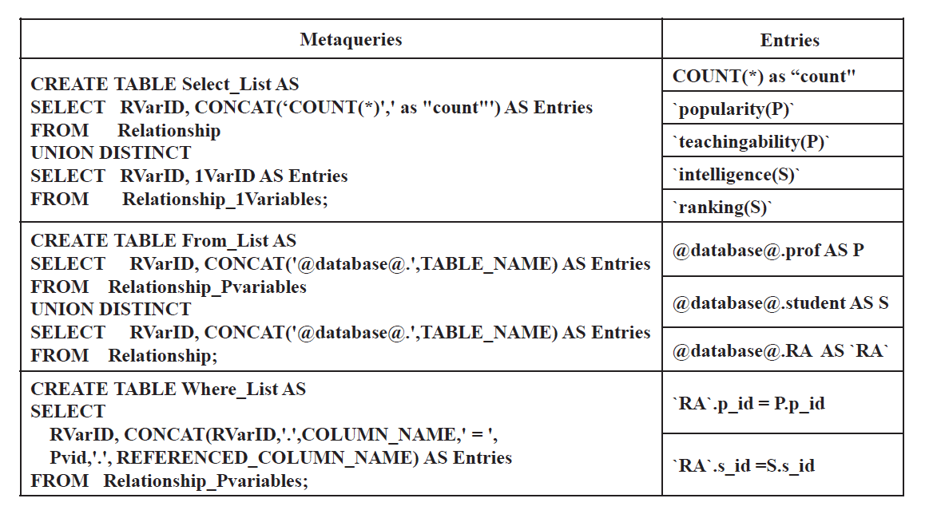
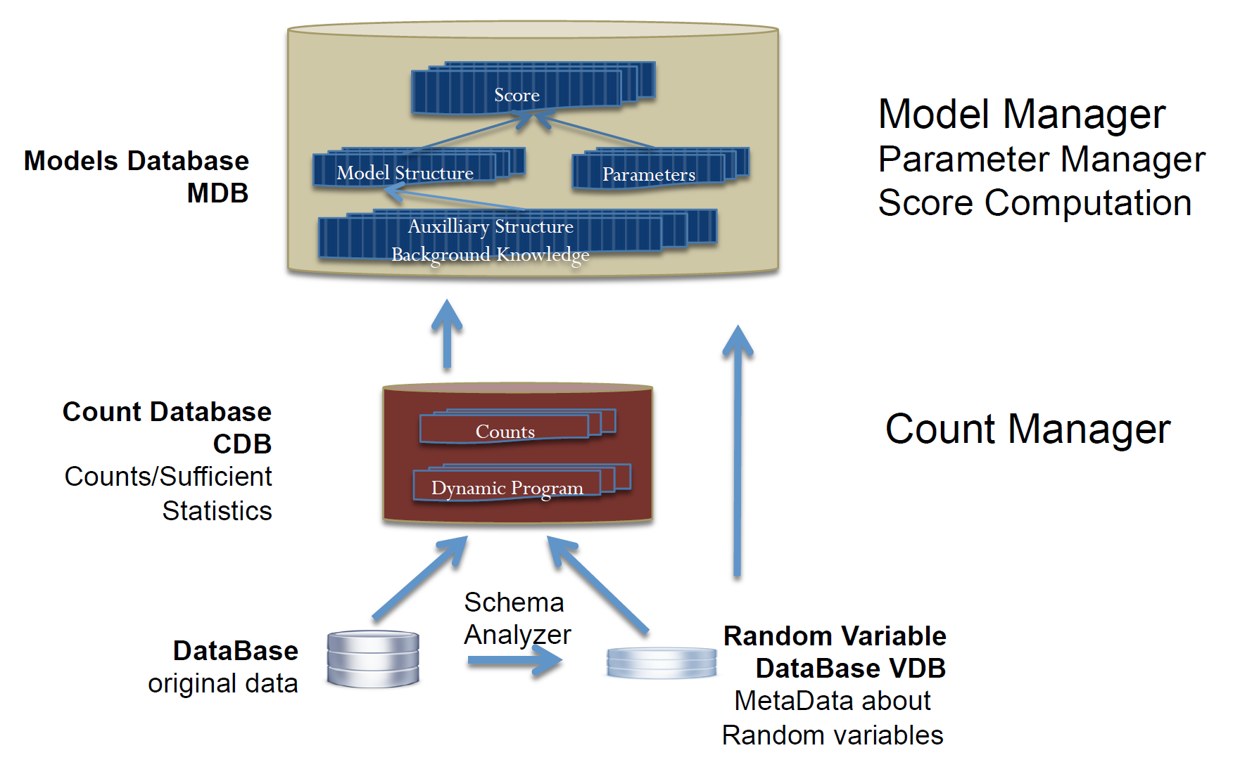
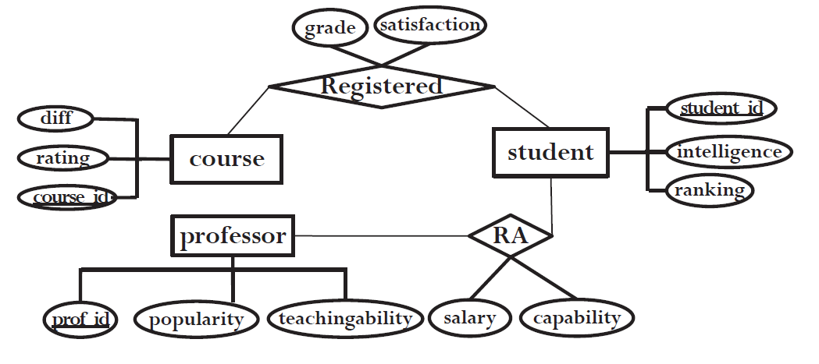
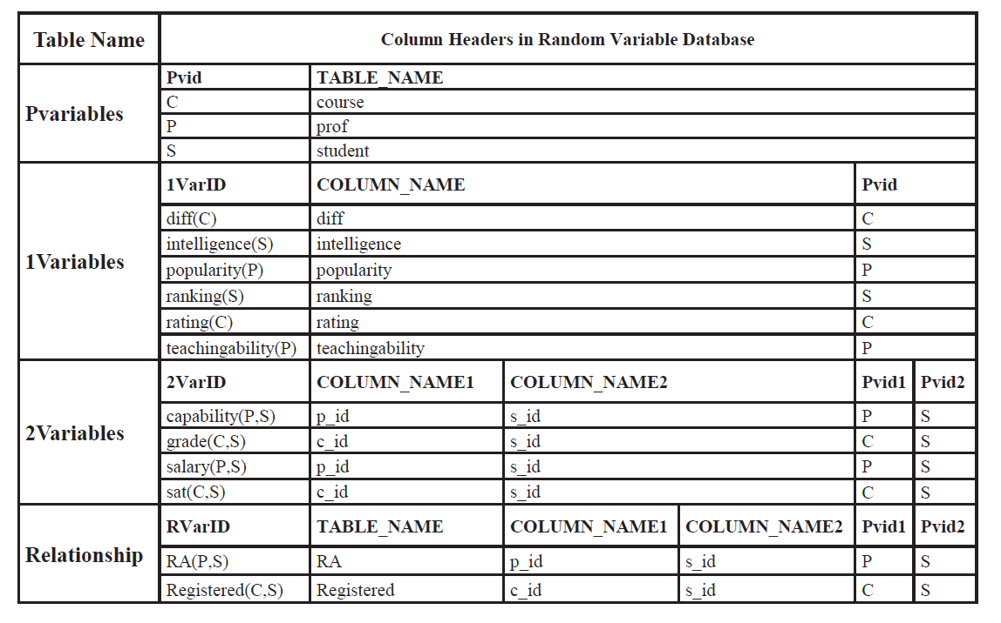
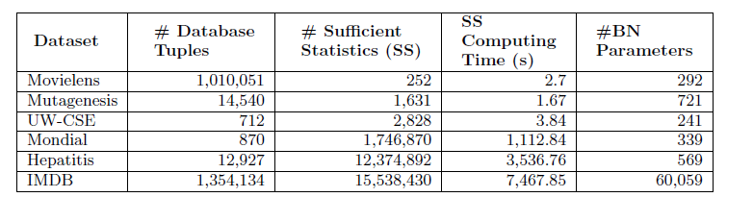
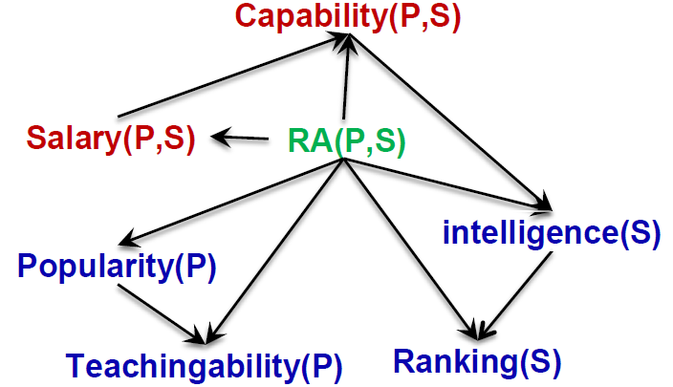
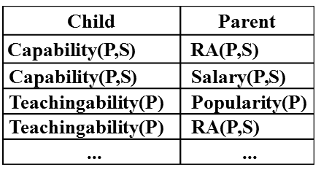
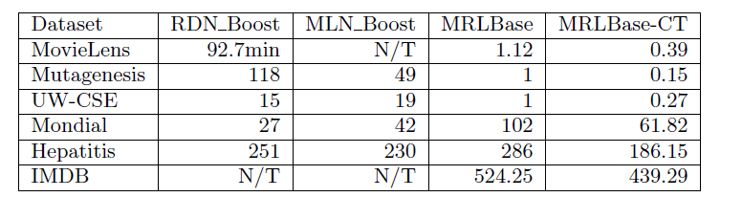
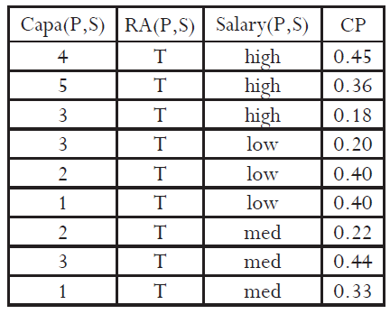
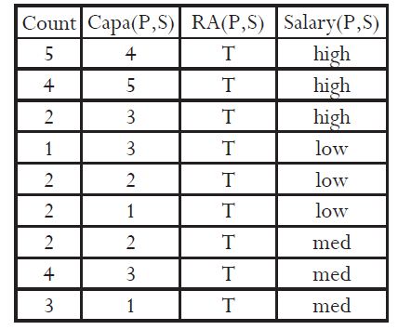
FACTORBASE: SQL for Multi-Relational Model Learning
Zhensong Qian and Oliver Schulte, Simon Fraser University, Canada
Introduction
The Count Manager
Statistical-Relational Learning: Learn a joint statistical model for all tables in the input database.
New approach to SRL system building:
The RDBMS stores structured objects for statistical analysis as first-class citizens in the database.
SQL is used to build and transform statistical objects:
Structured Model (Bayesian network, Markov Logic Network).
Parameter Estimates.
Sufficient Statistics.
Empirical evaluation: leveraging the RDBMS capabilities achieves scalable learning and fast model testing.
All code and datasets are available online [1].
Goal: for a conjunctive query, compute the instantiation count = result set size.
Stored in Contingency (CT) Table [4].
Main computational cost in learning.
Problem: need to generate SQL queries for arbitrary variable lists.
Solution: use Meta Data + Meta Queries
General Form of SQL Count Query:
SELECT COUNT(*) AS Count, <VARIABLE-LIST> FROM TABLE-LIST
GROUP BY <VARIABLE-LIST> WHERE <Join-Conditions>
Contributions
Identifying new system requirements for multi-relational machine learning that go beyond single table machine learning.
An integrated set of SQL-based solutions for providing these system capabilities.
Variable List
Related Works
Meta Query
BayesStore [3]: all statistical objects are first-class citizens in a relational database. Inference, no learning.
MadLib [5]: leverages SQL for single-relational data table analysis.
Tuffy [7]: reliable and scalable inference and parameter learning for Markov Logic Networks with an RDBMS. No structure learning.
System Overview
Count(*) Query
The Random Variable Database
Meta data about random variables stored in database tables.
Domain of possible values.
Pointer to corresponding data table/column.
...
ER-Design for University Domain
Schema Analyzer: examines the information in the DB system catalog to define a default set of random variables.
Count Manager: uses the meta data in the VDB database to compute multi-relational sufficient statistics for a set of random variables [4].
Model Manager: supports the construction and querying of large structured statistical models.
Results
The Model Manager
Task: learning a multi-relational Bayesian network
Database and performance statistics for FactorBase
Comparison with other statistical-relational learning (Markov Logic Networks)
The RDBMS support for multi-relational learning translates into orders of magnitude improvements in speed and scalability.
Goal: Learn First-Order Bayesian Network [2].
Bayesian Network Structure Learning [6].
Nodes = Random Variables
Edges are stored in Database tables
Model selection scores are also stored, not shown (BIC, AIC, BDeu)
Speedup on other tasks: compute model selection score, test models, cross-validation. Not shown.
The Parameter Manager
Conclusions
Goal: Learn Bayesian Network Parameters
Stored in Conditional Probability (CP) table.
Maximum Likelihood Estimate are easy to compute from database counts.
Multi-relational learning requires new system capabilities.
leverage SQL, RDBMS.
Fast system development through high-level SQL constructs.
Manage large statistical objects: parameters, sufficient statistics.
Fast native support for counting (count(*)).
Future Directions:
distributed processing, in-memory computing (SparkSQL)
Integrate with inference systems (BayesStore, Tuffy)
SELECT COUNT(*) AS Count, Capability as `Capa(P,S)`, 'T' as `RA(P,S)`, Salary as `Salary(P,S)`
FROM `RA`;
CP table
Contingency Table
Specific SQL Query
References
References
Qian, Z.; Schulte, O. & Sun, Y. Computing Multi-Relational Sufficient Statistics for Large Databases, CIKM 2014, 1249-1258.
Hellerstein, J. M.; Ré, C.; Schoppmann, F.; & et al, The MADlib Analytics Library: Or MAD Skills, the SQL, PVLDB, 2012, 5, 1700-1711
Schulte, O. & Khosravi, H. Learning graphical models for relational data via lattice search Machine Learning, 2012, 88, 331-368
Niu, F.; Ré, C.; Doan, A. & Shavlik, J. W. Tuffy: Scaling up Statistical Inference in Markov Logic Networks using an RDBMS PVLDB, 2011, 4, 373-384
Qian, Z.; Schulte, O. The BayesBase System. www.cs.sfu.ca/~oschulte/BayesBase
Russell, S. & Norvig, P. Artificial Intelligence: A Modern Approach Prentice Hall, 2010.
Wang, D. Z.; Michelakis, E.; & et al. BayesStore: managing large, uncertain data repositories with probabilistic graphical models, PVLDB, 2008, 1, 340-351.
Notes:
Created on Nov 30, 2015. NIPS Learning System workshop, 36in wide and 48 in tall
Dec.12. Montreal

Slide 2




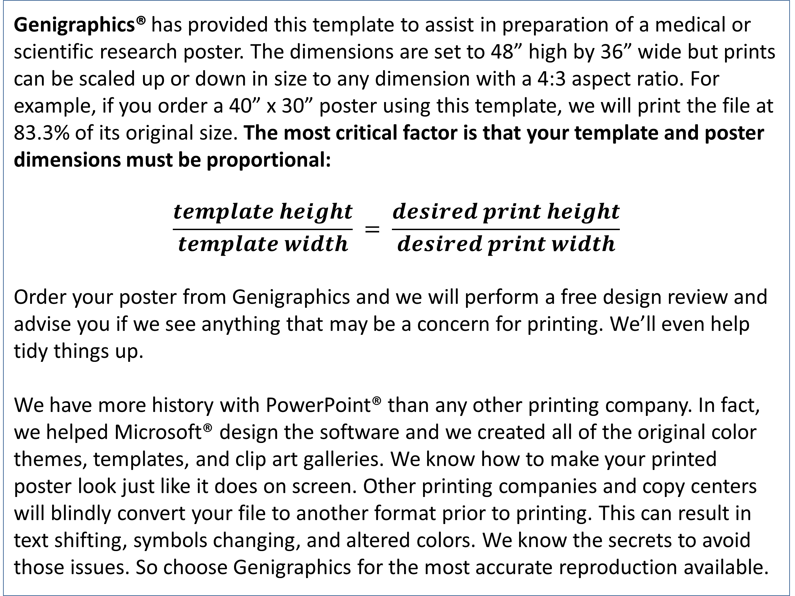
Template Provided By Genigraphics – 800.790.4001
Replace This Text With Your Title
REPLACE THIS BOX WITH YOUR ORGANIZATION’S
HIGH RESOLUTION LOGO
REPLACE THIS BOX WITH YOUR ORGANIZATION’S
HIGH RESOLUTION LOGO
John Smith, MD¹; Jane Doe, PhD²; Frederick Jones, MD, PhD^{1,2}
¹University of Affiliation, ²Medical Center of Affiliation
Abstract
Results
Click here to insert your Abstract text. Type it in or copy and paste from your Word document or other source.
This text box will automatically re-size to your text. To turn off that feature, right click inside this box and go to Format Shape, Text Box, Autofit, and select the “Do Not Autofit” radio button.
To change the font style of this text box: Click on the border once to highlight the entire text box, then select a different font or font size that suits you. This text is Calibri 32pt and is easily read up to 4 feet away on a 48x36 poster.
Zoom out to 100% to preview what this will look like on your printed poster.
Click here to insert your Results text. Type it in or copy and paste from your Word document or other source.
This text box will automatically re-size to your text. To turn off that feature, right click inside this box and go to Format Shape, Text Box, Autofit, and select the “Do Not Autofit” radio button.
To change the font style of this text box: Click on the border once to highlight the entire text box, then select a different font or font size that suits you. This text is Calibri 32pt and is easily read up to 4 feet away on a 48x36 poster.
Zoom out to 100% to preview what this will look like on your printed poster.
Speaking of Results, yours will look better if you remember to run a spell-check on your poster! After you’ve added your content click on Review, Spelling, or press F7.
Introduction
Genigraphics® has provided this template to assist in preparation of a medical or scientific research poster. The dimensions are set to 48” high by 36” wide but prints can be scaled up or down in size to any dimension with a 4:3 aspect ratio. For example, if you order a 40” x 30” poster using this template, we will print the file at 83.3% of its original size. The most critical factor is that your template and poster dimensions must be proportional:
$$\frac{template height}{template width} = \frac{desired print height}{desired print width}$$
Order your poster from Genigraphics and we will perform a free design review and advise you if we see anything that may be a concern for printing. We’ll even help tidy things up.
We have more history with PowerPoint® than any other printing company. In fact, we helped Microsoft® design the software and we created all of the original color themes, templates, and clip art galleries. We know how to make your printed poster look just like it does on screen. Other printing companies and copy centers will blindly convert your file to another format prior to printing. This can result in text shifting, symbols changing, and altered colors. We know the secrets to avoid those issues. So choose Genigraphics for the most accurate reproduction available.
Chart 1. Label in 24pt Calibri.
Discussion
Click here to insert your Discussion text. Type it in or copy and paste from your Word document or other source.
This text box will automatically re-size to your text. To turn off that feature, right click inside this box and go to Format Shape, Text Box, Autofit, and select the “Do Not Autofit” radio button.
To change the font style of this text box: Click on the border once to highlight the entire text box, then select a different font or font size that suits you. This text is Calibri 32pt and is easily read up to 4 feet away on a 48x36 poster.
Zoom out to 100% to preview what this will look like on your printed poster.
Table 1. Label in 24pt Calibri.
 | Heading | Heading | Heading
Item | 800 | 790 | 4001
Item | 356 | 856 | 290
Item | 228 | 134 | 238
Methods and Materials
Click here to insert your Methods and Materials text. Type it in or copy and paste from your Word document or other source.
This text box will automatically re-size to your text. To turn off that feature, right click inside this box and go to Format Shape, Text Box, Autofit, and select the “Do Not Autofit” radio button.
To change the font style of this text box: Click on the border once to highlight the entire text box, then select a different font or font size that suits you. This text is Calibri 32pt and is easily read up to 4 feet away on a 48x36 poster.
Zoom out to 100% to preview what this will look like on your printed poster.
Figure 1. Label in 20pt Calibri.
Figure 2. Label in 20pt Calibri.
Figure 3. Label in 20pt Calibri.
Conclusions
Click here to insert your Conclusions text. Type it in or copy and paste from your Word document or other source.
This text box will automatically re-size to your text. To turn off that feature, right click inside this box and go to Format Shape, Text Box, Autofit, and select the “Do Not Autofit” radio button.
Contact
References
<your name>
<your organization>
Email:
Website:
Phone:

