Slide 1


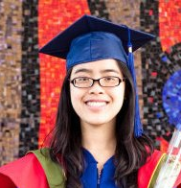
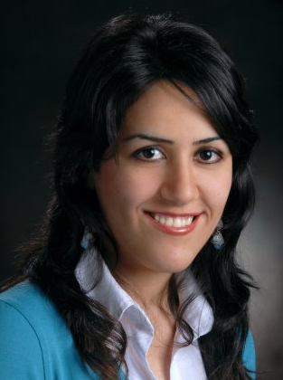
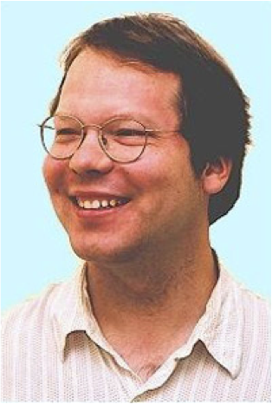

Learning Markov Logic Networks with Many Descriptive Attributes
School of Computing Science
Simon Fraser University
Vancouver, Canada
Hassan Khosravi | Oliver Schulte | Tong Man | Xiaoyuan Xu | Bahareh Bina

Slide 2
Outline
Markov Logic Networks (MLNs) and motivation for this research
Parameterized Bayes nets (PBNs)
From PBN to MLN
Learn-and-Join Algorithm for PBNs.
Empirical Evaluation

Slide 3
Markov Logic Networks (Domingos and Richardson ML 2006)
A logical KB is a set of hard constraints on the set of possible worlds
MLNs make them soft constraints:
When a world violates a formula, It becomes less probable, not impossible
A Markov Logic Network (MLN) is a set of pairs (F, w) where
F is a formula in first-order logic
w is a real number
First Order Logic | Weight | English
 | 2.3 | If a student is intelligent then he is well ranked
 | 0.7 | If a student has an intelligent friend then he is intelligent
Notes:
It would be nice if the variable x was upper case, see next. Domingos tends to put variables lower case, constants upper case, we do the opposite.

Slide 4
Why MLNs are important
MLNs are proposed as a unifying framework for Statistical relational learning. Their authors show how other approaches are special cases of MLNs.
They are popular
Event modeling and recognition using markov logic networks
Efficient weight learning for Markov logic networks
Bottom-up learning of Markov logic network structure
Discriminative training of Markov logic networks
Learning the structure of Markov logic networks
Entity resolution with markov logic
Mapping and revising Markov logic networks for transfer learning
Hybrid markov logic networks
Discriminative structure and parameter learning for Markov logic networks
Learning Markov logic network structure via hypergraph lifting
Improving the accuracy and efficiency of map inference for markov logic

Slide 5
Limitation
Structure learning in MLNs is mostly ILP(Inductive Logic Programming) based
The complexity of search space is exponential in the number of predicates
For datasets with many descriptive attributes current MLN learning algorithms are infeasible as they either never terminate or are very slow
Notes:
Inductive logic programming

Slide 6
Parametrized Bayes Nets (Poole UAI 2003)
A functor is a function symbol with typed variables f(X), g(X,Y), R(X,Y).
A PBN is a BN whose nodes are functors.
We use PBNs with variables only. Not intelligence(Jack)
registered(S,C)
intelligence(S)
teach-ability(C)
grade(S,C)
ranking(S)
diff(C)
popularity(C)
satisfaction(S,C)
rating(C)

Slide 7
Overview
Relational
Bayes Net learner
Turn BN to Formula
Dataset
Bayes
Net
First Order Logic
formula
MLN Parameter learning
MLN

Slide 8
From PBN to FOL formula
Parameterized Bayes Nets(PBNs) can be converted to a set of first order formula easily.
Moralize PBN (marry parents, drop arrows).
For every CP-table value in PBN, add a formula
ranking (S₁, R₁) , intelligence(S₁, I₁)
ranking (S₁, R₁), intelligence(S₁, I₂)
ranking (S₁, R₂), intelligence(S₁, I₁)
ranking (S₁, R₂), intelligence(S₁, I₂)
Diff(C)
Popularity(C)
Diff(C)
teach-ability(C)
Popularity(C)
teach-ability(C)
rating(C)
rating(C)
 | Rank=R₁ | Rank=R₂
Int =I₁ | P₁ | P₂
Int =I₂ | P₃ | P₄
Intelligence(S)
Ranking(S)
Notes:
Nice slide. Still have the uppercase-lowercase issue. Need to comment on how MLNs switch to predicate rather than functional notation.

Slide 9
Learning PBN Structure
Required: single-table BN learner L. Takes as input
Single data table.
A set of edge constraints required edges
A set of edge constraints forbidden edges
Nodes:
Descriptive attributes (e.g. intelligence(S))
Boolean relationship nodes (e.g., Registered(S,C)).
Edges
Learning correlations between attributes

Slide 10
Phase 1: Entity tables
intelligence(S)
Students
Name | intelligence | ranking
Jack | 3 | 1
Kim | 2 | 1
Paul | 1 | 2
BN learner L
ranking(S)
diff(C)
Course
Number | rating | difficulty | Prof-popularity | Prof- teachablity
101 | 3 | 1 | 1 | 2
102 | 2 | 2 | 2 | 2
103 | 3 | 2 | 1 | 1
BN learner L
teach-ability(p(C))
rating(C)
popularity(p(C))
Notes:
I switched back to our original example, mainly because I was in a rush and this had the variables in it (intelligence(S)) rather than intelligence. It’s important to have those because o.w. it’s inconsisent with poole. Plus we need the variables to represent autocorrelations.

Slide 11
Phase 2: relationship tables
Registration |  |  |  | Student |  | Course
S.Name | C.number | grade | satisfaction | intelligence | ranking | rating | difficulty | Popularity | Teach-ability
Jack | 101 | A | 1 | 3 | 1 | 3 | 1 | 1 | 2
…. | …. | … | … | … | … | … | … | … | …
intelligence(S)
diff(C)
teach-ability(p(C))
BN learner L
rating(C)
popularity(p(C))
ranking(S)
intelligence(S)
diff(C)
teach-ability(p(C))
grade(S,C)
ranking(S)
rating(C)
satisfaction(S,C)
popularity(p(C))
Notes:
Statistical Motivation

Slide 12
Phase 3: add Boolean relationship indicator variables
intelligence(S)
diff(C)
teach-ability(p(C))
grade(S,C)
ranking(S)
rating(C)
satisfaction(S,C)
popularity(p(C))
registered(S,C)
intelligence(S)
teach-ability(p(C))
diff(C)
grade(S,C)
ranking(S)
satisfaction(S,C)
rating(C)
popularity(p(C))
Notes:
Also messed up, probably need to make fonts smaller or move text.

Slide 13
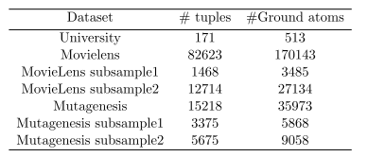
Datasets
University
Movielens
Mutagenesis

Slide 14
Systems
Moralized Bayes Nets(MBN) is a Parameterized Bayes nets (PBNs) converted into a Markov logic network.
LHL(current implementation of structure learning in Alchemy)
Const_LHL: Following the data reformatting used by Kok and Domingos 2007.
Salary(Student, salary_value) =>
Salary_high(student)
Salary_low(student)
Salary_medium(student)

Slide 15
Evaluation Plan
Dataset
Table format
Ground facts
Constant format
PBN learning
LHL structure learning
LHL parameter learning
Alchemy default inference
MBN
LHL
LHL_const
Notes:
Can we get the original flowchart to modify this? Instead of “first-order logic”, we should say “ground facts” or “tuples”

Slide 16
Evaluation Metrics(Default)
Running time
Accuracy
How accurate our prediction is
Conditional Log Likelihood (CLL)
How confident we are with the prediction
Area Under Curve (AUC)
Avoid false negatives
Notes:
Add reference to share this is mlns default metrics

Slide 17
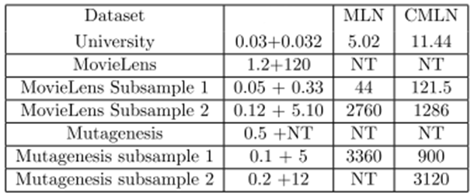
Running time
MBN
Time in Minutes. NT = did not terminate.
X+Y = PBN structure learning + MLN parameter learning

Slide 18
Accuracy

Slide 19

Conditional Log likelihood

Slide 20
Area Under Curve

Slide 21
Future Work: Parameter Learning
Dataset
Table format
Ground facts
Constant format
PBN Structure learning
LHL structure learning
PBN parameter learning
LHL parameter learning
Alchemy default inference
MBN
LHL
LHL_const
Notes:
Slide is optional, can skip

Slide 22
Summary
Key idea: learn directed model, convert to undirected to avoid cycles.
New efficient structure learning algorithm for Parametrized Bayes Nets.
Fast and scalable (e.g., 5 min vs. 21 hr).
Substantial Improvements in all default Evaluation Metrics
Notes:
I’d like to show the total number of slides, e.g 18/23. In this stupid new version of powerpoint I can’t make that work.

Slide 23

Thank you!
Any questions?

Slide 24
Learning PBN Structure
Required: single-table BN learner L. Takes as input (T,RE,FE):
Single data table.
A set of edge constraints (forbidden/required edges).
Nodes: Descriptive attributes (e.g. intelligence(S)) Boolean relationship nodes (e.g., Registered(S,C)).
RequiredEdges, ForbiddenEdges := emptyset.
For each entity table E_{i}:
Apply L to E_{i} to obtain BN G_{i}. For two attributes X,Y from E_{i},
If X→ Y in G_{i}, then RequiredEdges += X→ Y .
If X→ Y not in G_{i}, then ForbiddenEdges += X→ Y .
For each relationship table join of size s = 1,..k
Compute Rtable join, join with entity tables := J_{i}.
Apply L to (J_{i} , RE, FE) to obtain BN G_{i}.
Derive additional edge constraints from G_{i}.
Add relationship indicators: If edge X→ Y was added when analyzing join R₁ join R₂ … join R_{m}, add edges R_{i} → Y.
Notes:
To deal with autocorrelation, duplicate entity tables. May want to have back-up slide on that. Explain that you will give an example in a moment. The main thing to note is that we recursively add more and more edge constraints and feed those back into later stages of the search.
Neumann question: how do you know which data tables to use? Answer: this is based on the relational schema. Without relational schema, may be able to get this from functor structure only – interesting question.

Slide 25
Restrictions
Learn-and-Join learns dependencies among attributes, not dependencies among relationships.
The structure is limited to certain patterns
Only works with many descriptive attributes
Parameter learning still a bottleneck.

Slide 26
Inheriting Edge Constraints From Subtables
Intuition: Evaluate dependencies on the smallest possible join.
Statistical Motivation: Statistics can change between tables, e.g. distribution of students’ age may differ in Student table from Registration table.
Computational Motivation: as larger join tables are formed, many edges need not be considered → fast learning.
Notes:
Optional slide, can skip.

