Slide 1

Pseudo-Likelihood for Relational Data
Oliver Schulte
School of Computing Science
Simon Fraser University
Vancouver, Canada
To appear at SIAM SDM conference on data mining.

Slide 2
The Main Topic
In relational data, units are interdependent
  no product likelihood function for model.
How to do model selection?
Proposal of this talk: use pseudo likelihood.
  Unnormalized product likelihood.
  Like independent-unit likelihood, but with event frequencies instead of event counts.

Slide 3
Overview
Define pseudo log-likelihood for directed graphical models (Bayes Nets).
Interpretation as expected log-likelihood of random small groups of units.
Learning Algorithms:
  MLE solution.
  Model Selection.
Simulations.

Slide 4
Outline
Brief intro to relational databases.
Statistics and Relational Databases.
Briefer intro to Bayes nets.
Relational Random Variables.
Relational (pseudo)-likelihoods.

Slide 5
Relational Databases
1970s: Computers are spreading. Many organizations use them to store their data.
Ad hoc formats
  hard to build general data management systems.
  lots of duplicated effort.
The Standardization Dilemma:
  Too restrictive: doesn’t fit users’ needs.
  Too loose: back to ad-hoc solutions.

Slide 6
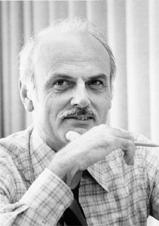
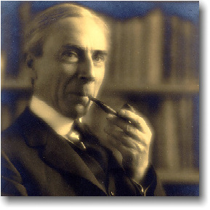
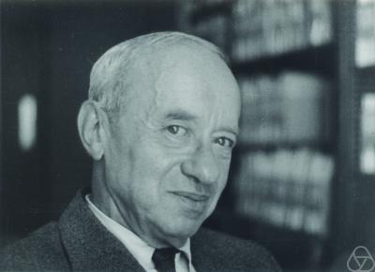
The Relational Format
Codd (IBM Research 1970)
The fundamental question: What kinds of information do users need to represent?
Answered by 1st-order predicate logic!
(Russell, Tarski).
The world consists of
  Individuals/entities.
  Relationships/links among them.

Slide 7

Tabular Representation
Tables for Entity Types, Relationships.
Student
s-id | Intelligence | Ranking
Jack | 3 | 1
Kim | 2 | 1
Paul | 1 | 2
Course
c-id | Rating | Difficulty
101 | 3 | 1
102 | 2 | 2
Professor
p-id | Popularity | Teaching-a
Oliver | 3 | 1
Jim | 2 | 1
RA
s-id | p-id | Salary | Capability
Jack | Oliver | High | 3
Kim | Oliver | Low | 1
Paul | Jim | Med | 2
Registration
s-id | c.id | Grade | Satisfaction
Jack | 101 | A | 1
Jack | 102 | B | 2
Kim | 102 | A | 1
Paul | 101 | B | 1

Slide 8
Database Management Systems
Maintain data in linked tables.
Structured Query Language (SQL) allows fast data retrieval.
  E.g., find all SFU students who are statistics majors with gpa > 3.0.
Multi-billion dollar industry, $15+ bill in 2006.
IBM, Microsoft, Oracle, SAP, Peoplesoft.

Slide 9
Relational Domain Models
Visualizing Domain Ontology.
Active Area of Research.
  Unified Modelling Language (UML).
  Semantic Web (XML).
Classic Tool: The Entity-Relationship (ER) Diagram.

Slide 10
ER Diagram Example
grade
Students
Registered
satisfaction
name
intelligence
ranking
number
Courses
Professors
teaches
rating
difficulty
name
popularity
teaching
ability

Slide 11
ER Model for Social Network
name
Ring Diagram
Actors
Friend
Social Network
Smokes
Smokes = true
Smokes = true
Cancer
Anna
Bob
Data Tables
Actors
Friend
Cancer = true
Cancer = false
Name | Smokes | Cancer
Anna | T | T
Bob | T | F
Name1 | Name2
Anna | Bob
Bob | Anna

Slide 12
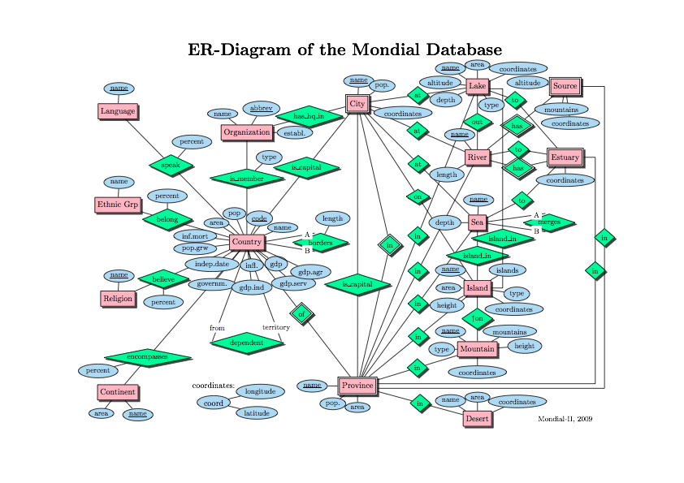
Notes:
More realistic, still relatively small. http://www.dbis.informatik.uni-goettingen.de/Mondial/

Slide 13
Relationship to Social Network Analysis
A single-relation social network is a simple special case of a relational database.
Converse also true if you allow:
  Different types of nodes (“actors”).
  Labels on nodes.
  Different types of (hyper)edges.
  Labels on edges.
    See Newman (2003) SIAM Review.
Observation A relational database is equivalent to a general network as described.

Slide 14
Outline
Brief intro to relational databases.
Statistics and Relational Databases.
Briefer intro to Bayes nets.
Relational Random Variables.
Relational (pseudo)-likelihoods.

Slide 15

Beyond storing and retrieving data
Much new interest in analyzing databases.
  Data Mining.
  Data Warehousing.
  Business Intelligence.
  Predictive Analytics.
Fundamental Question: how to combine logic and probability?
Domingos (U of W, CS): “Logic handles complexity, probability represents uncertainty.”

Slide 16
Typical Tasks for Statistical-Relational Learning (SRL)
Link-based Classification: given the links of a target entity and the attributes of related entities, predict the class label of the target entity.
Link Prediction: given the attributes of entities and their other links, predict the existence of a link.

Slide 17
Link-based Classification
Predict Attributes given Links, other Attributes
E.g., P(diff(101))?
Student
s-id | Intelligence | Ranking
Jack | 3 | 1
Kim | 2 | 1
Paul | 1 | 2
Course
c-id | Rating | Difficulty
101 | 3 | ???
102 | 2 | 2
Professor
p-id | Popularity | Teaching-a
Oliver | 3 | 1
Jim | 2 | 1
RA
s-id | p-id | Salary | Capability
Jack | Oliver | High | 3
Kim | Oliver | Low | 1
Paul | Jim | Med | 2
Registration
s-id | c.id | Grade | Satisfaction
Jack | 101 | A | 1
Jack | 102 | B | 2
Kim | 102 | A | 1
Paul | 101 | B | 1

Slide 18

Link prediction
Predict links given links, attributes.
E.g.,P(Registered(jack,101))?
Student
s-id | Intelligence | Ranking
Jack | 3 | 1
Kim | 2 | 1
Paul | 1 | 2
Course
c-id | Rating | Difficulty
101 | 3 | 1
102 | 2 | 2
Professor
p-id | Popularity | Teaching-a
Oliver | 3 | 1
Jim | 2 | 1
RA
s-id | p-id | Salary | Capability
Jack | Oliver | High | 3
Kim | Oliver | Low | 1
Paul | Jim | Med | 2
Registration
s-id | c.id | Grade | Satisfaction
Jack | 101 | A | 1
Jack | 102 | B | 2
Kim | 102 | A | 1
Paul | 101 | B | 1

Slide 19
Generative Models
Model the joint distribution over links and attributes.
Today’s Topic.
We’ll use Bayes nets as the model class.

Slide 20
What is a Bayes (belief) net?
Compact representation of joint probability distributions via conditional independence
Family of Alarm
Qualitative part:
Directed acyclic graph (DAG)
Nodes - random vars.
Edges - direct influence
E
B
P(A | E,B)
Earthquake
Burglary
e
b
0.9
0.1
e
b
0.2
0.8
Radio
Alarm
e
b
0.9
0.1
e
b
0.01
0.99
Call
Together:
Define a unique distribution in a factored form
Quantitative part:
Set of conditional probability distributions
Figure from N. Friedman

Slide 21
Why are Bayes nets useful?
Graph structure supports
  Modular representation of knowledge
  Local, distributed algorithms for inference and learning
  Intuitive (possibly causal) interpretation
A solution to the relevance problem: Easy to compute “Is X relevant to Y given Z”.
Nice UBC Demo .

Slide 22
Outline
Brief intro to relational databases.
Statistics and Relational Databases.
Briefer intro to Bayes nets.
Relational Random Variables.
Relational (pseudo)-likelihoods.

Slide 23
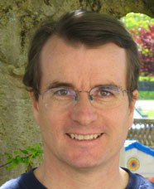

Relational Data: what are the random variables?
Intuitively, the attributes and relationships in the database.
  i.e., the columns plus link existence.
  i.e., the components of the ER diagrams.
Proposal from David Poole (CS UBC): apply the concept of functors from Logic Programming.
I’m combining this with Halpern (CS Cornell) and Bacchus’ (CS U of T) random selection probabilistic semantics for logic.

Slide 24
Population Variables
Russell: “A good notation thinks for us”.
Consider a model with multiple populations.
Let X₁, X₂, Y₁,Y₂, .. be population variables.
Each variable represents a random draw from a population.
Population variables are jointly independent.
A functor f is a function of one or more population variables.
A functor random variable is written as
f₁(X) or f₂(X,Y) or f₃(X,Y,Z).

Slide 25
Unary Functors = Descriptive Attributes of Entities
Population of Students, Professors.
Population variables S,P.
Attributes r.v.s age(S), gpa(S), age(P),rank(P).
Can have several selections age(S₁),age(S₂).
If S is uniform over students in the database:
  P(gpa(S)=3.0) = empirical or database frequency of 3.0 gpa in student population.
Can instantiate or ground functors with constants.
  E.g., gpa(jack) returns the gpa of Jack.
Notes:
Can also instantiate or ground functors; gpa(jack) returns the gpa of jack.

Slide 26
Binary Functors = Relationships
Registered(S,C): indicator function of existence of relationship.
If S,C uniformly distributed over observed population:
  P(Registered(S,C)=1) =
  #(s,c) s.t. Student s is registered in course c/
  #Students x #Courses.
  = Database Frequency of Registration.
Can also form chains:
P(grade(S,C)=A,Teaches(C,P)=1).
Notes:
Adjancency matrix: only binary. Awkward for chains. Stores 0s as well.

Slide 27
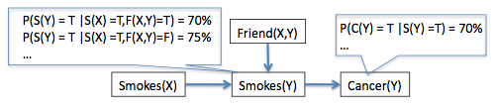
Functor Bayes Nets
Poole IJCAI 2003: A functor Bayes Net is a Bayes net whose nodes are functor random variables.
Notes:
Poole’s term is “parametrized Bayes net”

Slide 28
Likelihood Functions for Functor Bayes Nets: Latent Variables
Problem: Given a database D and an FBN model B, how to define P(D|B)?
Fundamental Issue: interdependent units, not iid.
One approach: introduce latent variables such that units are independent conditional on hidden “state” (e.g., Kersting et al. IJCAI 2009).
  Cf. social network analysis Hoff, Rafferty (U of W Stats), Linkletter SFU Stats.
  Cf. nonnegative matrix factorization----Netflix challenge.

Slide 29
Likelihood Function for Single-Table Data
For single table T:
Smokes(Y)
Cancer(Y)
Actors
Name | Smokes | Cancer
Anna | T | T
Bob | T | F
Table count of co-occurrences of child node value and parent state
Parameter of Bayes net

Slide 30
Proposed Pseudo Log-Likelihood
For database D:
Smokes(X)
Friend(X,Y)
Smokes(Y)
Cancer(Y)
Actors
Name | Smokes | Cancer
Anna | T | T
Bob | T | F
Database joint frequency of child node value and parent state
Parameter of Bayes net
Friend
Name1 | Name2
Anna | Bob
Bob | Anna
Notes:
First pseudo-likelihood for a Bayes net. Pseudo likelihoods are common, used widely in Markov nets (Besag) and in relational Markov nets (Domingos). Reasons for using the frequencies: a) put variables on the same scale. b) provide syntactic invariance.

Slide 31

Random Selection Log-Likelihood
Randomly select instances X₁ = x₁,…,X_{n}=x_{n}. for each variable in FBN.
Look up their properties, relationships in database.
Compute log-likelihood for the FBN assignment obtained from the instances.
L^{R} = expected log-likelihood over uniform random selection of instances.
Smokes(X)
Friend(X,Y)
Smokes(Y)
Cancer(Y)
L^{R} = -(2.254+1.406+1.338+2.185)/4 ≈ -1.8
Proposition The random selection log-likelihood equals the pseudo log-likelihood.
Notes:
No independence assumpttions! Note the match with the random selection semantics.

Slide 32
Parameter Estimation
Proposition For a given database D, the parameter values that maximize the pseudo likelihood are the empirical conditional frequencies.
Notes:
Predicates are capitalized, attributes lower calse

Slide 33
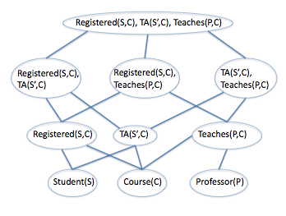
Model Selection
New model selection algorithm (Khosravi, Schulte et al. AAAI 2010).
Level-wise search through table join lattice.

Slide 34
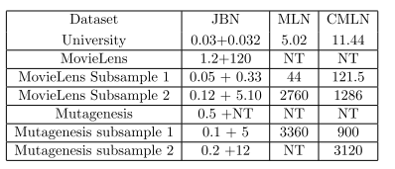
Running time on benchmarks
Time in Minutes. NT = did not terminate.
x + y = structure learning + parametrization (with Markov net methods).
JBN: Our join-based algorithm.
MLN, CMLN: standard programs from the U of Washington (Alchemy)
Notes:
C is transformed data

Slide 35
Accuracy
Basically, leave-one-out average.
Notes:
Similar results for log-likelihood.

Slide 36
Future Work: Inference
Prediction is usually based on knowledge-based model construction (Ngo and Haddaway, 1997; Koller and Pfeffer, 1997; Haddaway, 1999).
Basic Idea: instantiate population variables with all population members. Predict using instantiated model.
With Bayes nets, can lead to cycles.
My conjecture: cycles can be handled with a normalization constant that has a closed form.
Help?!
Notes:
Mill’ers principle: conditional on the fact that the class-level probability P(ϕ(X)) = p, we have that P(ϕ(a)) = p.

Slide 37
Summary: Likelihood for relational data.
Combining relational databases and statistics.
  Very important in practice.
  Combine logic and probability.
Interdependent units ➔ hard to define model likelihood.
Proposal: Consider a randomly selected small group of individuals.
Pseudo log-likelihood = expected log-likelihood of randomly selected group.

Slide 38
Summary: Statistics with Pseudo-Likelihood
Theorem: Random pseudo log-likelihood equivalent to standard single-table likelihood, replacing table counts with database frequencies.
Maximum likelihood estimates = database frequencies.
Efficient Model Selection Algorithm based on lattice search.
In simulations, very fast (minutes vs. days), much better predictive accuracy.

Slide 39

Thank you!
Any questions?

Slide 40
Choice of Functors
Can have complex functors, e.g.
  Nested: wealth(father(father(X))).
  Aggregate: AVG_{C}{grade(S,C): Registered(S,C)}.
In remainder of this talk, use functors corresponding to
  Attributes (columns), e.g., intelligence(S), grade(S,C)
  Boolean Relationship indicators, e.g. Friend(X,Y).

Slide 41
Hidden Variables Avoid Cycles
U(X)
U(Y)
Rich(X)
Friend(X,Y)
Rich(Y)
Assign unobserved values u(jack), u(jane).
Probability that Jack and Jane are friends depends on their unobserved “type”.
In ground model, rich(jack) and rich(jane) are correlated given that they are friends, but neither is an ancestor.
Common in social network analysis (Hoff 2001, Hoff and Rafferty 2003, Fienberg 2009).
$1M prize in Netflix challenge.
Also for multiple types of relationships (Kersting et al. 2009).
Computationally demanding.
Notes:
Hoff gives a justification by applying de Finetti’s exchangeability theorem (matrix version).

Slide 42
Typical Tasks for Statistical-Relational Learning (SRL)
Link-based Classification: given the links of a target entity and the attributes of related entities, predict the class label of the target entity.
Link Prediction: given the attributes of entities and their other links, predict the existence of a link.

